Slide 1
INITIAL PUBLIC OFFERRING(IPO)
BY
SAURABH HARIBHAUJI RAO
SUNIL SHIVAJI GAWADE
KSHIJITH
PRANAV SALVE
RAHUL KUMAR PANDEY

Slide 2
INTRODUCTION
An initial public offering (IPO) refers to the process of offering shares of a private corporation to the public in a new stock issuance for the first time. An IPO allows a company to raise equity capital from public investors.
The transition from a private to a public company can be an important time for private investors to fully realize gains from their investment as it typically includes a share premium for current private investors. Meanwhile, it also allows public investors to participate in the offering.

Slide 3
NEED
This project will help end users to automatically on-board new merchants in IPO portal.

Slide 4

TOOLS USED

Slide 5
SERVICE NAME AND PORT NUMBER
Service Name : IPOProject
Port Number : 9092

Slide 6
FUNCTIONAL FLOW-DIAGRAM
Dashboard
Create Merchant
Approval Status
(View)
User
Logout
Login
Dashboard
Create Merchant
Approval Status
(View,Approve)
Reporting Manager

Slide 7
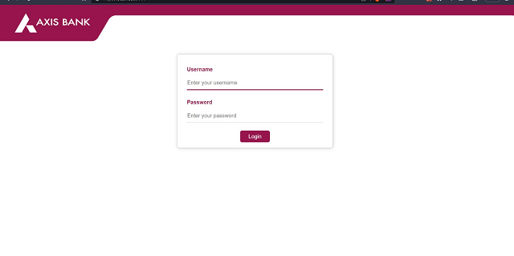
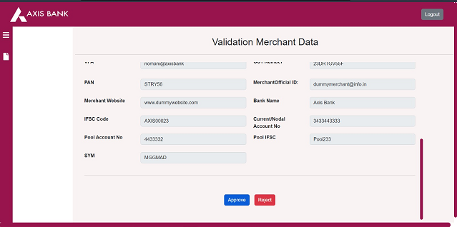
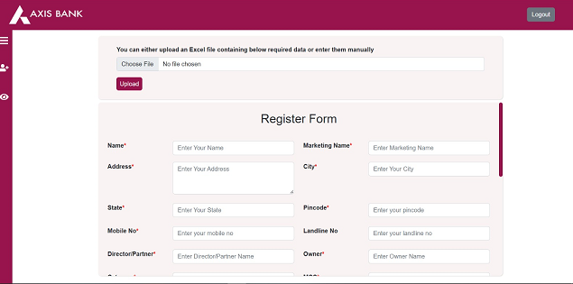
APPLICATION IMAGES

Slide 8
DATA REQUIRED
All Merchant Data which is required to add New Merchant in IPO Portal
For example: Name, Marketing Name, Address,City, State, Pincode, Mobile No, Landline No, Director/Partner, Category, MCC,MCC Desc, Type of integration,VPA, GST Number, PAN, Merchant Official ID, Merchant Website, Bank Name, IFSC Code, Current/Nodal A/C Account No, Pool Account A/C No, Pool IFSC, SYM

Slide 9
CONCLUSION
For onboarding new merchants the overall process is manual which indeed consume enough resources and manpower.
So By Using this application, We automate the above process for onboarding new merchants.

Slide 10
Thank You

