Slide 1

Verbal Fluency &
Spatial Arrangement Methods
Descriptive and Inferential Statistics
Team — The Hawthornes
Malay Damani · Nikhil Jain · Saurabh Rawat
Behavioral Research: Statistical Methods | March 11, 2026

Slide 2
The Mental Lexicon
How words live in your mind
Structured Internal Store
The mental lexicon is the organized network of words, meanings, and associations available to a speaker — not a random list but a richly connected system.
Retrieval Reveals Structure
When asked to generate related words, speakers search through this internal network — revealing clusters, activation patterns, and search efficiency.
Semantic + Phonological Links
Research shows semantically similar words also tend to have similar forms across languages (Dautriche et al., 2017), and phonological cues can guide search when a cluster is depleted (Kumar et al.).
Hindi speakers
retrieval patterns
VFT + SpAM
Two complementary tasks
to map the mental lexicon

Slide 3



Research Questions
Three hypotheses guiding our investigation
RQ1
RQ2
RQ3
Semantic
Clustering
Neighbourhood
Density
Fluency &
Efficiency
Do Hindi speakers retrieve words in semantic clusters rather than randomly? Consecutive words should be semantically closer than random pairs.
Do faster retrievals reflect tighter semantic neighbourhoods? Dense regions should yield quicker responses.
Does Hindi fluency predict retrieval efficiency? More fluent speakers should produce more words, faster, in larger clusters.

Slide 4



Methodology — Two Core Tasks
Verbal Fluency Task (VFT)
Spatial Arrangement Method (SpAM)
Hindi semantic prompt shown to participant
60-second window to generate related words
Records both words and Inter-Response Time (IRT) in milliseconds
Captures temporal dynamics of lexical retrieval
Same participant sees their generated words
Drag-and-drop on a 2D canvas
Related words placed closer; unrelated words farther apart
Normalized (x, y) coordinates in range [0, 1]

Slide 5
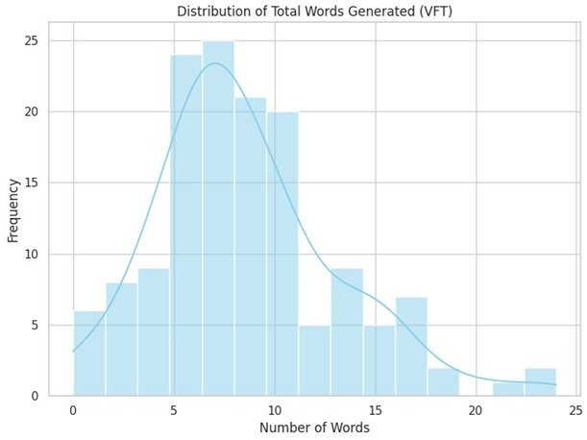
Participant Data & Descriptives
30
8.56
7,866
4.52
Participants
Avg Words / Trial
Mean IRT (ms)
Std Dev (Words)
Key Observations
High variability in word output (0 to 24 words) reflects diverse retrieval capacities across participants.
Mean IRT of ~7.9 seconds with SD of 5.4s indicates right-skewed response time data.
Inclusion: comfortable reading and conversing in Hindi.
📊 Place Figure 1 here
Distribution of Total Words Generated (VFT)

Slide 6
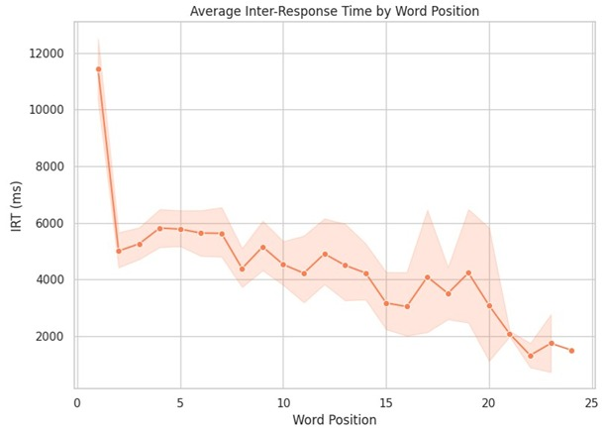
The Cognitive Cost of Retrieval
Why later words take longer
Serial Position Effect
Early words (positions 1–5) are retrieved rapidly from high-activation regions of the mental lexicon.
As easily accessible words are exhausted, participants must search deeper — inter-response times increase steadily.
The upward IRT trend aligns with models of spreading activation: nearby nodes fire first, then the search expands to increasingly remote connections.

Slide 7
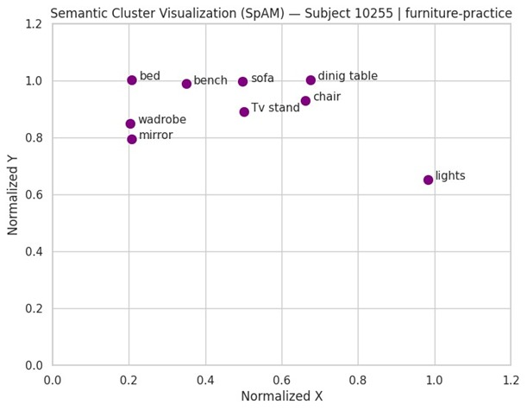
RQ1
Do We Retrieve in Clusters?
✓ YES — Confirmed
0.257
0.373
Adjacent Mean Distance
Random Mean Distance
T = −10.84 *** p < 0.001
U = 358,166 p < 0.001
Welch t-test
Mann-Whitney U
Sequential retrievals are significantly closer in semantic space than randomly sampled word pairs, providing strong evidence for clustered retrieval in Hindi speakers.

Slide 8
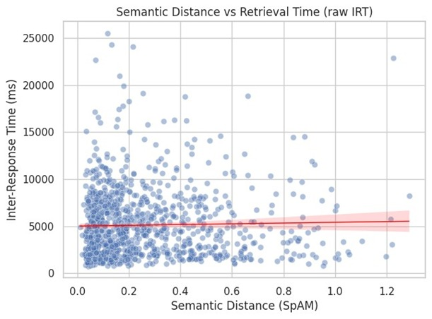
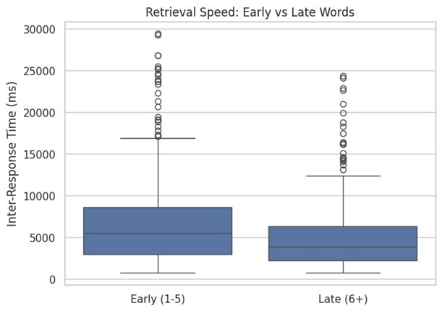
RQ2
Does Density Equal Speed?
✓ YES — Confirmed
r = -0.201, p < 0.001
Words in tighter semantic neighbourhoods are retrieved faster, supporting a spreading-activation account of lexical retrieval. Log-transformed IRT correlated negatively with mean neighbour distance.

Slide 9
RQ3
Does Fluency Predict Efficiency?
✗ NOT SUPPORTED
r = −0.115
r = 0.199
r = −0.180
p = 0.509
p = 0.251
p = 0.316
Fluency vs Total Words
Fluency vs Mean IRT
Fluency vs Cluster Size
Surprising Insight: Self-reported Hindi fluency did not significantly predict lexical retrieval efficiency, word output, or the capacity to sustain larger semantic clusters. This suggests that the relationship between perceived fluency and actual retrieval mechanisms is more nuanced than a simple linear model would predict.

Slide 10

Future Directions
What comes next in Report 2
01
Mixed-Effects Regression
Log-transformed IRTs with random intercepts for subject-level variance to improve statistical robustness.
02
Normalize SpAM Distances
Within-participant and within-domain normalization to correct for individual canvas usage differences.
03
Phonological Similarity
Levenshtein distance on phonetic transcriptions to test whether phonological cues guide retrieval when semantic clusters deplete.
04
ANOVA & GLM Models
Test clustering differences across semantic domains (animals vs. furniture) and model fluency, domain, and position effects simultaneously.

Slide 11



Team Contributions
The Hawthornes — Who did what
Malay Damani
Established the theoretical framework. Managed raw JSON dataset, performed data cleaning, extracted demographic survey data for Hindi Fluency Scores. Drafted Introduction and Methodology.
Literature Review & Data Cleaning
Nikhil Jain
Built the primary Python pipeline to parse VFT data. Computed word counts, parsed IRTs, extracted SpAM coordinates. Computed descriptive statistics and formalized Research Questions.
Data Pipeline & Descriptives
Saurabh Rawat
Executed all inferential statistics (Pearson, Welch T-test, Mann-Whitney U). Generated all data visualizations using seaborn/matplotlib. Drafted Results, Conclusions, and Future Directions.
Inferential Analysis & Visualization
Code: github.com/nj301365/Brsm

