Slide 1
Voice recognition based food ordering system for fast food joints using an IoT based model
TSSM’S BHIVARABAI SAWANT COLLEGE OF ENGINEERING AND RESEARCH, NARHE
Project by-
Saurabh Pawar
Virendrasingh Rajput
Shubham Pawar
Ronak Landge
Guided by- Prof.S.A.Pawar.

Slide 2
CONTENTS
Introduction
Problem definition with scope
Motivation
Objectives
Mathematical model
Algorithm
Proposed System Design
System Architecture
Data Flow Diagram
UML Diagrams
System Features
Functional Requirements
Non functional Requirements
System Implementation plan
Time Line Chart
Advantages and Disadvantages
Conclusion
References

Slide 3
INTRODUCTION
In the modern day world where technology covers almost every field of action and procedural work.
Social robots have shown great development with their abilities to assist humans in daily life.
However , a very few studies have shown the use of these robots in the public services .
The idea is to use a robot for the various interactions which are required in these services.

Slide 4
Problem Definition and Scope
Problem Definition-
To develop a voice recognition based food ordering system using an IoT based model.
Scope-
New inventions will keep on emerging.
The human work will be replaced by machines.
Thus an automated service will always be in demands as it reduces human efforts.

Slide 5
Motivation
There is the rising concern about the replacement of human jobs by robots.
The rapid development of AI technology in recent years.

Slide 6
Objective
The main objective is to replace the human incorporated work with the uprising Artificial Intelligence methods.
Making food service easy.

Slide 7
Mathematical model
Let us consider S for Food Ordering System..
S=
INPUT:
Identify the inputs
F= f1, f2, f3 , FN— F as set of functions to execute commands.
I= i1, i2, i3—I sets of inputs to the function set
O= o1, o2, o3.—O Set of outputs from the function sets, S= I, F, O
I = user voice commands
O = Output i.e. Order placed
F = Functions implemented to get the output Space Complexity:
The space complexity depends on Presentation and visualization of discovered pat- terns.
More the storage of data more is the space complexity. Time Complexity:
Check No. of tokens available in the datasets= n
If (n(1)) then retrieving of information can be time consuming. So the time com- plexity of this algorithm is O (nˆn).
= Failures and Success conditions. Failures:
1. Huge database can lead to more time consumption to get the information.
2. Hardware failure.
3. Software failure. Success:
4. Search the required information from available in Datasets.
5. User gets result very fast according to their needs.

Slide 8
Algorithm
Start on detection of human presence.
Ask to start conversation-
No → Exit by saying “Thank You”.
Yes → Proceed.
Product selection with quantity.
Verification-
Failed → Says “Not connected” and go-to Step-3.
Success → Proceed.
Show cart and confirmation status-
No → Go to Step-3.
Yes → Proceed.
Confirm product list-
Yes-
Save to database.
Generate token number.
Method for payment.
No-
Go to Step-5
End user interaction.
Send cart details to back-end for processing.

Slide 9
Current market survey
Firstly talking about chatbot and humanoid robot, there are some robots under development , Archie ,ATLAS are some examples of interactive robots and have an obstacle detection facilities.
As the scope of our project is for fast food industries , currently in japan there is a hotel name Helen-na hotel which translates to strange/change hotel.
It consists of various robots for their management services ,
A] robot front for the reception,
B]robot cloak to take the luggage,
C] tulie , an interaction robot in the room

Slide 10
In India, a restaurant in Banglore uses a robotic waiter to take the order from the desk to the customers table. This basically is a path following robot with no other functionality.
The presented information was sourced from technology sections of various news papers and a survey paper from IEEE.

Slide 11
Literature Survey
Sr.no. | Title | Description | Date
1 | Dynamic obstacle detection based on multi-sensor information fusion, Liu Meichen, Chen Jun, Zhao Xiang, Wang Lu, Tian Yongpeng | In this study, a method of dynamic obstacle detection based on multi-sensor information fusion is presented by selecting a Compass Equipment, an Inertial Measurement Unit and a 2D laser scanner as the system's external sensors. | March,2018

Slide 12
Sr.no. | Title | Desription | Date
2 | Obstacle Detection and Avoidance of a cost-oriented humanoid robot, F.d’Apolito | Cost-oriented humanoid robots (COHR) research started in 2011. These robots are designed to be able to support humans in everyday life on the working place. | May,2017

Slide 13
Sr.no. | Title | Description | Date
3 | Appearance-Based Obstacle Detection with Monocular Color Vision, Iwan Ulrich and Illah Nourbakhsh | This paper presents a new vision-based obstacle detection method for mobile robots. Each individual image pixel is classified as belonging either to an obstacle or the ground based on its color appearance. | August, 2000

Slide 14
Sr.no | Title | Description | Date
4 | Probabilistic Mapping with Ultrasonic Distance Sensors, Ilze Andersonea | This paper proposes a probabilistic robotic mapping approach to merge ultrasonic distance readings by modeling them as Gaussian random variables and using scan matching to reduce uncertainty in mapping process. | December ,2017

Slide 15
Sr.no | Title | Description | Date
5 | Design of E-Commerce Chat Robot for Automatically Answering Customer Question, Adhitya Bhawiyuga, M. Ali Fauzi, Eko Sakti Pramukantoro, Widhi Yahya | In order to provide an excellent service, the seller in e-commerce world is required to actively involves in communication with its customer. Nevertheless, in several condition e.g. in vacation or during a rest, the seller might be unable to communicate with his/her customer. | September-October, 2017

Slide 16
Sr.no. | Title | Description | Date
6 | Analysis of Robot Hotel: Reconstruction of Works with Robots , Hirotaka Osawa, Arisa Ema, Hiromitsu Hattori, Naonori Akiya, Nobotsugu Kanzaki, Akinori Kubo, Tora Koyama, Ryutaro Ichise | Due to the rise of artificial intelligence (AI) technology, discussions are progressing on how robots could replace human labor. | August-September,2017

Slide 17
Sr.no. | Title | Description | Date
7 | Listening to vs Overhearing Robots in a Hotel Public Space, Yadong Pan ,Haruka Okada,Kenji Suzuki,Tochiyaki Uchiyama. | This report presents a preliminary work performed using robots with different social interactive functionalities in a hotel public space in order to investigate human-robot interaction (HRI). | January, 2013

Slide 18
Sr.no | Title | Description | Date
8 | Direct and Indirect Social Robot Interactions in a Hotel Public Space, Yadong Pan, Haruka Okada, Toshiaki Uchiyama and Kenji Suzuki | This paper presents a study using multiple robots with different socially interactive functionalities in a hotel public space. | Dec,2013

Slide 19
SYSTEM DESIGN

Slide 20
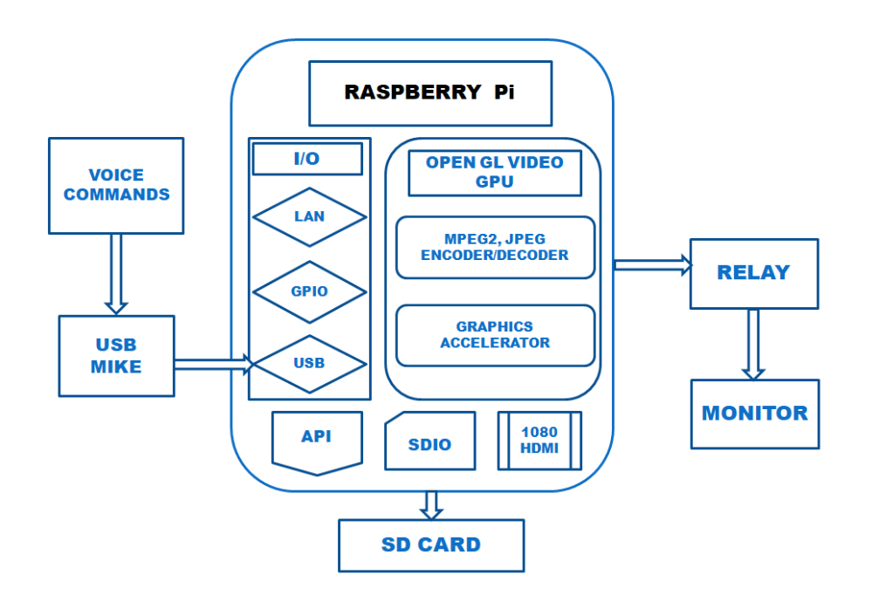
System Archiyecture
[PRODUCT_CATEGORY=>STARTERS, MAINCOURSE, DESSERTS, etc.]
[DISH_DETAILS=>INGREDIETS MAKING UP THE DISH]

Slide 21
OVERVIEW OF USER-INTERFACE

Slide 22
THIRD INTERFACE (THE CART)
Product_Category | Dish_Details | Price | Qty | Total (cost*qty)
Product_1 | ....... | Rs.__
Product_2 | ....... | Rs.__
..... | ....... | .....
Product_N | ....... | Rs.__
+
-
+
n
-
+
-
+
n
-
PREV_PAGE | HOMEPAGE | PROCEED
Total=

Slide 23
SECOND INTERFACE (IN CASE OF MANUAL INPUT)
Product_Category | Dish_Details | Price | Qty
Product_1 | ....... | Rs.__
Product_2 | ....... | Rs.__
..... | ....... | .....
Product_N | ....... | Rs.__
<
>
+
n
-
+
n
-
+
n
-
+
n
-
PREV_CATEGORY | HOMEPAGE | CART | NEXT_CATEGORY
[PRODUCT_CATEGORY=>STARTERS, MAINCOURSE, DESSERTS, etc.]
[DISH_DETAILS=>INGREDIETS MAKING UP THE DISH]

Slide 24
FOURTH INTERFACE (CONSUMER'S DETAILS)
ENTER YOUR DETAILS:
NAME:____________
MOBILE NO:______________
PAYMENT METHOD=> CASH ONLINE

Slide 25
FIFTH INTERFACE (THE PAYMENT GATEWAY)
SELECT YOUR CARD TYPE:
CREDIT DEBIT
CARD DETAILS:
CARD NO.:
CVV:
NAME OF THE CARD HOLDER:
VALID THROUGH:

Slide 26
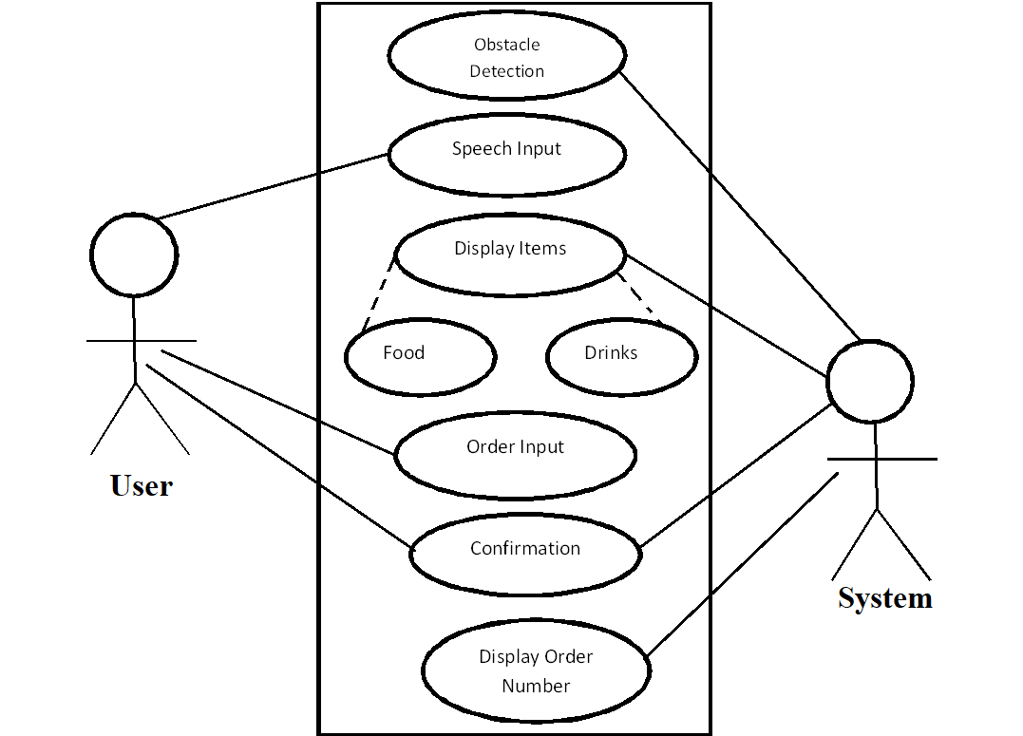
Use case diagram

Slide 27
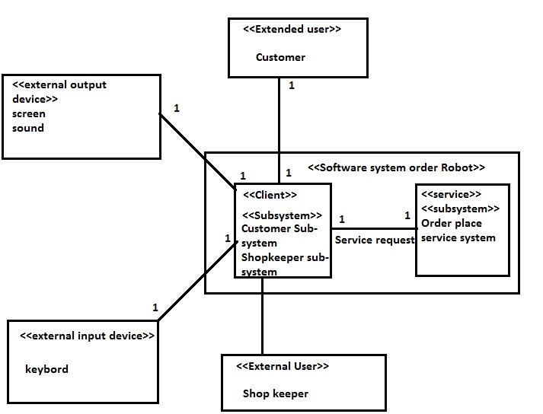
Component diagram

Slide 28
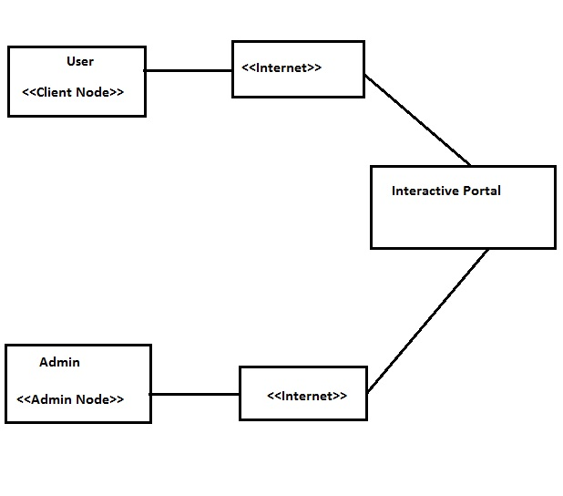
Deployment diagram

Slide 29
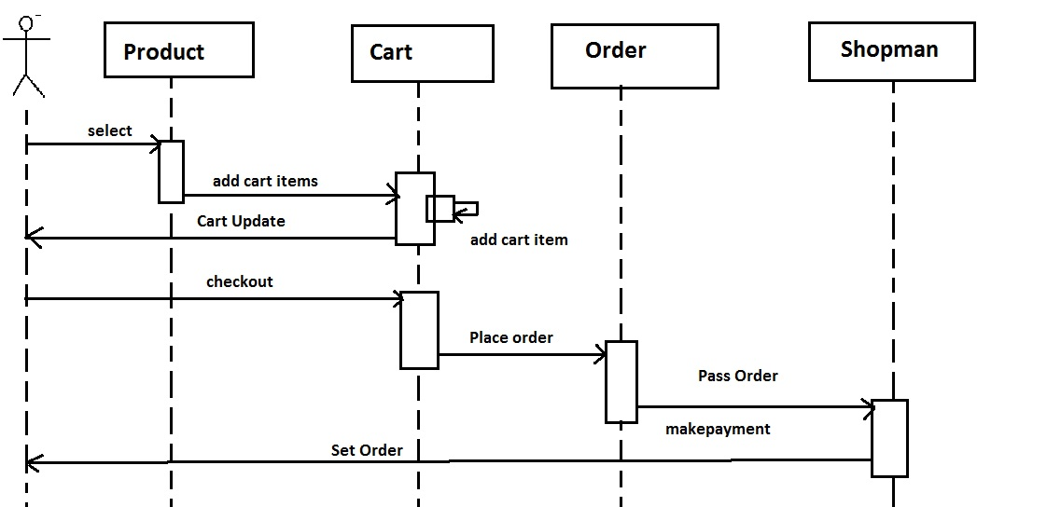
Sequence diagram

Slide 30
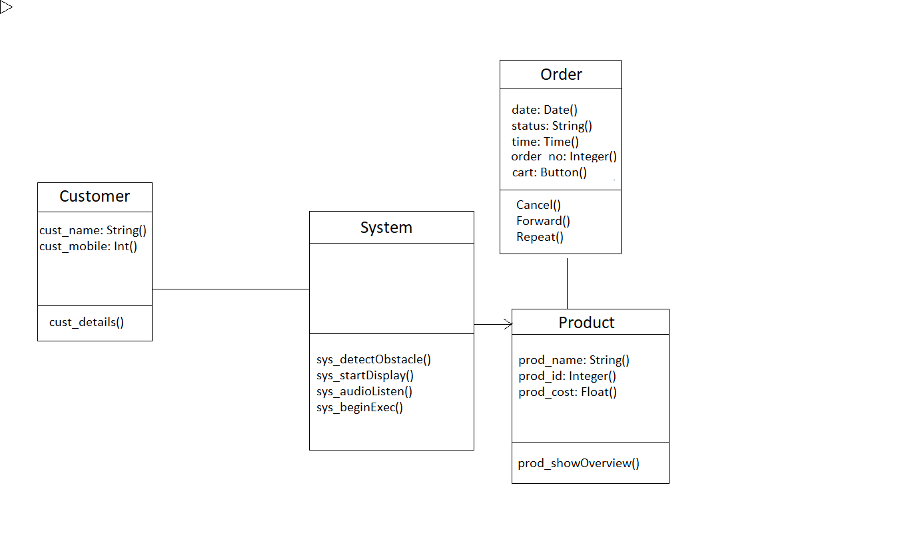
Class diagram

Slide 31
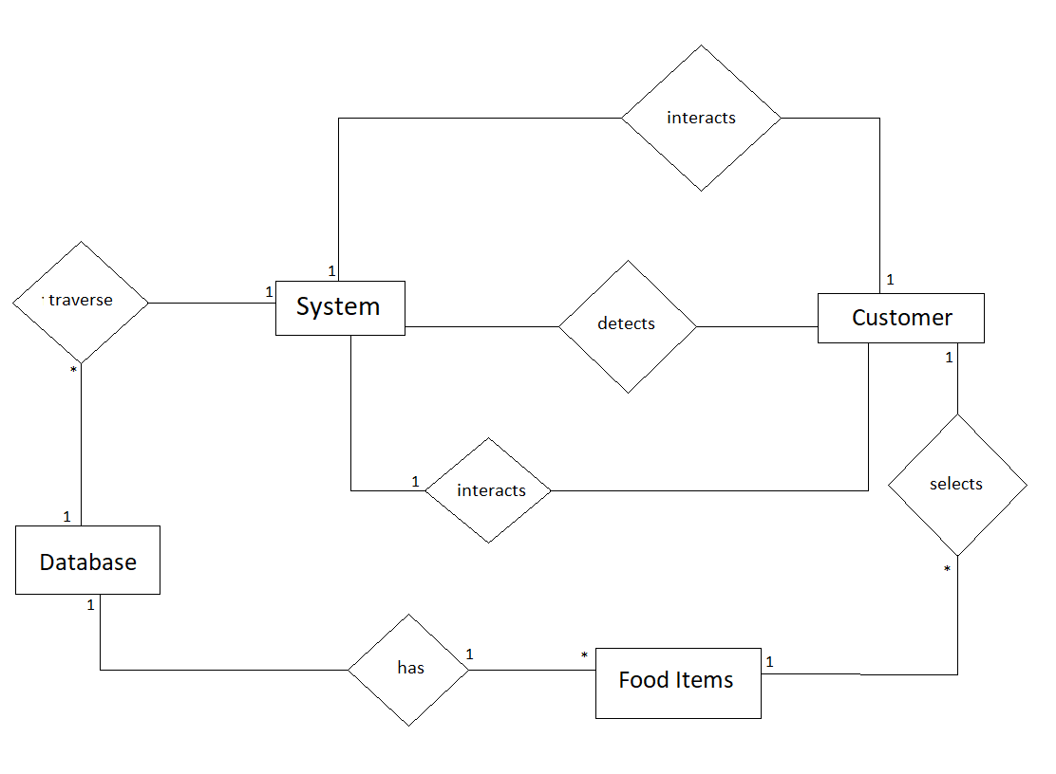
Entity-Realtionship diagram

Slide 32
System Features
Functional Requirements-
1.Automatic food ordering service
Voice recognition based
Obstacle detection

Slide 33
Nonfunctional Requirements
Performance Requirements-
The system needs a high speed internet connection for greater performance.
Safety Requirements-
To ensure the safety of the system, perform regular monitoring of the system so as to trace the proper working of the system. An authenticated user is only able to access system.
Security Requirements-
Any unauthorized user should be prevented from accessing the system. Password authentication can be introduced.

Slide 34
Advantages
The technology provides a reliable system for handling the various services in a fast food joint .
The system is more reliable.
Efficient work with an innovative and attractive interface.
As the bill scripting will be online, no physical bills will be generated ,thus reduces the use of plast-o-paper.

Slide 35
DISADVANTAGES
Designing a precise voice recognition robot is a tough task.
Speed of processing.
Speech to text conversion and the resultant database searching protocol might be tedious.
Cash acceptance is not available.

Slide 36
Conclusion
In the growing need of automation , the system eases up the process of ordering food at a fast food joint by either speech recognition or an interactive interface.
The resultant product will provide an artificial interface to the customers of a fast food joint, thus the work of the employees can be entirely incorporated by this system.

Slide 37
References
[1] Design of E-Commerce Chat Robot for Automatically Answering Customer Question.Adhitya Bhawiyuga, M. Ali Fauzi, Eko Sakti Pramukantoro, Widhi Yahya.2017.
[2] Listening to vs Overhearing Robots in a Hotel Public Space. Yadong Pan, Haruka Okada.2013
[3] Direct and Indirect Social Robot Interactions in a Hotel Public Space,
Yadong Pan, Haruka Okada, Toshiaki Uchiyama and Kenji Suzuki,December,2013.
[4] Dynamic obstacle detection based on multi-sensor information fusion, Liu Meichen, Chen Jun, Zhao Xiang, Wang Lu, Tian Yongpeng ,March,2018.
[5] Obstacle Detection and Avoidance of a cost-oriented humanoid robot, F.d’Apolito,May,2017.
[6] Appearance-Based Obstacle Detection with Monocular Color Vision,
Iwan Ulrich and Illah Nourbakhsh,August,2000.
[7] Probabilistic Mapping with Ultrasonic Distance Sensors, Ilze Andersonea,December,2017.
[8] Analysis of Robot Hotel: Reconstruction of Works with Robots ,Hirotaka Osawa, Arisa Ema, Hiromitsu Hattori, Naonori Akiya, Nobotsugu Kanzaki, Akinori Kubo, Tora Koyama, Ryutaro Ichise ,August-September,2017.

