Slide 1
DEEP LEARNING BASED ATTENDANCE TRACKING SYSTEM -SAURABH SALUNKHE

Slide 2
CURRENT SYSTEM AND DRAWBACKS
MANUAL ATTENDANCE BY CALLING OUT NAMES. PROBLEMS- TIME CONSUMING AND IT CAN TOUGH TO PRONOUNCE SOME NAMES
PASSING ATTENDANCE SHEET- DISTURBANCE DURING THE LECUTURE AND SHEET CAN BE MISPLACED
USING SMART ID CARDS OR FINGER PRINT SCANNING – RESOURCE AND COST INCURRED IS HIGH

Slide 3
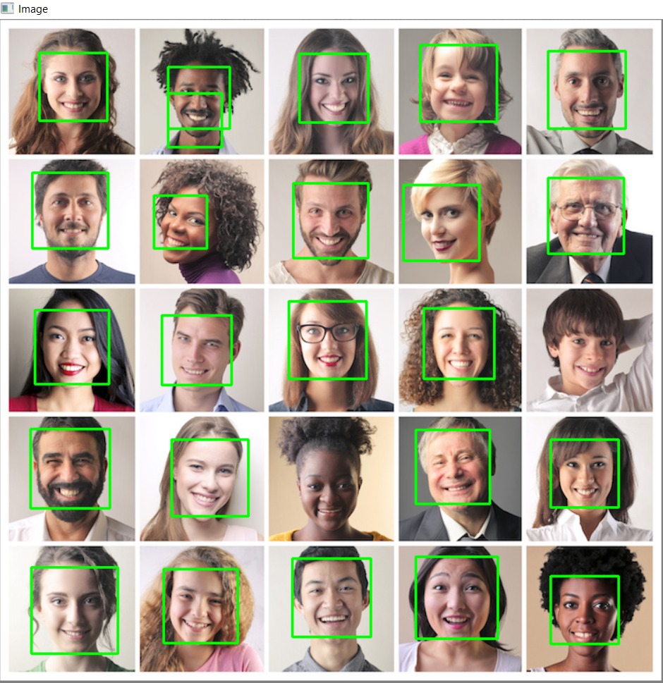
PROPOSED SOLUTION
TRACK ATTENDANCE OF A LECTURE OR MEETING WITH A SINGLE CLICK OF A PHONE AND AUTOMATICALLY SAVE THE ATTENDANCE INTO THE DATABASE
Place your screenshot here

Slide 4
PROCESS
GETTING IMAGE IN EITHER REAL TIME OR VIA IMAGE UPLOAD BY THE END USER
FACE DETECTION, FEATURE EXTRACTION USING MTCNN
USING RESNET 101 OR SPARK INCEPTION V3 FOR TRAINING AND FACIAL RECOGNITION
EVALUATION METRICS USING TRUE POSITIVES AND TRUE NEGATIVES

Slide 5
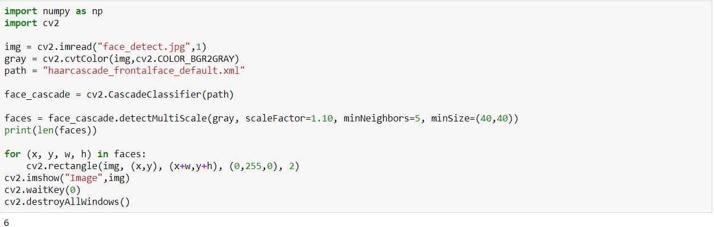
FACE DETECTION VIA IMAGE UPLOAD
USING END USER APPLICATION FOR GETTING IMAGE
UTILIZING CASCADE FILES LIKE HAAR CASCADE FOR FACE DETECTION FEATURES IN VIDEO STREAM

Slide 6


Slide 7
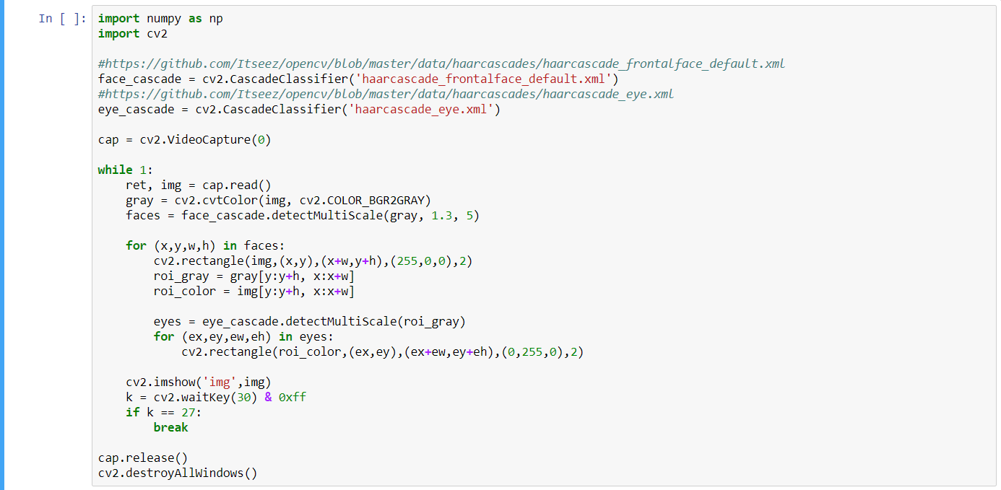
FACE DETECTION IN REAL TIME
USING OPENCV FOR CAPTURING VIDEO IN REAL TIME
UTILIZING CASCADE FILES LIKE HAAR CASCADE FOR FACE DETECTION FEATURES IN VIDEO STREAM

Slide 8
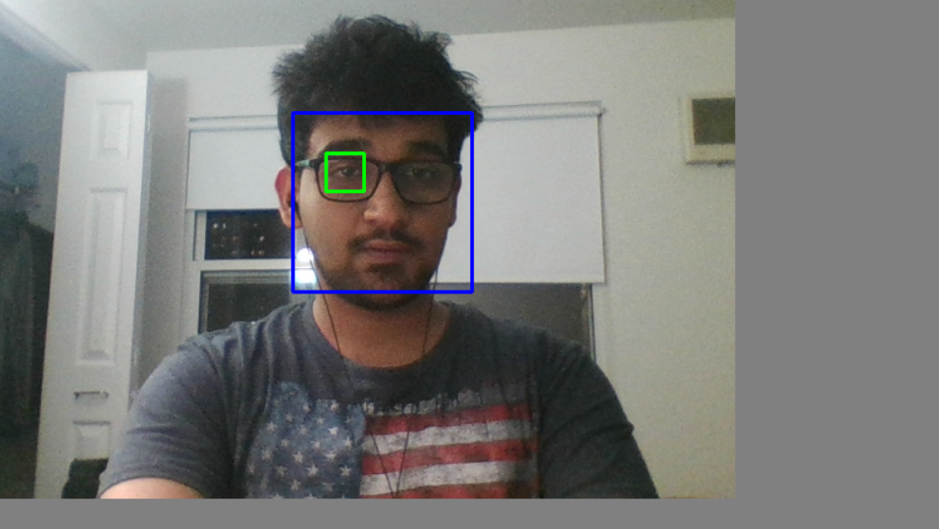

Slide 9
NEXT STEPS AND THOUGHTS

Slide 10
ACTION PLAN ANTICPATED FOR FACIAL RECOGNITION- SPARK DEEP LEARNING
SPARK DEEP LEARNING USING TENSOR FLOW FOR TRANSFORMING IMAGES TO NUMERIC FEATURES
USING SPARK INCEPTION V3 AND LOGISTIC REGRESSION TO DETERMINE OUTCOMES
DEEP IMAGE FEATURIZER PEELS THE LAST LAYER AND USES THE OUTPUT FROM ALL PREVIOUS LAYERS AS FEATURES FOR LOGISTIC REGRESSION
MULTICLASS CLASSIFICATION OR PRECISION/RECALL FOR EVAULUATION METRICS

Slide 11
ACTION PLAN ANTICPATED FOR FACIAL RECOGNITION- COSINE SIMILARITIES
TRAINING DATA INCLUDES 5-10 PHOTOGRAPHS OF EVERY INDIVIDUAL
FEED THE IMAGES IN THE DATABASE
AFTER FACE DETECTION, APPLY COSINE SIMILARITIES AGAINST EVERY PICTURE IN THE DATABASE AND CHOOSE THE PICTURE WITH THE MAXIMUM COSINE SIMILARITY
BOILS DOWN TO PURE SUPERVISED MACHINE LEARNING PROBLEM !

Slide 12
Thanks!
Any questions?
You can find me at Salunkhe.s@husky.neu.edu

