Slide 1


End-to-End Data Analytics Project with Python on Student Exam Scores Dataset
This end-to-end data analytics project leverages Python to analyze a dataset of student exam scores. By uncovering insights from the data, we can better understand student performance and identify areas for improvement in the education system.
by Saurabh Shah

Slide 2
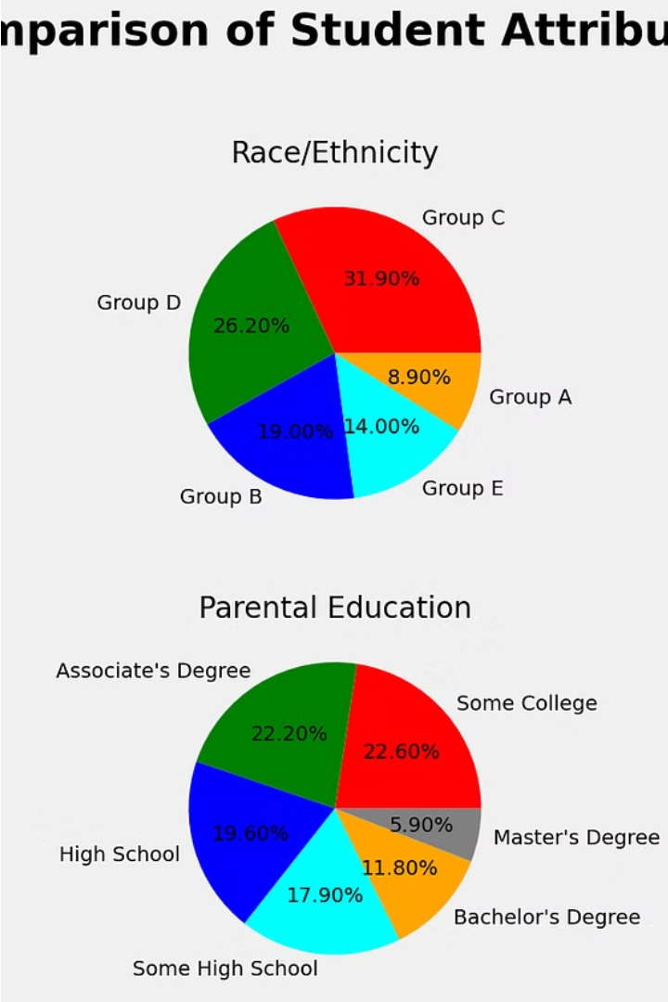
Exploring the Student Exam Scores Dataset
The student exam scores dataset provides a comprehensive view of student performance across various subjects and exams. This data offers valuable insights into academic achievement and can inform strategic decisions to improve educational outcomes.
By analyzing this dataset, we can uncover patterns, trends, and relationships that shed light on factors influencing student success, enabling more targeted interventions and personalized learning strategies.

Slide 3
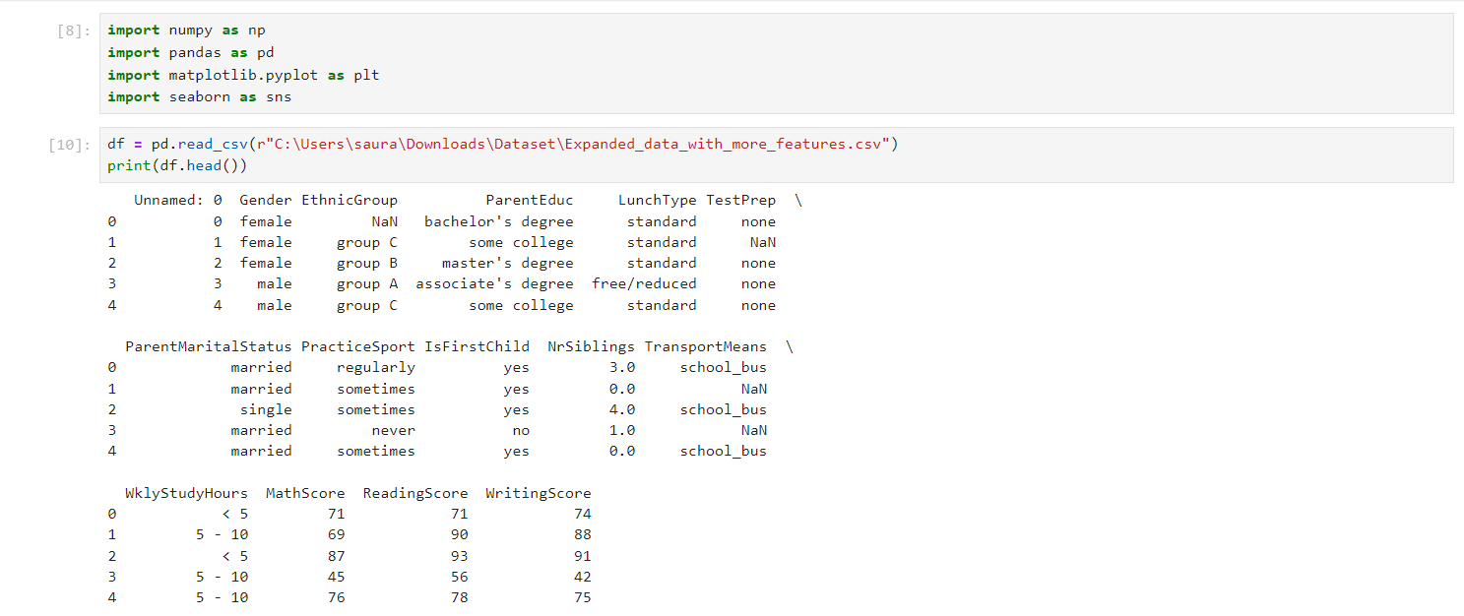
Import Libraries and CSV File

Slide 4
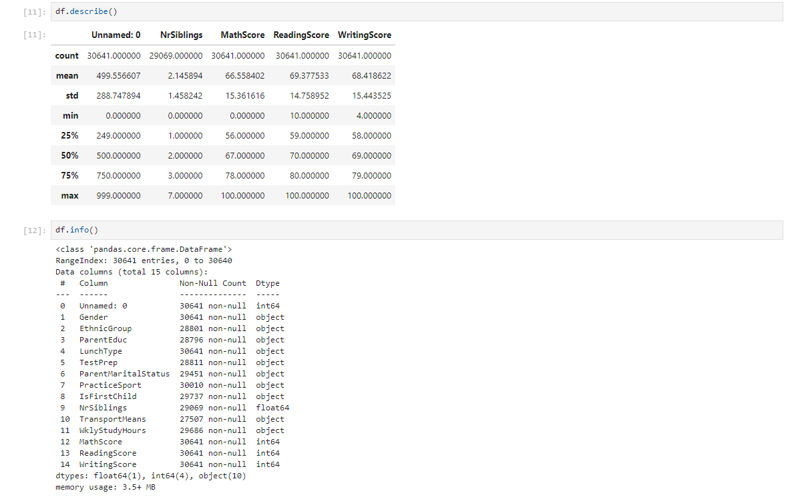
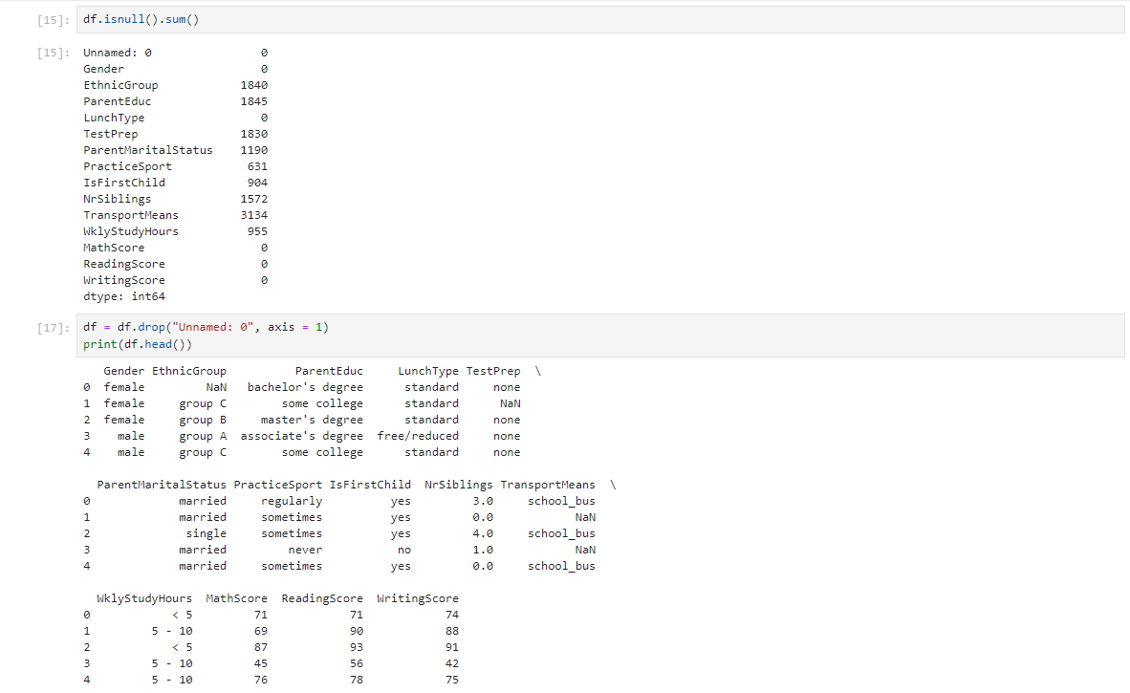
Transform Data

Slide 5
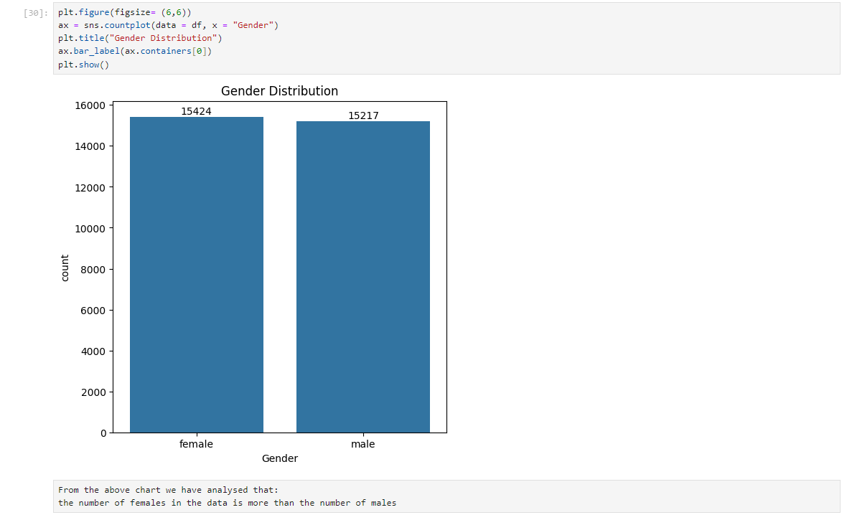
Gender Distribution

Slide 6
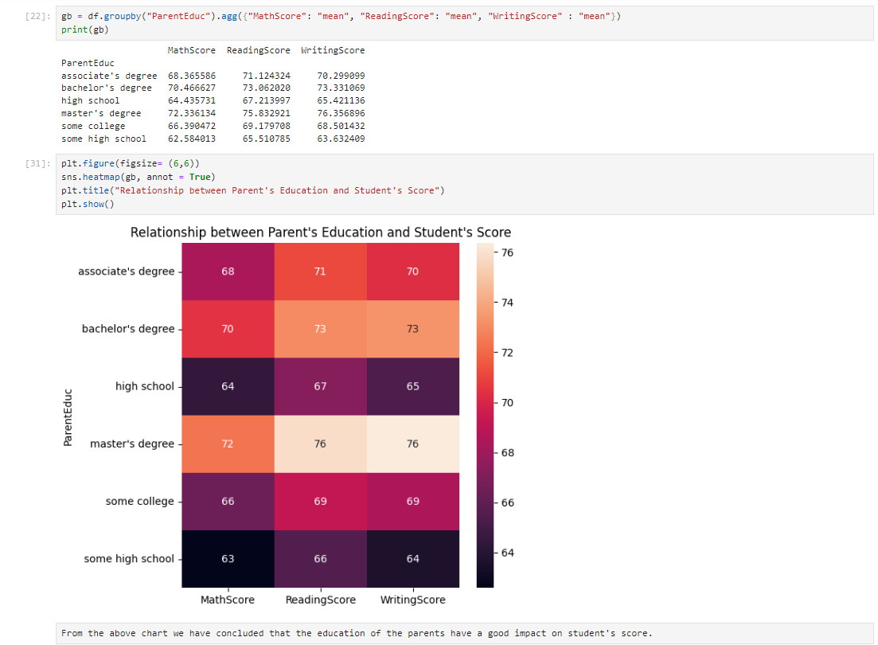
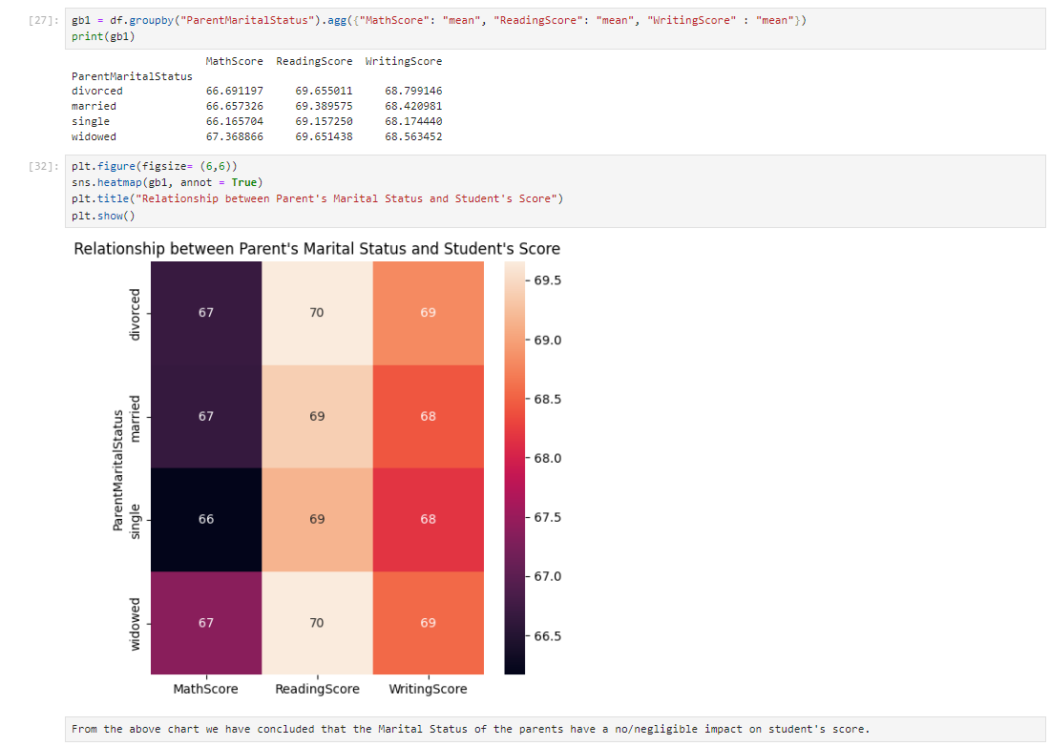
Analytics(1)

Slide 7
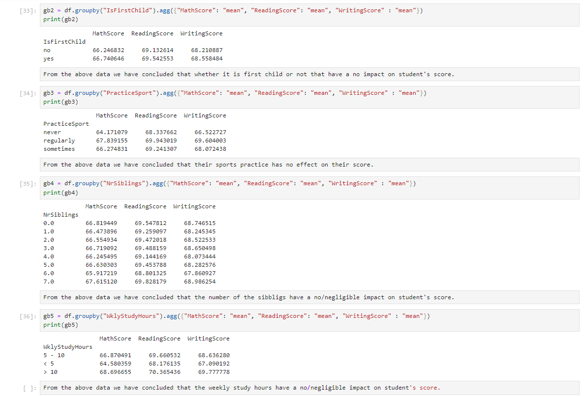
Analytics(2)

Slide 8
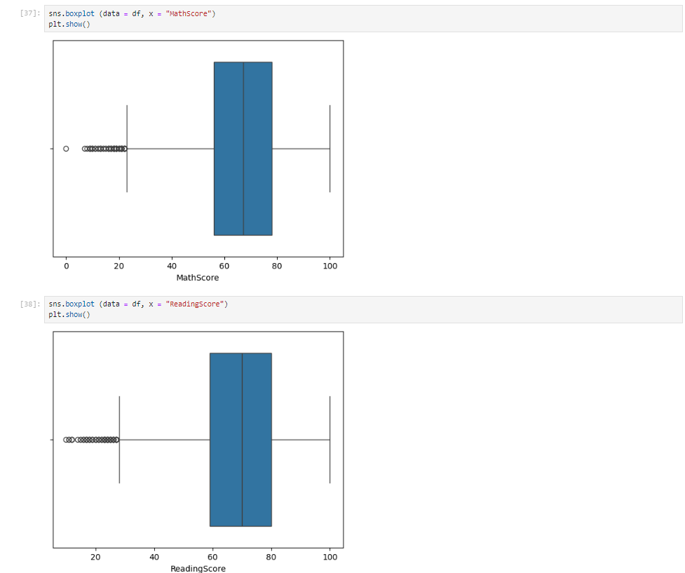
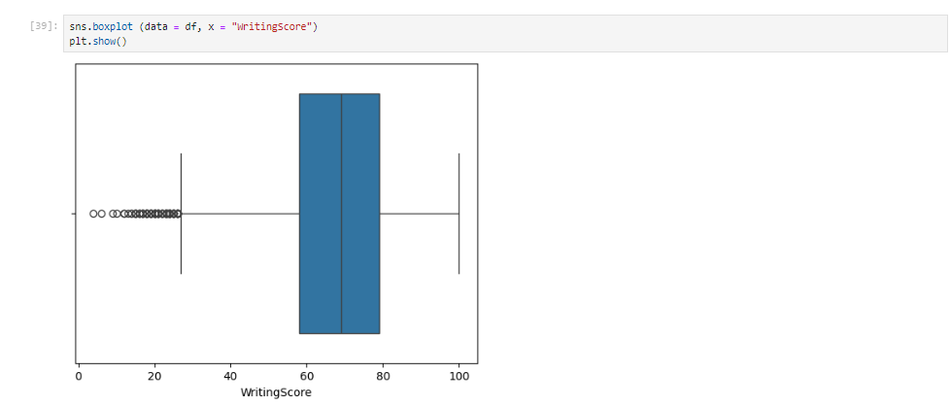
Boxplot on basis of scores

Slide 9
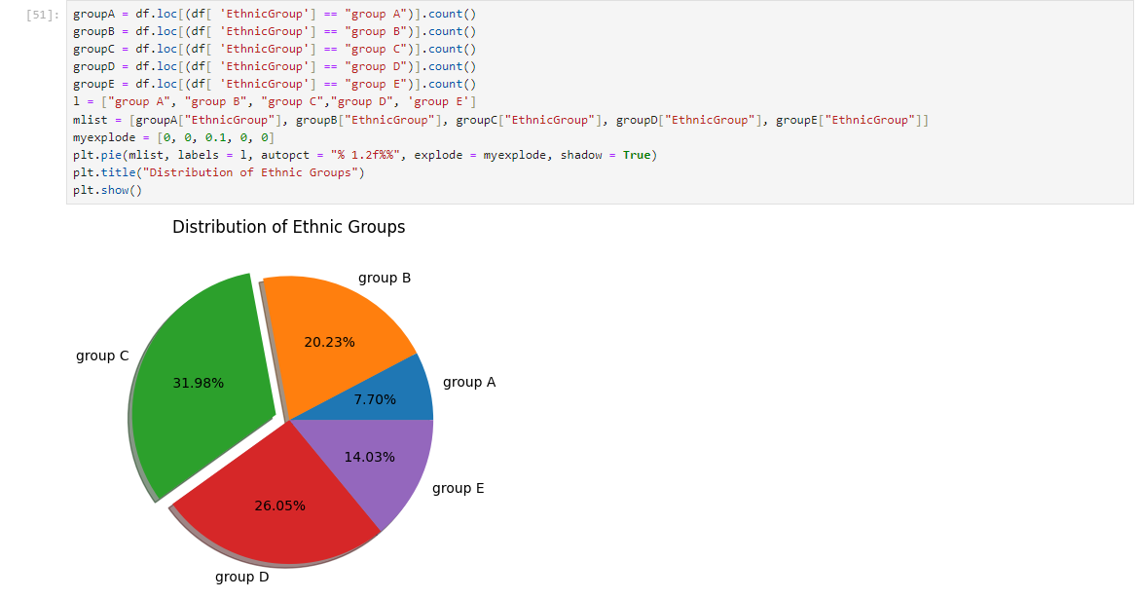
Distribution od Ethnic Group

Slide 10

Thank You for Your Interest
Thank you for your interest in our End-to-End Data Analytics Project with Python on the Student Exam Scores Dataset. We appreciate your time and attention, and hope you found the project informative and valuable. Please don't hesitate to reach out if you have any further questions or would like to discuss potential collaboration opportunities.
by Saurabh Shah

