Slide 1


Introduction to the Pizza Sales With
SQL
by Saurabh Shah

Slide 2
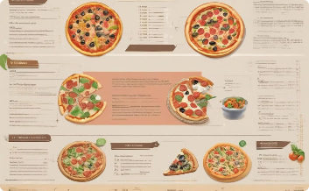
Project Overview
The SQL project on pizza sales analysis involves a comprehensive examination of a dataset containing details about pizza orders, including information on order quantities, pizza types, sizes, and revenue. The project aims to extract valuable insights and key performance indicators (KPIs) to support data-driven decision-making for the pizza business. I solved and performed queries on a range of questions, from easy to advanced levels, including identifying the busiest days and times, best-selling pizzas, and average order value. The analysis covered various aspects of the pizza store's operations, such as sales trends, customer preferences, and operational efficiency. By leveraging SQL and Power BI, the project provides actionable insights and recommendations to optimize operations, improve customer satisfaction, and enhance profitability.

Slide 3

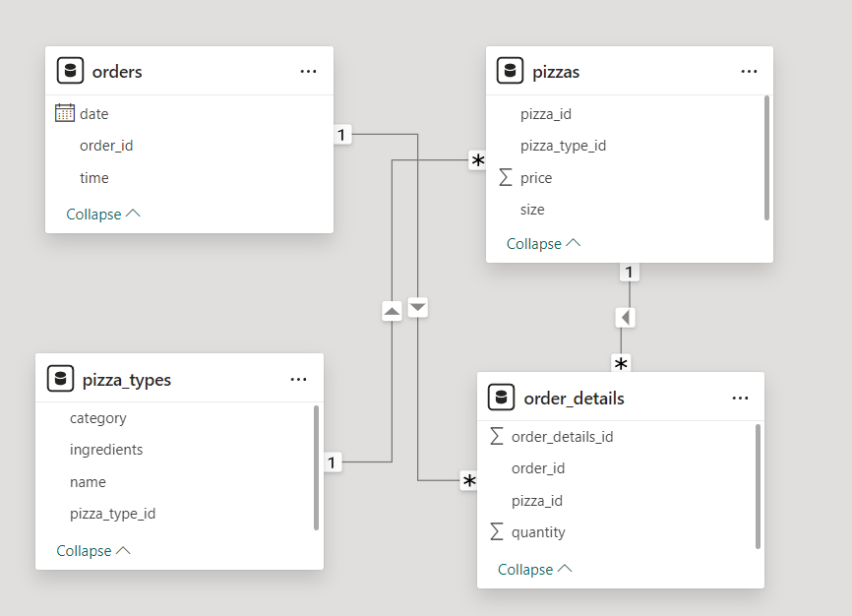

Data Overview
Order Table : It Contains the data related to order like date, time & order_id .
Pizzas Table : It Contains Essential data like pizza_id, pizza_type_id, price & size.
Pizza_types Table : It Contains data related to pizza like category, ingredients, name & pizza_type_id .
Order_details Table : It Contains essential data like order_details_id, order_id, pizza_id & quantity.

Slide 4


Query 1: Retrieve the total number of orders placed.

Slide 5
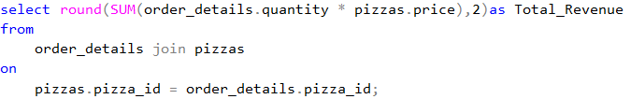

Query 2: Calculate the total revenue generated from pizza sales.

Slide 6
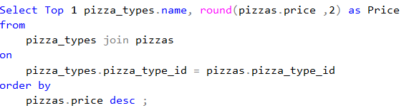

Query 3: Identify the highest-priced pizza.

Slide 7
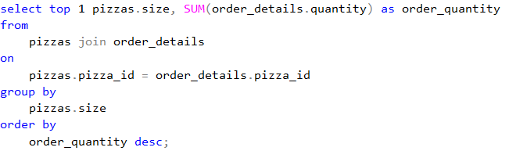

Query 4: Identify the most common pizza size ordered.

Slide 8
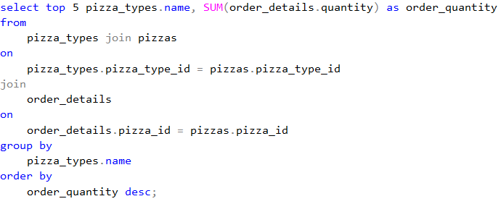
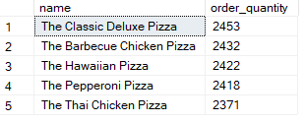
Query 5: List the top 5 most ordered pizza types along with their quantities.

Slide 9
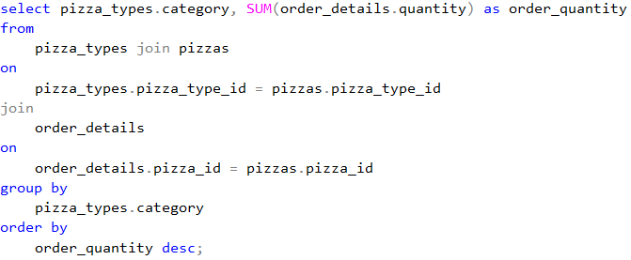
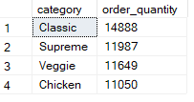
Query 6: Join the necessary tables to find the total quantity of each pizza category ordered.

Slide 10
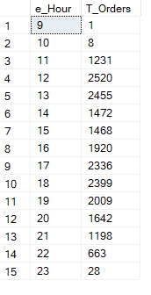
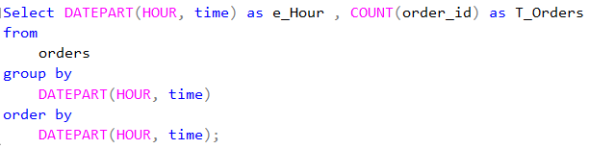
Query 7: Determine the distribution of orders by hour of the day.

Slide 11
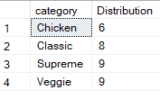
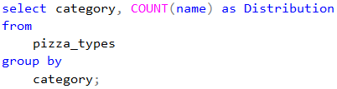
Query 8: Join relevant tables to find the category-wise distribution of pizzas.

Slide 12
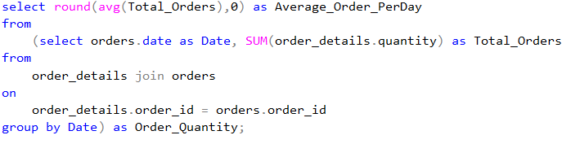

Query 9: Group the orders by date and calculate the average number of pizzas ordered per day.

Slide 13
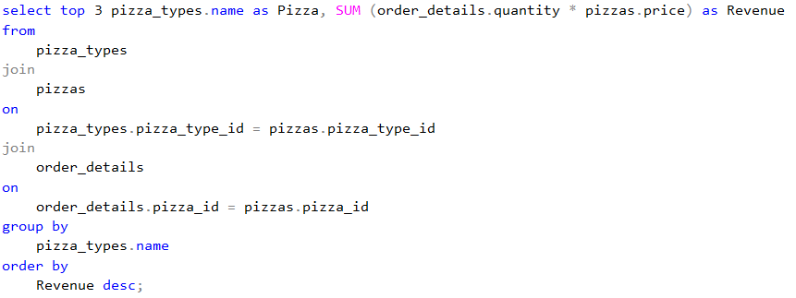

Query 10: Determine the top 3 most ordered pizza types based on revenue.

Slide 14
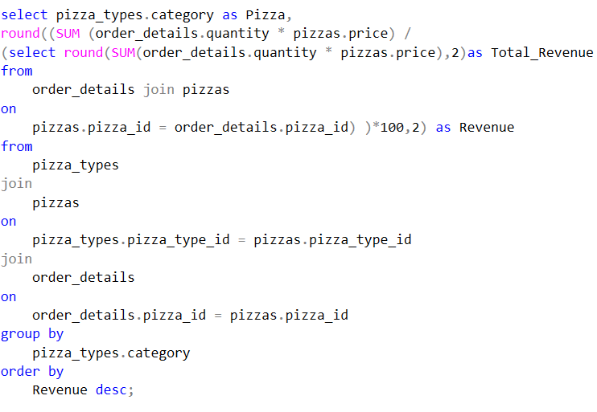
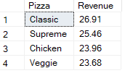
Query 11: Calculate the percentage contribution of each pizza type to total revenue.

Slide 15
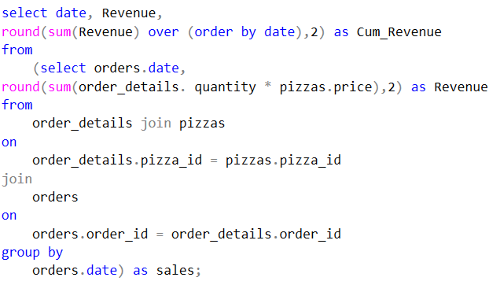
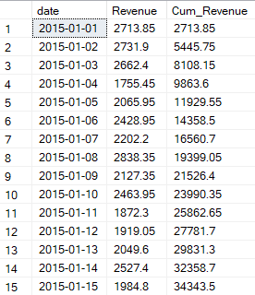
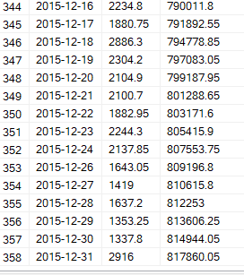
Query 12: Analyze the cumulative revenue generated over time.

Slide 16
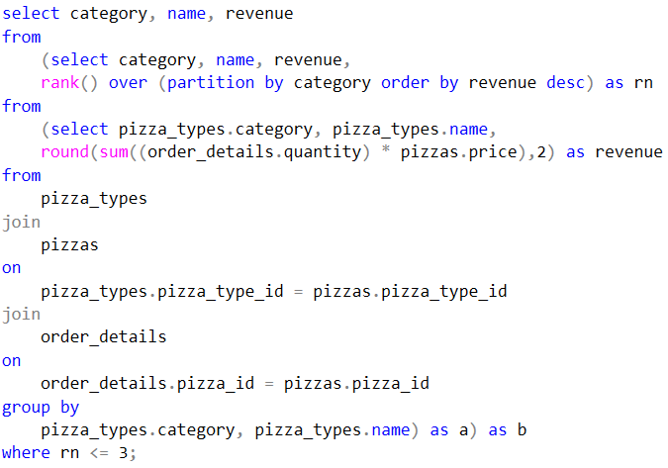
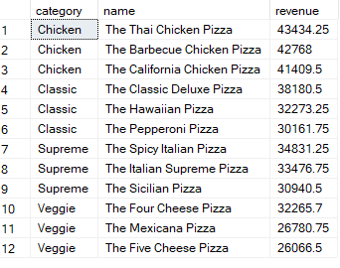
Query 13: Determine the top 3 most ordered pizza types based on revenue for each pizza category.

Slide 17

THANK
YOU

