Slide 1

INVESTMENT BANKING
HOUSE
Investment that will Make you Grow…

Slide 2

INVESTMENT BANKING HOUSE
Investment Banking House is a financial service company or division of a bank that provides advisory services to individuals, and corporations in relation to underwriting, capital raising, merger, and acquisition, etc. It acts as a bridge between companies (who need investment to run and grow their business) and investors (who want to invest their funds in the market).
House

Slide 3
WHY YOU SHOULD CHOOSE INVESTMENT BANKING
In Today's world Everyone Should Invest In Mutual fund Or any Type of Fund So that their Money will not Get Affected By Inflations That Is 4% Per year. And The Percent Matters A lot. For ex:-If a Person Invests ,1,00,000/- Rs. In Fixed Deposit or Recurring Deposit In A Bank With Current Interest Rates i.e.4.50-5.50 The Estimated return Value For a year Would Be 1,04,500. Approx Respectively. And If You Invest In Share,Stocks,Mutual Funds The Returns may Upto 8% that is almost Twice Of Bank Interest.

Slide 4
TYPES OF INVESTMENT BANKING
Regional Boutique: Smaller in size, they deal with not more than a dozen customers and specializes in a single area.
Elite Boutique: They are similar to bulge bracket banks and provide high–value deals, have multiple offices in the country, but do not have a global presence like bulge bracket banks.
Middle Market: They deal between $50 m to $500m, have a larger presence than regional boutique division, and do not have a global presence.
Bulge Bracket: They are multinational investment banking firms. These banks deal with large clients and deals; they have a global presence and recognizable name, and also have offices across the globe.

Slide 5

FOR YOUR REFERENCE :
Goldman sachs
Deutsche bank
Barclays investment bank
Bank of america

Slide 6
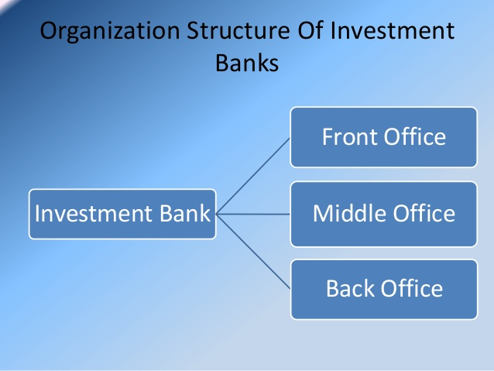
STRUCTURE OF INVESTMENT BANKING
It is mainly divided into three levels.
Front Office: People in this division face customers directly. It is a revenue-generating division. Activities include advisory services on merger & acquisitions, underwriting, trading, and research service.
Middle Office: People in this division are responsible for information technology and risk management related services.
Back Office: Back office staff deals with customer services, human resources, office management, staff payroll, etc.

Slide 7
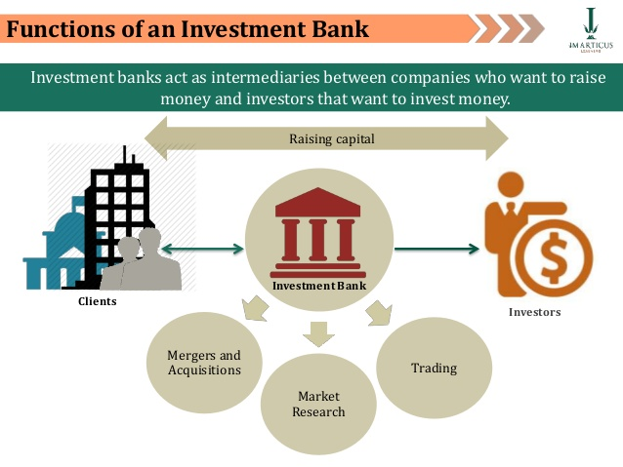
FUNCTIONS AND IMPORTANCE
Functions
Acts as an intermediary between investors and the company.
It helps companies in raising capital.
Provide advisory services for underwriting and merger & acquisition.
Provide ancillary services like equity, derivative trading, facilitating transactions, market-making, promotion of securities, etc.
Importance
In a growing economy where all the companies want to raise capital through stock and shares, Investment Bank with their expertise helps these companies by providing underwriting services, so that businesses can maximize their revenue while staying within the regulatory requirement.
They provide other ancillary advisory services as well to their clients. Therefore, in a nutshell, these organizations play a pivot role by helping corporate, individuals, and government bodies.
With their expertise, they help in the growth of the local, national, and the global economy as a whole.

Slide 8
Popular Investment Options in India
You have numerous investment options to choose from. However, you have to ensure that you are investing in only those options that fall under your risk tolerance and serve your requirements. The following are the top 7 investment options in India:
i) Direct Equity Direct equity, commonly referred to as investing in stocks, is probably the most potent investment vehicle. When you buy a company’s stock, you buy partial ownership of that company. You directly invest in the company’s growth and development. You need to have enough time and possess the market knowledge to benefit from your investment. If not, then investing in direct equity is as good as speculation.
Stocks are offered publicly listed companies through the recognised stock exchanges and can be bought by any investor who has Demat account and undergone KYC verification. Stocks are ideal for long-term investments. You have to actively manage your investments as various economic and business factors influence stocks. Also, you need to understand that the returns are not guaranteed and be willing to assume the associated risks.
ii) Mutual Funds Mutual funds have been around for the past few decades, and are gaining popularity amongst millennials. A mutual fund pools investment from various individual and institutional investors who have a common investment objective. The pooled sum is managed by a finance professional called the fund manager, who invests in securities and assets to generate optimum returns for investors. Mutual funds are broadly divided into equity, debt and hybrid funds.
Equity mutual funds invest in stocks and equity-related instruments, while debt mutual funds invest in bonds and papers. Hybrid funds invest across equity and debt instruments. Mutual funds are flexible investment vehicles, in which you can begin and stop investing as per your convenience. Any individual may consider investing in mutual funds.

Slide 9
You don't need to have time or knowledge to invest in mutual funds as the fund manager takes care of portfolio constitution, and you only have to invest. However, it is advisable to invest in only those funds whose risk levels and objectives match yours. The returns are not guaranteed as they are dependent entirely on the market movements. Note that past performance of a fund does not indicate future returns.
iii) Goal Investment goals can be either short or long-term. You should opt for a safer investment for a short-term goal and consider the high return-generating potential of equities for long-term goals. Some of your requirements can also be negotiable and non-negotiable. For non-negotiable goals like children's education or down payment for a house, guaranteed-return investments would be a good choice. If the goal is negotiable, which means that it can be pushed back by a few months, then investing in equity mutual funds or stocks can be beneficial. Do not forget that if these investments perform well, you can even meet your goals much sooner than expected.

Slide 10
WHAT IS COMPOUNDING ?
Compound interest or compounding means you not only receive the interest on the basic principal amount that you have invested, but also on the interest that keeps getting added to it. It essentially means reinvesting the earnings you get from your initial invested amount instead of spending it elsewhere. For example, if you invest Rs 100 with 8% interest every year, then your principal amount is Rs 100 and the earnings, at the end of the year, are Rs 8 (8% of Rs 100). However, instead of spending it, if you choose to reinvest it, then your principal amount for the next year becomes Rs 108 (Rs 100 + Rs 8) and the earnings you get are Rs 8.64 (8% of Rs 108), which are Rs 0.64 more compared to the first year.
Even though this looks like a small amount, it can make a huge difference to your investments, if you let the magic of compounding work over a long term.
How Compound Interest works in Investments
Consider an example to understand how the power of compounding works: Ravi invested Rs 1,00,000 as a lump sum this year. He is going to earn an interest of 12% on this investment every year. Now let's see how much interest Ravi earns over 10 years, if he takes his interest out each year, as compared to letting the principle of compounding work for him.

Slide 11

INVESTMENT BANKING
VS
PRIVATE EQUITY
It is an advisory service for capital raising and merger & acquisitions while private equity is the investment of funds collected from wealthy individuals, pension funds, insurance companies, etc.
In other words, private equity is investing activity while investment banking majorly includes advisory services. They both do help in capital raising for investment, but private equity takes funds from high net worth individuals or companies, while investment banking tries to raise the capital from the market.

Slide 12
COMPOUNDING INTEREST CALCULATION
Scenario 1: Ravi keeps his earned interest aside | Scenario 2: Ravi reinvests his interest and lets compounding work
Year | Principal Amount | Interest Earned (@12%p.a) | Year | Principal Amount | Interest Earned (@12%p.a)
1 | 1,00,000 | 12,000 | 1 | 1,00,000 | 12,000
2 | 1,00,000 | 12,000 | 2 | 1,12,000 | 13,440
3 | 1,00,000 | 12,000 | 3 | 1,25,440 | 15,052.8
4 | 1,00,000 | 12,000 | 4 | 1,40,492.8 | 16,859.1
5 | 1,00,000 | 12,000 | 5 | 1,57,351.9 | 18,882.2
6 | 1,00,000 | 12,000 | 6 | 1,76,234.1 | 21,148.1
7 | 1,00,000 | 12,000 | 7 | 1,97,382.1 | 23,685.9
8 | 1,00,000 | 12,000 | 8 | 2,21,462.7 | 26,528.2
9 | 1,00,000 | 12,000 | 9 | 2,48,038.2 | 29,711.6
10 | 1,00,000 | 12,000 | 10 | 2,77,802.7 | 33,276.9
Total interest earned Rs 1,20,000 | Total interest earned Rs 2,10,584.4
Total value of investment Rs 2,20,000 after 10 years | Total value of investment Rs 3,10,584.4 after 10 years
You can see that by merely reinvesting the interest earned on his principal amount, Ravi manages to earn almost double the interest on his one-time investment as compared to him taking his interest out each year. This shows the power of compounding.

Slide 13
ADVANTAGES OF INVESTMENT BANKING
Investment banking division with its expertise handles their client’s project most efficiently, help them in raising capital by maximizing their revenue, creating their brand value in the long run.
It helps their client in managing large projects, by identifying the risk associated with the projects beforehand, thus saving time.
They also provide advisory services to their clients in relation to the restructuring of the business, so that business can become more efficient and maximize its profit.

Slide 14

When you are young, you think you don't have enough money to invest. Your initial steps into the working world also come with more expenses. Now that you finally have the money to buy that cell phone, TV or the car you always wanted, your salary or income disappears faster than you realise. Keeping some money aside for investing may feel unimportant. So you may think why not start investing a few years later when you have more money to spend and save? Unfortunately, this cycle never ends. By the time you realise the importance of investing, you may lose the advantage of time by your side.
Even a small amount can create a big value if given enough time.
Investing early can give you a big advantage. You can not only plan your investments but also give them enough time to grow into a corpus that meets your financial goals.
Power of compounding
Compounding essentially means reinvesting the profits from your investments to make your investments grow exponentially. Let us say you start with just Rs1 that keeps doubling every day for 25 days. How much do you think will be the final amount at the end of the 25th day? From Rs 1 it will go to Rs 2 the second day, Rs 4 the third day and so on, reaching a phenomenal amount of Rs 1.67 crore rupees on the 25th day!
This is the power of compounding However, if you follow the same example for 20 days, then the amount is just Rs 5.24 lakh '96% less than what you get after 5 more days. This shows that when giving your investments the power of compounding, giving enough time for them to grow is equally important.

Slide 15

Benefits of compounding
So how do you take advantage of the power of compounding in your investments?
Make sure you start investing, even small amounts, as soon as you start earning for compounding to work.
Avoid any withdrawals as it reduces your invested amount, giving lower returns.
Consider an example:
Mayank and Vivek are brothers. Mayank is 25 years old and starts a Systematic Investment Plan (SIP) of Rs 5,000 per month in a mutual fund, with growth option (which means returns will be reinvested for compounding to work). SIP essentially means that he does not need to have a large sum to invest in a mutual fund. He can instead break it into monthly regular parts for his investment.
Meanwhile, 30-year-old Vivek also starts the same SIP with Mayank. They both want to keep investing till they retire at 60 years. Assuming they got an average return of 9% each year when they both turn 60, Mayank's accumulated amount would have reached Rs1.35 crore and Vivek's amount will be Rs 85.7 lakh rupees. So by starting just five years earlier, Mayank will get Rs 49.9 lakh more than Vivek!
This simple example shows that if you start early, invest regularly and avoid withdrawing from this accumulating amount, your investment will grow manifold. This will enable you to create wealth and fulfil your financial goals in life like buying that dream house, funding your child's education or your own retirement in a much easier way.

Slide 16

BONDS
Bond is a debt security, in which the authorized issuer owes the holders a debt and, depending on the terms of the bond, is obliged to pay interest (the coupon) to use and/or to repay the principal at a later date, termed maturity. A bond is a formal contract to repay borrowed money with interest at fixed intervals (ex semi annual, annual, sometimes monthly).
Bonds provide the borrower with external funds to finance long-term investments, or, in the case of government bonds, to finance current expenditure. Bonds and stocks are both securities, but the major difference between the two is that (capital) stockholders have an equity stake in the company (i.e., they are owners), whereas bondholders have a creditor stake in the company (i.e., they are lenders). Another difference is that bonds usually have a defined term, or maturity, after which the bond is redeemed, whereas stocks may be outstanding indefinitely
Capital gain bonds
Capital Gains Bonds are instruments which offer tax exemption for transferring gains of long term capital assets. The Investment in these Bonds is to be made within six months from the date of such transfer of capital assets (Land/House Property etc.) for being exempted from Capital Gains Tax under Section 54EC of the Income Tax Act, 1961.

Slide 17

ETF
A stock ETF, or exchange-traded fund, is an asset that tracks a particular set of equities, similar to an index. It trades just as a normal stock would on an exchange, but unlike a mutual fund, prices adjust throughout the day rather than at market close. These ETFs can track stocks in a single industry, such as energy, or an entire index of equities like the S&P 500. Other tracking methods include the Stochastic Oscillator and the Stochastic Momentum Index.
Stock ETFs offer investors a wealth of benefits so it makes sense that fund inflows have skyrocketed in recent years. In fact, as of Nov. 2020, the U.S. ETF market topped a record $5 trillion in assets.³﻿ The broad advantages cannot go understated. They are an excellent option for investors looking to diversify their portfolio in a flexible, low cost, and tax-efficient manner. In fact, a growing body of research suggests passive investments like stock ETFs tend to outperform actively managed funds over a long time frame.¹﻿
Different Styles of Stock ETFs
The more popular stock ETFs track benchmark indexes like the S&P 500 or Dow 30. The SPDR S&P 500 (SPY), which is maintained by State Street, is consistently the most active asset with an average daily volume exceeding 67 million shares in the past three months.⁴﻿
Other styles of stock ETFs adopt a factor-based strategy that accounts for specific attributes like market capitalization, momentum, and value. This subset of assets is a popular strategy known as Smart Beta. It attempts to deliver better risk-adjusted returns than a conventional market-cap-weighted index

Slide 18
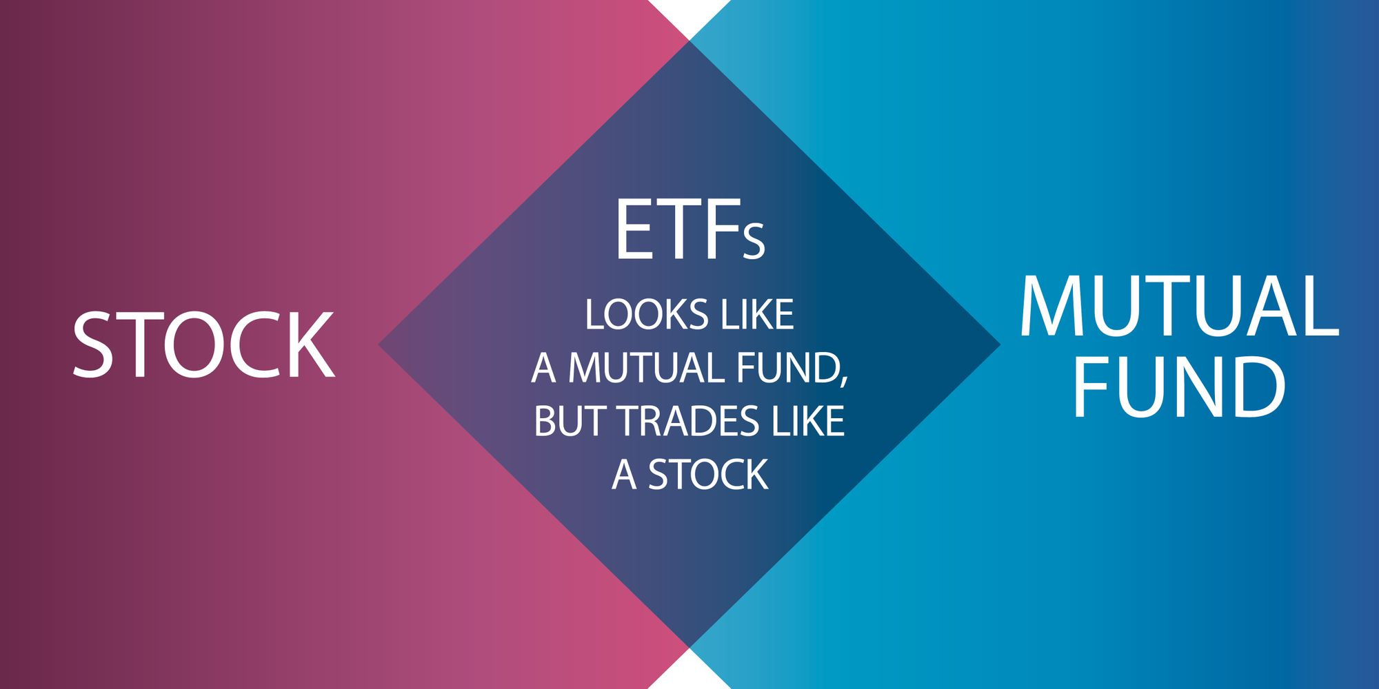
ETFs, FOFs, & SPECIAL SITUATION SCHEME
Exchange Traded Fund (ETF), are mutual funds that trade just as stocks, in that ETF units are traded on exchanges on which the ETF is listed at market-determined prices.
The units can be bought and sold at any moment during market hours through demat accounts.The most common ETFs aim to track the performance of a market benchmark or an Index`s total return.) is a mutual fund scheme that invests in other mutual funds.
Special situation schemes focus on peculiar goals such as retirement. Such schemes invest in a mix of equity and debt instruments. Hence, have a dual objective of wealth creation and stability.

Slide 19
WHY INVESTING IN A MUTUAL FUND
IS A WISE CHOICE
Diversification
One of the biggest advantages mutual funds give you is that of immediate diversification. You may not have enough money to spread your investments in varied stocks and sectors, but by pooling money from thousands of similar investors, a mutual fund spreads your investment and hence, risk. It is highly unlikely that all the stocks will go down by the same proportion on any particular day. This ensures that you have not kept all your eggs in one basket and are safe from incurring huge losses from a single bad investment.
Professional Management
Another big benefit of investing in mutual funds is the professional expertise it provides for your investments. Asset Management Companies (AMCs) provide qualified fund managers who, with the help of strong research teams and their own expertise, pick the best options to meet the fund's objective. This saves you time and the stress of constantly monitoring your investments and wondering if you made the right buy or sell decision. With mutual funds, you do not have to worry about market swings.
Affordability
You may want to buy shares of large companies or want to invest in big companies in a particular sector of choice. However, you may not have the money to make a big investment. Mutual funds trade in big volumes, giving their investors the advantage of lower trading costs. Anyone can start an investment in a mutual fund through a Systematic Investment Plan (SIP) with as little as Rs 500.

Slide 20
For example, say Pooja has just started her career and wishes to put aside atleast Rs 48,000 annually to go on an overseas vacation after three years. Instead of waiting to collect a lump sum of Rs 48,000 to kick start the investment, mutual funds allow Pooja to invest a small sum of Rs 4,000 every month, in the form of a SIP. This makes it affordable for Pooja and at the same time keeps her goal on track.
Liquidity
You can easily move your money in and out of mutual fund investments. Investments in open-ended funds can be redeemed in part or as a whole any time to receive the current value of the units.
Tax Benefits
There are various tax benefits available on your investments in mutual funds. For example, investments in Equity Linked Savings Schemes (ELSS) qualify for tax deductions under Section 80C of the Income Tax Act. There is no tax on capital gains on units of equity schemes held for more than 12 months.
Schemes other than equity-oriented schemes are treated in the debt category for tax purposes. Short term capital gain is applicable for redemption of debt mutual funds within 3 years. Long term capital gain (more than 3 years) from debt mutual funds is taxable after claiming the benefit of Indexation.
Well Regulated
In India, all mutual funds are regulated by the Securities and Exchange Board of India (SEBI). All mutual funds are required to follow transparent processes, as laid down by SEBI, protecting the interest of investors. Further, SEBI makes it compulsory for all mutual funds to disclose their portfolios every month

Slide 21
CONCLUSION
From the above discussion, we can conclude that it is an integral part of the global economy. Investment Banking personnel with their expert help in the growth
of the economy and provide a number of services to their clients. Though there are some limitations, the pros in this case specifically are overshadowing all the cons.

Slide 22

OUR MISSION
Grow our clients investments
WE
WANT
TO
BE
THE BEST
IBH
GREAT SUPPORT
A Firm That will Help You Grow Together
We Support Our Client To Achieve Their Financial Goal
SATISFACTION
Returns
As Per Customer Reviews Service Satisfaction is Best
We Provide Best Returns

Slide 23
CONTENT OVERVIEW
WELCOME
ABOUT US
OUR MISSION
OUR VISION
OUR TEAM
OUR SERVICES
OUR PORTFOLIO
OUR DEVICES

Slide 24

Goal , Capital Gain
Investment And Satisfaction

Slide 25
OUR VALUES
Grow our clients investments
IBH
SUPPORT
CHAT 24/7
MAILING
A Firm That will Help You Grow Together
We Support Our Client To Achieve Their Financial Goal
Our Team Will Be In support For You 24/7
You Can Mail Us At Registered E-mail Regarding Any Queries

Slide 26
OUR SERVICES
YOUR GREAT SUBTITLE
01
02
03
RESEARCH
REVIEW
STUDY
We Research About Best Stocks And Shares , ETFS, Mutual Funds
Review From the Individuals About The Market
Apply For The Fund As Per Review
04
05
06
COMPANY PROFILE
AGENT INFORMATION
EMAILING
Your Trust Is Our Responsibility
We Give Call According To Our Agent Information
Approved Call Of The Customer Will Be Email To Agents

Slide 27

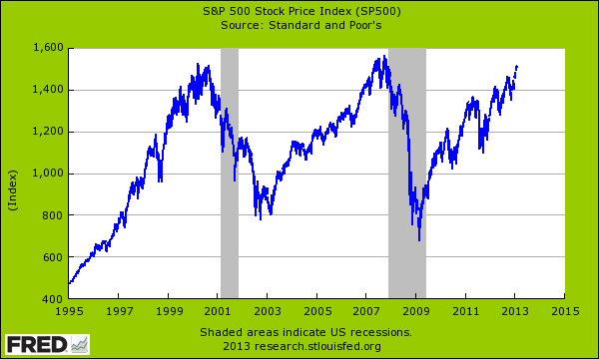

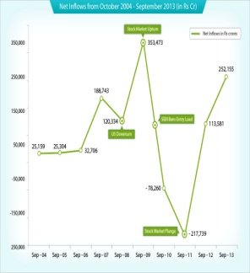
ARROW INFOGRAPHIC
Investment that will Make you Grow…
01
SHARES
Shares are units of equity ownership interest in a corporation that exist as a financial asset providing for an equal distribution .
STOCK
02
A stock (also known as equity) is a security that represents the ownership of a fraction of a corporation. ...
ETF
03
An exchange traded fund (ETF) is a type of security that involves a collection of securities' such as stocks
MUTUAL FUND
A mutual fund is a company that pools money from many investors and invests the money in securities such
As stocks, bonds, and short-term debt
04

