Slide 1

A Project
MID-TERM PRESENTATION
ON
‘Hire-Hawk : An Applicant Tracking System’
PRESENTED BY:
SUPERVISED BY:
Mandip Kunwar (5-2-1131-18-2019)
Sagar Rana Magar
Lecturer, Swastik College
Saurabh Subedi (5-2-1131-30-2019)
Shiwam Paudel (5-2-1131-32-2019)

Slide 2

Presentation Outline
Title Slides | 01
Introduction | 03
Problem Statement
Objective
Literature Review
Methodology
Functional Requirements
Diagrams
Result
Task Remaining
References

Slide 3
Introduction
The "Hire-Hawk: An Applicant Tracking System" simplifies and modernize the recruitment process.
The goal is to help companies quickly find the right candidates without going through time-consuming and challenging procedures.
Background
Importance
Scope
HireHawk analyses applied applicant resumes and assists HR in recruiting the perfect candidates for the given vacancy.
Streamline hiring by automating resume analysis and scoring
Efficient and accurate matching of skills to job requirements, benefiting both employers and applicants.
Comprehensive online recruitment system.
Effective in Corporate Industries, Human Resource Department & Recruitment Agencies.
Applicant submissions with automated resume analysis.
1
2
3

Slide 4
Background
Traditional hiring faces challenges with manual screening and subjective evaluations.
Overwhelmed recruiters, time constraints, and a lack of in-depth analysis of resumes.
"Hire-Hawk" addresses these challenges using the cosine similarity algorithm for objective and efficient resume analysis.

Slide 5
Importance
Revolutionizes recruitment with a transparent and accessible platform.
Automates screening, saving time for recruiters and providing a fair chance for job seekers.
Enhances efficiency and accuracy in matching skills to job requirements.
Objective assessment through the cosine similarity algorithm ensures a fair and efficient evaluation of candidates.

Slide 6
Scope
Comprehensive online recruitment system.
Job posting, updating, and deletion functionalities for administrators.
Applicant submissions with automated resume analysis.
Scoring mechanism for applicants based on resumes and job criteria. Security measures for authentication and scalability for growing data and user volumes.

Slide 7
Problem Statement
To address challenges in traditional hiring processes characterized by manual screening and subjective evaluations.
To alleviate the overwhelming workload on recruiters dealing with a high volume of resumes.
To ensure a transparent and efficient connection between employers and job seekers.

Slide 8
Objective
Analyze applied applicant resumes and assist HR in the recruitment
To save time by automating the initial screening of resumes
To identify qualified candidates quickly and easily

Slide 9
Literature Review
Cites (Date) | Paper | Algorithm | Limitation
1 (2020) | AN AUTOMATED RESUME SCREENING SYSTEM USING NATURAL LANGUAGE PROCESSING AND SIMILARITY | TF-IDF Vectorization & Cosine Similarity | may miss out on providing complete information, affecting the accuracy of the system's matching.
2(2017) | JRC: A Job Post and Resume Classification System for Online Recruitment | Section-Based Segmentation Module & Integrated Knowledge Base | Lacks an automatic matching procedure between candidate resumes and their corresponding job postings
3(2017) | Applying Learning-to-Rank to Human Resourcing's Job-Candidate Matching Problem: A Case Study. | Gradient Boosted Regression Trees (GBRT) & LambdaMART | Incorrectly categorized data & Lacks Automatic mailing system
Proposed | Categorized and provided with complete information with transparent salary, highly accurate | Cosine Similarity

Slide 10
Methodology
Determine
Project Vision
Planning
Algorithm Implementation
Review
Retrospect

Slide 11
Determine Project Vision
Determine
Project Vision
To create a transparent, accessible, and equitable platform for both employers and job seekers.
To save time for recruiters, empower applicants to showcase their skills effectively, and foster a more efficient and accurate matching of skills.

Slide 12
Planning
Planning
The project is systematically broken down into iterative cycles, known as sprints, allowing for regular reassessment and adaptation

Slide 13
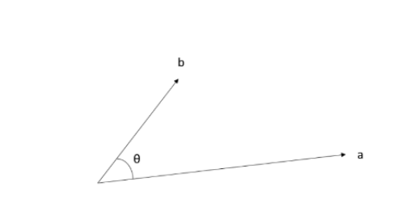
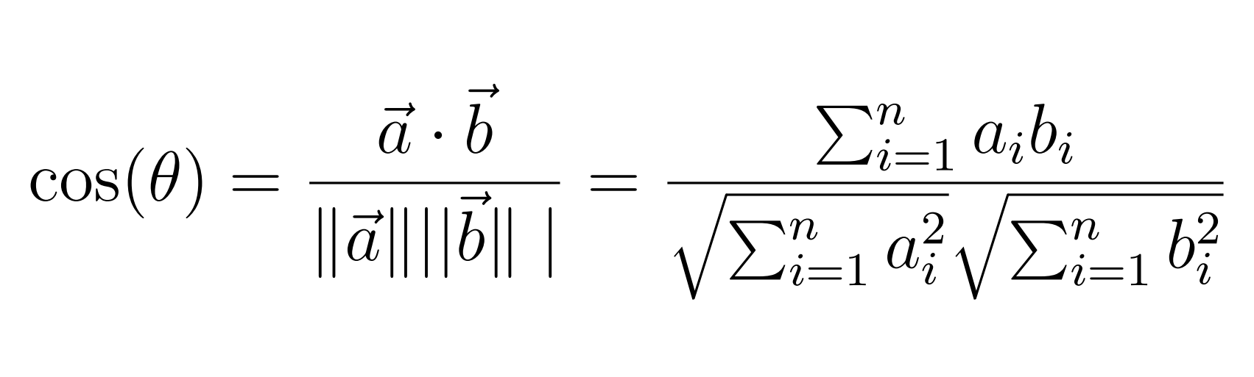
Algorithm Implementation
Algorithm Implementation
Vector Representation
Dot Product
Normalization
Angle Calculation
Similarity Value Calculation

Slide 14
Review
This phase serves as a checkpoint for reflecting on challenges faced, adapting to evolving project requirements, and identifying opportunities for refinement
Regular reviews are conducted to assess the progress made during each iteration and phase
technical reviews ensure that the implemented algorithms, such as the cosine similarity for resume analysis, are performing optimally
Review

Slide 15
Retrospect
Retrospect
This phase is crucial for understanding what worked well, identifying areas for improvement, and capturing lessons learned
the team reflects on project milestones, collaboration effectiveness, and the implementation of features
reviews are incorporated into future plans, enhancing the system's overall performance

Slide 16
Tools Used
Django
Github
Visual Studio Code
Figma
Draw.io
Overleaf

Slide 17
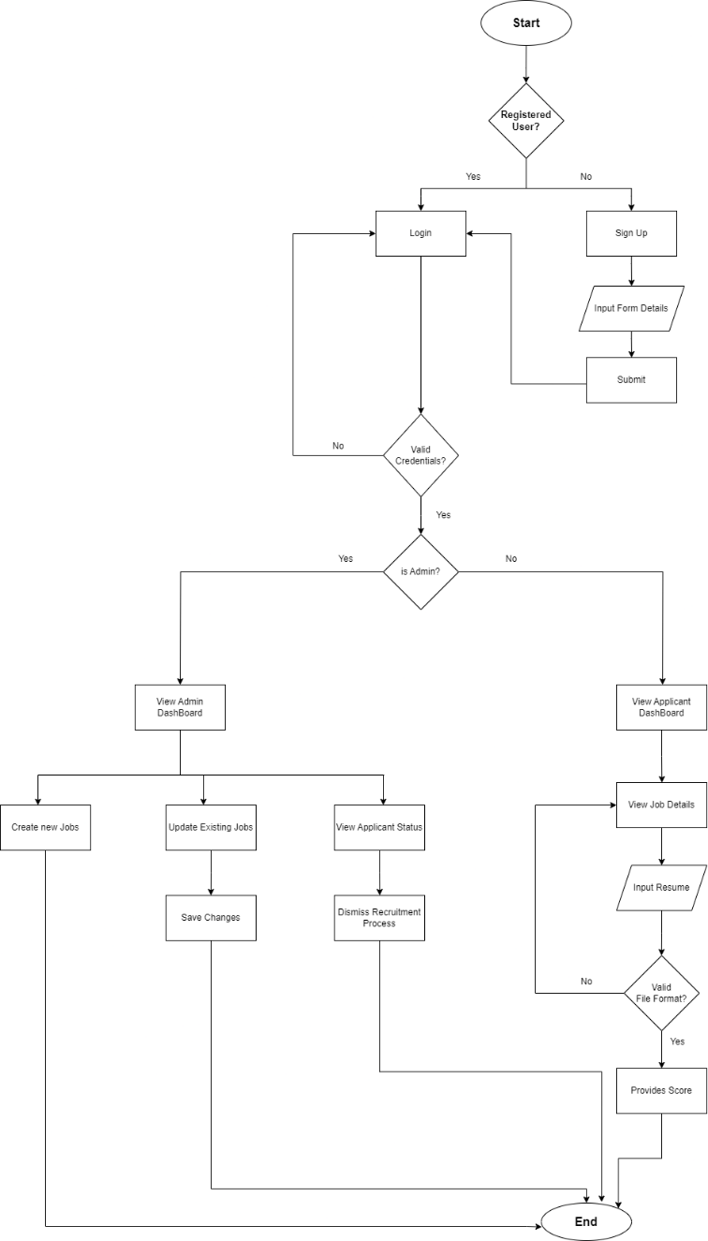
Proposed System Model
Tap to Open Diagram

Slide 18
Functional Requirement
Authentication System
User Dashboard
Vacancy Announcement Platform
Job Application with Resume Submission
Score Generator and Hiring Assistance

Slide 19
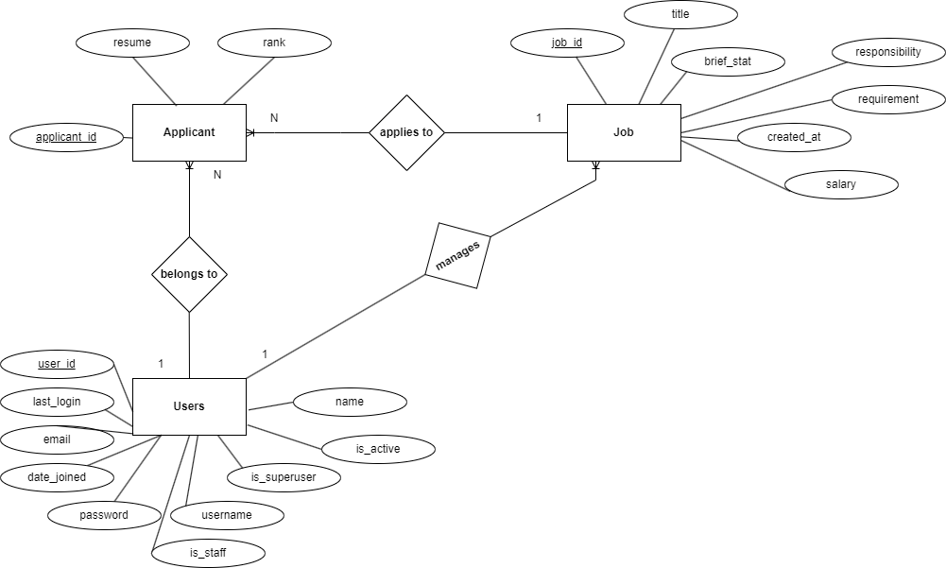
Diagrams
ER-Diagram of HireHawk System
Click to Open ERD

Slide 20
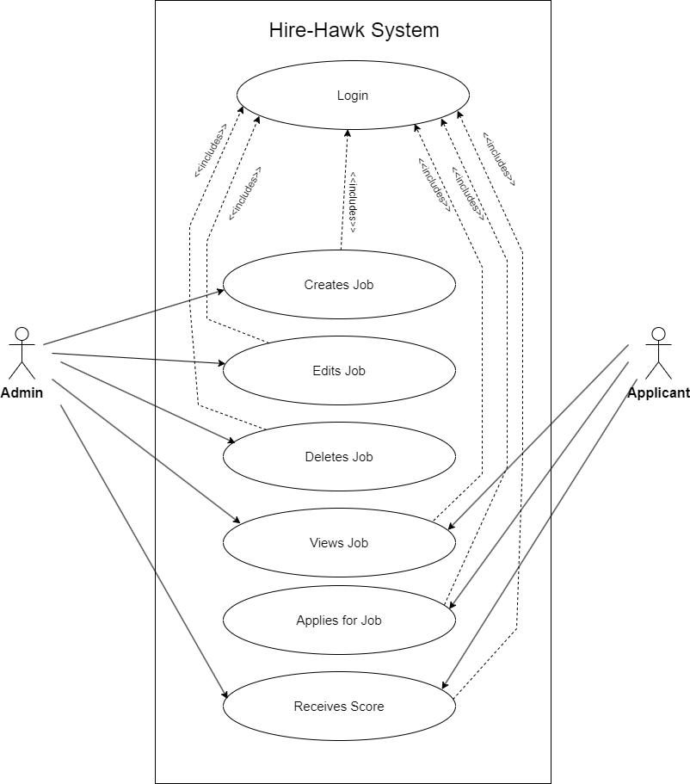
Diagrams
Use Case Diagram
Click to Open Use Case Diagram

Slide 21
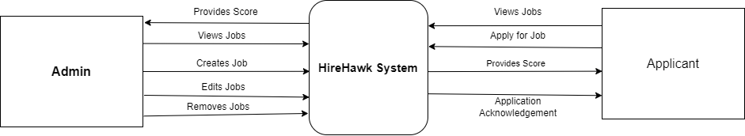
Diagrams
Context Diagram:
Click to Open Level0DFD

Slide 22
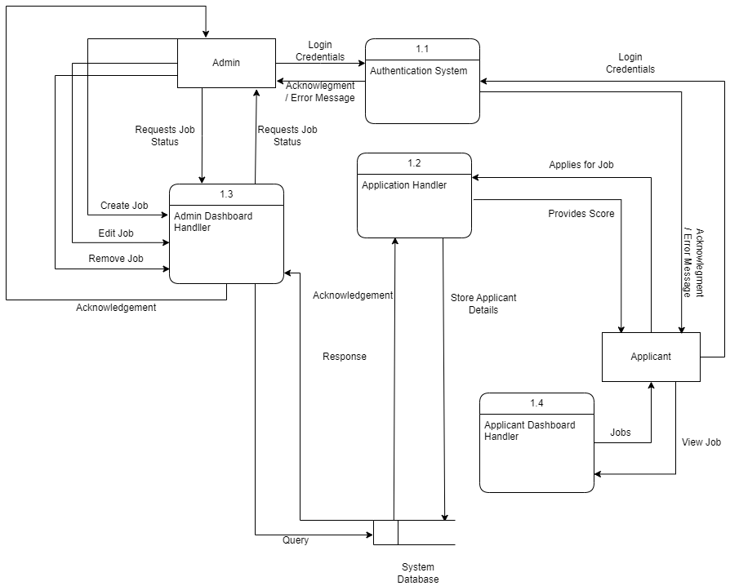
Diagrams
Level 1 DFD
Click to Open Level 1 DFD

Slide 23
Result
Obtain a ranked list of applicants based on the similarity of their resumes to the given job description.
The system provides a more efficient approach to candidate and job description matching, focusing on relevant qualifications.

Slide 24
Task Remaining
Supervisor’s Feedback
Certain Bug Fixes

Slide 25
References
[1] C. Daryani, G. S. Chhabra, H. Patel, I. K. Chhabra, and R. Patel, “An automated resume screening system using natural language processing and similarity,” ETHICS AND INFORMATION TECHNOLOGY [Internet]. VOLKSON PRESS, pp. 99–103, 2020
[2] H. Braun, “Applying learning-to-rank to human resourcing’s job-candidate matching problem: A case study.” 2017.
[3] A. Zaroor, M. Maree, and M. Sabha, “Jrc: a job post and resume classification system for online recruitment,” in 2017 IEEE 29th International Conference on Tools with Artificial Intelligence (ICTAI). IEEE, 2017, pp. 780–787

Slide 26

Questions?

