Slide 1

Presented by:
Saurabh Suman(46022656)

Slide 2
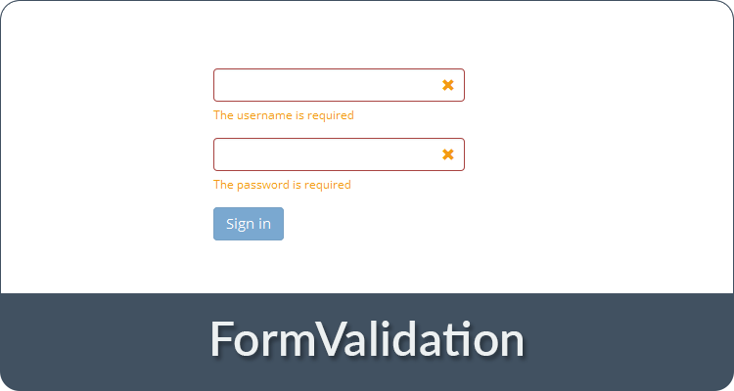
JavaScript Form Validation?
Form validation is the process of checking that a form has been filled in correctly before it is processed, this is called form validation.

Slide 3
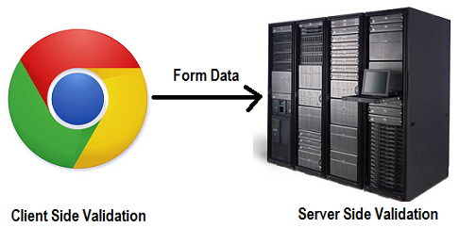
There are main two methods of validating form
1. Server Side method 2.Client Side method

Slide 4
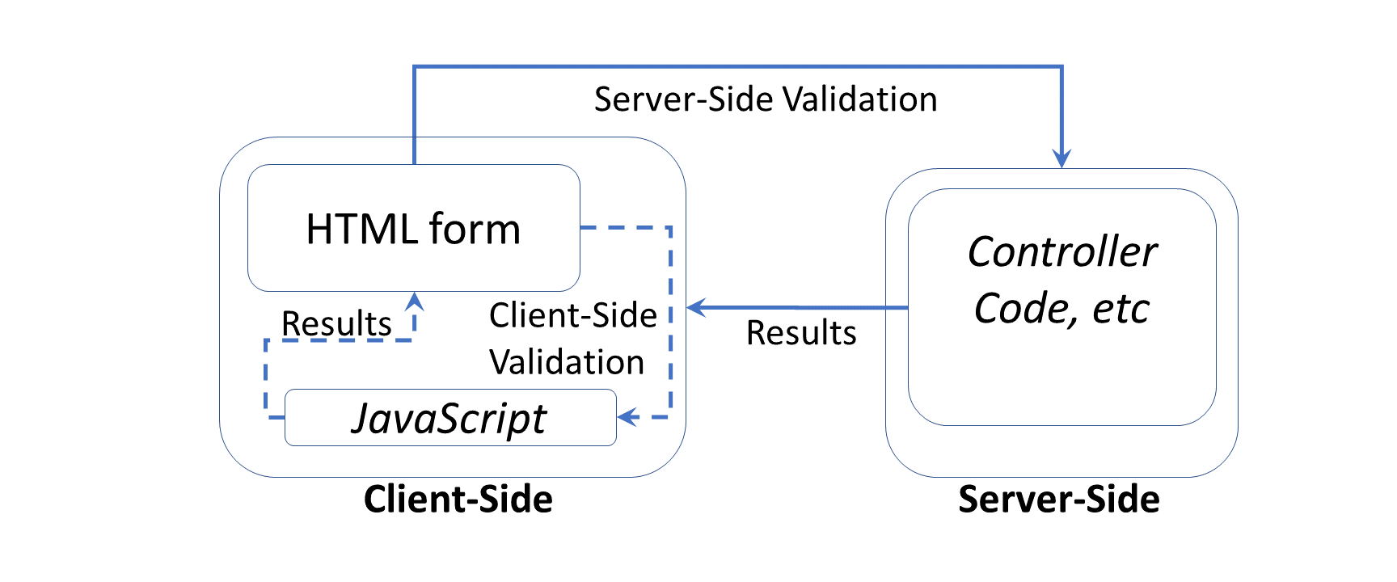
JavaScript provides a way to validate form’s data on the client’s computer before sending it to the web server.

Slide 5
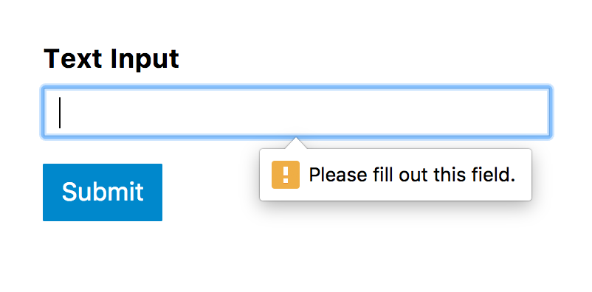
Form Validation generally performs two functions:
1. Basic Validation: First of all, the form must be checked to make sure data was entered into each form field that required it.

Slide 6
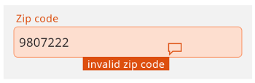
2. Data Format Validation: Secondly, the data is entered must be checked for correct form and value.

Slide 7

onsubmit : onsubmit is an event of JavaScript, it monitors for the submit action as someone clicks on
Methods : Methods are the action that can be performed on objects through which a browser sends form information to Server.
There are two types of methods:-
1.Post 2.Get
Post method : Post method is used for sending information to server. All programmers use mainly post method because it is secure and can transfer unlimited information.
Get method : Get method is used for sending information to server too. Get method is less secure than Post method.

Slide 8

A Simple Form with Validation :

Slide 9
HTML Form
<form name="myForm" action="/action_page.php" onsubmit="return validateForm()" method="post"> Name: <input type="text" name="fname"> <input type="submit" value="Submit"> </form>
JavaScript
function validateForm() { var x = document.forms["myForm"]["fname"].value; if (x == ”” || x<1 || x>10) { alert(“Invalid data”); return false; } }

Slide 10


