Slide 1

IDENTIFICATION OF MOST VALUABLE CUSTOMERS WITH rfm analysis
Saurabh Tayde
23-05-2019

Slide 2
Problem Statement
Project Goal: To select the best 500 customers amongst the 4373 customers to maximize subscriptions to the loyalty program
Tools used: R Studio, MS-Excel
Algorithm Used: RFM (Recency, Frequency, Monetary) Analysis
RFM :
Recency – How recently did the customer purchase our products?
Frequency – How often do they make the purchase?
Monetary – How much do they averagely spend per purchase?
Dataset Details: Number of Observations: 5,41,910 Number of Variables: 8
Variables : InvoiceNo, StockCode, Description, Quantity, InvoiceDate, UnitPrice, CustomerID, Country
RFM score calculated through both possible ways :
Without using ‘rfm’ package in R (RFM calculated through Date, Amount, Quantity etc): Scaled between 0 to 1
With package ‘rfm’: Binned into categories five categories [1,2,3,4,5]
Packages used in ‘R’:
readxl, ggplot2, DataExplorer, rfm

Slide 3
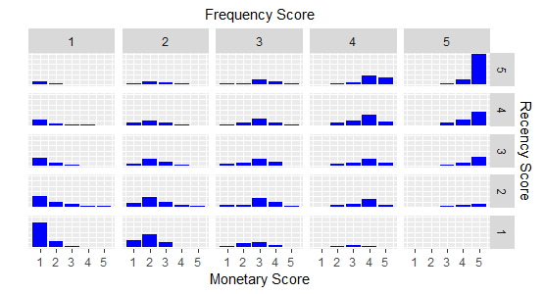
Solution Description
Analyzed the original dataset thoroughly and calculated Recency, Frequency, Monetary from it for each customerID
Created new dataset 'customers' with Variables Recency, Frequency, Monetary & customerID
R,F,M variables were right skewed, so applied log transformation
Scaled the values of R,F,M between 0 to 1 and determined Customer Importance (Higher the value, more important the customer)
Also from the 'rfm' package, categorised each R,F,M into 1,2,3,4,5 (This score can be used for segementation)

Slide 4
Business Benefits
After designing a solution on top customers provided by us, will help client to increase their customer spend and increase customer lifetime value.
Analysis of important customer base provided to the client, will help to build meaningful relationships with their existing clients
Developed model will help client in witnessing increase in partnering businesses and overall brand awareness.
By implementing a loyalty program on top customers will also help to attract other new users
Segment | Description | R | F | M
Champions | Bought recently, buy often and spend the most | 4 to 5 | 4 to 5 | 4 to 5
Loyal Customers | Spend good money. Responsive to promotions | 2 to 5 | 3 to 5 | 3 to 5
Potential Loyalist | Recent customers, spent good amount, bought more than once | 3 to 5 | 1 to 3 | 1 to 3
New Customers | Bought more recently, but not often | 4 to 5 | <=1 | <=1
Promising | Recent shoppers, but haven’t spent much | 3 to 4 | <=1 | <=1
Need Attention | Above average recency, frequency & monetary values | 2 to 3 | 2 to 3 | 2 to 3
About To Sleep | Below average recency, frequency & monetary values | 2 to 3 | <=2 | <=2
At Risk | Spent big money, purchased often but long time ago | <=2 | 2 to 5 | 2 to 5
Can’t Lose Them | Made big purchases and often, but long time ago | <=1 | 4 to 5 | 4 to 5
Hibernating | Low spenders, low frequency, purchased long time ago | 1 to 2 | 1 to 2 | 1 to 2
Lost | Lowest recency, frequency & monetary scores | <=2 | <=2 | <=2

Slide 5
Analytical Approach
Extracted data from Excel File into R Studio
Customer clusters vary by geography, so focused on country having maximum customers and restricted the data to one geographic unit.
As United Kingdom has 80% of total observations, selected the data of country UK only
Created new column which will differentiate returns and purchases
RFM Score Calculation:
A Recency score is assigned to each customer based on date of most recent purchase. The score is generated by either by scaling the values between 0 and 1 or binning the recency values into a number of categories (default is 5). Higher the value better the customer.
A frequency ranking is assigned in a similar way. Customers with high purchase frequency are assigned a higher score.
Monetary score is assigned on the basis of the total revenue generated by the customer in the period under consideration for the analysis. Customers with highest revenue/order amount are assigned a higher score.
A fourth score, RFM score is generated by two ways:
Scaled values of Recency, Frequency & Monetary between 0 to 1 .Find their mean value. Highest value indicates best customer.
By concatenating three individual scores into a single value.

Slide 6
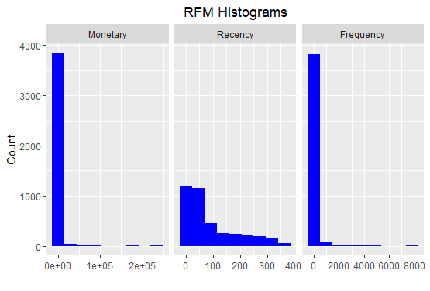
Data Visualisation (Histogram Without Log)
Newly created ‘customers’ dataset has Recency, Frequency, Monetary and CustomerID column
With histogram, we can examine the distribution of :
monetary value (total revenue generated by each customer)
recency days (days since the most recent visit for each customer)
frequency (transaction count for each customer)

Slide 7
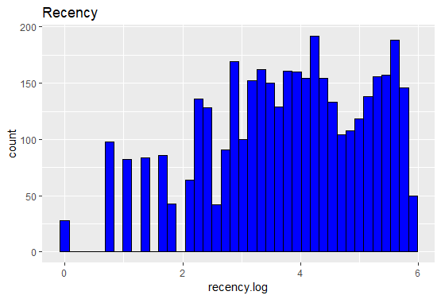
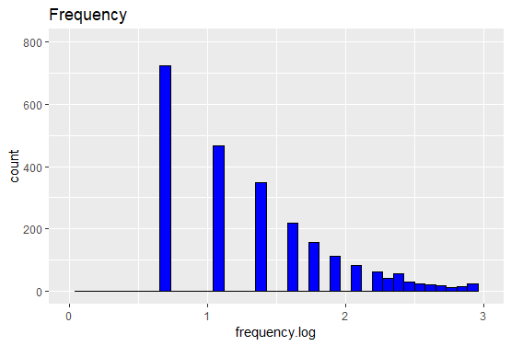
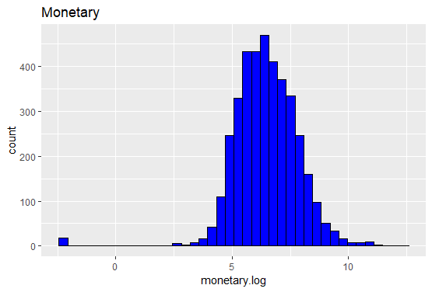
Data Visualisation (Histogram With Log)
RFM values were Positively Skewed, so used log transformation to reduce skewness.
After log transformation, skewness of RFM values is reduced:

Slide 8
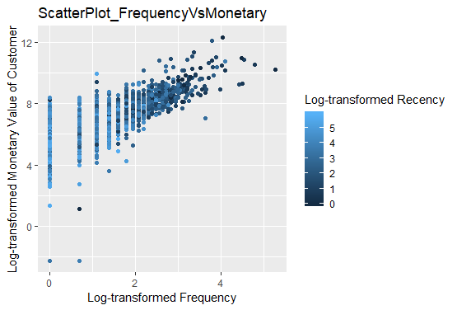
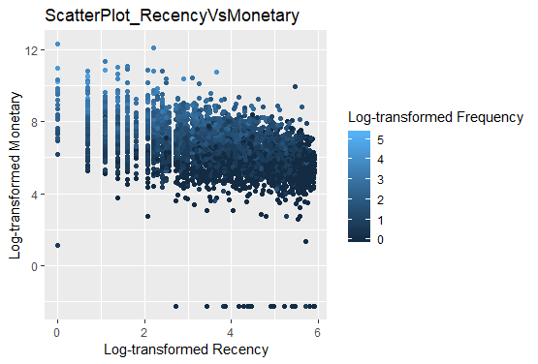
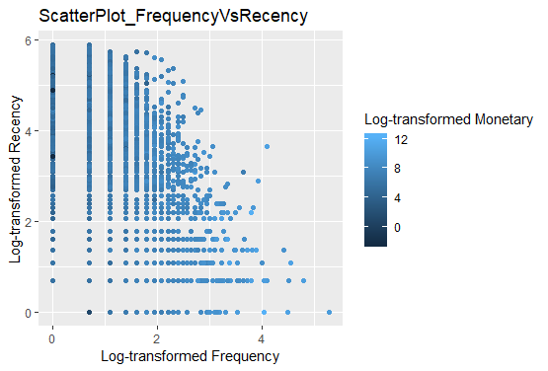
Data Visualisation (Scatterplot)
The best customers are those who:
bought most recently
most often
and spend the most

