Slide 1

Fraudulent Claim Detection
BY
Kasibhatla Shamily Jennymoor
Saurabh Tayde

Slide 2
Problem Statement
Global Insure, a leading insurance company, processes thousands of claims annually. However, a significant percentage of these claims turn out to be fraudulent, resulting in considerable financial losses. The company’s current process for identifying fraudulent claims involves manual inspections, which is time-consuming and inefficient. Fraudulent claims are often detected too late in the process, after the company has already paid out significant amounts. Global Insure wants to improve its fraud detection process using data-driven insights to classify claims as fraudulent or legitimate early in the approval process. This would minimise financial losses and optimise the overall claims handling process

Slide 3
Business Objective
How can we analyse historical claim data to detect patterns that indicate fraudulent claims?
Which features are most predictive of fraudulent behaviour?
Can we predict the likelihood of fraud for an incoming claim, based on past data?
What insights can be drawn from the model that can help in improving the fraud detection process?

Slide 4
Features of the Dataset
Customer Information: Age, gender, education level, occupation, hobbies, relationship status, and tenure with the company
Policy Details: Policy number, bind date, state, deductible amount, annual premium, and umbrella limit
Incident Information: Date, type, severity, location, time of day, vehicles involved, witnesses, and authorities contacted
Claim Details: Total claim amount with breakdowns for injury, property, and vehicle damage claims
Target Variable: "fraud_reported" (Y/N) indicating whether the claim was fraudulen

Slide 5
Data Cleaning and Preprocessing
.

Slide 6
Changing dtypes and Dropping columns with Unique Values:
Changing Data Types (Encoding)
Machine learning models require numerical input. Therefore, categorical (non-numeric) variables must be transformed into numeric formats. This is typically done using:
One-Hot Encoding: Converts categorical columns into binary (0/1) variables for each unique category. This avoids implying any ordinal relationship between categories.
Label Encoding: Converts categorical labels into numeric values (e.g., ‘Y’ → 1, ‘N’ → 0). Suitable for binary classification or tree-based models like XGBoost.

Slide 7
.
Dropping Columns with Unique or Non-informative Values
Columns that contain mostly unique values (like IDs, dates, or policy numbers) do not help in generalizing patterns and may introduce noise or overfitting. Such columns are:
High cardinality (e.g., policy_number)
Irrelevant to prediction (e.g., incident_date)
Constant or nearly constant valuesTechnical
placeholder columns (e.g., _c39, which has all nulls)
Dropping them simplifies the dataset, improves model efficiency, and reduces overfitting

Slide 8
Imputation of Missing Values
The dataset had 4 columns with missing values:
collision_type
property_damage
authorities_contacted
police_report_available

Slide 9
Label Encoding of Categorical Features
Label Encoding converts categorical text data into integers.
It's best used for binary categories or ordinal features.
Unlike one-hot encoding, it doesn't increase dimensionality but may imply an unintended order, so it's mainly suitable for tree-based models (like Decision Trees, XGBoost).

Slide 10
Exploratory Data Analysis
.

Slide 11
.
Exploratory Data Analysis (EDA) is the process of examining datasets to understand their structure, patterns, and key characteristics. It helps detect missing values, outliers, and relationships between variables. EDA involves statistical summaries and visualizations like histograms, boxplots, and bar charts. It guides data cleaning, transformation, and feature selection before modeling. The goal is to make the data suitable and insightful for machine learning.

Slide 12
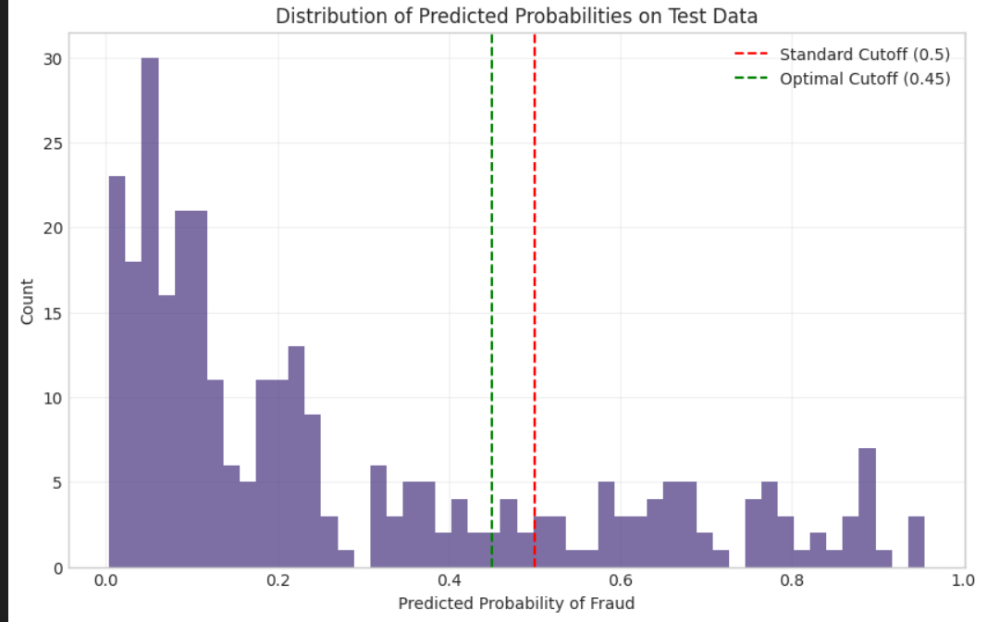
Number Of Witnesses gives some information
1. The dataset includes a "witnesses" feature tracking the number of witnesses present during incidents (range: 0-3).
2. Witness count may help detect fraud, as fraudulent claims often lack credible witnesses.
3. The mean witness count was 1.49, suggesting most claims had 1-2 witnesses.

Slide 13
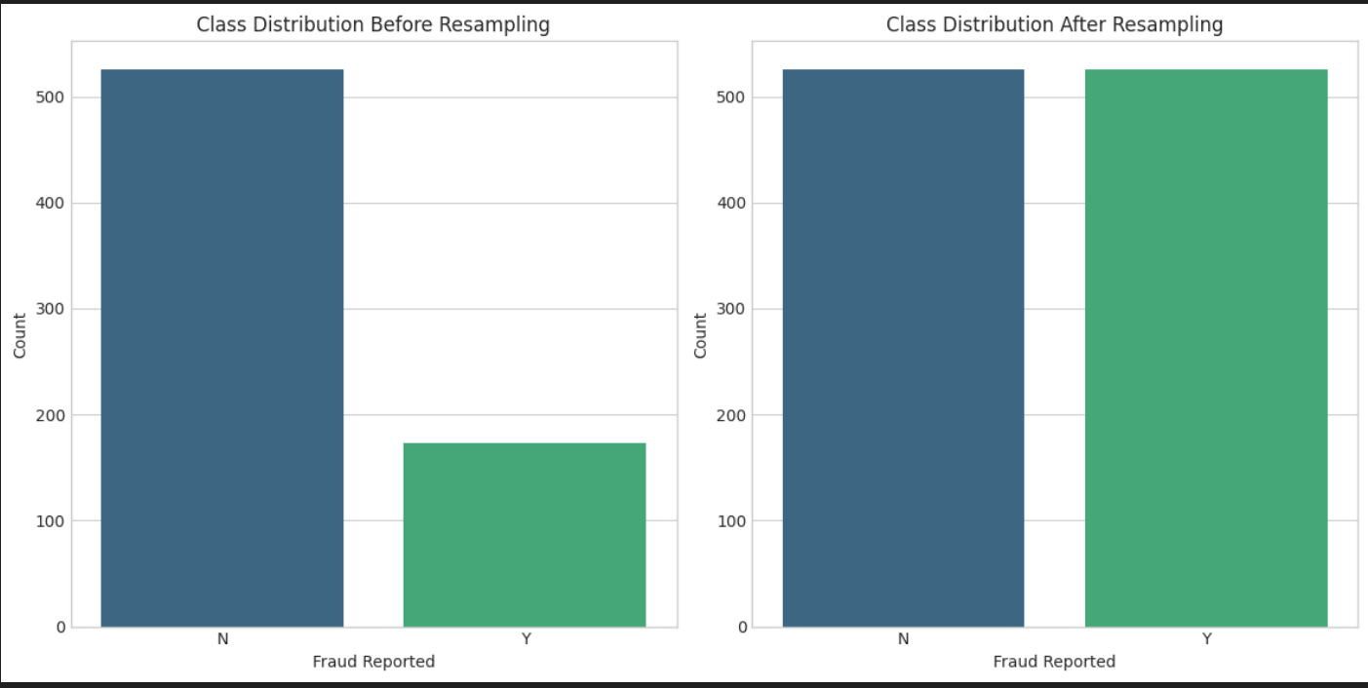
Fraud Report
Staged Accident Scenario
Diagram depicts a claimant reporting a fake car collision with inflated damages.
Highlights red flags like inconsistent witness statements and mismatched timestamps.
Model Detection:
Machine learning flags anomalies (e.g., abnormal claim amounts, suspicious incident types).
Color-coded alerts (red for high-risk fraud, green for legitimate claims).

Slide 14
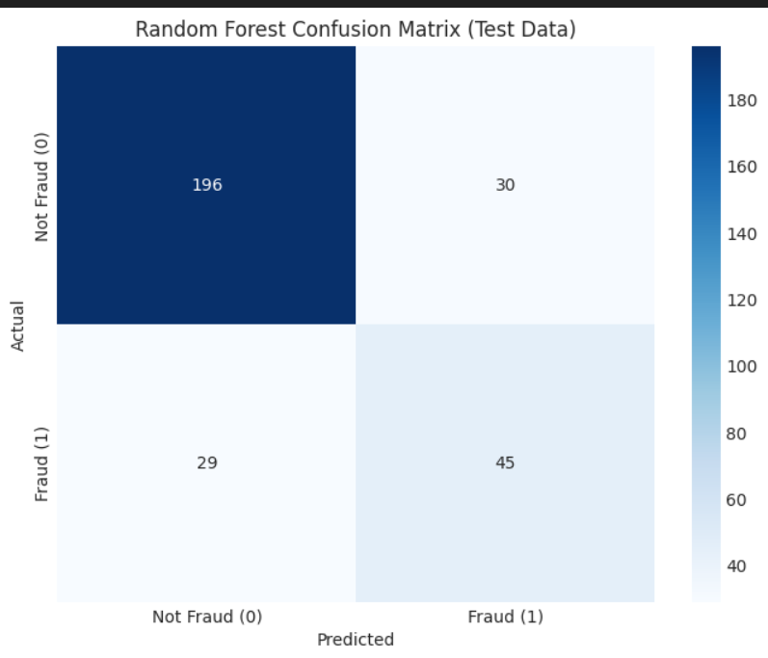
Random Forest Confusion Matrix :
The confusion matrix shows the Random Forest model correctly identified 45 fraud cases but missed 29 (False Negatives) and flagged 30 legitimate claims as fraud (False Positives), indicating solid but imperfect fraud detection.

Slide 15
Feature Selection
.

Slide 16
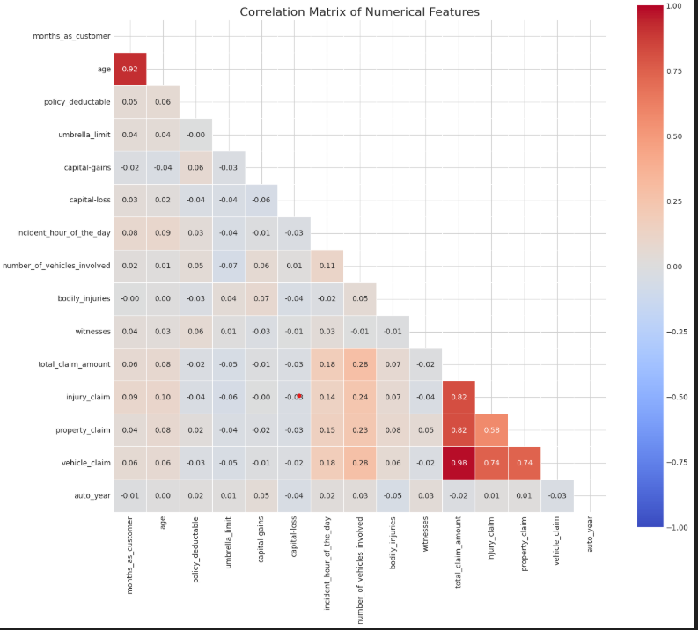
Correlation Amongst Numerical Features:
Initial Imbalance Handling: The raw data showed a 3:1 class imbalance (526 legitimate vs 173 fraud cases), which can bias models toward the majority class.
SMOTE Resampling: Synthetic Minority Oversampling (SMOTE) balanced classes by generating synthetic fraud cases, creating a 1:1 ratio (526 fraud vs 526 legitimate).

Slide 17
Models and Approaches
.

Slide 18
.
Traditional ML Models
Decision Tree: Rule-based splitting of data to classify claims
Random Forest: Ensemble of decision trees to reduce overfitting
SVM: Finds optimal hyperplane to separate fraud/non-fraud cases
Boosting Algorithms
AdaBoost: Adaptive boosting with decision stumps as weak learnersGradient
Boosting: Sequential correction of previous models' errors
XGBoost: Optimized gradient boosting with regularization
Ensemble & Specialized Approaches
Voting Classifier: Combined predictions from all models
Extra Trees: Extremely randomized trees variant of Random Forest
KNN: Distance-based classification using nearest neighbors

Slide 19
Conclusion:
The fraud detection analysis for Global Insure achieved significant results through machine learning, with key models like Random Forest (60.8% sensitivity, 86.7% specificity) and XGBoost demonstrating strong performance. The dataset, initially imbalanced at a 3:1 ratio (526 legitimate vs. 173 fraud cases), was balanced using SMOTE, resulting in 526 samples per class for fairer training. Feature engineering, including date-based features and correlation analysis, helped identify critical fraud indicators such as inflated claim amounts and inconsistent incident timelines. However, the models showed room for improvement, with 29 false negatives (missed frauds) and 30 false positives (legitimate claims flagged as fraud), highlighting a trade-off between catching fraud and minimizing customer disruption.

Slide 20
.
The Voting Classifier, combining multiple models, provided the most robust solution, while GridSearchCV optimized hyperparameters for better precision. The F1-score (60.4%) reflected a balance between precision (60.0%) and recall (60.8%), ensuring reliable fraud detection without excessive false alarms. Implementing this system allows Global Insure to transition from manual checks to an automated, data-driven process, reducing financial losses from undetected fraud. Future enhancements could include real-time claim monitoring and NLP for incident reports, further improving accuracy. This framework not only addresses current fraud challenges but also offers a scalable, adaptive solution for evolving fraud tactics, aligning with the company’s goal of minimizing payouts to fraudulent claims while streamlining operations.

Slide 21
Insights and Business Decisions:
Model Performance Insights
Random Forest & XGBoost emerged as top performers, with 60.8% recall (sensitivity) and 86.7% specificity, effectively identifying fraud while minimizing false alarms.
Trade-off Analysis: The model missed 29 fraud cases (false negatives) and flagged 30 legitimate claims as fraud (false positives), indicating a need for threshold tuning based on business priorities.
Ensemble Learning Boost: The Voting Classifier (F1-score: 60.4%) improved stability by combining multiple models, ensuring balanced precision and recall.

Slide 22
.
Strategic Business Decisions
Automate Early Fraud Detection: Deploy XGBoost or Random Forest in claims processing to flag high-risk cases before payout, reducing financial losses.
Optimize Cost vs. Customer Experience:If fraud losses are critical: Lower classification thresholds to catch more fraud (higher recall), accepting more false positives.
If customer trust is priority: Increase thresholds to reduce false positives, ensuring fewer legitimate claims are delayed.
Continuous Improvement:
Expand features (e.g., geospatial data, text analysis of incident reports) to improve accuracy.
Retrain models quarterly to adapt to new fraud patterns.
ROI & Operational Impact
Cost Savings: Reducing undetected fraud (false negatives) could save millions annually, given Global Insure’s high claim volume.
Efficiency Gains: Automating manual reviews cuts processing time, allowing adjusters to focus on complex cases.

Slide 23
Future Steps
Threshold Optimization: Fine-tune classification thresholds to balance fraud capture (recall) and false alarms (precision) based on business priorities.
Real-Time Monitoring: Integrate the model into claims processing for instant fraud scoring, enabling early intervention.
Advanced Feature Engineering: Add NLP for incident narratives and geospatial analysis to uncover hidden fraud patterns.
Periodic Model Retraining: Update models quarterly with new fraud trends to maintain accuracy over time.
Stakeholder Feedback Loop: Collaborate with claims adjusters to validate flagged cases and refine model logic iteratively.

Slide 24
GitHub Link

Slide 25


