Slide 1
Flood Forecasting using Machine Learning
B.Tech. Project Presented By: Saurabh Tiwari (2020CE10295)
Supervised By: Prof. A. K. Keshari

Slide 2
Introduction
The most frequent natural disaster in the world, flooding affects hundreds of millions of people and kills between 6,000 and 18,000 people annually, with 20% of those deaths occurring in India.
India is the country with the highest annual risk of flooding in the entire world. An area of more than 40 million ha. in India has been identified as flood prone. On an average, floods have affected about 33 million persons between 1953-2000.
Floods cause an economic loss of nearly 40 billion USD annually worldwide, and 15 billion USD per year in India alone.

Slide 3
Problem Statement
Due to the large amounts of flood-related data available for the US, creating a model to predict and determine future floods in the US is a relatively simple task.
However, given the extremely limited data available regarding floods in India, the problem is to innovate a method to create a prediction model for the Indian Subcontinent.

Slide 4
Objectives
1. Data Collection
2. Machine Learning Model
Collect and integrate various data sources, including meteorological data, and historical flood records, particularly in the challenging context of the Indian Subcontinent.
Develop and implement machine learning models like logistic regression and Random Forest Classification to enhance flood prediction accuracy.
3. Data Visualization
4. Web App Development
The objective is to employ advanced data visualization techniques to enhance the interpretability and accessibility of flood-related insights.
Create a web app capable of providing real-time flood forecasts to aid in disaster preparedness and response.

Slide 5
Methodology
Data Collection
My goal was to predict floods from weather data using machine learning.
Obtaining flood-related data at a sufficient scale over the Indian Subcontinent proved to be a challenging task, with limited available data.
As such, I innovated a two-step method of obtaining this data, which first mines flood reports from news sources, and then retrieves historical weather conditions based on temperature, maximum temperature, humidity, cloud cover, windspeed, and precipitation in accordance with the extracted flood data.
This method aims to form a connection between environmental factors and floods.
Thus, for the dataset, I first scraped the website http://floodlist.com/tag/india using the python beautiful-soup 4 library.
This website provided me with information about past and current floods India, as well as their date and location.
I then used the Visual Crossing weather API to obtain historic weather data such as precipitation, humidity, temperature, cloud cover, and windspeed in those areas and during those times.

Slide 6
Methodology
Machine Learning Model
My machine learning model is based on the python sci-kit learn library.
I used pandas to generate a data-frame for the dataset, and then tried various machine learning models from Logistic Regression to K-Nearest Neighbours to Random Forest Classification.
I proceeded to save the model with highest accuracy in a pickle file.

Slide 7
Methodology
Data Visualization
I first obtained a dataset of the major cities and towns in India (around 200 of them) along with their latitude, longitude, and population.
I then obtained the numerous weather factors in each city using the weather API and ran the data into my machine learning model.
Next, I plotted the data from the model on various different types of maps, using Plotly chart studio.
The maps represent various data such as flood prediction, precipitation analysis, and damage estimates, in the form of scatter plots, bubble plots and density maps.
Quantifying flood damage is challenging due to the complex nature of such events. To better understand the impact, I've adopted a method that involves multiplying precipitation by population.
This approach aims to offer a reference for estimating potential flood damage, considering the interaction of meteorological factors and affected population density.

Slide 8
Methodology
Web app Frontend and Hosting
My web app is based on the Flask python framework.
I rendered HTML templates – with CSS for styling and JavaScript for added functionality – and integrated it with my machine learning models and datasets via the flask back-end.
I then used AWS Elastic Beanstalk hosting service to host my web application for everyone to try.

Slide 9
Literature Survey
Ambore, Charan, et al. (2023): The authors presents an examination of diverse machine learning algorithms for predicting floods based on rainfall data in Indian districts. Previous works on flood prediction using techniques like support vector machines, neural networks, image processing, and big data analytics are reviewed. The employed machine learning algorithms in this study include XGBoost, K Nearest Neighbours, Decision Trees, Logistic Regression, and Random Forest.
Mosavi, Ozturk, et al. (2018): The report presents the challenges and importance of flood prediction for risk reduction and water resource management. The advantages and disadvantages of different types of models, such as physically based, statistical, and data-driven models.
Xiong & O’Connor (2002): The author presents a comparison of four updating models for real-time river flow forecasting, based on the simulation errors of a rainfall-runoff model. The author recommends the use of the AR model for error-forecast updating in real-time river flow forecasting.
Nevo, Morin et al. (2018): Google’s operational flood warning system uses machine learning models to provide accurate and timely alerts to agencies and the public in India and Bangladesh. The system consists of four subsystems: data validation, stage forecasting, inundation modelling, and alert distribution.

Slide 10
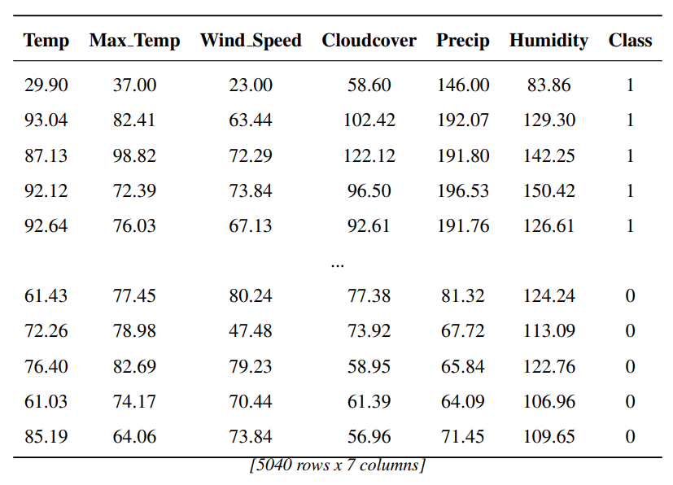
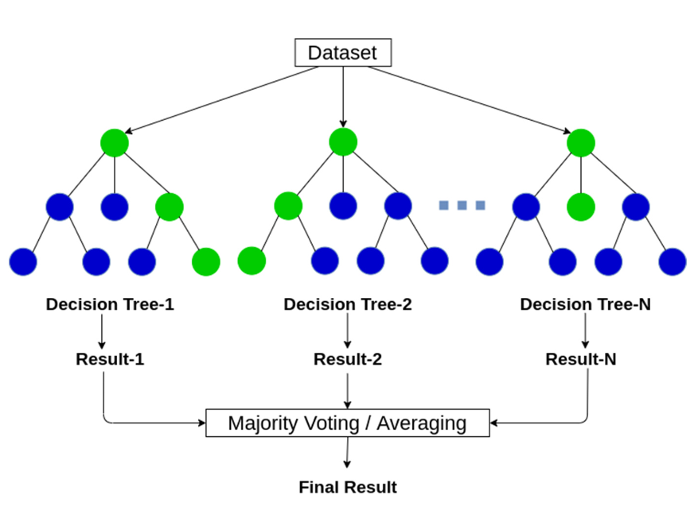
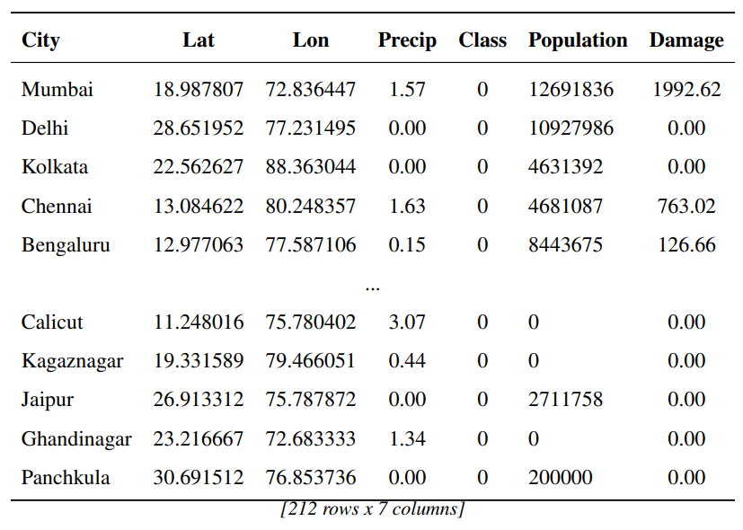
Results and Discussion
Data used for model training and plotting
1. Final data required for ML training.
2. Random Forest Classifier gave the highest accuracy of 98.71% on the test set.
3. Final data for plotting.

Slide 11
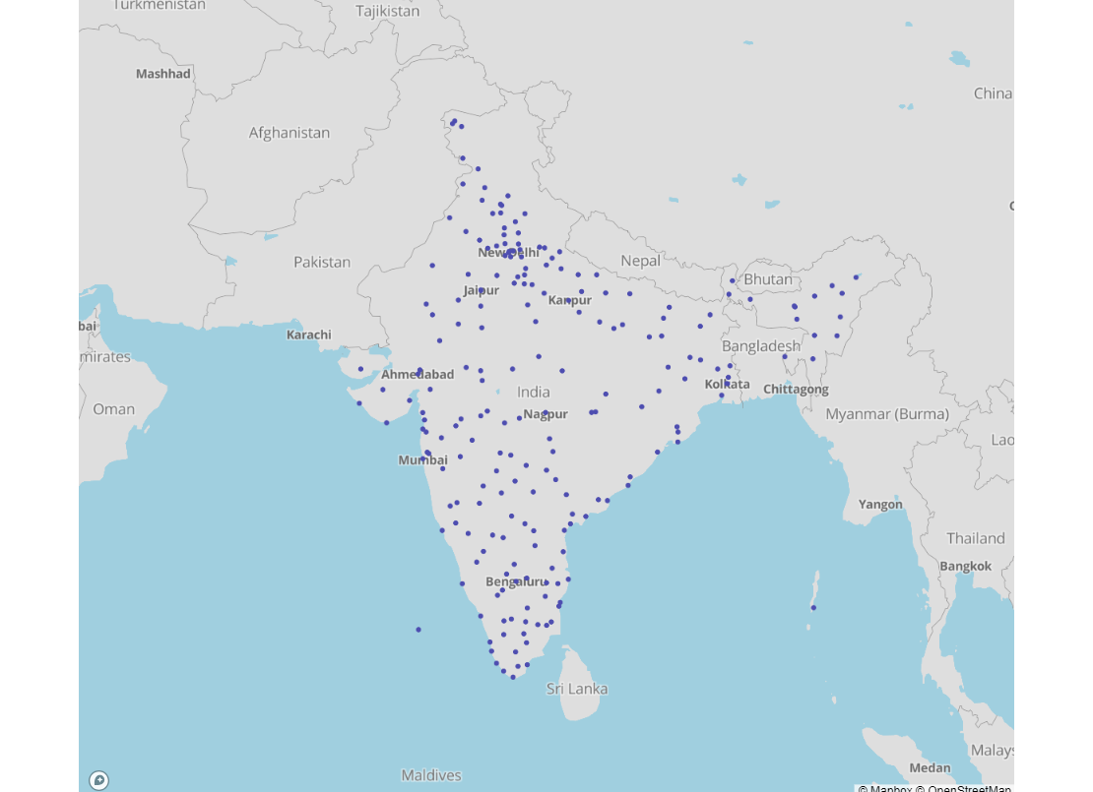
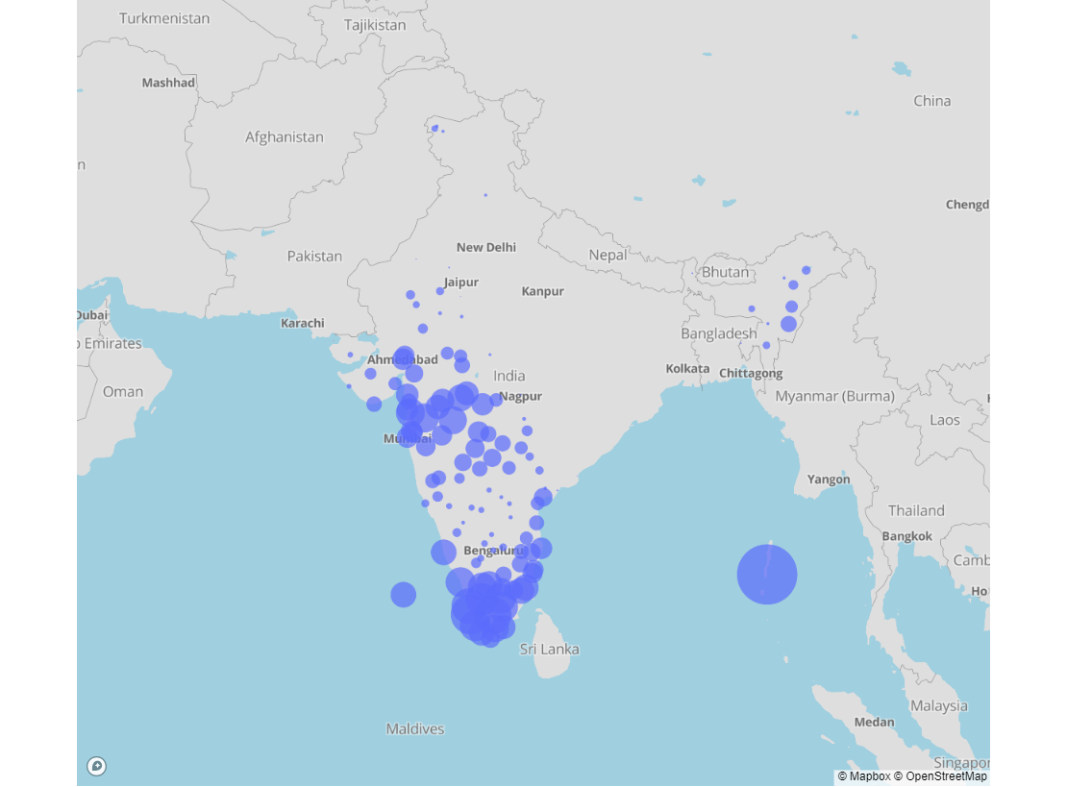
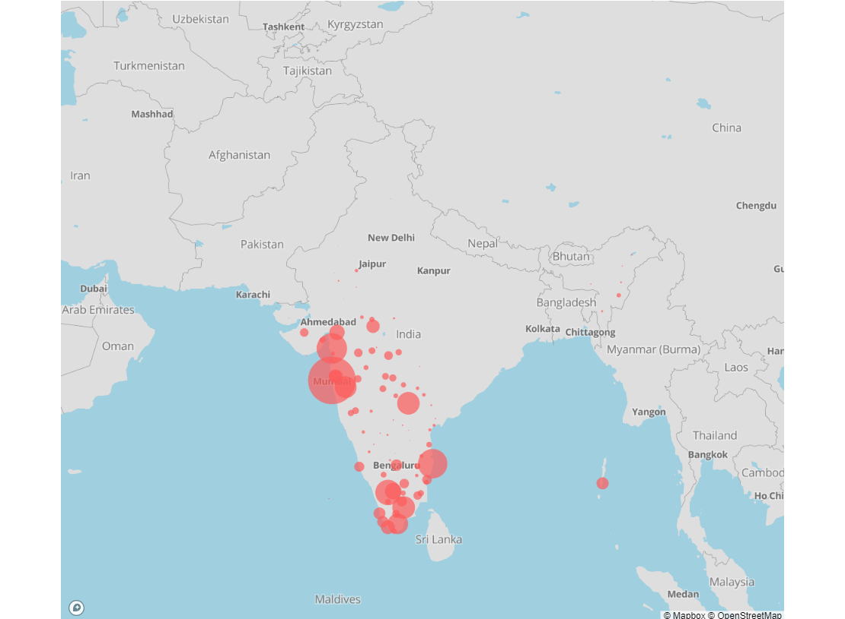
Results and Discussion
Scatter plot and bubble plots
1. Flood prediction plot, flood marked by red dots.
2. Precipitation plot, larger bubbles indicating more precipitation.
3. Damage analysis plot, size of the bubbles indicates damage.

Slide 12
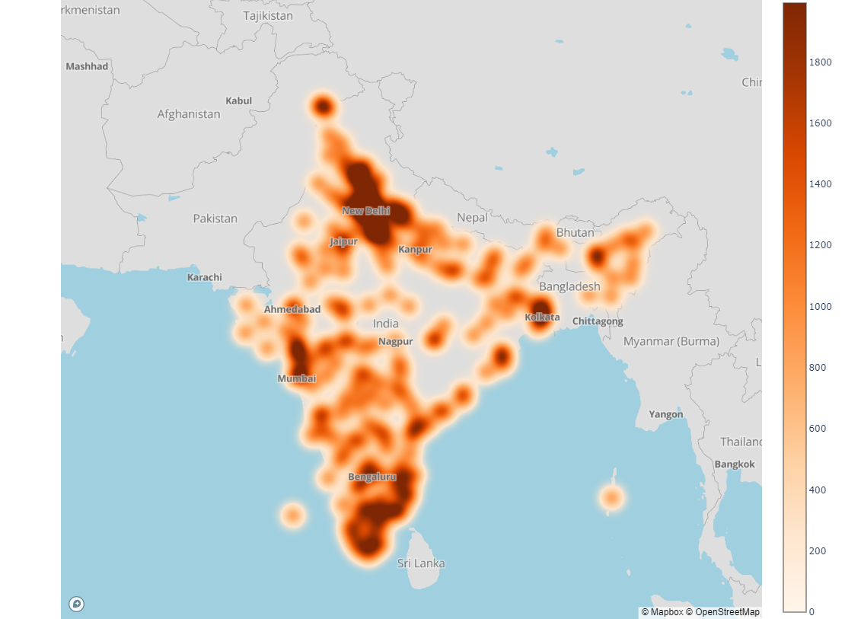
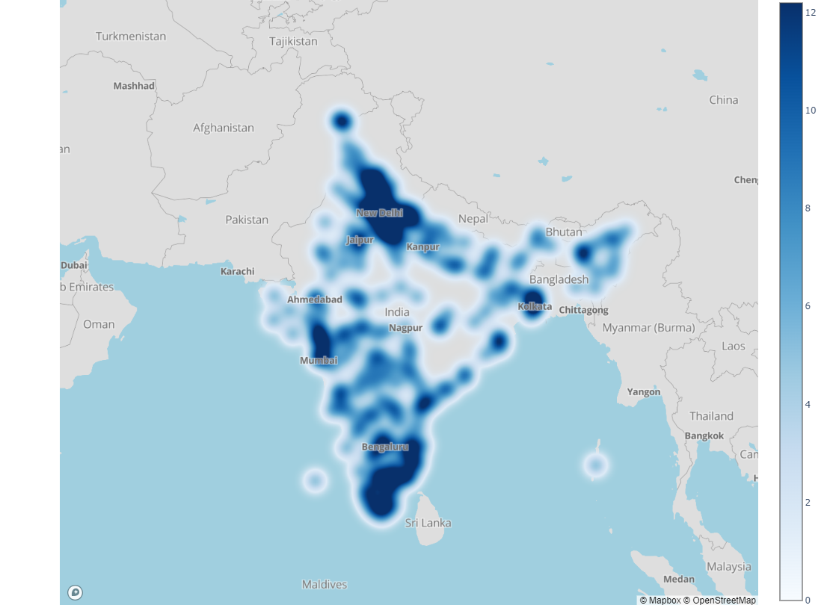
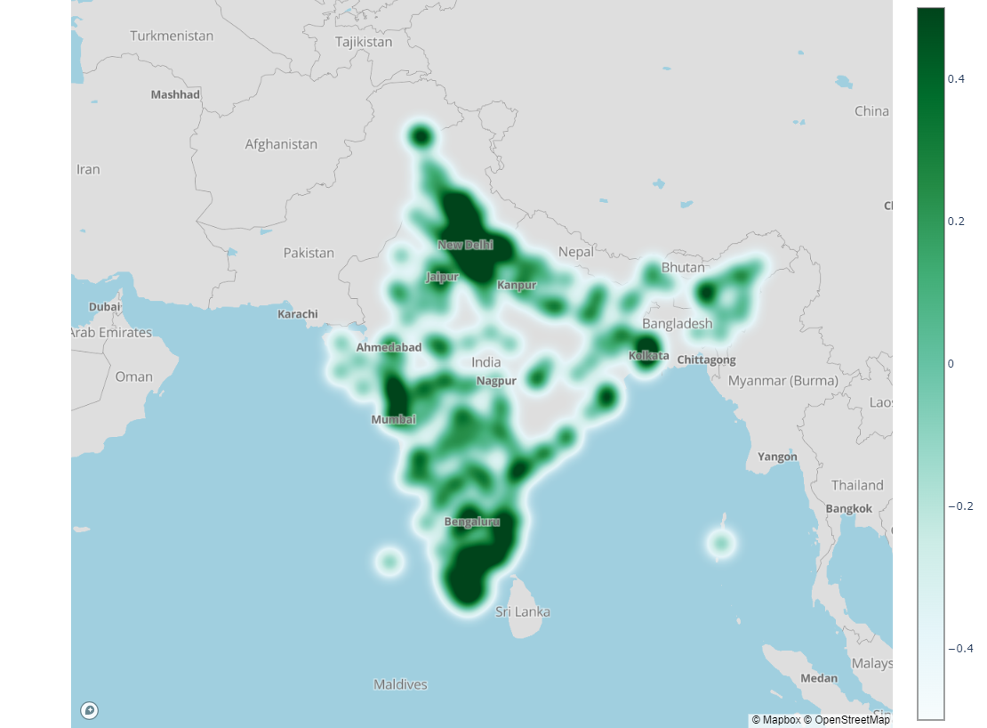
Results and Discussion
Density Maps
1. Damage analysis density map, colour scale of the density map indicates damage.
2. Precipitation density map, darker areas indicating greater precipitation.
3. Flood prediction map, flood is most likely marked by darker spots.

Slide 13
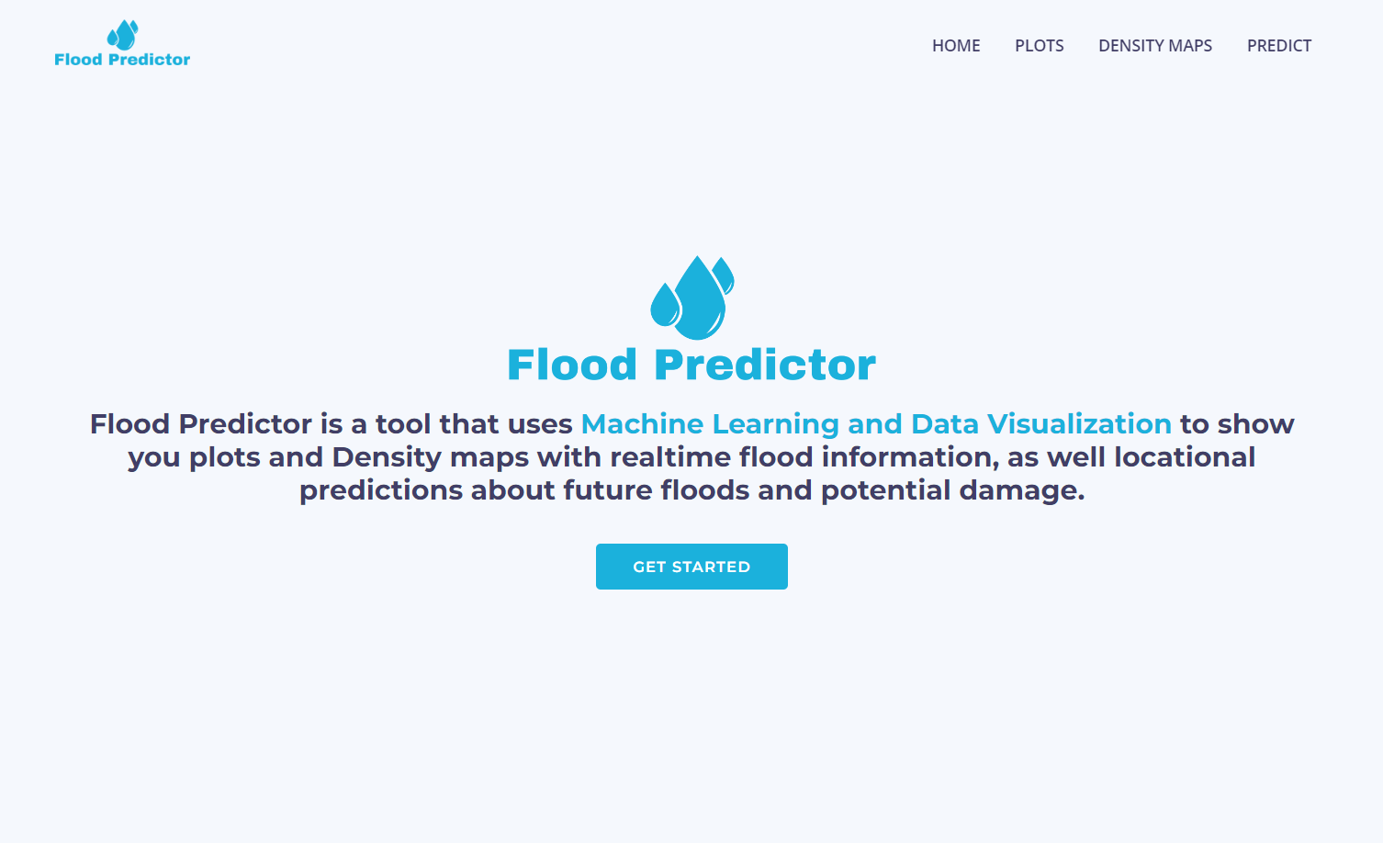
Web app!
Results and Discussion
GitHub Repo: GitHub - SaurabhTiwari4093/Flood-Forecasting
URL: https://flood-predictor.iccntsd.in/

Slide 14
Conclusion
Data Challenges
Modelling Success
Continuous Learning
Overcame limited data obstacles in flood-related research through innovative data mining and scraping techniques, ensuring a comprehensive dataset.
Proudly achieved a machine learning model accuracy exceeding 98%, showcasing substantial growth in modelling skills and effective integration of data manipulation techniques.
Expanded expertise in web scraping, data mining, and Plotly, marking a continuous learning journey, with a specific focus on enhancing machine learning skills. Additionally, learned LaTeX to effectively create and format report.

Slide 15
Plan for future
I would like to expand my web application to cover cities in countries all around the world, and to make my visualizations and predictions accessible to people across all nations.
Facilitate real-time updates to the plot and density map on the web application seamlessly, eliminating the need for manual intervention.
Furthermore, I recognize the potential of incorporating satellite data for enhanced flood detection and plan to develop an image classification model for this purpose.

Slide 16
References
Amazon Web Service: https://aws.amazon.com/
Anil Kumar Ambore, T. Sri Sai Charan, U. Rohit Reddy, T. Samara Simha Reddy, Tarun. G (2023), Flood Prediction using Machine Learning, International Journal for Research in Applied Science & Engineering Technology (IJRASET) ISSN: 2321-9653; IC Value: 45.98; SJ Impact Factor: 7.538 Volume 11 Issue V May 2023
Beautiful soup 4: https://pypi.org/project/beautifulsoup4/
Flask: https://flask.palletsprojects.com/en/3.0.x/
FloodList: https://floodlist.com/
LIHUA XIONG & KIERAN M. O’CONNOR (2002) Comparison of four updating models for real-time river flow forecasting, Hydrological Sciences Journal, 47:4, 621-639, DOI: 10.1080/02626660209492964

Slide 17
References
Mosavi, A., Ozturk, P., & Chau, K.-w. (2018). Flood prediction using machine learning models: Literature review. Department of Computer Science (IDI), Norwegian University of Science and Technology (NTNU), NO-7491 Trondheim, Norway; Department of Civil and Environmental Engineering, Hong Kong Polytechnic University, Hong Kong, China; dr.kwok-wing.chau@polyu.edu.hk. Correspondence: amir.mosavi@ntnu.no (A.M.); pinar@ntnu.no (P.O.). Received: 1 September 2018; Accepted: 17 October 2018; Published: 27 October 2018.
Nevo, S., Morin, E., Rosenthal, A. G., Metzger, A., Barshai, C., Weitzner, D., ... Matias, Y. (2023). Flood forecasting with machine learning models in an operational framework. Google Research, Yigal Alon 96, Tel-Aviv 6789141, Israel; Hebrew University of Jerusalem, Safra Campus, Jerusalem 91904, Israel.
Plotly chart studio: https://chart-studio.plotly.com/
Python: https://www.python.org/
Population Data: https://public.opendatasoft.com/
Weather Data & API Global Forecast & History Data: https://www.visualcrossing.com

Slide 18
Thanks!
Do you have any questions?

