Slide 1
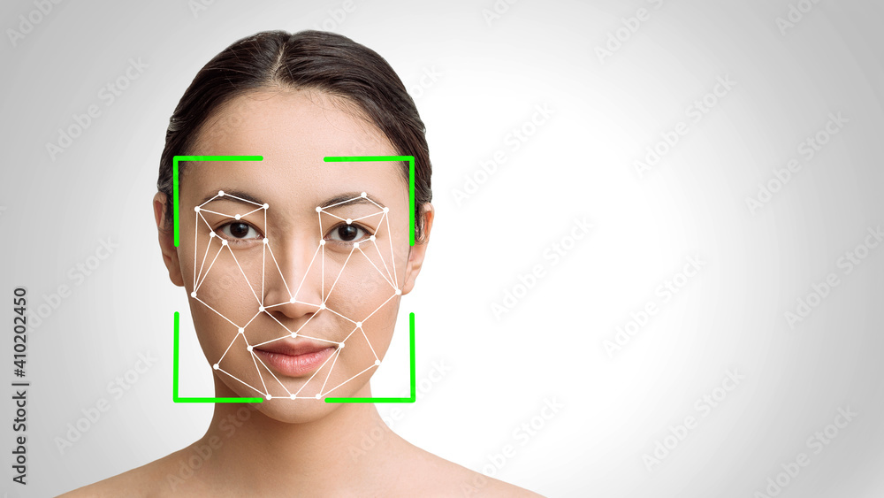
Emotion Detection by Facial Recognition using CNN

Slide 2




Team Members
Saurabh Verma
Tushar Chotlani
Meet Vora
Vinesh Sangoi

Slide 3
Problem Statement
Developing an emotion detection system using computer vision techniques to support mental health monitoring and intervention.
Targeting expressions to better understand and address individuals' emotional states.
Empowering applications in mental health support, foster empathetic interactions, and enhance emotional well-being.

Slide 4

Data Description and Preparation
Data Source: Facial Expression Recognition 2013 Dataset
Data Loading
Data Parsing
Data Cleaning
Data Normalization
Data Analysis
Data Preprocessing

Slide 5

Model Creation
Custom CNN from Scratch
CNN with data augmentation
Transfer learning with VGGNet
Transfer learning with ResNet50

Slide 6
Results
Model | training accuracy | validation accuracy
custom CNN from scratch | 65.2 | 56.6
CNN with data augmentation | 57.21 | 57.87
Transfer Learning VGGNET | 55.42 | 55
Transfer Leanring - ResNet50 | 61.86 | 60.74

Slide 7

Conclusion
Development of an emotion detection system using computer vision techniques, focusing on facial expressions recognition
Exploration of various neural network architectures and training methodologies to achieve notable results
Potential applications in mental health support, virtual communication, and customer feedback analysis, fostering empathetic interactions and enhancing emotional well-being

Slide 8

Further Development
Integrate
Integrate multimodal data (e.g., facial expressions, voice tone, body language) for comprehensive emotion detection.
Adapt
Adapt emotion detection systems for specific populations or contexts, like children, elderly individuals, or those with neurodevelopmental disorders.
Enable
Enable real-time emotion detection for immediate feedback and interventions in dynamic environments.
Explore
Explore ethical implications of deploying emotion detection systems and develop guidelines for responsible use.

