Slide 1
📈 Overall Revenue Dashboard Overview
- This slide presents the full dashboard displaying key performance indicators for all available years.
- Includes slicers for dynamic filtering by Year, Quarter, and Store Rank.
- Highlights total revenue trends across:
• 🌍 Regions (Asia, U.K., U.S.A.)
• 🏬 Stores
• 🛒 Product Categories
• 📅 Monthly and Quarterly Trends
- Provides insights into:
• 🎯 Total & Average Revenue
• 🌟 Top-performing Sales Reps
• 🧮 Transaction and Country Counts

Slide 2
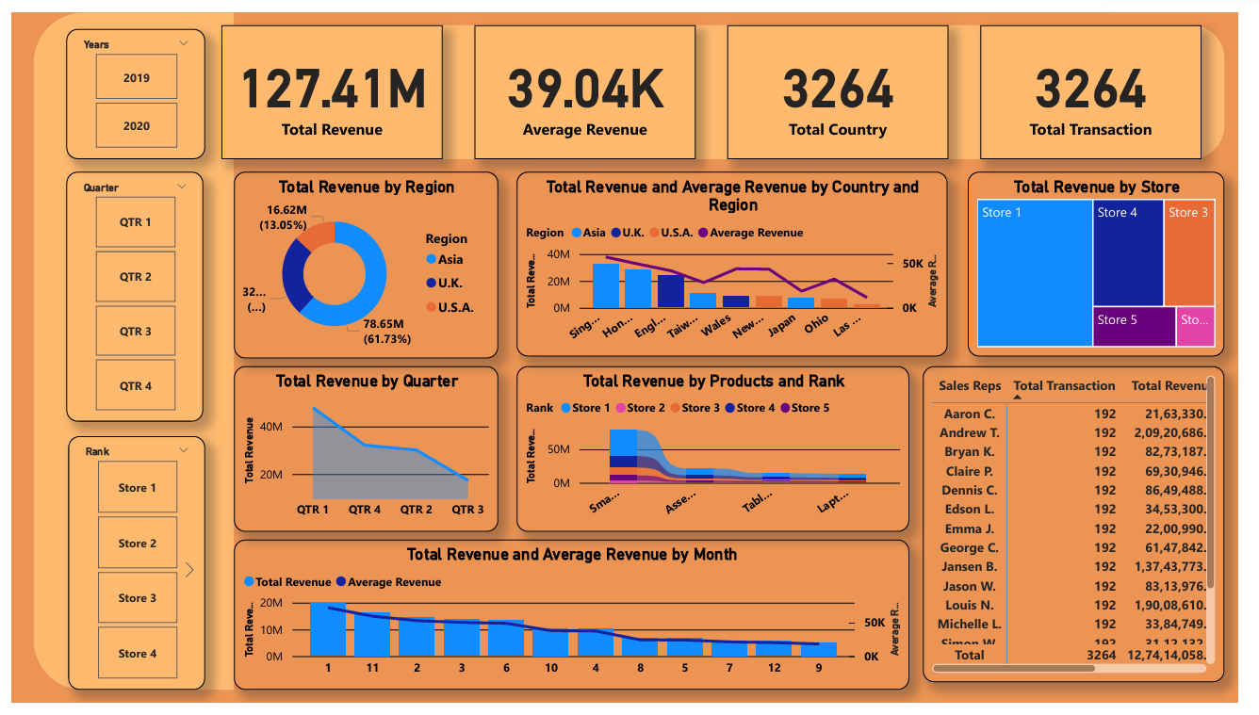
📈 Overall Revenue Dashboard Overview

Slide 3
📊 Overall Sales Dashboard – Year 2019
A focused view of sales performance for the year 2019 using the dashboard slicer.
- Summary of key metrics:
• 💰 Total Revenue: ₹73.16M
• 📊 Average Revenue: ₹44.83K
• 🔢 Total Transactions: 1,632
- Region-wise performance:
• 🌏 Asia leads with 62.14% of total revenue.
- Store-wise and product-wise breakdowns:
• 🏬 Top Store: Store 1
• 📱 Top Product Category: Smartphones
- 👤 Top Sales Representative: Bryan K.

Slide 4
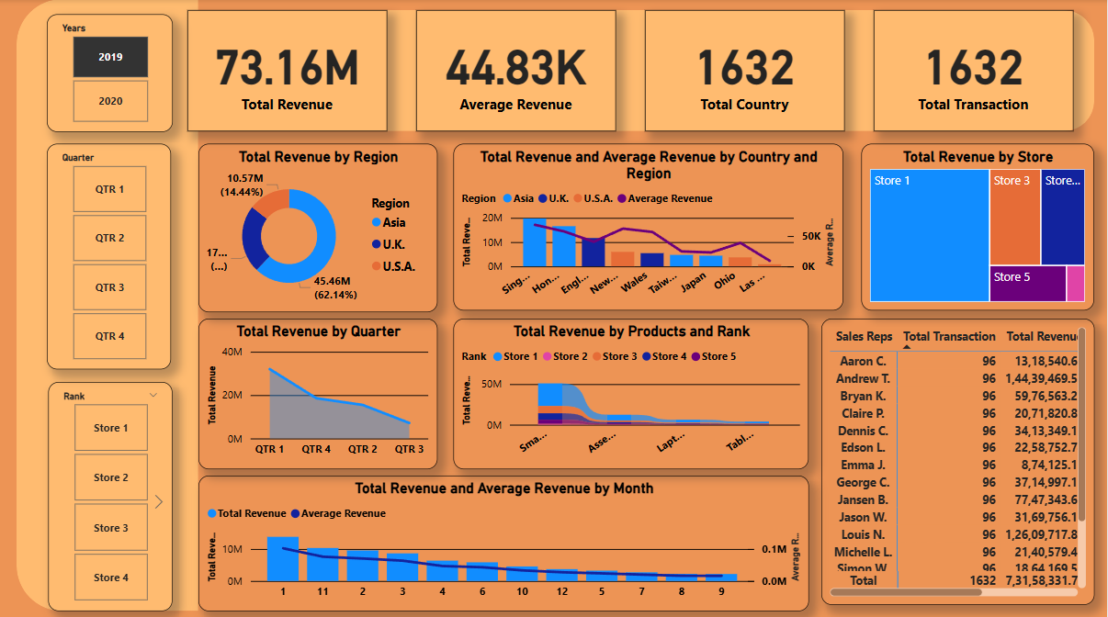
📊 Overall Sales Dashboard – Year 2019

