Slide 1

Customer Shopping Behavior Analysis
Uncovering insights from 3,900 purchases to guide strategic business decisions

Slide 2
Dataset Overview
3,900
18
37
Transactions
Features
Missing Values
Purchase records analyzed
Data points per transaction
Review ratings imputed
Customer Data
Purchase Details
Behavior Metrics
Demographics (Age, Gender, Location)
Subscription Status
Previous Purchases
Item, Category, Amount
Season, Size, Color
Discount & Promo Codes
Frequency of Purchases
Review Ratings
Shipping Type

Slide 3
Data Preparation Process
01
02
Data Loading
Exploration
Imported dataset using pandas
Checked structure with info() and describe()
03
04
Missing Data
Standardization
Imputed 37 missing review ratings by category
Renamed columns to snake case format
05
06
Feature Engineering
Database Load
Created age groups and purchase frequency days
Connected to PostgreSQL for SQL analysis

Slide 4
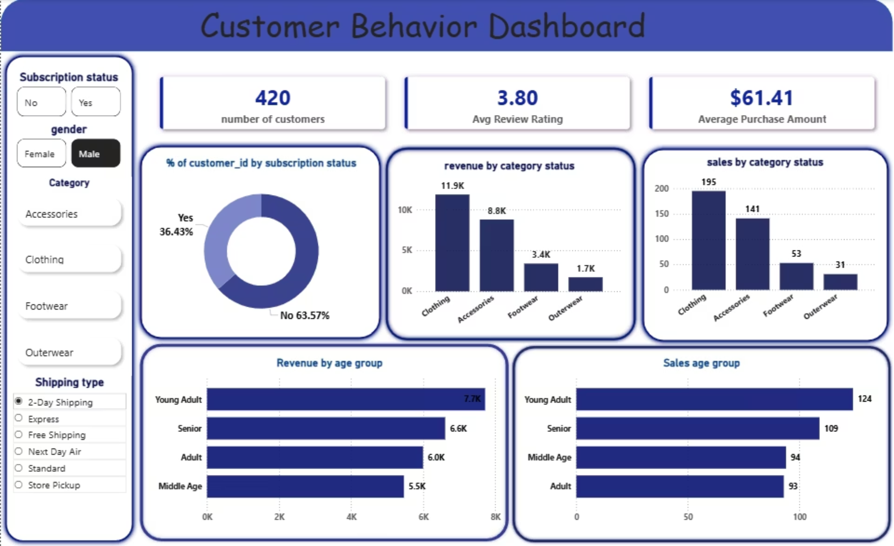
Revenue by Gender
Male customers generated 2.1x more revenue than female customers

Slide 5

Top Products by Rating
1
2
3
Gloves
Sandals
Boots
3.86 average rating
3.84 average rating
3.82 average rating
4
5
Hat
Skirt
3.80 average rating
3.78 average rating

Slide 6

Shipping & Subscription Impact
Shipping Type
Subscription Status
Standard: $58.46 avg
Express: $60.48 avg
Subscribers: 1,053 customers
Non-Subscribers: 2,847 customers
Express shipping customers spend $2 more per purchase
Non-subscribers generate 2.7x more revenue

Slide 7




Discount-Dependent Products
50%
49.66%
49.07%
Hat
Sneakers
Coat
Half purchased with discount
High discount dependency
Seasonal discount pattern
48.17%
47.37%
Sweater
Pants
Regular discount usage
Discount-driven purchases
Top 5 products with highest percentage of discounted purchases

Slide 8

Customer Segmentation
Loyal
Returning
3,116 customers
701 customers
High repeat purchase rate
Multiple purchases
New
83 customers
Single purchase only
98% of customers are either loyal or returning buyers

Slide 9
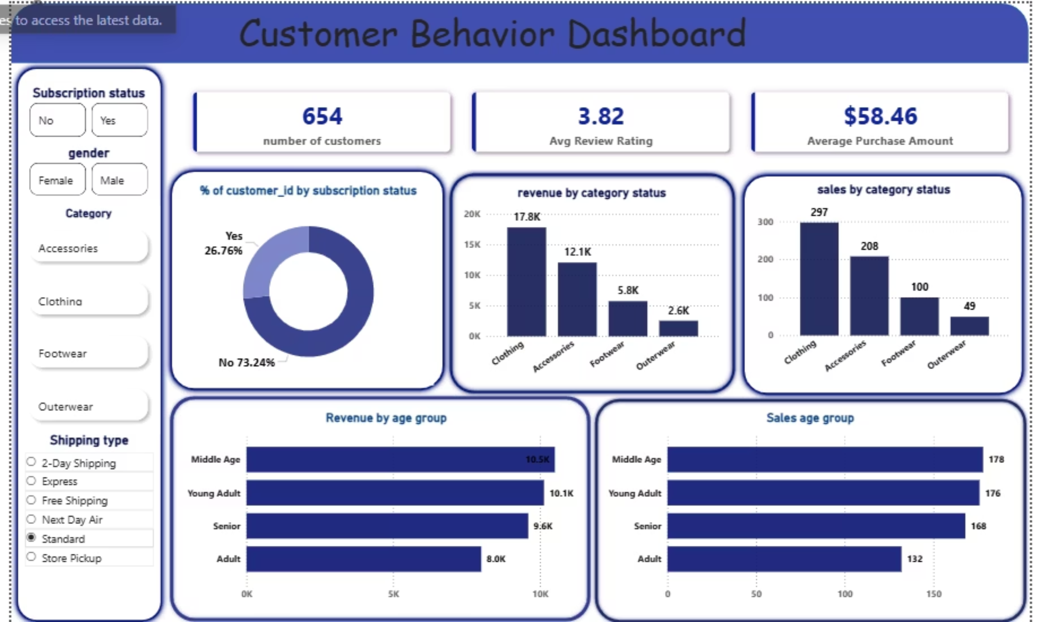
Revenue by Age Group
Young adults drive the highest revenue, followed by middle-aged customers

