Slide 1
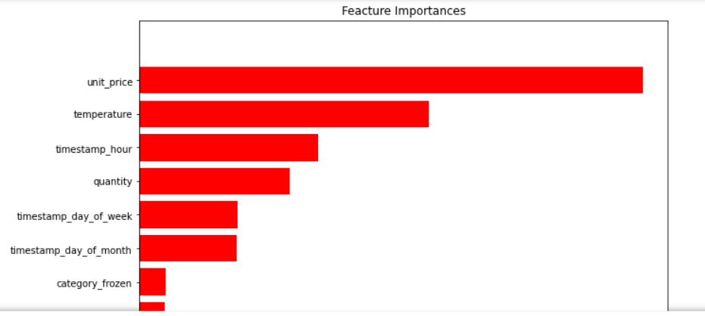
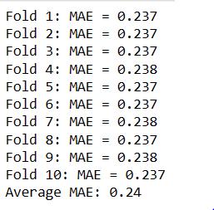
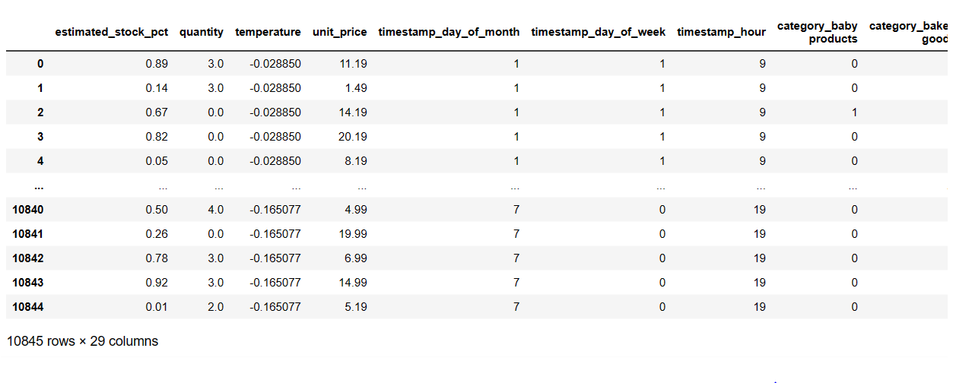


INSIGHTS FROM THE MODELING
Modeling steps Performed as below :
• from all 3 dataset we’ve modified and merge all with ‘timestamp feature, After merging the data we’ve converted all categorical column to numeric for predictive modeling.
• After Merging the dataset we’ve scaled the data and used Randomforest Regressor algorithm to train and test the data.
• Thereafter we’ve calculated the MAE as performance metrics which shows that our model is consistent with each fold.
• With the help of the visualization we can conclude below insights :
Unit_Price, Temperature and timestamp_hour are the major factors for predicting the stocks
Other features are not as important for stock Predictions.
With the help of these two statement we can answer our problem statement.

