Slide 1
Title : ICICN Paper Template
Authors : Rishabh Nagendra Dubey
Deepak Nandlal Jaiswar
Ramjan Garibullah Khan

Slide 2
Index
Introduction
Proposed Architecture
Implementation / Testing
Results and Discussion
Conclusion

Slide 3
Introduction
Sorting of products is a very difficult industrial process. Continuous manual sorting creates consistency issues. This project describes a working prototype designed for automatic sorting of objects based on the color. TCS3200 sensor is used to detect the color of the product and the Arduino Uno and MATLAB are used to control the overall process. The identification of the color is based on the frequency analysis of the output of TCS3200 sensor.

Slide 4
Implementation / Testing
1. Start.
2. Initialization of color sensor, servomotor and LCD.
3. Check for object color.
4. If color is Red then display Red color on LCD, Servomotor
rotates by 45 degree.
5. Once identifies the color go to step 12 .
6. If color is Green then display Green color on LCD,
Servomotor rotates by 90 degree.

Slide 5
Implementation / Testing
7. Once identifies the color go to step 12 .
8. If color is Blue then display Blue color on LCD,
Servomotor rotates by 135 degree.
9. Once identifies the color go to step 12 .
10. If color is unknown then display unknown on LCD,
Servomotor rotates by 180 degree.
11. Once identifies the color go to step 12 .
12. Stop.

Slide 6
Implementation / Testing
The ‘Objrec’ algorithm is written in MATLAB for performing the operation object recognition operation is presented in .
The ‘Objrec’ algorithm is executed to identify the object and send the appropriate commands to the microcontroller using serial communication for the robot to perform the sorting operation.
A mechatronics color sorting system presented in based on application of image processing. It aims in classifying the colored objects by color, size, which are coming on the conveyor by picking and placing the objects in its respective pre-programmed place.

Slide 7
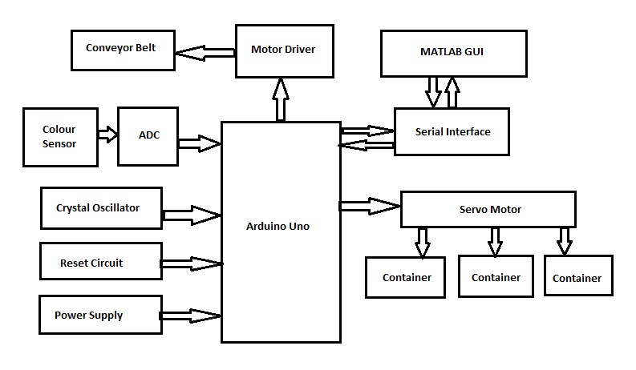
Implementation/Testing

Slide 8
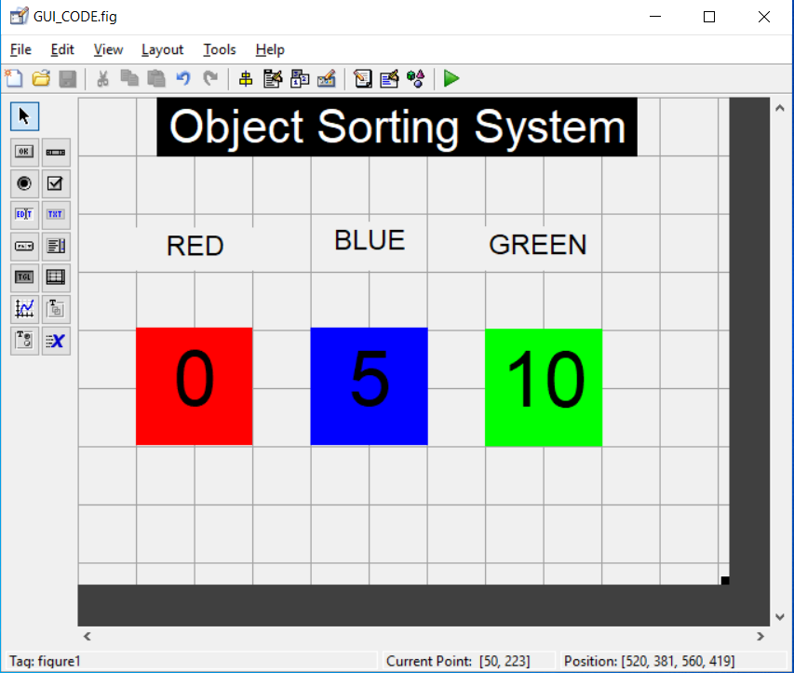
Results and Discussion

Slide 9
Results and Discussion
Results given by algorithms used for automatic colour object counting and sorting in prototype system design to implement automation in automatic technique to determine colour of object ,object count and sort object based on colour using image processing approach are as follows, An approach for object colour detection, count calculation and object sorting has been implemented. Implemented system gives accurate result for purely Red, Green and blue coloured objects. With some software changes this system can be used for different shades of basic specified colour.

Slide 10
Conclusion
The conclusions drawn from results given by algorithms used for automatic color object counting and sorting in prototype system design to implement automation in automatic technique to determine color of object, object count and sort object based on color using image processing approach are as follows.
An approach for object color detection, count calculation and object sorting has been implemented.
Implemented system gives accurate result for purely Red, Green and blue color objects.
With some software changes this system can be used for different shades of basic specified color.

Slide 11
Thank You

