Slide 1
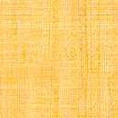


OBJECT SORTING SYSTEM BASED ON COLOR SENSING USING MATLAB paper id-412
rISHABH nAGENDRA DUBEY
dEEPAK nANDLAL JAISWAR
rAMJAN Garibullah KHAN
EMPLOYABILITY SKILL DEVELOPMENT (ESD) PROGRAM

Slide 2
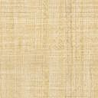

Flow of Presentation
Introduction
Problem Statement
Description
Implementation
Discussion
Conclusion
EMPLOYABILITY SKILL DEVELOPMENT (ESD) PROGRAM

Slide 3
Introduction
Sorting of products is a very difficult industrial process. Continuous manual sorting creates consistency issues. This project describes a working prototype designed for automatic sorting of objects based on the color.
TCS3200 sensor is used to detect the color of the product and the Arduino Uno and MATLAB are used to control the overall process. The identification of the color is based on the frequency analysis of the output of TCS3200 sensor.
EMPLOYABILITY SKILL DEVELOPMENT (ESD) PROGRAM

Slide 4
Problem Statement
In many packaging industries, colour object counting and sorting is the major task that needs to be done at final dispatch section. Manual sorting is the tradition approach that preferred by industries. In this approach, visual inspection performed by human operators. This traditional approach is tedious, time consuming, slow and nonconsistent. Therefore the efforts are made to design and implementation of automatic technique to determine colour. of object, colour based object counting and sorting using image processing technique.
Colour is the most common feature to distinguish between objects, sorting, recognizing and tracking. Generally colour sensor is put in the workspace to detect the colour of the object. This technology can be used in material handling in logistics and packaging industry where the object moving through a conveyer belt can be separated using a colour sensor Key words: Matlab, Colour Object Counting, Image Processing, Object Sorting and Arduino Uno
EMPLOYABILITY SKILL DEVELOPMENT (ESD) PROGRAM

Slide 5
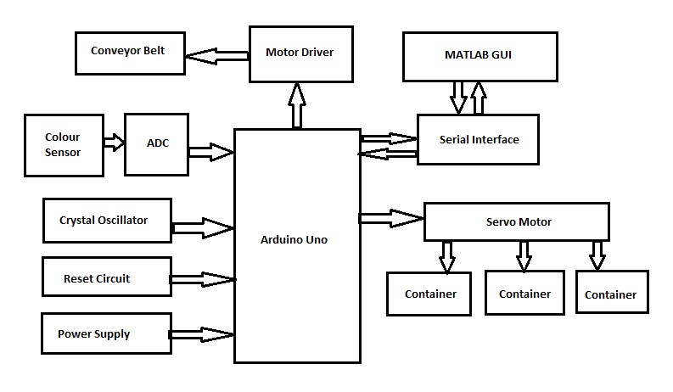
description
EMPLOYABILITY SKILL DEVELOPMENT (ESD) PROGRAM

Slide 6
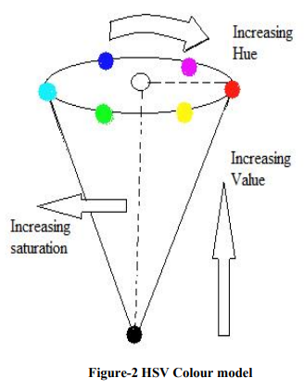
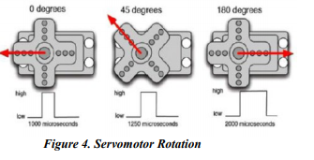
description
EMPLOYABILITY SKILL DEVELOPMENT (ESD) PROGRAM

Slide 7
implementation
Hardware used:Arduino Uno ,Conveyer belt ,Power supply ,TCS230 colour sensor ,Dc motor Servo motor
Software used : Matlab
Aurdino and matlab programming language has been used
EMPLOYABILITY SKILL DEVELOPMENT (ESD) PROGRAM

Slide 8
implementation
The ‘Objrec’ algorithm is written in MATLAB for performing the operation object recognition operation is presented in .
The ‘Objrec’ algorithm is executed to identify the object and send the appropriate commands to the microcontroller using serial communication for the robot to perform the sorting operation.
A mechatronics color sorting system presented in based on application of image processing. It aims in classifying the colored objects by color, size, which are coming on the conveyor by picking and placing the objects in its respective pre-programmed place.
Thereby eliminating the monotonous work done by human, achieving accuracy and speed in the work.
The eBox-3300MX is used as the hardware to integrate OpenCV with robotic arm.
EMPLOYABILITY SKILL DEVELOPMENT (ESD) PROGRAM

Slide 9
implementation
1. Start
2. Initialization of color sensor, servomotor and LCD.
3. Check for object color.
4. If color is Red then display Red color on LCD, Servomotor
rotates by 45 degree.
5. Once identifies the color go to step 12 .
6. If color is Green then display Green color on LCD,
Servomotor rotates by 90 degree.
EMPLOYABILITY SKILL DEVELOPMENT (ESD) PROGRAM

Slide 10
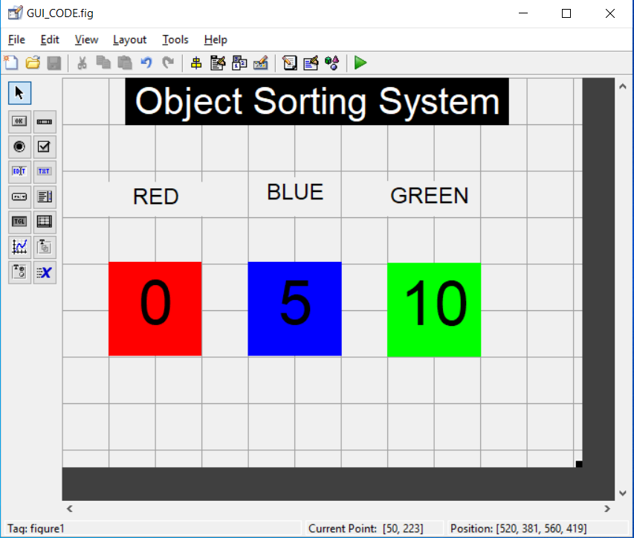
implementation
7. Once identifies the color go to step 12 .
8. If color is Blue then display Blue color on LCD,
Servomotor rotates by 135 degree.
9. Once identifies the color go to step 12 .
10. If color is unknown then display unknown on LCD,
Servomotor rotates by 180 degree.
11. Once identifies the color go to step 12 .
12. Stop.
EMPLOYABILITY SKILL DEVELOPMENT (ESD) PROGRAM

Slide 11
discussion
Limitations: In the existing system the objects are sorted based on only RGB color.Process is not fully automated just like robot.We need to put object manually on conveyor belt.Object can not be sorted based on other parameter like shape of object.
Future Scope:The disadvantages of existing systems can be overcome using the proposal systems. In the proposed system a colour sensor will be mounted on top of the conveyor belt along with a proper support. The colour sensor will detect the colour of the object based on the frequency and will send this information to Matlab. This will help to keep track of the objects of a particular colour and also record when they were detected.
EMPLOYABILITY SKILL DEVELOPMENT (ESD) PROGRAM

Slide 12
Conclusion
The conclusions drawn from results given by algorithms used for automatic colour object counting and sorting in prototype system design to implement automation in automatic technique to determine colour of object ,object count and sort object based on colour using image processing approach are as follows, An approach for object colour detection, count calculation and object sorting has been implemented.
Implemented system gives accurate result for purely Red, Green and blue coloured objects.With some software changes this system can be used for different shades of basic specified colour. Due to use of automation in colour determination and count calculation process, manual efforts are reduced which leads to improving accuracy as well as saves money and time.
EMPLOYABILITY SKILL DEVELOPMENT (ESD) PROGRAM

