Slide 1

Lead Scoring Case Study

Slide 2
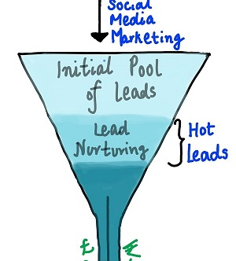
Problem Statement
To make the process of getting and converting leads more efficient, the company wishes to identify the most potential leads, also known as ‘Hot Leads’. If they successfully identify this set of leads, the lead conversion rate should go up as the sales team will now be focusing more on communicating with the potential leads rather than making calls to everyone.

Slide 3
Analysis Approach
It is clearly a classification problem as we need to classify the leads into potential conversion or not. So, applying logistic Regression on the data will be a good approach to the problem.
1. Importing & Analysing Data
2. Data Cleaning & EDA
3. Preparing Data for model building
4. Building Logistics regression model
5. Prediction and Model Evaluation - Train Set
6. Prediction and Model Evaluation - Test Set
7. Results

Slide 4

Data Cleaning & EDA
A. Categorical Columns
Converted all “SELECT” values into NULL Values.
Deleted the rows with more than 45% of null values.
Imputed null values for ‘City’ feature with ‘Mumbai’ (Mode).
Imputed null values for ‘Specialization’ with ‘No Specialization’.
For Tags, Specialization , Last activity , Lead source – Grouped the values with less frequency as ‘Others’ in order to reduce the number of categories
Dropped all the columns with imbalance data.
B. Numerical Columns
1. Capped the outlier values for features – Page Views Per Visit and total visits

Slide 5
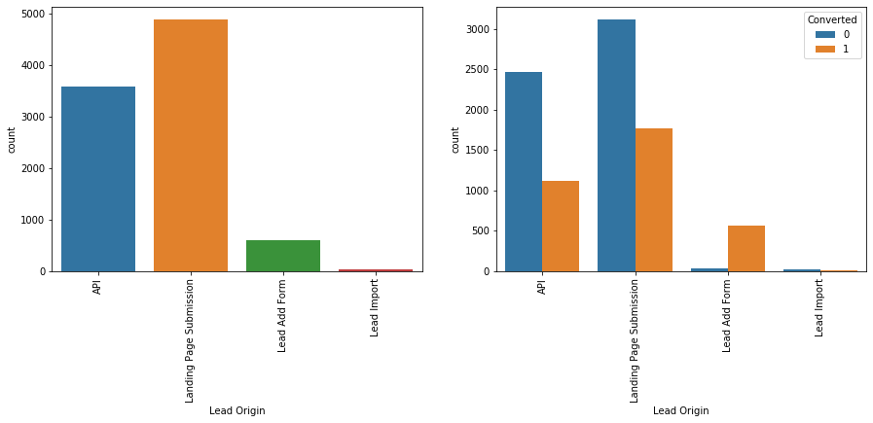
Important Inferences
Landing Page Submission has higher number of conversion.
Lead Add Form has a very high conversion rate but count of leads are not very high.

Slide 6
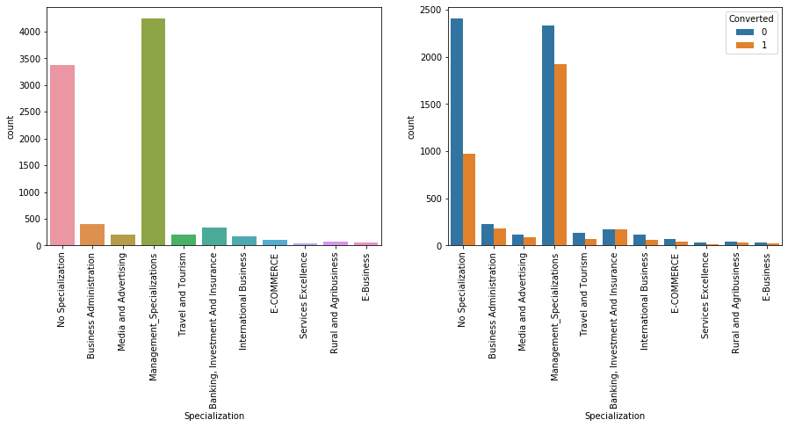
Leads with any kind of management specialization are higher and shows better conversion rate

Slide 7
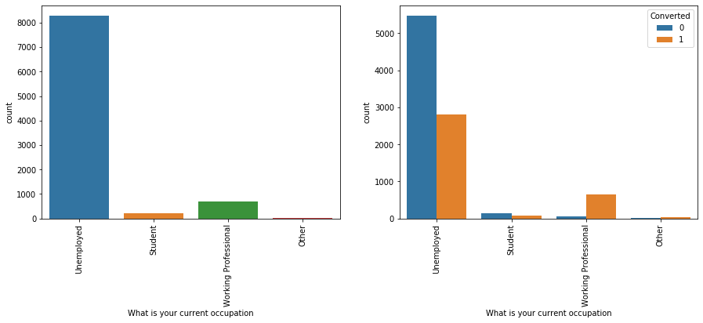
Working Professionals going for the course have high chances of Conversion

Slide 8
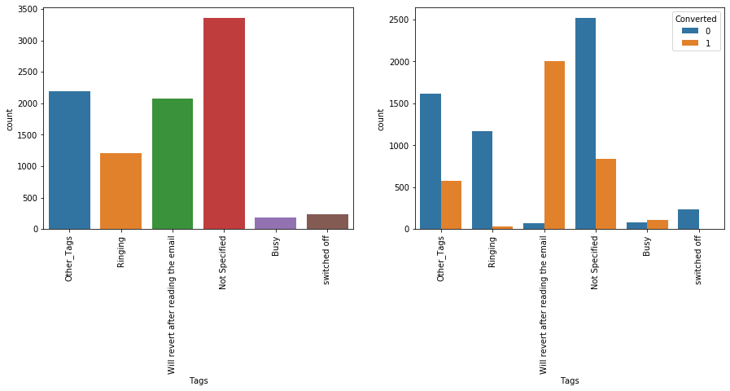
People interested in getting mail regarding the course have better chances of choosing a course.

Slide 9
Landing Page Submission has higher number of conversion.
Lead Add Form has a very high conversion rate but count of leads are not very high.

Slide 10
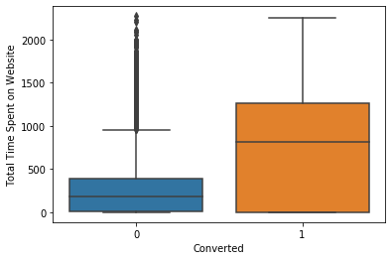
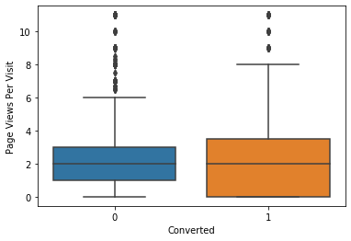
Leads spending more time on the website are more likely to be converted.

Slide 11
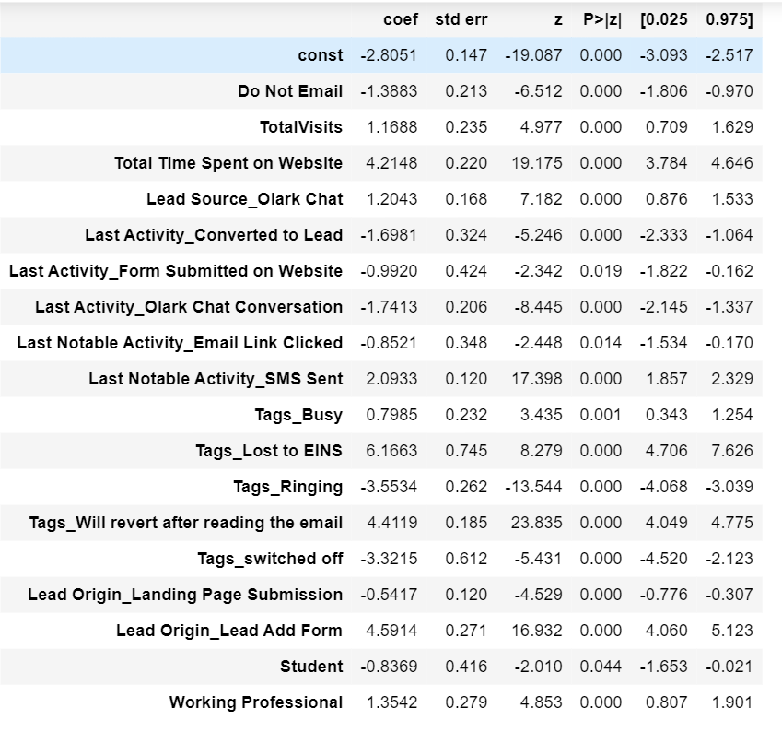
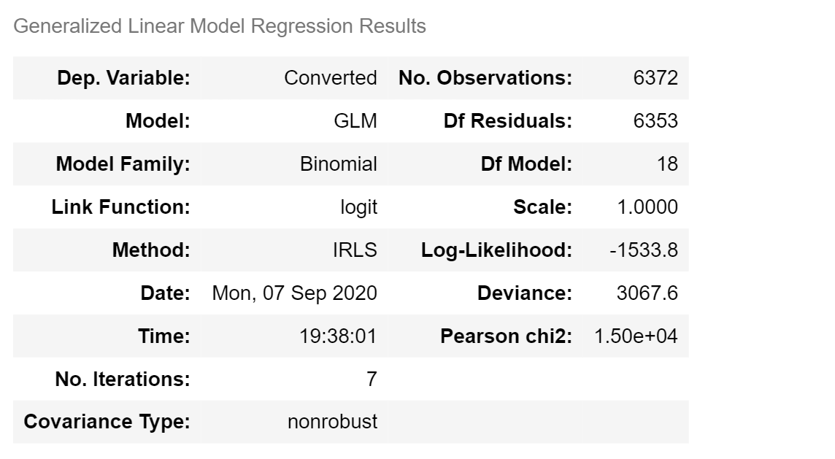
Final Model Statistics

Slide 12
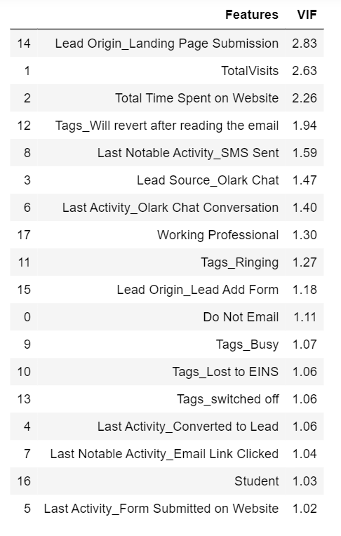
VIF Values

Slide 13
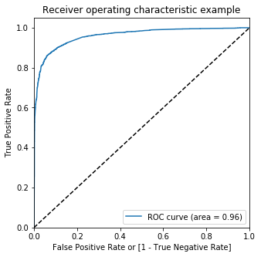
ROC Curve
Area under the ROC curve is 0.96 which is a good parameter to perform logistic regression for prediction

Slide 14
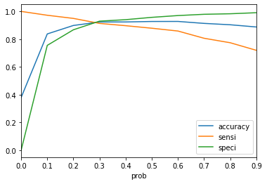
Trade off
Trade off point is at 0.3 probability
Trade off curve between Accuracy, Sensitivity and Specificity

Slide 15
Accuracy : 89.70
Sensitivity : 89.30
Specificity : 90.00
Results for Training set
False Positive Rate : 0.101
Positive Predictive Value: 0.844
Negative Predictive Value: 0.932
Precision : 0.84
Recall: 0.89
F-measure: 0.86

Slide 16
Accuracy : 92.83
Sensitivity : 92.0
Specificity : 93.30
Results for Test set
False Positive Rate : 0.092
Positive Predictive Value: 0.858
Negative Predictive Value: 0.939
Precision : 0.86
Recall: 0.9
F-measure: 0.87

Slide 17
Important Inferences
Company can focus on working professionals as they seems to choose the course more frequently
Websites can be made interactive as the person spending more time on websites seems to convert for the course .
People who prefer to get details on email likely to choose the course. Hence, emails can be sent with as much information as possible.

