Slide 1

React
By Saurabh Sharma

Slide 2
What is React?
Open source java script library for building user interface
It was developed by Facebook and released in 2013.
React uses a virtual DOM to improve performance by updating only the parts of the actual DOM that have changed, rather than re-rendering the entire DOM each time there's a change in the application state.
Not a framework
Focus on UI
Large Ecosystem and Community Support

Slide 3
Why learn React?
Efficiency and Performance
Component-Based Architecture
Created and maintained by Facebook
Huge community
In demand skillset
JSX
Cross-Platform Development

Slide 4
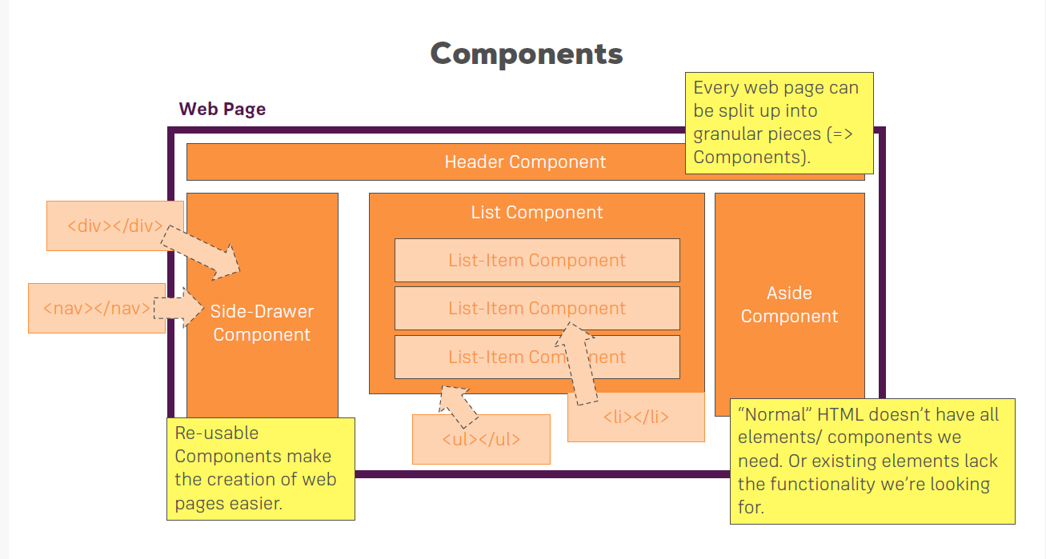
Component-Based Architecture

Slide 5
React is declarative
Tell React what you want and react will build the actual UI
React's declarative syntax allows developers to describe the desired UI based on the application state. This makes the code more predictable and easier to understand, leading to improved developer productivity and fewer bugs.
DOM updates are handles gracefully in react

Slide 6
More on why React?
Seamlessly integrate react into any of your applications.
React can be used to build not only web applications but also mobile applications using frameworks like React Native. This allows developers to leverage their existing knowledge of React to build native mobile apps for iOS and Android platforms, further increasing productivity and reducing development time.

Slide 7
Prerequisites
HTML
CSS
JavaScript
ES6
We will start React from scratch

Slide 8
Development Environment
Node Js : JavaScript runtime environment
Visual Studio Code as code editor

Slide 9
Create First React App
Open command prompt or terminal in vs code
Use below command to create react app
npx create-react-app <project name>
Open project in vs code
To run the project use command npm start
It will open a browser and run project on port 3000

Slide 10
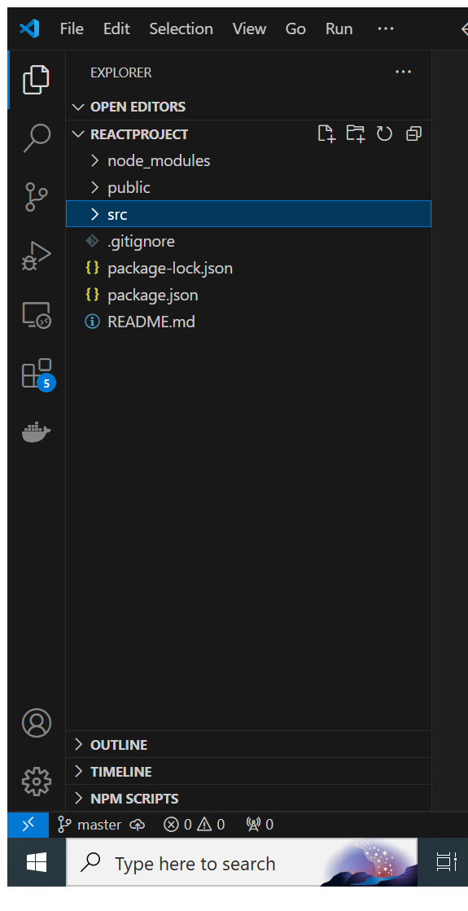
Folder structure of React App

Slide 11
Component

Slide 12
Component
In React, a component is a reusable building block for creating user interfaces. Components are the fundamental units of a React application, and they encapsulate both the UI elements and the behavior of a particular part of the user interface.
Is a JavaScript file.
It will save with .js extension like app.js is a component.

Slide 13
Types of component
Functional component
Class Component

Slide 14
Functional Component
Functional components are JavaScript functions that take in props (short for properties) as input and return JSX (JavaScript XML) elements representing the UI. They are typically used for presentational purposes and don't have their own internal state or lifecycle methods but from React version 16.8 Hooks were added. Hooks allow function components to have access to state and other React features. We will discuss about Hooks in coming session.
Example:
function Hello(props) {
return <h1>Hello, {props.name}!</h1>;
}

Slide 15
Class Component
Class components are ES6 classes that extend the React.Component class. They have their own internal state and can define lifecycle methods.
Class components are used when the component needs to manage its own state or respond to lifecycle events.
Example:
class Hello extends React.Component {
render() {
return <h1>Hello, {this.props.name}!</h1>;
}
}
Note: From react version 16.8 functional component work same like class component, so class components are generally no longer needed.

Slide 16
JSX
JSX stands for JavaScript XML. It is a syntax extension for JavaScript that allows developers to write HTML-like code within JavaScript. JSX makes it easier and more intuitive to define the structure of UI components in React.
Write XML-like code for element and components.
JSX have tag name, attribute and children.
JSX is not necessity to write react application.
JSX makes your react code simpler and elegent.
JSX code is transpiled into regular JavaScript code before being executed in the browser. During this process, JSX is checked for syntax errors, which helps catch mistakes early in the development process.

Slide 17
JSX differences
Attribute class -> className
for -> htmlFor
Property naming convention is in camelCase
Like onclick -> onClick
onsubmit -> onSubmit

Slide 18
Props
In React, props is a short form of "properties", and it is an object that contains data passed to a component from its parent component. Props are read-only, meaning that a component cannot modify the props it receives.
Props allow you to customize and configure a component when it is being used. They are analogous to attributes in HTML elements. You can pass any data type as props, including strings, numbers, arrays, objects, functions, and even React elements.
Props are an essential concept in React because they allow components to be flexible and reusable. They enable components to receive data from their parent components, making it easy to create dynamic and customizable UIs.

Slide 19
State
A “state” is a JavaScript object that represents the current condition of a component. It's used to store data that can change over time due to user interactions, network responses, or other dynamic aspects of an application. By using state, React components can manage their own data and automatically re-render when the state changes, ensuring that the user interface stays in sync with the underlying data.

Slide 20
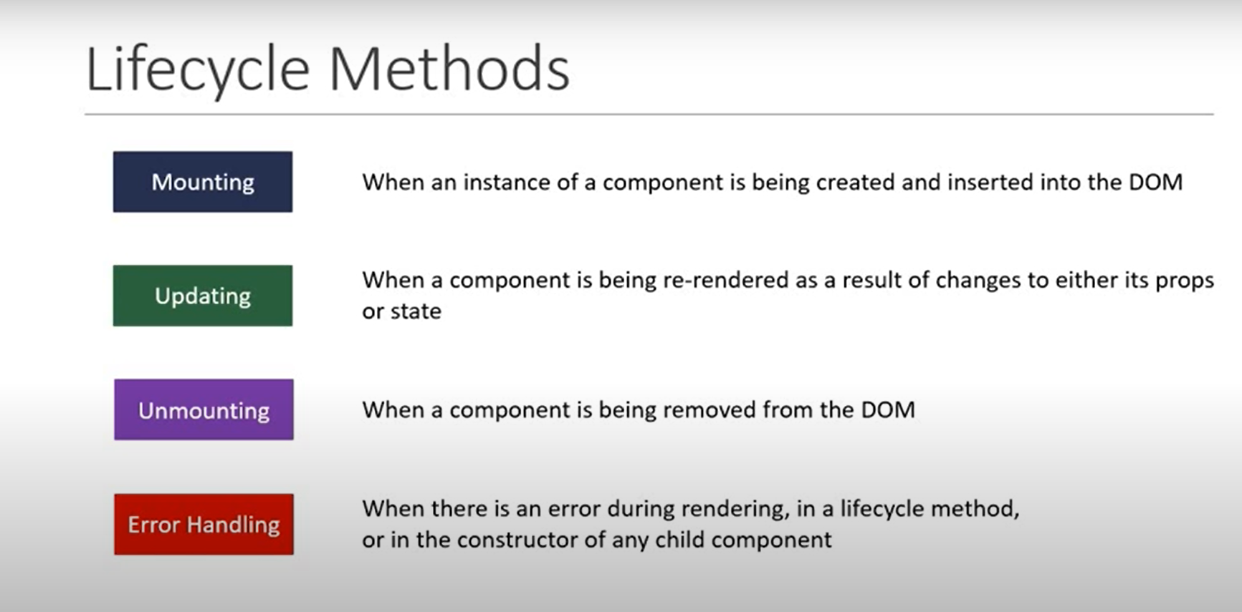

Slide 21
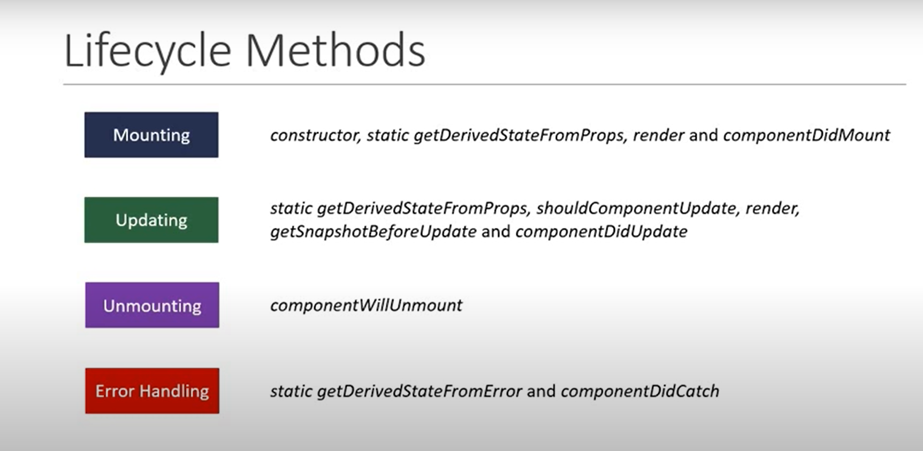

Slide 22

Day 1: Questions

