Slide 1


Core Java
Session5 By Saurabh Sharma

Slide 2
Agenda
Today we will cover the following modules:
Concurrency Framework

Slide 3
Framework Overview
Task Scheduling Framework: The Executor is a framework for handling the invocation, scheduling and execution of tasks
Concurrent Collection: Concurrent implementations of commonly used classes like map, list and queue (no more reinventing the wheel.
Atomic Variables: classes for atomic manipulation of single variables, provides higher performance than simply using synchronization primitives
Locks: High performance implementation of locks with the same semantics as the synchronized keyword, with additional functionality like timeouts
Timers: Provides access to a nanosecond timer for making fine grained timing measurements, useful for methods that accept timeouts

Slide 4
Advantages of using the Framework
Reusability and effort reduction: Many commonly used concurrent classes already implemented.
Superior performance: Inbuilt implementation highly optimized and peer reviewed by experts
Higher reliability, less bugs: Working from already developed building blocks lead to more reliable programs
Improved maintainability and scalability: Reusable components leads to programs that are easier to maintain and scale much better
Increased productivity: Developers no longer have to reinvent the wheel each time, programs easier to debug, more likely to understand standard library implementations

Slide 5
The Executor Framework
The Executor framework provides a mechanism for invoking, scheduling, and executing tasks according to a set of policies.
Java executor framework (java.util.concurrent.Executor), released with the JDK 5 is used to run the Runnable objects without creating new threads every time and mostly re-using the already created threads.
Creating a thread in java is a very expensive process which includes memory overhead also. So, it’s a good idea if we can re-use these threads once created, to run our future runnables.

Slide 6
Example
public static void main(String args[]) {
ExecutorService e=Executors.newFixedThreadPool(5);
for(int i=0; i<20; i++)
{
//Thread t=new Thread(new MyTask());
//t.start();
e.execute(new MyTask());
}
}

Slide 7
Thread Pool
Java Thread pool represents a group of worker threads that are waiting for the job and reuse many times.
In case of thread pool, a group of fixed size threads are created. A thread from the thread pool is pulled out and assigned a job by the service provider. After completion of the job, thread is contained in the thread pool again.
Instead of starting a new thread for every task to execute concurrently, the task can be passed to a thread pool. As soon as the pool has any idle threads the task is assigned to one of them and executed. Internally the tasks are inserted into a Blocking Queue which the threads in the pool are dequeuing from. When a new task is inserted into the queue one of the idle threads will dequeue it successfully and execute it. The rest of the idle threads in the pool will be blocked waiting to dequeue tasks.
Advantage of Java Thread Pool
Better performance It saves time because there is no need to create new thread.

Slide 8
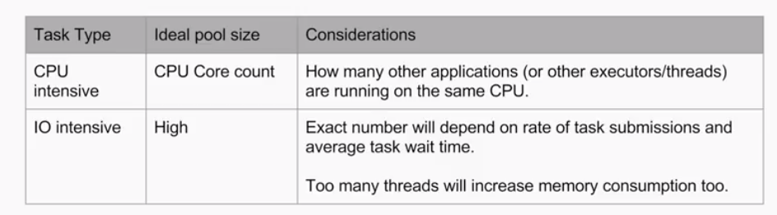
What is the ideal Pool size?

Slide 9
Types Of Thread Pool
FixedThreadPool
Creates a fixed size thread pool. if all threads are being currently run by the executor then the pending tasks are placed in a queue and are executed when a thread becomes idle.
CachedThreadPool
Creates a thread pool that creates new threads as needed, but will reuse previously constructed threads when they are available
ScheduledThreadPool
Schedule the task to run based on time delay.
SingleThreadedExecutor
Creates a single thread.

Slide 10
Semaphore
The Semaphore class present in java.util.concurrentpackage is a counting semaphore in which a semaphore, conceptually, maintains a set of permits.
Semaphore class in Java has two methods that make use of permits-
acquire()- Acquires a permit from this semaphore, blocking until one is available, or the thread is interrupted. It has another overloaded version acquire(int permits).
release()- Releases a permit, returning it to the semaphore. It has another overloaded method release(int permits).

Slide 11
How Semaphore Works?
Thread that wants to access the shared resource tries to acquire a permit using acquire() method. At that time if the Semaphore's count is greater than zero thread will acquire a permit and Semaphore's count will be decremented by one.
If Semaphore's count is zero and thread calls acquire() method, then the thread will be blocked until a permit is available.
When thread is done with the shared resource access, it can call the release() method to release the permit. That results in the Semaphore's count incremented by one.

Slide 12
Semaphore constructors
Semaphore(int permits)- Creates a Semaphore with the given number of permits and nonfair fairness setting. If a Semaphore is initialized with 5 permits that means atmost 5 threads can call the acquire method without Calling release method.
Semaphore(int permits, boolean fair)- Creates a Semaphore in Java with the given number of permits and the given fairness setting.When fairness is set to true, the semaphore guarantees that threads invoking any of the acquire methods are selected to obtain permits in the order in which their invocation of those methods was processed (first-in-first-out; FIFO).

Slide 13
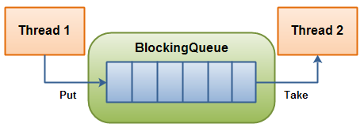
Blocking Queues
A blocking queue is a queue that blocks when you try to dequeue from it and the queue is empty, or if you try to enqueue items to it and the queue is already full. A thread trying to dequeue from an empty queue is blocked until some other thread inserts an item into the queue. A thread trying to enqueue an item in a full queue is blocked until some other thread makes space in the queue, either by dequeuing one or more items or clearing the queue completely.

Slide 14
Blocking Queues cont…
The Java BlockingQueue interface in the java.util.concurrent package represents a queue which is thread safe to put into, and take instances from. In this text I will show you how to use this BlockingQueue.
A BlockingQueue is typically used to have on thread produce objects, which another thread consumes.
Since BlockingQueue is an interface, you need to use one of its implementations to use it. The java.util.concurrent package has the following implementations of the BlockingQueue interface (in Java 6):
ArrayBlockingQueue
DelayQueue
LinkedBlockingQueue
PriorityBlockingQueue
SynchronousQueue

Slide 15

Questions

