Slide 1

Spring Boot
By Saurabh Sharma

Slide 2
Course Objectives
At the end of this course, you should be able to:
Spring Boot
Web Applications with Boot
Thymeleaf
JSP
Spring Data JPA
Spring Data Rest

Slide 3
Prerequisites:
Learners are supposed to have understanding of Core Java, Spring core and MVC
Must have worked on any generation of programming language

Slide 4
What is Spring Boot
Radically faster getting started experience.
“Opinionated” approach to configure / defaults.
Intelligent defaults
Get out of the way quickly.
What does it involve
Easier dependency management. (Maven or gradle)
Automatic configuration / reasonable default
Different built / deployment options.

Slide 5
What is Spring Boot Not
Plugins for IDEs
Use Boot with any IDE (or none at all)
Code generation

Slide 6
Demonstration – Spring Boot
Creating a new, bare-bones spring application

Slide 7
What Just Happened?
Boilerplate project structure created
Mostly folder structure
“Application” class + test
Maven POM or Gradle if desired
Dependency Management

Slide 8
Running Spring Boot- What Just Happened?
Spring Application
Created Spring Application Context
@SpringBootApplication
Combination of @Configuration
Marks a configuration file.
Java equivalent of <beans > file
…And @ComponentScan
Looks for the @Components (none at the moment)
…And @EnableAutoConfiguration
Master runtime switch for spring boot
Examines ApplicationContext and classpath
Creates missing beans based on intelligent defaults.

Slide 9
Adding Web Capability
Adding Spring-Boot-starter-web dependency.
Adding HelloController.

Slide 10
Adding HelloController
@Controller
public class HelloController {
@RequestMapping("/hi")
public @ResponseBody String sayHello()
{
return "hello";
}
}

Slide 11
What Just Happened?
Spring-boot-starter-web dependency
Adds spring-web, spring-mvc jars
Adds embedded tomcat jars.
When Application starts...
Your beans are created
@EnableAutoConfiguration looks for missing beans
Based on your beans + classpath.
Notices @Controller/Spring MVC jars
Automatically creates MVC beans
DispatcherServlet, HandlerMappings, ViewResolvers etc..
Launches embedded Tomcat instance.

Slide 12
But wait, I want a WAR...
To convert from JAR to WAR:
Change POM packaging
Extends SpringBootServletInitializer
public class ServletInitializer extends SpringBootServletInitializer {
@Override
protected SpringApplicationBuilder configure(SpringApplicationBuilder application) {
return application.sources(DemoApplication.class);
}
}
Deploy to app server

Slide 13
What about Web Pages?
Spring MVC supports a wide range of view options.
Easy to use JSP, Freemarker, Velocity, Thymeleaf
Boot automatically establishes defaults
InternalResourceViewResolver for JSPs
ThymeleafViewResolver
IF Thymeleaf is on classpath
Spring-boot-starter-thymeleaf

Slide 14
What is Thymeleaf ?
Thymeleaf is a modern server-side Java template engine for both web and standalone environments.
Thymeleaf's main goal is to bring elegant natural templates to your development workflow — HTML that can be correctly displayed in browsers and also work as static prototypes, allowing for stronger collaboration in development teams.
With modules for Spring Framework, a host of integrations with your favourite tools, and the ability to plug in your own functionality, Thymeleaf is ideal for modern-day HTML5 JVM web development — although there is much more it can do.

Slide 15
Example with Web Pages.

Slide 16
Adding Thymeleaf into POM
<dependency>
<groupId>org.springframework.boot</groupId>
<artifactId>spring-boot-starter-thymeleaf</artifactId>
</dependency>

Slide 17
Adding Controller
@Controller
public class MyController {
@RequestMapping("/hi")
public String sayHello(Map model, String name)
{
model.put("Name", "Saurabh Sharma");
return "hello";
}
}

Slide 18
Adding View
Adding view into resources\templates(hello.html)
<!DOCTYPE html>
<html>
<body>
<h1>Welcome To Spring Boot <span th:text="${Name}">name-goes-here</span></h1>
</body>
</html>

Slide 19
What Just Happened?
spring-boot-starter-thymeleaf
Brought in required jars
Automatically configured ThymeleafViewResolver
Controller returned a logical view name.
ViewResolver found a matching template.
Render

Slide 20
But Wait, I want JSPs..
Thymeleaf and other templating approaches are way too advanced for my organization!
Beside, we have lots of existing JSPs.
No Problem!
Just as easy to use JSPs!
Place JSPs in desired web-relative location.
Set prefix and suffix as needed.
Remove thymeleaf starter POM.

Slide 21
Example..
First remove thymeleaf dependency from POM and add Tomcat dependency .
<dependency>
<groupId>org.springframework.boot</groupId>
<artifactId>spring-boot-starter-tomcat</artifactId>
<scope>provided</scope>
</dependency>

Slide 22
Then add Prefix and Suffix
Open application.properties and add
spring.mvc.view.prefix= /WEB-INF/views/
spring.mvc.view.suffix= .jsp

Slide 23
JSPs
Create JSPs in webapp/WEB-INF
<%@ page language="java" contentType="text/html; charset=ISO-8859-1"
pageEncoding="ISO-8859-1"%>
<!DOCTYPE html>
<html>
<body>
<h1>Hello: ${Name} I am JSP view!!!</h1>
</body>
</html>

Slide 24
What Just Happened?
No ThymeleafViewResolver Configured.
Controller returned a logical view name.
InternalResourceViewResolver forwarded to JSP.
Render.

Slide 25
Spring & Rest
Rest capability is built in to Spring MVC
Simply use domain Objects as a parameters/ return value
Mark with @RequestBody / @ResponseBody
Spring MVC automatically handles XML/JSON conversions
Based on converter available in classpath.

Slide 26
Example REST...

Slide 27
Spring & Rest
Controller returns a domain object
Not a logical view name (Page)
Spring MVC noticed @ResponseBody or @RestController
Invoke correct HttpMessageConverter based on
Requested Format
JARs on classpath

Slide 28
What Just Happened?
Controller returns a domain object.
Not a logical view name ( page )
Spring MVC noticed @ResponseBody or @RestController
Invoke correct HttpMessageConverter
Based on
Requested format
JARs on classpath

Slide 29
What If I want XML?
No Problem!
Annotate domain classes with JAXB annotations @XMLRootElement
JAXB already part of Java SE
When web starts
Spring creates HttpMessageConverter for JAXB
Based on classpath contents
XML or JSON returned
Based on requested format

Slide 30
Adding JPA Capability
Adding the “spring-boot-starter-data-jpa” Dependency.
Adds spring JDBC / TransactionManagment
Adds spring ORM
Adds Hibernate / Entity Manager
Adds spring Data JPA subproject
Does not adds Database Driver
Adds one manually (MySQL or your database)

Slide 31
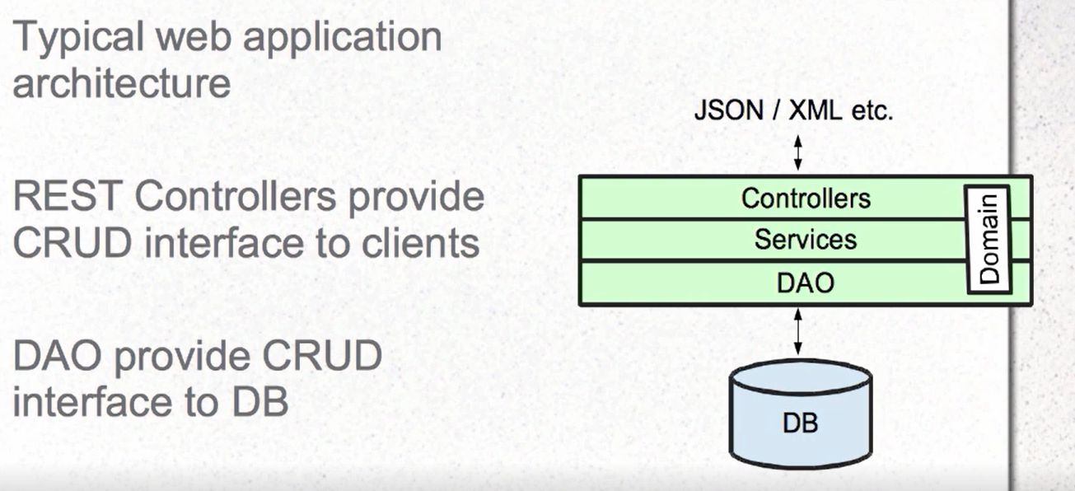
Spring Data JPA

Slide 32
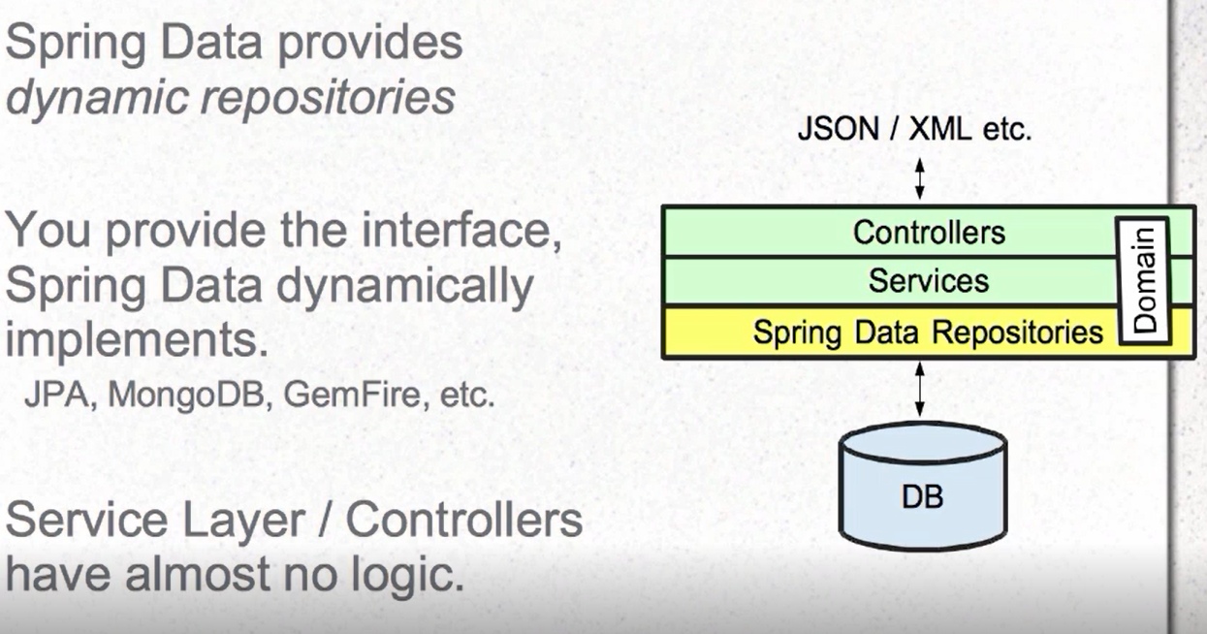
Spring Data – Instant Repositories

Slide 33
Example Spring Data-JPA

Slide 34
Add Dependency
<dependency>
<groupId>org.springframework.boot</groupId>
<artifactId>spring-boot-starter-data-jpa</artifactId>
</dependency>
<dependency>
<groupId>mysql</groupId>
<artifactId>mysql-connector-java</artifactId>
<version>5.1.6</version>
</dependency>

Slide 35
Application.properties
spring.mvc.view.prefix= /WEB-INF/views/
spring.mvc.view.suffix= .jsp
spring.jpa.hibernate.ddl-auto=update
spring.datasource.url=jdbc:mysql://localhost:3306/test
spring.datasource.username=root
spring.datasource.password=root
spring.datasource.driver-class-name=com.mysql.jdbc.Driver

Slide 36
Entity class
@Entity
public class Employee {
@Id
private int eid;
@Column(name="Name")
private String name;
@Column(name="Age")
private int age;
@Column(name="Salary")
private String salary;
}

Slide 37
DAO
public interface EmployeeDao extends CrudRepository<Employee, Integer> {
@Query("select e from Employee e where e.name like :name%")
List<Employee> find(@Param("name") String name);
List<Employee> findByName(String name);
}

Slide 38
Controller
@Controller
public class EmployeeController {
@Autowired
EmployeeDao employeeDao;
}

Slide 39
Spring Data JPA – What Just Happened?
What I did:
Added dependency for JPA and MySQL
Added domain object with plain JPA Annotation
Added an interface for spring Data JPA
Dependency injected into controller
When application starts...
Spring data dynamically implements repositories
Find(), delete(), save() methods implemented.
DataSource, Trnasaction Management , all handled.

Slide 40

Day 1: Questions

