Slide 1
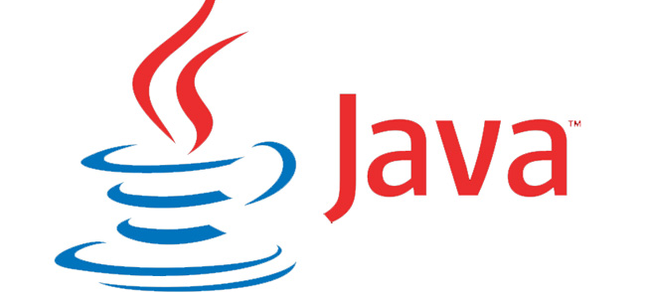

Core Java
Session5 By Saurabh Sharma

Slide 2
Agenda
Today we will cover the following two modules:
Java 8 new Features.

Slide 3
Java 8 Enhancements
Lambda expressions
Method references
Functional interfaces
Default methods
Static methods in interface
Collectors class
ForEach() method
JDBC Enhancements
and many more………..

Slide 4
Lambda expressions
Lambda expression helps us to write our code in functional style. Lambda expression (or function) is just an anonymous function, i.e., a function with no name and without being bounded to an identifier. They are written exactly in the place where it’s needed, typically as a parameter to some other function.
Following are the important characteristics of a lambda expression.
Optional type declaration − No need to declare the type of a parameter. The compiler can inference the same from the value of the parameter.
Optional parenthesis around parameter − No need to declare a single parameter in parenthesis. For multiple parameters, parentheses are required.
Optional curly braces − No need to use curly braces in expression body if the body contains a single statement.
Optional return keyword − The compiler automatically returns the value if the body has a single expression to return the value. Curly braces are required to indicate that expression returns a value.

Slide 5
Example
interface Add {
int sum(int a, int b);
}
public class AddDemo {
public static void main(String[] args) {
Add obj=(a,b)->a+b;
System.out.println(obj.sum(3, 2));
}
}

Slide 6
Method references
Method references help to point to methods by their names. A method reference is described using "::" symbol. A method reference can be used to point the following types of methods −
Static methods
Instance methods
Constructors using new operator

Slide 7
Example static Method
interface Sayable{
void say();
}
public class MethodReference {
public static void saySomething(){
System.out.println("Hello, this is static method.");
}
public static void main(String[] args) {
Sayable sayable = MethodReference::saySomething;
sayable.say();
}
}

Slide 8
Example Instance Method
interface Sayable{
void say();
}
public class Demo {
public void saySomething(){
System.out.println("This is non-static method.");
}
public static void main(String[] args) {
AddDemo methodReference = new AddDemo();
Sayable sayable = methodReference::saySomething;
sayable.say();
Sayable sayable2 = new AddDemo()::saySomething;
sayable2.say();
}}

Slide 9
Reference to a Constructor
package com;
interface Sayable{
void say();
}
public class Demo {
Demo()
{
System.out.println("Hello Constructor!!!!!");
}
public static void main(String[] args) {
Sayable s=AddDemo::new;
s.say();
}
}

Slide 10
Example
public class Test {
public static void main(String args[]) {
List names = new ArrayList();
names.add("Mahesh");
names.add("Suresh");
names.add("Ramesh");
names.add("Naresh");
names.add("Kalpesh");
names.forEach(System.out::println);
} }

Slide 11
Functional Interfaces
An Interface that contains exactly one abstract method is known as functional interface. It can have any number of default, static methods but can contain only one abstract method. It can also declare methods of object class.
For example, a Comparable interface with a single method ‘compareTo’ is used for comparison purpose. Java 8 has defined a lot of functional interfaces to be used extensively in lambda expressions.
Predicate <T> interface is a functional interface with a method test(Object) to return a Boolean value. This interface signifies that an object is tested to be true or false.
A functional interface can extends another interface only when it does not have any abstract method.
We can use “@FunctionalInterface” annotation to create functional interface.

Slide 12
Example
public class AddDemo { public static void main(String args[]) { List<Integer> list = Arrays.asList(1, 2, 3, 4, 5, 6, 7, 8, 9); System.out.println("Print all numbers:"); eval(list, n -> true); System.out.println("Print numbers greater than 5:"); eval(list, n -> n > 5); } | public static void eval(List<Integer> list, Predicate<Integer> predicate) { for (Integer n : list) { if (predicate.test(n)) { System.out.println(n + " "); } } } }

Slide 13
Default Method
Java provides a facility to create default methods inside the interface. Methods which are defined inside the interface and tagged with default are known as default methods. These methods are non-abstract methods.
This capability is added for backward compatibility so that old interfaces can be used to leverage the lambda expression capability of Java 8.
For example, ‘List’ or ‘Collection’ interfaces do not have ‘forEach’ method declaration. Thus, adding such method will simply break the collection framework implementations. Java 8 introduces default method so that List/Collection interface can have a default implementation of forEach method, and the class implementing these interfaces need not implement the same.

Slide 14
Default Method
Java interface default methods will help us in extending interfaces without having the fear of breaking implementation classes.
Java interface default methods has bridge down the differences between interfaces and abstract classes.
Java 8 interface default methods will help us in avoiding utility classes, such as all the Collections class method can be provided in the interfaces itself.
Java interface default methods will help us in removing base implementation classes, we can provide default implementation and the implementation classes can chose which one to override.
One of the major reason for introducing default methods in interfaces is to enhance the Collections API in Java 8 to support lambda expressions.
If any class in the hierarchy has a method with same signature, then default methods become irrelevant. A default method cannot override a method from java.lang.Object. The reasoning is very simple, it’s because Object is the base class for all the java classes. So even if we have Object class methods defined as default methods in interfaces, it will be useless because Object class method will always be used. That’s why to avoid confusion, we can’t have default methods that are overriding Object class methods.
Java interface default methods are also referred to as Defender Methods or Virtual extension methods.

Slide 15
Java Interface Static Method
Java interface static method is similar to default method except that we can’t override them in the implementation classes. This feature helps us in avoiding undesired results incase of poor implementation in implementation classes.
Java interface static method is part of interface, we can’t use it for implementation class objects.
Java interface static methods are good for providing utility methods, for example null check, collection sorting etc.
Java interface static method helps us in providing security by not allowing implementation classes to override them.
We can’t define interface static method for Object class methods, we will get compiler error as “This static method cannot hide the instance method from Object”. This is because it’s not allowed in java, since Object is the base class for all the classes and we can’t have one class level static method and another instance method with same signature.
We can use java interface static methods to remove utility classes such as Collections and move all of it’s static methods to the corresponding interface, that would be easy to find and use

Slide 16
Java Streams
Before we look into Java Stream API Examples, let’s see why it was required. Suppose we want to iterate over a list of integers and find out sum of all the integers greater than 10.
private static int sumList(List<Integer> list) {
Iterator<Integer> it = list.iterator();
int sum = 0;
while (it.hasNext()) {
int num = it.next();
if (num > 10)
{ sum += num; }
}
return sum;
}

Slide 17
There are three major problems with the above approach:
We just want to know the sum of integers but we would also have to provide how the iteration will take place, this is also called external iteration because client program is handling the algorithm to iterate over the list.
The program is sequential in nature, there is no way we can do this in parallel easily.
There is a lot of code to do even a simple task.
To overcome all the above shortcomings, Java 8 Stream API was introduced. We can use Java Stream API to implement internal iteration, that is better because java framework is in control of the iteration.
Internal iteration provides several features such as sequential and parallel execution, filtering based on the given criteria, mapping etc.

Slide 18
Let’s see how can we write above logic in a single line statement using Java Streams.
private static int sumStream(List<Integer> list)
{
return list.stream().filter(i -> i > 10).mapToInt(i -> i).sum();
}

Slide 19
Streams
A Stream is a free flowing sequence of elements. They do not hold any storage as that responsibility lies with collections such as arrays, lists and sets. Every stream starts with a source of data, sets up a pipeline, processes the elements through a pipeline and finishes with a terminal operation. They allow us to parallelize the load that comes with heavy operations without having to write any parallel code. A new package java.util.stream was introduced in Java 8 to deal with this feature.
Streams adhere to a common Pipes and Filters software pattern. A pipeline is created with data events flowing through, with various intermediate operations being applied on individual events as they move through the pipeline. The stream is said to be terminated when the pipeline is disrupted with a terminal operation. Please keep in mind that a stream is expected to be immutable — any attempts to modify the collection during the pipeline will raise a ConcurrentModifiedException exception.

Slide 20
Creating Java Streams
There are several ways through which we can create a java stream from array and collections. Let’s look into these with simple examples.
Stream<Integer> stream = Stream.of(1,2,3,4);
Stream<Integer> stream = Stream.of(new Integer[]{1,2,3,4});
List<Integer> myList = new ArrayList<>();
for(int i=0; i<100; i++) myList.add(i);
Stream<Integer> sequentialStream = myList.stream(); //sequential stream
Stream<Integer> parallelStream = myList.parallelStream(); //parallel stream

Slide 21
Stream.generate() and Stream.iterate()
Stream generate(Supplier<T> s) returns an infinite sequential unordered stream where each element is generated by the provided Supplier. This is suitable for generating constant streams, streams of random elements, etc.
Stream.generate(new Random()::nextInt) .limit(5).forEach(System.out::println);
Stream<String> stream1 = Stream.generate(() -> {return "abc";});
The iterate() method takes two arguments: a seed and a function. A seed is the first element of the stream. The second element is generated by applying the function to the first element. The third element is generated by applying the function on the second element.
Stream<Long> tenNaturalNumbers = Stream.iterate(1L, n -> n + 1) .limit(10);
tenNaturalNumbers.forEach(System.out::println);

Slide 22
Streams on Arrays in Java
Stream method of Arrays class which is added in Java 8, it simplifies many operations on arrays as well have improved the efficiency.
Addition of different features like lambdas and streams in java 8 have made java efficient to write elegant code which have improve the readability providing increase in efficiency of performance in most case .
Example:
LongStream is = Arrays.stream(new long[]{1,2,3,4});
long l=is.sum();
System.out.println(l);

Slide 23
Streams Filter
Java stream provides a method filter() to filter stream elements on the basis of given predicate. Suppose you want to get only even elements of your list then you can do this easily with the help of filter method.
This method takes predicate as an argument and returns a stream of consisting of resulted elements.
predicate: It takes Predicate reference as an argument. Predicate is a functional interface. So, you can also pass lambda expression here.
The signature of Stream filter() method is given below:
Stream<T> filter(Predicate<? super T> predicate)

Slide 24
Streams Map
Stream map(Function mapper) returns a stream consisting of the results of applying the given function to the elements of this stream.
Stream map(Function mapper) is an intermediate operation. These operations are always lazy. Intermediate operations are invoked on a Stream instance and after they finish their processing, they give a Stream instance as output.
Example:
public static void main(String[] args) {
List<Integer> list = Arrays.asList(3, 6, 9, 12, 15);
list.stream().map(number -> number * 3).forEach(System.out::println);
}

Slide 25
Parallel Streams
The Stream API enables developers to create the parallel streams that can take advantage of multi-core architectures and enhance the performance of Java code. In a parallel stream, the operations are executed in parallel and there are two ways to create a parallel stream.
Using the parallelStream() method on a collection
Using the parallel() method on a stream
Do remember, Parallel Streams must be used only with stateless, non-interfering, and associative operations i.e.
A stateless operation is an operation in which the state of one element does not affect another element
A non-interfering operation is an operation in which data source is not affected
An associative operation is an operation in which the result is not affected by the order of operands

Slide 26
Parallel Streams
Let’s take a scenario where you have a list of employee objects and you have to count the employees whose salary is above 15000. Generally, to solve this problem you will iterate over list going through each employee and checking if employee’s salary is above 15000. This takes O(N) time since you go sequentially.
Streams give us the flexibility to iterate over the list in a parallel pattern and can give the total in quick fashion. Stream implementation in Java is by default sequential unless until it is explicitly mentioned in parallel. When a stream executes in parallel, the Java runtime partitions the stream into multiple sub-streams. Aggregate operations iterate over and process these sub-streams in parallel and then combine the results.

Slide 27
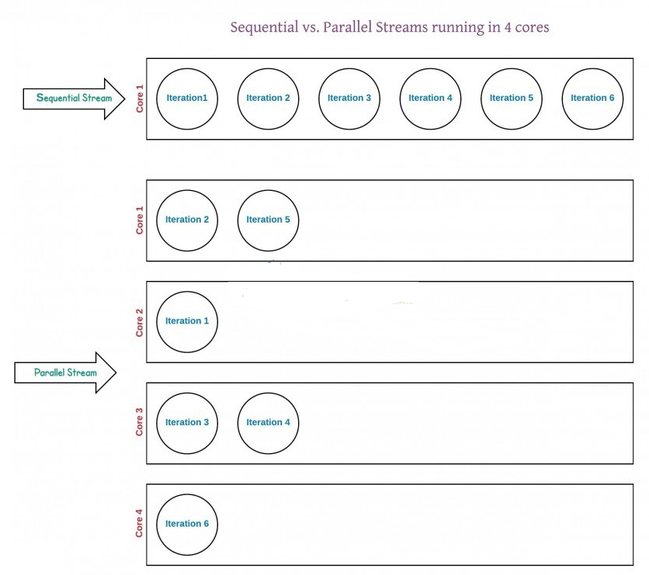
Sequential vs Parallel Streams

Slide 28
Parallel Streams Performance Implications
Parallel Stream has equal performance impacts as like its advantages.
Since each sub-stream is a single thread running and acting on the data, it has overhead compared to the sequential stream
Inter-thread communication is dangerous and takes time for coordination

Slide 29
When to use Parallel Streams?
They should be used when the output of the operation is not needed to be dependent on the order of elements present in source collection (i.e. on which the stream is created)
Parallel Streams can be used in case of aggregate functions
Parallel Streams quickly iterate over the large-sized collections
Parallel Streams can be used if developers have performance implications with the Sequential Streams
If the environment is not multi-threaded, then Parallel Stream creates thread and can affect the new requests coming in

Slide 30
Java Collectors
Collectors is a final class that extends Object class. It provides reduction operations, such as accumulating elements into collections, summarizing elements according to various criteria, etc.
Java Collectors class provides various methods to deal with elements like:
toList
summingDouble
averagingDouble
toSet
Counting
And many more…………

Slide 31
Example
class Employee { String name; int age; int salary; public Employee(String name, int age, int salary) { super(); this.name = name; this.age = age; this.salary = salary; } } | public class AddDemo { public static void main(String args[]) { List<Employee> li=new ArrayList<Employee>(); li.add(new Employee("A",32,45000)); li.add(new Employee("C",22,55000)); li.add(new Employee("B",42,35000)); li.add(new Employee("D",12,25000)); List<Integer> salary=li.stream(). map(x->x.salary).collect(Collectors.toList()); System.out.println(salary); double totalSalary= li.stream(). collect(Collectors.averagingDouble(x->x.salary)); System.out.println(totalSalary); } }

Slide 32
Java 8 JDBC Improvements
The JDBC-ODBC Bridge has been removed.
Added some new features in JDBC 4.2.
Addition of java.sql.DriverAction Interface
Addition of security check on deregisterDriver Method in DriverManager Class
Addition of the java.sql.SQLType Interface Addition of the java.sql.JDBCType Enum Add Support for large update counts

Slide 33
Java JDBC DriverAction
It is an interface that must be implemented when a Driver wants to be notified by DriverManager.
DriverAction Method
void deregister()
This method called by DriverManager.deregisterDriver(Driver) to notify the JDBC driver that it was de-registered.
If there are active connections to the database at the time that the deregister method is called, it is implementation specific as to whether the connections are closed or allowed to continue. Once this method is called, it is implementation specific as to whether the driver may limit the ability to create new connections to the database, invoke other Driver methods or throw a SQLException.

Slide 34
Example
package com; import java.sql.*; class DriverExample implements DriverAction{ @Override public void deregister() { System.out.println("Driver deregistered"); } | public static void main(String args[]){ try{ Driver driver = new com.mysql.jdbc.Driver(); DriverAction da = new DriverExample(); DriverManager.registerDriver(driver, da); Connection con= DriverManager.getConnection(url,uname,password); System.out.println("Connected!!!!!!!!!!!"); con.close(); DriverManager.deregisterDriver(driver); }catch(Exception e){ System.out.println(e);} } }

Slide 35

Questions

