Slide 1


Microservices
Session By Saurabh Sharma

Slide 2
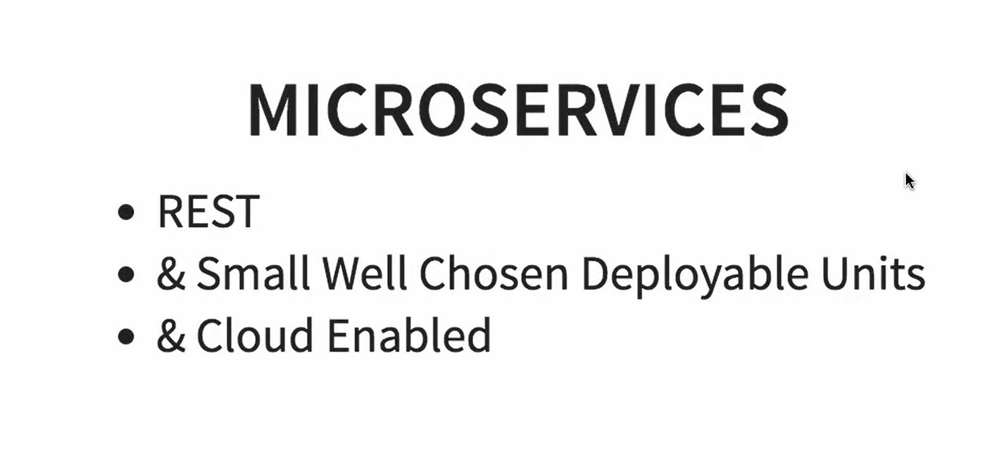

Slide 3
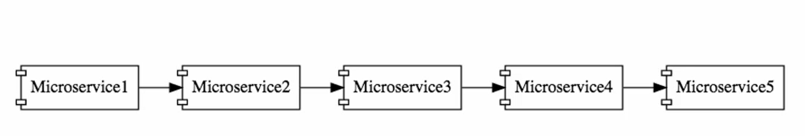

Slide 4
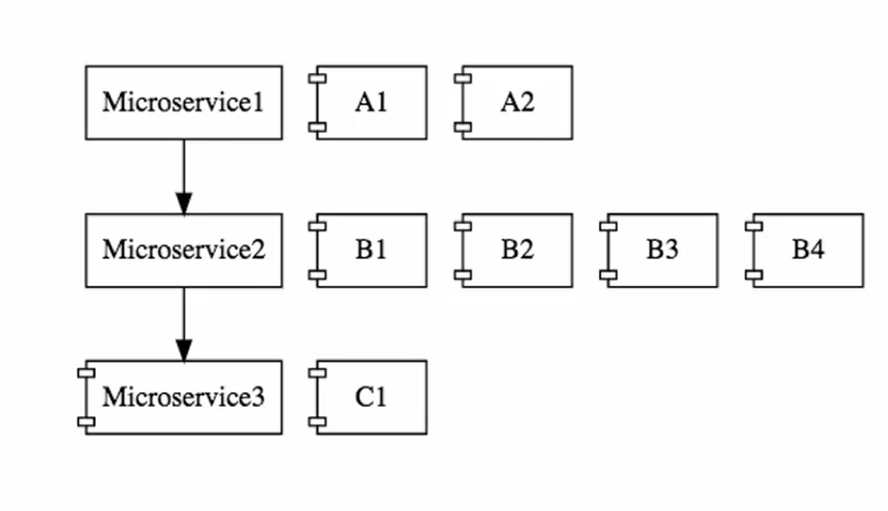
Cloud Enable

Slide 5
Challenges
Bounded Context
Configuration Management
Dynamic scale up and scale down
Visibility
Pack of cards

Slide 6


Slide 7
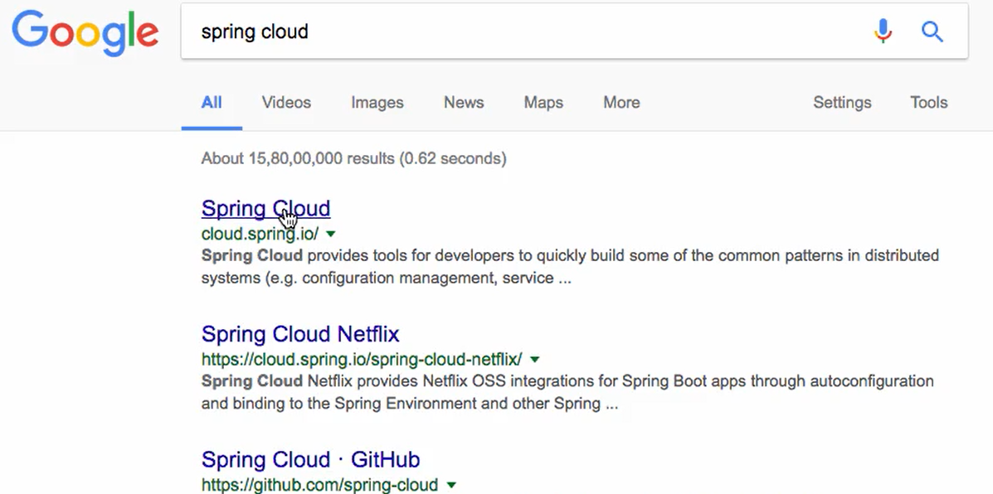

Slide 8

Challenges

Slide 9
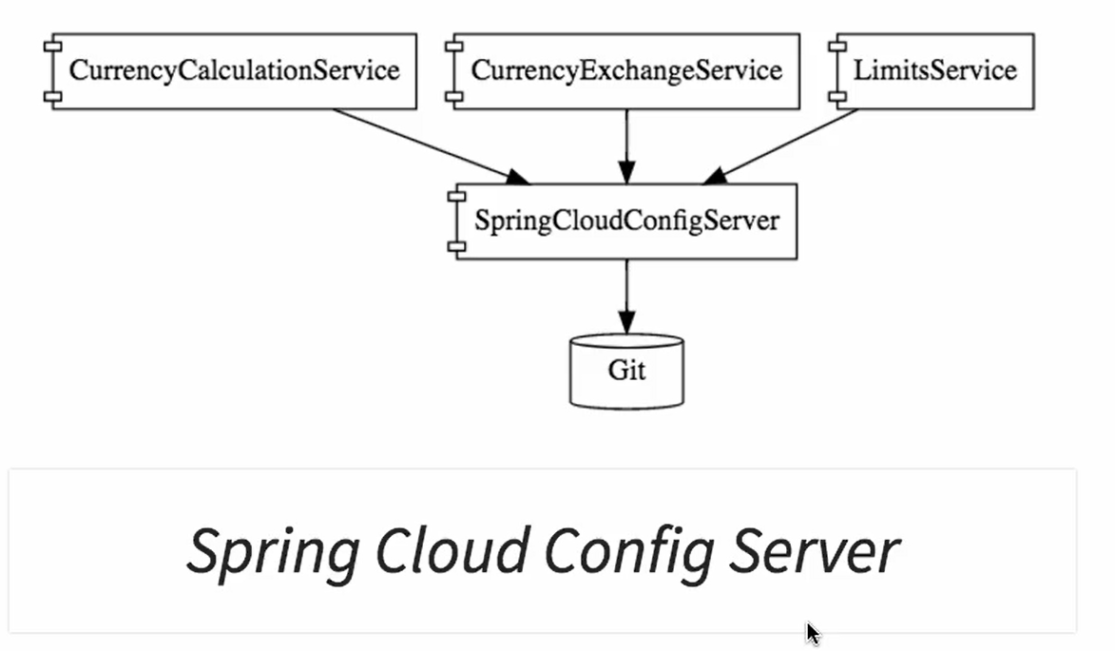
Challenges

Slide 10
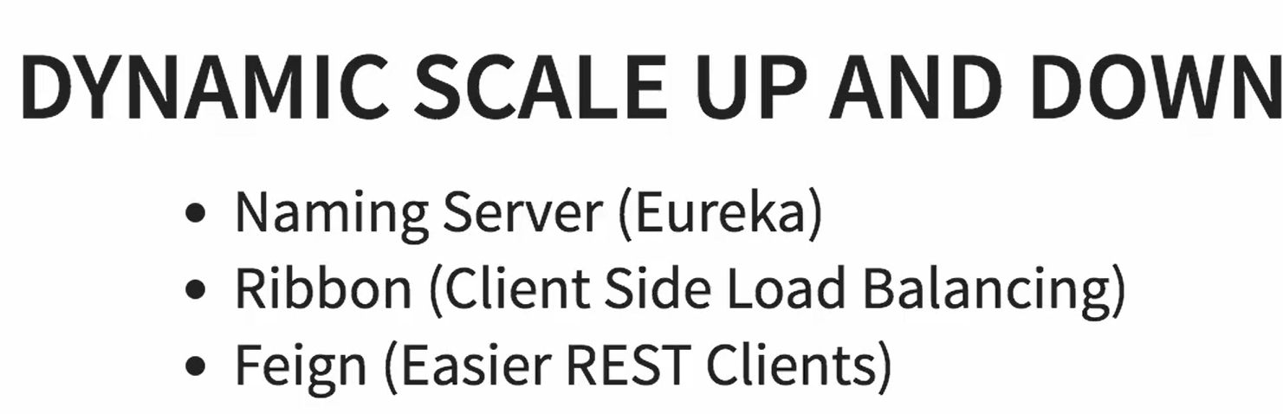
Challenges

Slide 11
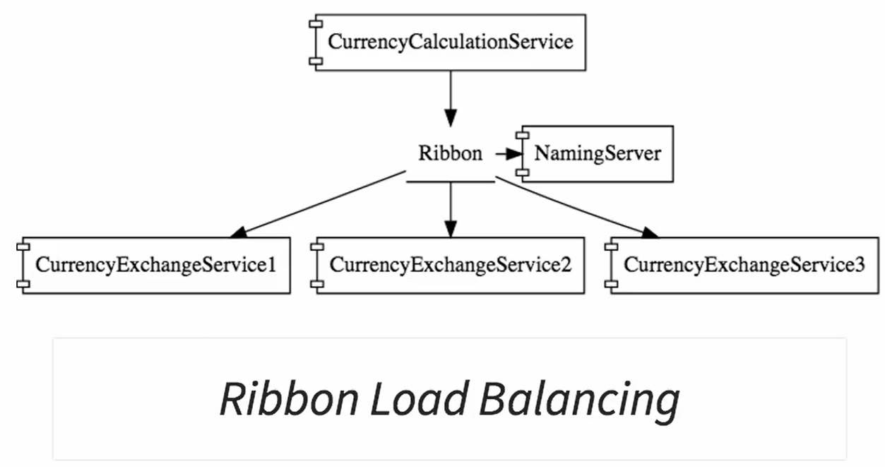
Challenges

Slide 12
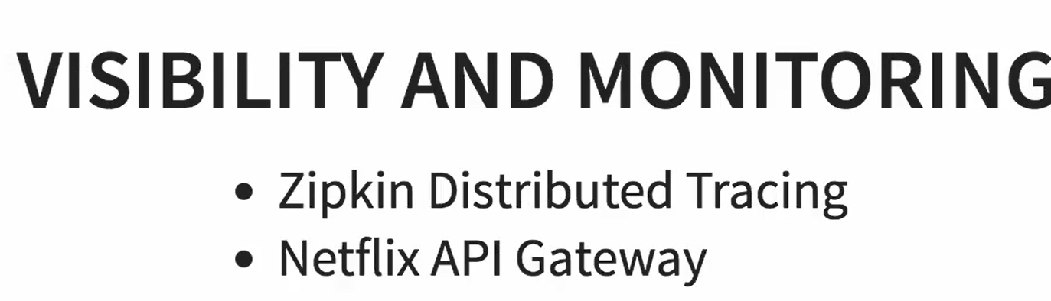
Challenges

Slide 13

Challenges

Slide 14
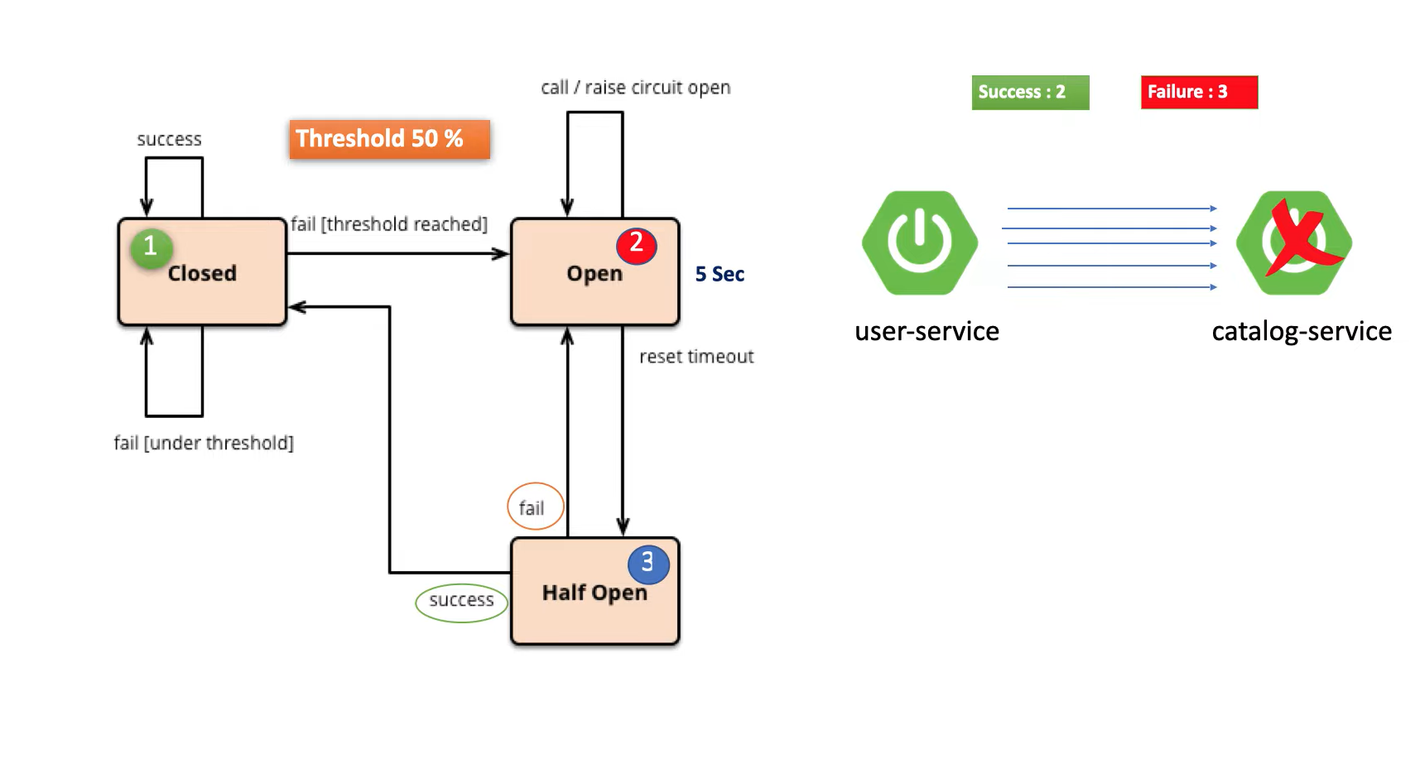
Challenges

Slide 15


Slide 16
Advantages
New technology and process adaption
Dynamic Scaling
Faster release cycles

Slide 17
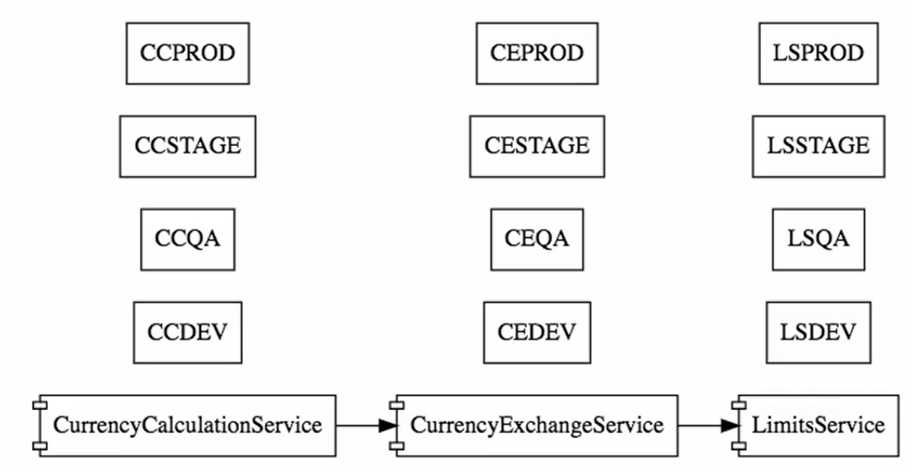
Example

Slide 18
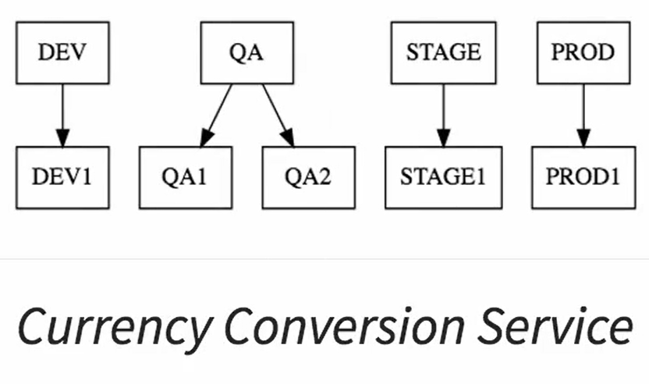
Example

Slide 19
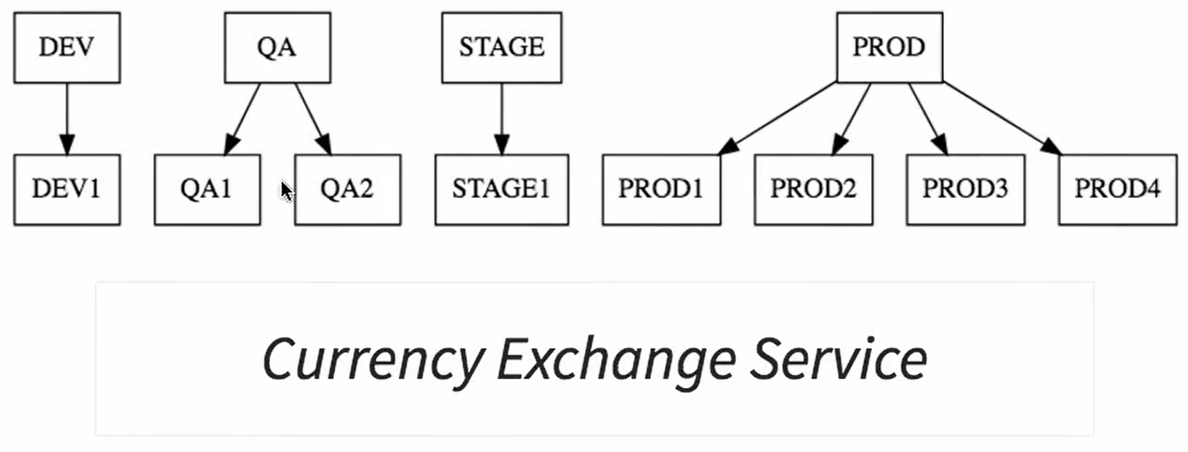
Example

Slide 20
Centralize config server

Slide 21

Questions

