Slide 1
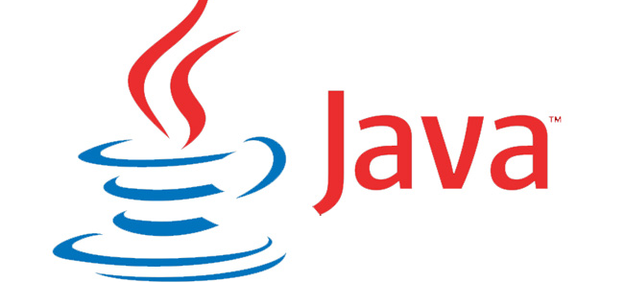

Core Java: Session6
By Saurabh Sharma

Slide 2
Agenda
Today we will cover the following two modules:
Building Database Applications with JDBC(Java Database connectivity).
Localization.

Slide 3
Module 1: Objectives
After completion of this module, you should be able to:
Define database and their architecture.
Define JDBC architecture.
Explain JDBC drivers.
Explain JDBC API.
Explain transaction.

Slide 4
Database architecture
There are three types of database architecture, such as:
One-tier.
Two-tier.
N-tier.

Slide 5
One-tier
Imagine a person on a desktop computer who uses Microsoft Access to load up a list of personal addresses and phone numbers that he or she has saved in MS Windows' “My Documents” folder. This is an example of a one-tier database architecture. The program (Microsoft Access) runs on the user's local machine, and references a file that is stored on that machine's hard drive, thus using a single physical resource to access and process information.
One-tier architectures can be beneficial when we are dealing with data that is relevant to a single user (or small number of users) and we have a relatively small amount of data. They are somewhat inexpensive to deploy and maintain.

Slide 6
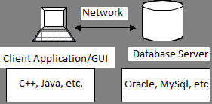
Two-tier Client/Server Architectures
A two-tier architecture is one that is familiar to many of today's computer users. A common implementation of this type of system is that of a Microsoft Windows based client program that accesses a server database such as Oracle or SQL Server. Users interact through a GUI (Graphical User Interface) to communicate with the database server across a network via SQL (Structured Query Language).

Slide 7
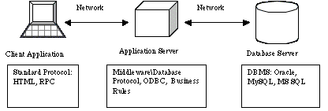
N-tier
Most n-tier database architectures exist in a three-tier configuration. In this architecture the client/server model expands to include a middle tier (business tier), which is an application server that houses the business logic. This middle tier relieves the client application(s) and database server of some of their processing duties by translating client calls into database queries and translating data from the database into client data in return. Consequently, the client and server never talk directly to one-another.

Slide 8
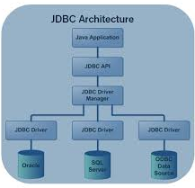
JDBC architecture
Java code calls JDBC library.
JDBC loads a driver.
Driver talks to a particular database.
Can have more than one driver -> more than one database.
Can change database engines without changing any application code.

Slide 9
JDBC drivers
JDBC drivers are divided into four types or levels. The different types of jdbc drivers are:
Type 1: JDBC-ODBC Bridge driver (Bridge).
Type 2: Native-API/partly Java driver (Native).
Type 3: All Java/Net-protocol driver (Middleware).
Type 4: All Java/Native-protocol driver (Pure).

Slide 10
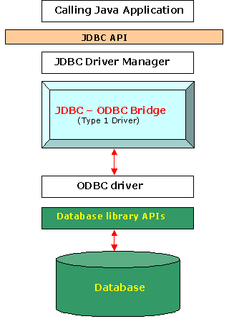
Type 1: JDBC-ODBC Bridge driver (Bridge)
Use bridging technology.
Translates query obtained by JDBC into corresponding
ODBC query, which is then handled by the ODBC
driver.
Almost any database for which ODBC driver is
installed, can be accessed.

Slide 11
Disadvantage of Type-I Driver
Since the Bridge driver is not written fully in Java, Type 1 drivers are not portable.
A performance issue is seen as a JDBC call goes through the bridge to the ODBC driver, then to the database, and this applies even in the reverse process. They are the slowest of all driver types.
The client system requires the ODBC Installation to use the driver.
Not good for the Web.

Slide 12
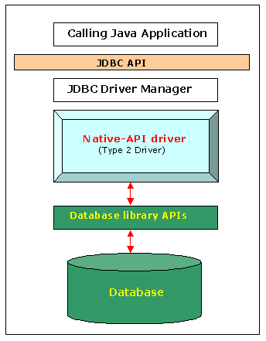
Type 2: Native-API/partly Java driver (Native)
Native API drivers.
Better performance than Type 1 since no jdbc to
odbc translation is needed.
Converts JDBC calls into calls to the client API
for that database.

Slide 13
Disadvantage of Type-2 Driver
Native API must be installed in the Client System and hence type 2 drivers cannot be used for the Internet.
Like Type 1 drivers, it’s not written in Java Language which forms a portability issue.
If we change the Database we have to change the native api as it is specific to a database.
Mostly obsolete now.
Usually not thread safe.

Slide 14
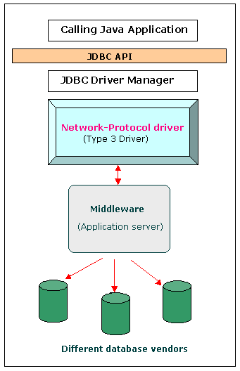
Type 3: Middleware
This driver is server-based, so there is no need for any vendor
database library to be present on client machines.
This driver is fully written in Java and hence Portable. It is
suitable for the web.
There are many opportunities to optimize portability,
performance, and scalability.
The net protocol can be designed to make the client JDBC
driver very small and fast to load.
The type 3 driver typically provides support for features such
as caching (connections, query results, and so on), load
balancing, and advanced system administration such as
logging and auditing.
This driver is very flexible allows access to multiple databases
using one driver.
They are the most efficient amongst all driver types.

Slide 15
Disadvantage of Type-3 Driver
It requires another server application to install and maintain. Traversing the recordset may take longer, since the data comes through the backend server.
Requires database-specific coding to be done in the middle tier.
An extra layer added may result in a time-bottleneck.

Slide 16
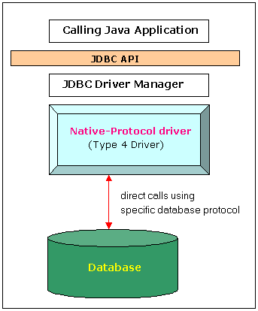
Type 4: Pure java driver
The major benefit of using a type 4 jdbc drivers are that they
are completely written in Java to achieve platform
independence and eliminate deployment administration
issues. It is most suitable for the web.
Number of translation layers is very less i.e. type 4 JDBC
drivers don't have to translate database requests to ODBC or a
native connectivity interface or to pass the request on to
another server, performance is typically quite good.
You don’t need to install special software on the client or
server. Further, these drivers can be downloaded dynamically.

Slide 17
Disadvantage of Type-3 Driver
With type 4 drivers, the user needs a different driver for each database.

Slide 18
JDBC API
JDBC 4.0 (part of JSE 6) is an API that provides standard for connectivity to variety of data sources like SQL databases, spreadsheets and flat.
JDBC provides call-level API for SQL databases meaning, API defines a set of interfaces and abstract methods. The database vendors (like Oracle, MySQL) must implement the JDBC API.
Therefore before writing JDBC code we must make sure that we have the library with respect to the data source that we intend to use.
JDBC is based on the X/Open SQL Call Level Interface (CLI). JDBC 4.0 complies with the SQL 2003 standard.
JDBC 4.0
java.sql (JDBC core API) javax.sql (JDBC optional package API)

Slide 19
JDBC API (continued)
The commonly used classes and interfaces in the JDBC API are:
DriverManager class: Loads the driver for a database.
Driver interface: Represents a database driver. All JDBC driver classes must implement the Driver interface.
Connection interface: Enables you to establish a connection between a Java application and a database.
Statement interface: Enables you to execute SQL statements.
ResultSet interface: Represents the information retrieved from a database.
SQLException class: Provides information about the exceptions that occur while interacting with databases.

Slide 20
Steps to create JDBC application
Load a driver
Connect to a database
Create and execute SQL statement
Handle SQL Exception

Slide 21
Load A Driver
Loading a Driver can be done in two ways:
Programmatically:
Using the forName() method.
Using the registerDriver()method.
Manually:
By setting system property.

Slide 22
Load A Driver Programmatically
Using the forName() method
The forName() method is available in the java.lang.Class class.
The forName() method loads the JDBC driver and registers the driver with the driver manager.
The method call to use the forName() method is:
Class.forName("sun.jdbc.odbc.JdbcOdbcDriver");

Slide 23
Load A Driver Programmatically(continued)
Using the registerDriver() method:
You can create an instance of the Driver class to load a JDBC driver.
This instance provide the name of the driver class at run time.
The statement to create an instance of the Driver class is:
Driver d = new sun.jdbc.odbc.JdbcOdbcDriver();
You need to call the registerDriver() method to register the Driver object with the DriverManager.
The method call to register the JDBC-ODBC Bridge driver is:
DriverManager.registerDriver(d);

Slide 24
Connect to a Database
Connecting to a Database Using DriverManager.getConnection() method:
Connection getConnection (String <url>)
Connection getConnection (String <url>, String <username>, String <password>)
Connects to given JDBC URL.
throws java.sql.SQLException.
Returns a connection object.
Example
Connection con=DriverManager.getConnection(“jdbc:oracle:thin:@localhost:1521:XE”, “hr”, “hr” );

Slide 25
Example: Connecting to a Database(Oracle) –older way
1. import java.sql.*;
2. Class TestConection
3. {
4. public static void main(String as[])
5. {
6. try {
7. Class.forName ("oracle.jdbc.driver.OracleDriver ");
8. Connection con = DriverManager.getConnection(“jdbc:oracle:thin:@localhost:1521:XE”, “hr”, “hr”);
9. Systeem.out.println(“Connection Established!!!!”);
10. }
11. catch (ClassNotFoundException e) { e.printStackTrace(); }
12. catch (SQLException e) { e.printStackTrace(); }
13. }
14.}

Slide 26
Example: Connecting to a Database(MySQL) –older way
1. import java.sql.*;
2. class TestConection
3. {
4. public static void main(String as[])
5. {
6. try {
7. Class.forName ("com.mysql.jdbc.Driver");
8. Connection con = DriverManager.getConnection("jdbc:mysql://localhost/test”,"root“,"root");
9. Systeem.out.println(“Connection Established!!!!”);
10. }
11. catch (ClassNotFoundException e) { e.printStackTrace(); }
12. catch (SQLException e) { e.printStackTrace(); }
13. }
14. }
Result:
Connection Established!!!

Slide 27
JDBC 4.0 way to connect to database
A JDBC 4-compliant JAR is identified using the Java service provider mechanism. It contains a text a file named “META-INF/services/java.sql.Driver”, which contains the name of the class(es) of the Drivers which exist in that JAR.
Extract the mysql-connector-java-5.0.4-bin.jar to check if there is a file called java.sql.Driver in the folder “META-INF/services” folder.
If you don’t have then to make it JDBC 4-compliant , follow simple steps :
Create a folder say MySQLJar. Copy the mysql-connector-java-5.0.4-bin.jar file inside it.
Create a folder called META-INF and then services inside META-INF.
Create a file named java.sql.Driver (without any extension).
Enter the driver name in the file:
com.mysql.jdbc.Driver # Class name of the Driver
Update the jar file by executing the command :
jar -uf mysql-connector-java-5.0.4-bin.jar META-INF/services/java.sql.Driver

Slide 28
Example: Connecting using JDBC 4.0 way
1. import java.sql.*;
2. class TestConection
3. {
4. public static void main(String as[])
5. {
6. try {
7. Connection con = DriverManager.getConnection("jdbc:mysql://localhost/test","root","root");
8. System.out.println("Connection Established!!!!");
9. }
10. catch (SQLException e) {
11. e.printStackTrace();
12. }
13. }}

Slide 29
Example: Connecting using JDBC 4.0 way
With JDBC 4.0 the Java service provider mechanism, applications no longer need to explicitly load JDBC drivers using Class.forName().
When the getConnection() is called, the DriverManager will attempt to locate a suitable driver from amongst specified in the classpath. (If there are more than one, the first one is used.)
The code is fundamentally same as the previous example- only line eliminated is Class.forName ("com.mysql.jdbc.Driver");

Slide 30
Create and Execute SQL Statements
Statement Interface
A Statement object is used for executing a static SQL statement and obtaining the results produced by it.
Statement createStatement()
returns a new Statement object.
Prepared Statement Interface
When you use a PreparedStatement object to execute a SQL statement, the statement is parsed and compiled by the database, and then placed in a statement cache. From then on, each time you execute the same PreparedStatement, it is once again parsed, but no recompile occurs. Instead, the precompiled statement is found in the cache and is reused.
PreparedStatement prepareStatement(String sql)
returns a new PreparedStatement object.
CallableStatement Interface
The interface used to execute SQL stored procedures.

Slide 31
Methods of Statement Interface
ResultSet executeQuery(String)
Execute a SQL statement that returns a single ResultSet.
int executeUpdate(String)
Execute a SQL INSERT, UPDATE or DELETE statement. Returns the number of rows changed.
boolean execute(String)
Execute a SQL statement that may return multiple results.

Slide 32
ResultSet Interface
Represents the result of an SQL statement.
Provides methods for navigating through the resulting data.
Only one ResultSet per Statement can be open at once.
The table rows are retrieved in sequence.
A ResultSet maintains a cursor pointing to its current row of data.
The 'next' method moves the cursor to the next row. you can’t rewind.

Slide 33
ResultSet Methods
boolean next() activates the next row. the first call to next() activates the first row. returns false if there are no more rows . void close() disposes of the ResultSet. allows you to re-use the Statement that created it. Type getType(int columnIndex) returns the given field as the given type. fields indexed starting at 1 (not 0). | Type getType(String columnName) same, but uses name of field less efficient. int findColumn(String columnName) looks up column index given column name.

Slide 34
ResultSet Methods (Continued)
String getString(int columnIndex)
boolean getBoolean(int columnIndex)
byte getByte(int columnIndex)
short getShort(int columnIndex)
int getInt(int columnIndex)
long getLong(int columnIndex
float getFloat(int columnIndex)
double getDouble(int columnIndex)
Date getDate(int columnIndex)
Time getTime(int columnIndex)
Timestamp getTimestamp(int columnIndex)

Slide 35
ResultSet Methods(Continued)
Method Name boolean first() boolean isFirst() boolean beforeFirst() boolean isbeforeFirst() | Description Shifts the control of a result set cursor to the first row of the result set. checks whether result set cursor points to the first row or not. moves the cursor before the first row. Checks whether result set cursor moves before the first row.

Slide 36
ResultSet Methods(Continued)
Method Name boolean last() boolean isLast() boolean afterLast() boolean isAfterLast() | Description Shifts the control to the last row of result set cursor. checks whether result set cursor points to the last row or not. moves the cursor after the last row. Checks whether result set cursor moves after the last row.

Slide 37
ResultSet Methods(Continued)
Method Name boolean next() boolean previous() boolean absolute(int rowno) boolean relative(int rowno) | Description Shifts the control to the next row of result set. Shifts the control to the previous row of the result set. Shifts the cursor to the row number that you specify as an argument. Shifts the cursor relative to the row number that you specify as an argument.

Slide 38
ResultSet Methods(Continued)
Method Name void insertRow() void deleteRow() void updateRow() | Description Inserts a row in the current result set. Deletes a row in the current result set. Updates a row of the current resultset.

Slide 39
ResultSet Methods(Continued)
Method Name void updateString(col name, String s) void updateInt(col name, int x) void updateFloat() void cancelRowUpdates() | Description Updates the specified column name with the given string value. Updates the specified column name with the given int value. Updates the specified column name with the given float value. Cancels all of the updates in a row.

Slide 40
ResultSet Fields
Field Name TYPE_FORWARD_ONLY TYPE_SCROLL_SENSITIVE TYPE_SCROLL_INSENSITIVE | Description The ResultSet object can moves forward only from first to last row. Indicates ResultSet is scrollable and it reflects changes in the data made by other user. Indicates ResultSet is scrollable and does not reflect changes in the data made by other user.

Slide 41
ResultSet Fields (Continued)
Field Name CONCUR_READ_ONLY CONCUR_UPDATABLE | Description Does not allow to update the ResultSet object. Allows to update the ResultSet object .

Slide 42
Example :Code to insert and fetch records
1. import java.sql.*; 2. class TestConection 3. { 4. public static void main(String as[]) 5. { 6. Connection con=null; 7. try { 8. con = DriverManager.getConnection("jdbc:mysql://localhost/test","root","root"); 9. Statement s= con.createStatement(); 10. s.executeUpdate("INSERT INTO STUDENT VALUES (1,‘Martin','M.C.A.', 1)"); 11. s.executeUpdate("INSERT INTO STUDENT VALUES (2,‘Mark','B.Tech', 2)"); 12. ResultS et rs=s.executeQuery("SELECT * FROM STUDENT"); | 13. System.out.println("ID Name Degree Semester"); 14. while (rs.next() ) 15. { 16. System.out.println( rs.getInt(1) +" "+rs.getString(2)+" "+rs.getString(3)+" "+rs.getInt(4)); 17.} 18.} 19. catch (SQLException e){ 20. System.err.println ("Failed to connect to database" +e); 21. } 22. finally { 23. if (con != null) { 24. try { con.close ();}catch (SQLException e) { } 25. } }}

Slide 43
Example: using advanced ResultSet
1. import java.sql.*;
2. class TestConection
3. {
4. public static void main(String as[])
5. {
6. Connection con=null;
7. try {
8. con = DriverManager.getConnection("jdbc:mysql://localhost/test","root","root");
9. Statement stmt = con.createStatement(ResultSet.TYPE_SCROLL_INSENSITIVE, ResultSet.CONCUR_UPDATABLE);
10. ResultSet rs = stmt.executeQuery("SELECT * FROM STUDENT");
11. System.out.println("Before...");
12. System.out.println("ID Name Degree Semester");

Slide 44
Example: Continued
13. while (rs.next() ) {
14. System.out.println( rs.getInt(1) +" "+rs.getString(2)+" "+rs.getString(3)+" "+rs.getInt(4));
15. }
16. rs.moveToInsertRow();
17. rs.updateInt("RegNo", 3);
18. rs.updateString("name", "John");
19. rs.updateString("degree", "B.sc.");
20. rs.updateInt("semester", 4);
21. rs.insertRow();
//updating 2nd row – changing name to Saurabh
22. rs.absolute(2);
23. rs.updateString(2,"Saurabh");
24. rs.updateRow();

Slide 45
Example: Continued
25. rs.beforeFirst();
26. System.out.println("After...");
27. System.out.println("ID Name Degree Semester");
28. while (rs.next() ) {
29. System.out.println( rs.getInt(1) +" "+rs.getString(2)+" "+rs.getString(3)+" "+rs.getInt(4)); }
30. }
31. catch (SQLException e) { System.err.println ("Failed to connect to database" +e); }
32. finally {
33. if (con != null) {
34. try { con.close (); } catch (SQLException e) { }
35. }
36. }
37. } }

Slide 46
Example: Continued
Result of execution of the code
Before...
ID Name Degree Semester
1 Martin M.C.A. 1
2 Mark B.Tech 2
After...
ID Name Degree Semester
1 Martin M.C.A. 1
2 Saurabh B.Tech 2
3 John B.sc. 4

Slide 47
PreparedStatement
Interface that inherits from Statement
If the same sql statement is executed many times it is more efficient to use a prepared statement.
It enables a SQL statement to contain parameters like functions. So same statement can be executed for different set of values.
Methods
public void clearParameters() throws SQLException
void setXxx(int parameterIndex, XXX x) All methods throws SQLException
XXX are all primitives, String, java.sql.Date, Object
And many more.

Slide 48
Example: Inserting data in the database using PreparedStatement
1. import java.sql.*; 2. class TestConection 3. { 4. public static void main(String as[]) 5. { 6. Connection con=null; 7. try { 8. con = DriverManager.getConnection("jdbc:mysql://localhost/test","root","root"); 9. PreparedStatement ps=con.prepareStatement("insert into student values(?,?,?,?)"); 10. ps.setInt(1,1001); 11. ps.setString(2,"Machiel"); 12. ps.setString(3,"M.Tec"); ps.setString(4,"4"); ps.executeUpdate(); | 15. System.out.println("Inserting Successfully!"); 16. ps.close(); 17. con.close(); 18. } 19. catch (Exception e) 20. { 21. System.out.println(e.getMessage()); 22. } 23. } } Result: Inserting Successfully!

Slide 49
Using PreparedStatement for batch updates
Apart from the batch related methods added by the Statement interface, PreparedStatement adds one more.
void addBatch() throws SQLException
is used to add batch of commands.
But since most of the batch operations are executed using same sql statement, it is usually used with PreparedStatement since it allows parameterized statements and hence they can be cached to give better performance.

Slide 50
Example: Batch updates
1. import java.sql.*; 2. class TestConection 3. { 4. public static void main(String as[]) 5. { 6. Connection con=null; 7. try { 8. con = DriverManager.getConnection("jdbc:mysql://localhost/test","root","root"); 9. PreparedStatement ps=con.prepareStatement("insert into student values(?,?,?,?)"); ps.setInt(1,1004); ps.setString(2,“AAA"); 12. ps.setString(3,"M.Tec"); 13. ps.setString(4,"4"); 14. ps.addBatch(); | 15. ps.setInt(1,1005); 16. ps.setString(2,"BBB"); 17. ps.setString(3,"B.Tec"); 18. ps.setString(4,"6"); 19. ps.addBatch(); 20. ps.executeBatch(); 21. con.close(); 21. System.out.println("Batch Updated!!!!"); 22. } 23. catch (Exception e) 24. { 25. System.out.println(e.getMessage()); 26. } 27. } } Result: Batch Updated!!!!

Slide 51
CallableStatement
Interface that inherits from PreparedStatement that is used to execute stored-procedure.
In Connection.prepareCall(String s)is used to create a CallableStatement.
The string parameter is of the form
{[?=] call <procedure-name>[<arg1>,<arg2>, ...]} //Line1
The arguments IN parameter values are set using the set methods inherited from PreparedStatement.
All OUT parameters must be registered before a stored procedure is executed.
void registerOutParameter(int parameterIndex, int sqlType) throws SQLException // Line2
java.sql.Types has all the parameters that can be sent as sqlType.

Slide 52
Example: CallableStatement
1. import java.sql.*;
2. class TestConection {
3. public static void main(String as[]) {
4. Connection con=null;
5. try {
6. con = DriverManager.getConnection("jdbc:mysql://localhost/test","root","root");
7. CallableStatement clst = con.prepareCall(“{call show_emp}”);
8. ResultSet rs = clst.executeQuery();
9. while(rs.next())
10. System.out.println(rs.getInt(1)+" "+rs.getString(2));
11. }
12. catch (Exception e){ System.out.println(e.getMessage()); }
13. } }
DELIMITER $$
DROP PROCEDURE IF EXISTS `test`.`showStudent` $$
CREATE PROCEDURE `test`.`showStudent` ()
BEGIN
select * from Student;
END $$
DELIMITER ;

Slide 53
Mapping Java Types to SQL Types
SQL type Java Type
CHAR, VARCHAR, LONGVARCHAR String
NUMERIC, DECIMAL java.math.BigDecimal
BIT boolean
TINYINT byte
SMALLINT short
INTEGER int
BIGINT long
REAL float
FLOAT, DOUBLE double
BINARY, VARBINARY, LONGVARBINARY byte[]
DATE java.sql.Date
TIME java.sql.Time
TIMESTAMP java.sql.Timestamp

Slide 54
Transaction
Transaction = more than one statement which must all succeed (or all fail) together.
If one fails, the system must reverse all previous actions.
Also can’t leave DB in inconsistent state halfway through a transaction.
COMMIT = complete transaction.
ROLLBACK = abort.
Transactions are not explicitly opened and closed.
if AutoCommit is true, then every statement is automatically committed.
default case: true.
if AutoCommit is false, then every statement is added to an ongoing transaction.
Must explicitly rollback or commit.

Slide 55
Transaction(continued)
Methods in Connection class helps to demarcate the set of statements into a transaction.
public void setAutoCommit(boolean autoCommit) throws SQLException
public void rollback() throws SQLException
public void commit() throws SQLException
To understand transactions we will use two tables Login ( id, login, password) and Student (regno, name,degree,semester). Insertion of student data will require us to insert data either into both the tables or in none of them in case there is an error. Login will be same as regno.

Slide 56
Example: Transaction
1. import java.sql.*; 2. class TestConection 3. { 4. public void insert(String uid, String pass, int id, String name) 5. { 6. Connection con=null; 7. try { 8. con = DriverManager.getConnection("jdbc:mysql://localhost/test","root","root"); 9. Statement st=con.createStatement(); 10. con.setAutoCommit(false); 11. st.executeUpdate("INSERT INTO Login VALUES("+ id+ ",'"+uid+"','"+pass+"')"); 12. st.executeUpdate("INSERT INTO Student VALUES("+uid+",'" + name + "','B.E.',1)"); | 13. con.commit(); 14. con.close(); 15. } catch(Exception e) { 16. try{ 17. System.out.println("Rolling back Exception :" + e.toString()); 18. con.rollback(); 19. e.printStackTrace();} 20. catch(Exception e1){} 21. } } 22. public static void main(String[] s) 23. { 24. insert("1111", "danger", 1,"Emily"); 25. } } Test the application by giving duplicate login values without transaction statements. with transaction statements.

Slide 57
JDBC Transaction Isolation Levels
Connection interface defines a method to set isolation level.
void setTransactionIsolation(int level) throws SQLException
Level can have following static constants define in Connection.
TRANSACTION_READ_UNCOMMITTED :Allows dirty reads, non-repeatable reads, and phantom reads to occur.
TRANSACTION_READ_COMMITTED :Ensures only committed data can be read.
TRANSACTION_REPEATABLE_READ: Is close to being serializable, however, phantom reads are possible.
TRANSACTION_SERIALIZABLE: Dirty reads, non-repeatable reads, and phantom reads are prevented.

Slide 58
Introduction to javax.sql.RowSet
JDBC Rowset is like ResultSet but more simpler and flexible than ResultSet
Rowset is an interface subclass of ResultSet interface.
A rowset can be used as a JavaBeans component and can be created and configured at design time and executed at run time.
Since it is designed like a JavaBean, there are setter and getter methods to retrieve datasource, usename, password etc.
The RowSet interface also supports JavaBeans events.
Events allow RowSet to notify other components in an application to when a change happens in the rowset .
Like all the other JDBC classes, JDBC driver vendors or database vendors have to provide a RowSet implementation as part of their JDBC products.

Slide 59
RowSet Method
String getCommand()
void setCommand(String cmd) throws SQLException
String getDataSourceName()
void setDataSourceName(String name) throws SQLException
String getUsername()
void setUsername(String name) throws SQLException
String getPassword()
void setPassword(String password) throws SQLException

Slide 60
RowSet Method
String getCommand()
void setCommand(String cmd) throws SQLException
String getDataSourceName()
void setDataSourceName(String name) throws SQLException
String getUsername()
void setUsername(String name) throws SQLException
String getPassword()
void setPassword(String password) throws SQLException
String getUrl() throws SQLException
void setUrl(String url) throws SQLException
int getTransactionIsolation()

Slide 61
RowSet Method (Continued)
void setTransactionIsolation(int level) throws SQLException
boolean isReadOnly()
void setReadOnly(boolean value) throws SQLException
XXX getXXX()
void setReadXXX(XXX x) where XXX are primitive, String, Object and java.sql.Date

Slide 62
RowSet Events
RowSet has fundamentally 3 events:
RowSet has changed.
Rows have been added or deleted or updated.
Cursor has movement while scrolling through RowSet.
A class which is interested in events of the RowSet must register itself with the RowSet using the method.
void addRowSetListener(RowSetListener listener)
This class must also implement methods of the interface RowSetListener.
This allows the RowSet to call back the methods of RowSetListener when the event fires.

Slide 63
RowSetListener
void rowSetChanged(RowSetEvent event)
Called when RowSet has changed.
void rowChanged(RowSetEvent event)
Called when rows have been added or deleted or updated.
void cursorMoved(RowSetEvent event)
Called when Cursor has movement while scrolling through RowSet.

Slide 64
Interfaces inheriting from RowSet
JdbcRowSet.
CachedRowSet.
WebRowSet.
JoinRowSet.
FilteredRowSet.
In this session we will look at the basic usage of JdbcRowSet .

Slide 65
Connected and disconnected RowSet
There are two ways in which a RowSet can connect to database.
Connected RowSet:
A RowSet object uses a JDBC driver to make a connection and maintain that connection throughout its life cycle.
Only JdbcRowSet interface is connected.
Disconnected RowSet:
A RowSet object makes a connection with a data source, gets data from it, and then close the connection.
A disconnected rowset may make changes to its data while it is disconnected and then send the changes back to the original source of the data, but it must reestablish a connection to do so.
All RowSet interface except JdbcRowSet disconnected.

Slide 66
Example : using JdbcRowSet
This examples deletes a row and displays the rows in Student table. When these events happen, the JdbcRowSetListener is notified.
1. import java.sql.*;
2. import javax.sql.rowset.*; import com.sun.rowset.JdbcRowSetImpl;
3. class TestConection
4. {
5. public static void main(String as[])
6. {
7. try {
8. Connection con = DriverManager.getConnection("jdbc:mysql://localhost/test","root","root");
9. JdbcRowSet rowSet = new JdbcRowSetImpl(con);
10. rowSet.setType(ResultSet.TYPE_SCROLL_INSENSITIVE);

Slide 67
Example : using JdbcRowSet (Continued)
11. String queryString = "SELECT * FROM student";
12. rowSet.setCommand(queryString);
13. rowSet.execute();
14. rowSet.addRowSetListener(new JdbcRowSetListener());
15. rowSet.next();
16. if(rowSet.getInt(1)==1) rowSet.deleteRow();
17. while (rowSet.next()) {
18. System.out.println("Reg Number: " + rowSet.getInt(1)); System.out.println("Name: " + rowSet.getString(2));
19. }
20. con.close();
21. }}

Slide 68
Example : using JdbcRowSet (Continued)
class JdbcRowSetListener implements RowSetListener {
public void cursorMoved(RowSetEvent event) {
System.out.println("Cursor Moved");
}
public void rowChanged(RowSetEvent event) {
System.out.println("Row Changed ");
}
public void rowSetChanged(RowSetEvent event){}
}
Result:
Cursor Moved
Row Changed
Cursor Moved
Reg Number: 3
Name: Machiel
Cursor Moved
Reg Number: 1111
Name: Emily
Cursor Moved

Slide 69
Core Java: Session 6
Module 2: Localization with NumberFormat and DateFormat

Slide 70
NumberFormat
Using the NumberFormat class enables a program to output amounts of money using the appropriate format
The NumberFormat class must first be imported in order to use it:
import java.text.NumberFormat
An object of NumberFormat must then be created using the getCurrencyInstance() method.
The format method takes a floating-point number as an argument and returns a String value representation of the number in the local currency.

Slide 71
Example: NumberFormat
1. import java.text.NumberFormat;
2. public class CurrencyFormatDemo {
3. public static void main(String[] args)
4. {
5. System.out.println("Default location:");
6. NumberFormat moneyFormater = NumberFormat.getCurrencyInstance();
7. System.out.println(moneyFormater.format(19.8));
8. System.out.println(moneyFormater.format(19.81111));
9. System.out.println(moneyFormater.format(19.89999));
10. System.out.println(moneyFormater.format(19));
11. System.out.println();
12. }
13.}
Result:
Default location:
Rs.19.80
Rs.19.81
Rs.19.90
Rs.19.00

Slide 72
Specifying Locale
Invoking the getCurrencyInstance() method without any arguments produces an object that will format numbers according to the default location.
In contrast, the location can be explicitly specified by providing a location from the Locale class as an argument to the getCurrencyInstance() method.
When doing so, the Locale class must first be imported:
import java.util.Locale;

Slide 73
Example: Locale
1. import java.text.NumberFormat;
2. import java.util.Locale;
3. public class CurrencyFormatDemo {
4. public static void main(String[] args)
5. {
6. System.out.println("US as location:");
7. NumberFormat moneyFormater2 = NumberFormat.getCurrencyInstance(Locale.US);
8. System.out.println(moneyFormater2.format(19.8));
9. System.out.println(moneyFormater2.format(19.81111));
10. System.out.println(moneyFormater2.format(19.89999));
11. System.out.println(moneyFormater2.format(19));
12. }
13.}
Result:
US as location:
$19.80
$19.81
$19.90
$19.00

Slide 74
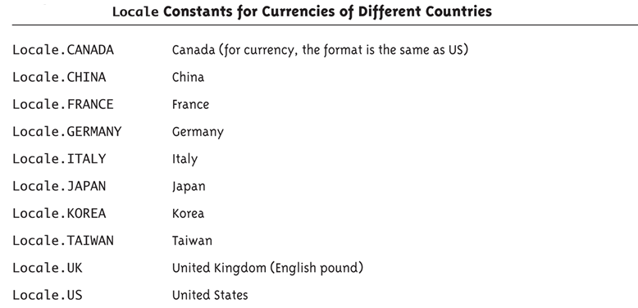
Locale Constants for Currencies of Different Countries

Slide 75
Locale Class
In Java, the Locale class provides programming support for locales.
Method
static Locale[] getAvailableLocales()
Returns a list of available locales (i.e., installed locales) supported by the JVM.
static Locale getDefault() : Returns the default locale of the JVM.
static void setDefault(Locale newLocale) : Sets the default locale of the JVM.
String getCountry() : Returns the country code for the locale object.
String getDisplayCountry() : Returns the country name for the locale object.
String getLanguage() : Returns the language code for the locale object.
String getDisplayLanguage() : Returns the language name for the locale object.

Slide 76
DateFormat Class
The DateFormat class provides support for processing date and time in a locale-sensitive manner (the name simply says DateFormat, but it supports both date and time).
Method
String format(Date date)
Formats the given date for the default locale and returns a textual representation. Its overloaded version takes a StringBuffer and position as arguments and returns a StringBuffer object; useful if an existing StringBuffer needs to be formatted for date.
Date parse(String source)
Reads the given String according to the default locale conventions to return a Date object; throws ParseException if it fails. It has an overloaded version that takes ParsePosition (the position from which to parse the String) as an additional argument.

Slide 77
Method of DateFormat Class (Continued)
static Locale[] getAvailableLocales()
Returns an array of Locales that are supported by the Java runtime for date/time formatting.
static DateFormat getInstance()
Returns the default DateFormat instance that supports both date and time; it uses DateFormat.SHORT style for both date and time.
static DateFormat getDateInstance()
Returns the DateFormat instance suitable for processing dates for default locale; its two overloaded versions take style and Locale as additional arguments.
static DateFormat getTimeInstance()
Returns the DateFormat instance suitable for processing time for a default locale; its two overloaded versions take style and Locale as additional arguments.

Slide 78
Method of DateFormat Class (Continued)
static DateFormat getDateTimeInstance()
Returns the DateFormat instance suitable for processing both date and time for a default locale; its two overloaded versions take style and Locale as additional arguments.

Slide 79
Example
1. import java.util.*;
2. import java.text.*;
3. class DatePrint {
4. public static void main(String[] args) {
5. Date today = new Date();
6. Locale [] locales = { Locale.CANADA, Locale.FRANCE, Locale.GERMANY, Locale.ITALY };
7. for(Locale locale : locales) {
8. DateFormat dateFormat = DateFormat.getDateInstance(DateFormat.FULL, locale);
9. System.out.println("Date in locale " + locale + " is: " + dateFormat.format(today));
10. }
11. }
12.}

Slide 80
Output
Date in locale en_CA is: Monday, September 9, 2013
Date in locale fr_FR is: lundi 9 septembre 2013
Date in locale de_DE is: Montag, 9. September 2013
Date in locale it_IT is: lunedì 9 settembre 2013

Slide 81

Questions

