Slide 1

Day-1
By: Saurabh Kumar Sharma

Slide 2
Objective
What is Spring framework?
Why Spring framework?
Spring framework architecture
Inversion of Control –IoC
Setter Injection
Constructor Injection
Spring’s Bean Life cycle
Spring DAO
Spring MVC

Slide 3
What is
Spring is an open source application development framework that tries to make application development EASIER.
Spring Entered the scene as an open source project in February 2003.
Version 1.0 – October 2003
Version 1.1 – September 2004
Version 1.2 – May 2005
Version 2.0 - October 2006
Version 2.5 - September 2008
Version 3.0 - August 2009
Spring has become a leading framework for enterprise applications.

Slide 4
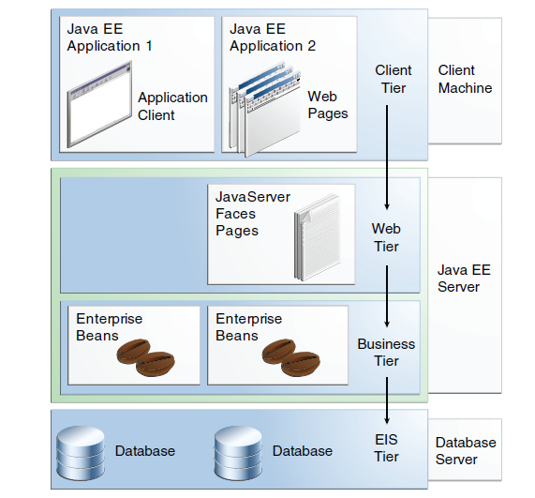
JEE N-tier Architecture

Slide 5
What does Spring do?
Lightweight Inversion of Control Container
A way to manage all of your application objects
Aspect Oriented Programming – AOP Framework.
JDBC Abstraction Layer
Make database programming less clumsy
JPA / Hibernate / JDO / iBATIS Abstraction Layer
Make object relational persistence less clumsy
Transaction Management
Provide a way for transaction management without having to resort to a full-blown EJB container .
Web Framework
Lightweight web application framework
Web-based workflow engine

Slide 6
Why Spring ?
Spring was created to reduce the complexity observed in Java enterprise application development –most notably in EJB development.
• It was meant to be a lightweight framework that could also be used in non-enterprise Java applications.
• In general, Spring leverages plain-vanilla Java objects (POJOs) or more precisely JavaBeans to achieve enterprise tasks.
• While based on simple JavaBean technology, today Spring is a large and all encompassing framework.
Notes:
A framework-based approach recognizes the fact that there is a missing piece in the J2EE jigsaw: the application developer's view. Much of what J2EE provides, such as JNDI, is simply too low level to be a daily part of programmer's activities. In fact, the J2EE specifications and APIs can be judged as far more successful, if one takes the view that they do not offer the developer a programming model so much as provide a solid basis on which that programming model should sit. Good frameworks supply this missing piece and give application developers a simple, productive, abstraction, without sacrificing the core capability of the platform.
Some parts of J2EE can properly be termed frameworks themselves. Among them, EJB amounts to a framework because it provides a structure for application code, and defines a consistent way of accessing services from the application server. However, the EJB framework is cumbersome to use and restrictive. The work involved in implementing an EJB is excessive, given that the architects of J2EE expected that all business logic in J2EE applications would be implemented in EJBs. Developers must cope with three to four Java classes for each EJB; two verbose deployment descriptors for each EJB JAR file; and excessive amounts of code for client access to EJBs and EJB access to their environment. The EJB component model, up to and including EJB 2.1, fails to deliver on many of its goals, and fails to deliver a workable structure for business logic in J2EE applications. The EJB Expert Group has finally realized this and is attempting an overhaul of the EJB model in EJB 3.0, but we need a solution, right now, and Spring already demonstrates a far superior one in most cases.

Slide 7
Cont…
Make developing enterprise applications easier .
Promote programming to Interfaces .
Reduce application complexity.
Loose coupling
Objects should not depend on Spring APIs
Objects should not implementing Spring Interfaces
Objects should not sub-classes Spring object
Your existing application should easily be able to take advantage of Spring!
Do not compete with existing solutions
Integrate with other best-of-breed solutions!
Notes:
A framework-based approach recognizes the fact that there is a missing piece in the J2EE jigsaw: the application developer's view. Much of what J2EE provides, such as JNDI, is simply too low level to be a daily part of programmer's activities. In fact, the J2EE specifications and APIs can be judged as far more successful, if one takes the view that they do not offer the developer a programming model so much as provide a solid basis on which that programming model should sit. Good frameworks supply this missing piece and give application developers a simple, productive, abstraction, without sacrificing the core capability of the platform.
Some parts of J2EE can properly be termed frameworks themselves. Among them, EJB amounts to a framework because it provides a structure for application code, and defines a consistent way of accessing services from the application server. However, the EJB framework is cumbersome to use and restrictive. The work involved in implementing an EJB is excessive, given that the architects of J2EE expected that all business logic in J2EE applications would be implemented in EJBs. Developers must cope with three to four Java classes for each EJB; two verbose deployment descriptors for each EJB JAR file; and excessive amounts of code for client access to EJBs and EJB access to their environment. The EJB component model, up to and including EJB 2.1, fails to deliver on many of its goals, and fails to deliver a workable structure for business logic in J2EE applications. The EJB Expert Group has finally realized this and is attempting an overhaul of the EJB model in EJB 3.0, but we need a solution, right now, and Spring already demonstrates a far superior one in most cases.

Slide 8
Cont…
The essence of spring is in providing enterprise services to Plain Old Java Objects (POJO's)
Spring can effectively organize your middle tier objects, whether or not you choose to use EJB.
Applications built using Spring are very easy to unit test
Spring can eliminate the need to use a variety of custom properties file formats, by handling configuration in a consistent way throughout applications and projects
The use of Inversion of Control and Dependency Injection helps achieve this simplification
Spring provides a consistent framework for data access, whether using JDBC or an O/R mapping product such as TopLink, Hibernate or a JDO implementation
Notes:
A framework-based approach recognizes the fact that there is a missing piece in the J2EE jigsaw: the application developer's view. Much of what J2EE provides, such as JNDI, is simply too low level to be a daily part of programmer's activities. In fact, the J2EE specifications and APIs can be judged as far more successful, if one takes the view that they do not offer the developer a programming model so much as provide a solid basis on which that programming model should sit. Good frameworks supply this missing piece and give application developers a simple, productive, abstraction, without sacrificing the core capability of the platform.
Some parts of J2EE can properly be termed frameworks themselves. Among them, EJB amounts to a framework because it provides a structure for application code, and defines a consistent way of accessing services from the application server. However, the EJB framework is cumbersome to use and restrictive. The work involved in implementing an EJB is excessive, given that the architects of J2EE expected that all business logic in J2EE applications would be implemented in EJBs. Developers must cope with three to four Java classes for each EJB; two verbose deployment descriptors for each EJB JAR file; and excessive amounts of code for client access to EJBs and EJB access to their environment. The EJB component model, up to and including EJB 2.1, fails to deliver on many of its goals, and fails to deliver a workable structure for business logic in J2EE applications. The EJB Expert Group has finally realized this and is attempting an overhaul of the EJB model in EJB 3.0, but we need a solution, right now, and Spring already demonstrates a far superior one in most cases.

Slide 9
Spring == J2EE Application Server ?
Spring is NOT a J2EE Application Server
Spring can nicely integrate with J2EE Application Servers (or any Java Environment)
Spring can elegantly replace the services traditionally provided by J2ee Application Server
Notes:
A framework-based approach recognizes the fact that there is a missing piece in the J2EE jigsaw: the application developer's view. Much of what J2EE provides, such as JNDI, is simply too low level to be a daily part of programmer's activities. In fact, the J2EE specifications and APIs can be judged as far more successful, if one takes the view that they do not offer the developer a programming model so much as provide a solid basis on which that programming model should sit. Good frameworks supply this missing piece and give application developers a simple, productive, abstraction, without sacrificing the core capability of the platform.
Some parts of J2EE can properly be termed frameworks themselves. Among them, EJB amounts to a framework because it provides a structure for application code, and defines a consistent way of accessing services from the application server. However, the EJB framework is cumbersome to use and restrictive. The work involved in implementing an EJB is excessive, given that the architects of J2EE expected that all business logic in J2EE applications would be implemented in EJBs. Developers must cope with three to four Java classes for each EJB; two verbose deployment descriptors for each EJB JAR file; and excessive amounts of code for client access to EJBs and EJB access to their environment. The EJB component model, up to and including EJB 2.1, fails to deliver on many of its goals, and fails to deliver a workable structure for business logic in J2EE applications. The EJB Expert Group has finally realized this and is attempting an overhaul of the EJB model in EJB 3.0, but we need a solution, right now, and Spring already demonstrates a far superior one in most cases.

Slide 10

Where do I get ?
http://www.springsource.org/download
Notes:
A framework-based approach recognizes the fact that there is a missing piece in the J2EE jigsaw: the application developer's view. Much of what J2EE provides, such as JNDI, is simply too low level to be a daily part of programmer's activities. In fact, the J2EE specifications and APIs can be judged as far more successful, if one takes the view that they do not offer the developer a programming model so much as provide a solid basis on which that programming model should sit. Good frameworks supply this missing piece and give application developers a simple, productive, abstraction, without sacrificing the core capability of the platform.
Some parts of J2EE can properly be termed frameworks themselves. Among them, EJB amounts to a framework because it provides a structure for application code, and defines a consistent way of accessing services from the application server. However, the EJB framework is cumbersome to use and restrictive. The work involved in implementing an EJB is excessive, given that the architects of J2EE expected that all business logic in J2EE applications would be implemented in EJBs. Developers must cope with three to four Java classes for each EJB; two verbose deployment descriptors for each EJB JAR file; and excessive amounts of code for client access to EJBs and EJB access to their environment. The EJB component model, up to and including EJB 2.1, fails to deliver on many of its goals, and fails to deliver a workable structure for business logic in J2EE applications. The EJB Expert Group has finally realized this and is attempting an overhaul of the EJB model in EJB 3.0, but we need a solution, right now, and Spring already demonstrates a far superior one in most cases.

Slide 11
Problems with the Traditional Approach to J2EE
J2EE applications tend to contain excessive amounts of "plumbing" code.
Many J2EE applications use a distributed object model where this is inappropriate.
The EJB component model is unduly complex.
J2EE applications are hard to unit test.
Notes:
A framework-based approach recognizes the fact that there is a missing piece in the J2EE jigsaw: the application developer's view. Much of what J2EE provides, such as JNDI, is simply too low level to be a daily part of programmer's activities. In fact, the J2EE specifications and APIs can be judged as far more successful, if one takes the view that they do not offer the developer a programming model so much as provide a solid basis on which that programming model should sit. Good frameworks supply this missing piece and give application developers a simple, productive, abstraction, without sacrificing the core capability of the platform.
Some parts of J2EE can properly be termed frameworks themselves. Among them, EJB amounts to a framework because it provides a structure for application code, and defines a consistent way of accessing services from the application server. However, the EJB framework is cumbersome to use and restrictive. The work involved in implementing an EJB is excessive, given that the architects of J2EE expected that all business logic in J2EE applications would be implemented in EJBs. Developers must cope with three to four Java classes for each EJB; two verbose deployment descriptors for each EJB JAR file; and excessive amounts of code for client access to EJBs and EJB access to their environment. The EJB component model, up to and including EJB 2.1, fails to deliver on many of its goals, and fails to deliver a workable structure for business logic in J2EE applications. The EJB Expert Group has finally realized this and is attempting an overhaul of the EJB model in EJB 3.0, but we need a solution, right now, and Spring already demonstrates a far superior one in most cases.

Slide 12
Problems with the Traditional Approach to J2EE
J2EE applications tend to contain excessive amounts of "plumbing" code. In the many code reviews we've done as consultants, time and time again we see a high proportion of code that doesn't do anything: JNDI lookup code, Transfer Objects, try/catch blocks to acquire and release JDBC resources. . . . Writing and maintaining such plumbing code proves a major drain on resources that should be focused on the application's business domain.
Many J2EE applications use a distributed object model where this is inappropriate. This is one of the major causes of excessive code and code duplication. It's also conceptually wrong in many cases; internally distributed applications are more complex than co-located applications, and often much less performant. Of course, if your business requirements dictate a distributed architecture, you need to implement a distributed architecture and accept the tradeoff that incurs (and Spring offers features to help in such scenarios). But you shouldn't do so without a compelling reason.

Slide 13
Problems with the Traditional Approach to J2EE
The EJB component model is unduly complex. EJB was conceived as a way of reducing complexity when implementing business logic in J2EE applications; it has not succeeded in this aim in practice.
J2EE applications are hard to unit test. The J2EE APIs, and especially, the EJB component model, were defined before the agile movement took off. Thus their design does not take into account ease of unit testing. Through both APIs and implicit contracts, it is surprisingly difficult to test applications based on EJB and many other J2EE APIs outside an application server. Yet unit testing outside an application server is essential to achieve high test coverage and to reproduce many failure scenarios, such as loss of connectivity to a database. It is also vital to ensuring that tests can be run quickly during the development or maintenance process, minimizing unproductive time waiting for redeployment.

Slide 14
Integration Points
Spring provides elegant integration points with :
JDO
EJB
RMI
Web Services
JMS
Hibernate

Slide 15
Features
It is a lightweight framework
There is no dependency on the framework
Spring does not reinvent the wheel. Instead it makes all the existing solutions easier to use
Spring is based on Dependency Injection flavor of Inversion of Control
Spring includes a proxy based AOP (Aspect Oriented Programming) framework
Spring does not provide its own ORM mapping framework
Spring integrates well with all leading O/R mapping frameworks like hibernate, TopLink, JDP, Apache OJB, etc.
It also integrates with a variety of web frameworks like struts, webwork, Spring MVC, Tapestry, JSP, etc.

Slide 16

Inversion of Control / Dependency Injection

Slide 17
IoC – Don’t call us…, we will call U
Java Enterprise Applications comprise of lots Objects :
Objects that store data
Order, Customer, Employee, etc.
Objects that execute business logic
Taking Orders, Processing customer funds, finding Employee details etc…
Objects that provide services
Authentication, Authorization, Configuration, Preferences, Logging, etc.
Objects that lay architecture ground work for the application
Application Plumbing!

Slide 18
IoC – Don’t call us…, we will call U
How do we get these objects to interact?
How do we resolve object dependencies?
How do we configure our objects?
This turns out to be a messy problem!
There are several ways for managing dependencies …
More coding work for the Enterprise Developers ....

Slide 19
IoC – Don’t call us…, we will call U
How do we get these objects to interact?
How do we resolve object dependencies?
How do we configure our objects?
This turns out to be a messy problem!
There are several ways for managing dependencies …
More coding work for the Enterprise Developers ....

Slide 20
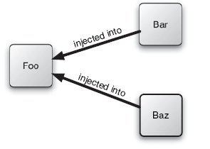
Dependency injection
Dependency injection involves giving an object its dependencies as opposed to an object having to acquire those dependencies on its own.
Dependency Injection (DI) is a design pattern that removes the dependency from the programming code so that it can be easy to manage and test the application. Dependency Injection makes our programming code loosely coupled.

Slide 21
Hard Coded Dependencies …
public class Foo
{
private Dependency dep = null;
public Foo() {
dep = new Dependency();
dep.setField1(…);
dep.setField2(…);
}
}
Dependency is hard-coded and configured into code!

Slide 22
Dependency resolution using Factory pattern
Offload object creation to another object (a Factory) that has the responsibility of instantiating the correct object and configuring it.
public class Foo {
private Dependency dep = null;
public Foo() {
Factory factory = new DependencyFactory();
dep = factory.getDependency();
}
}

Slide 23
Contextualized Dependency Lookup
Have an external resource (a container) set the dependency for you. Implement a call-back method that provides you the ability to look it up from the container.
Context ctx = new InitialContext();
Context environmentCtx = (Context) ctx.lookup("java:comp/env");
A obj = (A)environmentCtx.lookup("A");
Objects must implement the above interface. When the object is loaded (by the external container), the container will notice that the object implements the ContainerManagedComponent interface. It will then call the lookupDependency method.

Slide 24
Spring’s Inversion of Control
Inversion of Control
Let something else manage the interaction of the objects in your system!
Hollywood Principle: “Don’t Call Us… We’ll Call You!”
In IoC, instead of an application calling the framework, it is the framework that calls the components specified by the application.
Dependency Injection
Let something else manage the dependencies between objects!
Spring is a lightweight dependency injection container!

Slide 25
Spring’s Inversion of Control
In Spring, objects are not responsible for finding or creating the other objects that they need to do their job.
Instead, they are given references to the objects that they collaborate with by the container.
In Order Management component, may need a credit card authorizer—but it doesn’t need to create the credit card authorizer.
It just needs to show up empty-handed and it will be given a credit card authorizer to work with.
The act of creating these associations between application objects is the essence of dependency injection (DI) and is commonly referred to as wiring.

Slide 26
Spring Container
The container will create the objects, wire them together, configure them, and manage their complete lifecycle from cradle to grave (or new to finalize() as the case may be).
Spring’s container uses dependency injection (DI) to manage the components that make up an application.

Slide 27
Spring Container
There are two ways in which clients can use the functionality of the Spring Framework:
BeanFactory
ApplicationContext
Two of the most fundamental and important packages in Spring are:
org.springframework.beans
org.springframework.context

Slide 28
BeanFactory
Spring Core’s org.springframework.beans.BeanFactory interface, an implementation of the Factory design pattern that enables objects to be created and retrieved by name.
BeanFactory can also manage relationships between objects.
BeanFactory supports two object modes:
Singleton mode provides a shared instance of the object with a particular name, which will be retrieved on lookup. Singleton is the default and most often used object mode. It is ideal for stateless service objects.
Prototype mode ensures that each retrieval will result in the creation of an independent object. Prototype mode would be best used in a case where each user needed to have his or her own object.

Slide 29
BeanFactory
Spring Core’s org.springframework.beans.BeanFactory interface, an implementation of the Factory design pattern that enables objects to be created and retrieved by name.
BeanFactory can also manage relationships between objects.
BeanFactory supports two object modes:
Singleton mode provides a shared instance of the object with a particular name, which will be retrieved on lookup. Singleton is the default and most often used object mode. It is ideal for stateless service objects.
Prototype mode ensures that each retrieval will result in the creation of an independent object. Prototype mode would be best used in a case where each user needed to have his or her own object.

Slide 30
ApplicationContext
The ApplicationContext builds on top of the BeanFactory and adds other functionality such as :
easier integration with Springs AOP features
message resource handling (for use in internationalization)
event propagation
declarative mechanisms to create the ApplicationContext
application-layer specific contexts such as the WebApplicationContext

Slide 31
BeanFactory vs ApplicationContext
Users are sometimes unsure whether a BeanFactory or an ApplicationContext are best suited for use in a particular situation. Normally when building most applications in a J2EE environment, the best option is to use the ApplicationContext, since it offers all the features of the BeanFactory and adds on to it in terms of features, while also allowing a more declarative approach to use of some functionality, which is generally desirable. The main usage scenario when you might prefer to use the BeanFactory is when memory usage is the greatest concern (such as in an applet where every last kilobyte counts), and you don't need all the features of the ApplicationContext.

Slide 32
BeanFactory vs ApplicationContext
To summarize –
The BeanFactory provides the configuration framework and basic functionality
The ApplicationContext adds enhanced capabilities to it, some of them perhaps more J2EE and enterprise-centric

Slide 33
Dependency Injection
Two Types of Dependency Injection:
1. Setter Injection
2. Constructor Injection
No special code to resolve the dependencies
No special interfaces to implement
A Dependency Injection Container (like Spring) will actually construct and configure the dependencies for us!

Slide 34
DI - Setter Injection
Dependencies are set by the calling setter methods on an object. The Container will call the setter methods and configure/instantiate the object for you.
public class SomeObject {
private Dependency dep = null;
public SomeObject() { }
public void setDependency(Dependency inDep) {
dep = inDep;
}
}

Slide 35
DI- Constructor Injection
Dependencies are set by the Object Constructors. The Container will call the constructor and configure and instantiate the object for you.
Note: No special initialization logic. The container will handle the initialization for us!
public class SomeObject {
private Dependency dep = null;
public SomeObject(Dependency inDep)
{
dep = inDep;
}
}

Slide 36
Dependency Injection and Spring
Spring provides a framework for managing object dependencies and initializing / configuring objects through XML file.
Spring will make sure that the objects are initialized and configured.

Slide 37
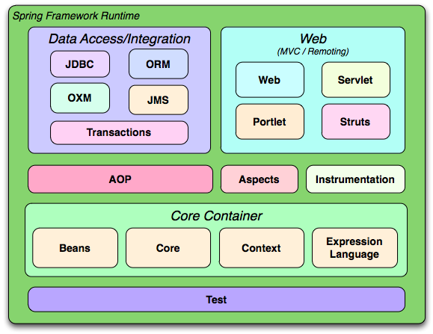
Spring 3 Framework Architecture

Slide 38
Overview of new features in Spring 3.x
Spring Expression Language
IoC enhancements/Java based bean metadata
General-purpose type conversion system and field formatting system
Object to XML mapping functionality (OXM) moved from Spring Web Services project
Comprehensive REST support
@MVC additions
Declarative model validation
Early support for Java EE 6
Embedded database support

Slide 39
Spring Core Package
Core package is the most fundamental part of the framework and provides the IoC container.
The core interface org.springframework.beans.factory.BeanFactory and
import org.springframework.context.ApplicationContext for accessing the Spring Container.
It provides a implementation of the factory pattern which removes the need for programmatic singletons and allows you to decouple the configuration and specification of dependencies from your actual program logic.

Slide 40
Spring DAO package
The DAO package provides a JDBC-abstraction layer that removes the need to do tedious JDBC coding and parsing of database-vendor specific error codes.
The JDBC package provides a way to do programmatic as well as declarative transaction management, not only for classes implementing special interfaces, but for all your POJOs.

Slide 41
Spring ORM package
The ORM package provides integration layers for popular object-relational mapping APIs, including JPA, JDO, Hibernate, iBatis, and JPA.
Using the ORM package you can use all those ORM tools in combination with all the other features Spring offers, such as the simple declarative transaction management.

Slide 42
Spring AOP package
AOP is another way of organizing your Program Structure .
Aspect-oriented programming (AOP) provides for simplified application of cross-cutting concerns.
Examples of cross-cutting concerns :
– Logging
– Transaction management
– Security
– Auditing
– Locking
– Event handling

Slide 43
Spring MVC package
Spring's MVC package provides a Model-View- Controller (MVC) implementation for web applications.
Spring's MVC framework is not just any old implementation; it provides a clean separation
between domain model code and web forms, and allows you to use all the other features of the Spring Framework.

Slide 44
Spring Core Module Applying Inversion of Control/Dependency Injection

Slide 45
First Spring Example
To use the Spring Framework in an application, there are three main steps. They are:
Developing a POJO
Mapping the POJO in XML config file.
Developing the Client

Slide 46
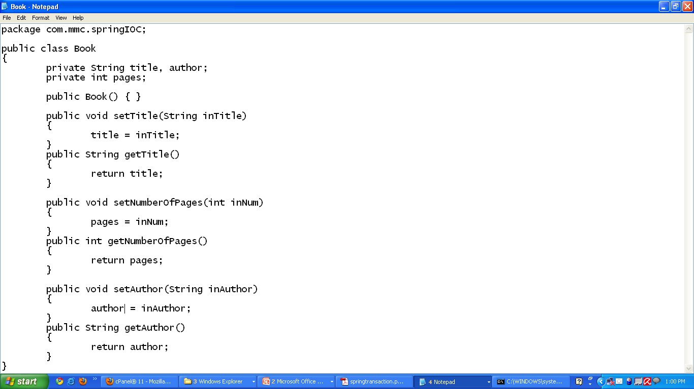
Book.java

Slide 47
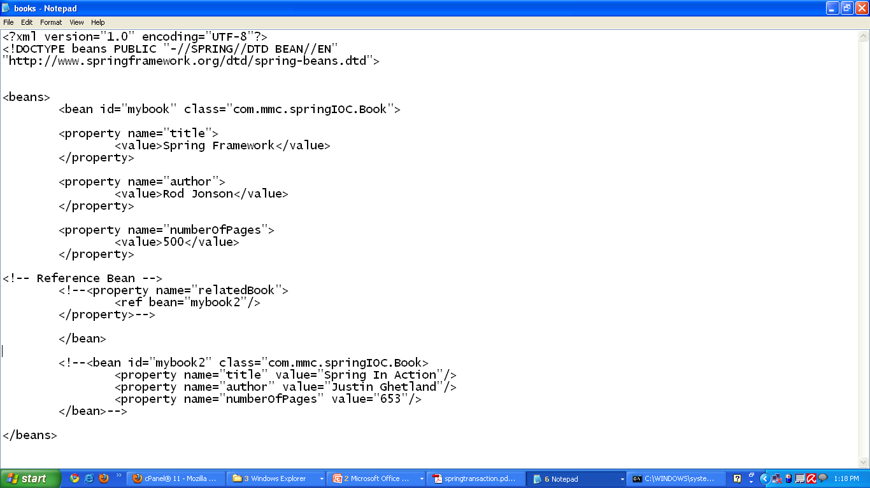
Spring Config xml file

Slide 48
Lifecycle of bean

Slide 49
Lifecycle of bean

Slide 50
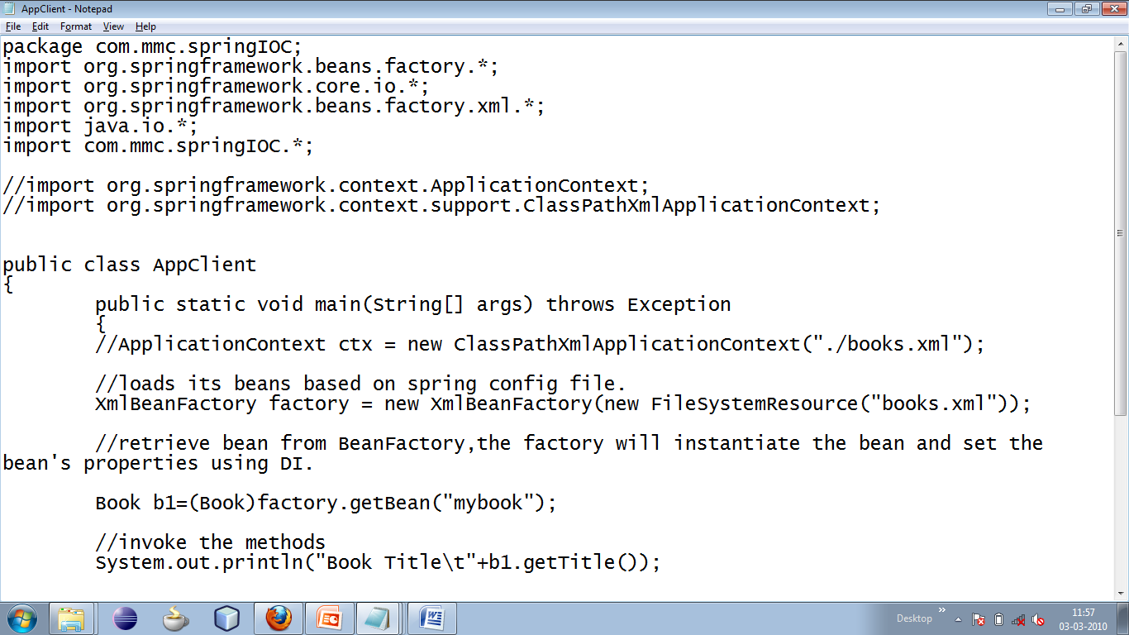

Slide 51
Lifecycle of bean example
public class HelloWord { private String message; public void setMessage(String message){ this.message = message; } public void getMessage(){ System.out.println("Your Message : " + message); } public void init(){ System.out.println("Bean is going through init."); } public void destroy(){ System.out.println("Bean will destroy now."); } } | <beans> <bean id="helloWorld" class="foo.HelloWord" init-method="init" destroy-method="destroy"> <property name="message" value="Hello World!" /> </bean> </beans>

Slide 52
Lifecycle of bean example using Interface
public class HelloWorld1 implements InitializingBean,DisposableBean { private String message; public void setMessage(String message){ this.message = message; } public void getMessage(){ System.out.println("Your Message : " + message); } @Override public void destroy() throws Exception { System.out.println("HelloWorld destroyed"); } @Override public void afterPropertiesSet() throws Exception { System.out.println("HelloWorld1 Initialized"); } | <beans> <bean id="helloWorld1" class="foo.HelloWord1"> <property name="message" value="Hello World!" /> </bean> </beans>

Slide 53
Lifecycle of bean example using Annotation
public class HelloWorld2 { private String message; public void setMessage(String message){ this.message = message; } public void getMessage(){ System.out.println("Your Message : " + message); } @PostConstruct public void init(){ System.out.println("HelloWorld2 is going to initialized."); } @PreDestroy public void destroy(){ System.out.println("Destroyed HelloWorld2"); } } | <beans> <context:annotation-config></context:annotation-config> <bean id="helloWorld2" class="foo.HelloWord2"> <property name="message" value="Hello World!" /> </bean> </beans>

Slide 54
Dependency Injection – Singleton scope
By default all beans in Spring are singletons. That is there will be a single instance of a bean per factory.
Singletons are great for stateless objects such as service layer objects, data access objects, web controllers.
Things to Consider
- Spring can manage lifecycle
- No instantiation overhead
- Need to be aware of multithreading
<bean id=“book1” class=“…”>
<bean id=“book1” class=“…” scope=“singleton”>

Slide 55
Dependency Injection – Prototype scope
Sometimes you want to retrieve a new instance of a bean when retrieving it from the factory .
Need to specify a scope of prototype.
Things to consider :
thread-safe
instantiation occurs on each request
lifecycle not managed by Spring
<bean id=“book1” class=“…” scope=“prototype”>

Slide 56
Dependency Injection – Prototype scope
Sometimes you want to retrieve a new instance of a bean when retrieving it from the factory .
Need to specify a scope of prototype.
Things to consider :
thread-safe
instantiation occurs on each request
lifecycle not managed by Spring
<bean id=“book1” class=“…” scope=“prototype”>

Slide 57
ApplicationContext Factory
ApplicationContext is an extension of BeanFactory.
Like 'BeanFactory' it can be used to load bean definitions, wire beans together and dispense beans upon request.
It allows you to configure and manage Spring and Spring-managed resources in a completely declarative way.

Slide 58
ApplicationContext Factory
ApplicationContext supports the following features not present in a BeanFactory:
• Internationalization
• Event publication
• Resource management and access
• Additional life cycle interfaces
• Improved automatic configuration of infrastructure components

Slide 59
ApplicationContext Factory
The three commonly used implementation of 'Application Context' are : 1. ClassPathXmlApplicationContext : It Loads context definition from an XML file located in the classpath, treating context definitions as classpath resources.
The application context is loaded from the application's classpath by using the code ApplicationContext context = new ClassPathXmlApplicationContext("bean.xml");
2. FileSystemXmlApplicationContext : It loads context definition from an XML file in the filesystem. The application context is loaded from the file system by using the code ApplicationContext context = new FileSystemXmlApplicationContext("bean.xml");
3. XmlWebApplicationContext : It loads context definition from an XML file contained within a web application.

