Slide 1

By: Saurabh Kumar Sharma

Slide 2

Spring framework
Advantages
A lightweight alternative to J2EE
POJO+DI+AOP instead of EJB (light component code)
annotation-based component-scanning reduced use of XML configuration (Spring 2.5)
Java-based configuration as a type-safe and refactorable option to XML (Spring 3.0)

Slide 3
Spring framework
Problems
Certain features like transaction management and Spring MVC still require explicit configuration
Enabling third-party library features such as Thymeleaf-based web views require explicit configuration
Configuring servlets and filters (such as Spring’s DispatcherServlet) required explicit configuration in web.xml or in a servlet initializer
project dependency management hell (library versions etc)

Slide 4
Spring Boot
Provides:
Automatic configuration for common web app functionalities (JPA, security, Spring MVC etc)
Starter dependencies (select tehnology stack and libraries are selected automatically)
The command-line interface (write just app code , no traditional project build needed)
The Actuator (dashboard to inspect inside running app) (HTTP request trace, conf. properties, resource metrics, threads state)
What Spring Boot isn’t : no app server, it embeds a servlet container, does not generate code

Slide 5
Spring vs Spring Boot
Spring: Spring Framework is the most popular application development framework of Java. The main feature of the Spring Framework is dependency Injection or Inversion of Control (IoC). With the help of Spring Framework, we can develop a loosely coupled application. It is better to use if application type or characteristics are purely defined.
Spring Boot: Spring Boot is a module of Spring Framework. It allows us to build a stand-alone application with minimal or zero configurations. It is better to use if we want to develop a simple Spring-based application or RESTful services.

Slide 6
Spring vs Spring Boot
Spring | Spring Boot
It aims to simplify Java EE development that makes developers more productive. | It aims to shorten the code length and provide the easiest way to develop Web Applications.
The primary feature of the Spring Framework is dependency injection. | The primary feature of Spring Boot is Autoconfiguration. It automatically configures the classes based on the requirement.
It helps to make things simpler by allowing us to develop loosely coupled applications. | It helps to create a stand-alone application with less configuration.
The developer writes a lot of code (boilerplate code) to do the minimal task. | It reduces boilerplate code.
To test the Spring project, we need to set up the sever explicitly. | Spring Boot offers embedded server such as Jetty and Tomcat, etc.
It does not provide support for an in-memory database. | It offers several plugins for working with an embedded and in-memory database such as H2.

Slide 7
Spring Boot CLI
Provides:
an easy way to get started with Spring Boot and to prototype simple applications
leverages starter dependencies and auto-configuration to let you focus on writing code

Slide 8
Spring Boot minimum requirements
Java 8 or greater
Maven 3 or Gradle 4
Spring 4 or greater

Slide 9
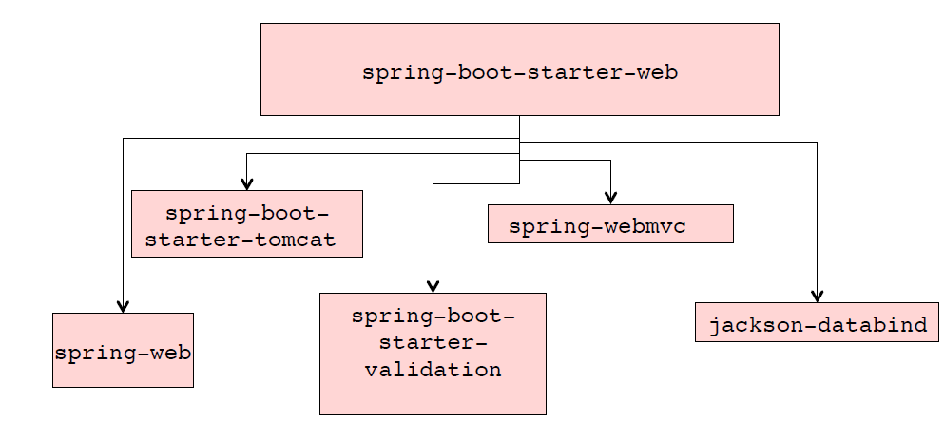
Spring Boot Starters
Starters are virtual packages deployed to Maven central. They pull in other dependencies while containing no code of their own

Slide 10
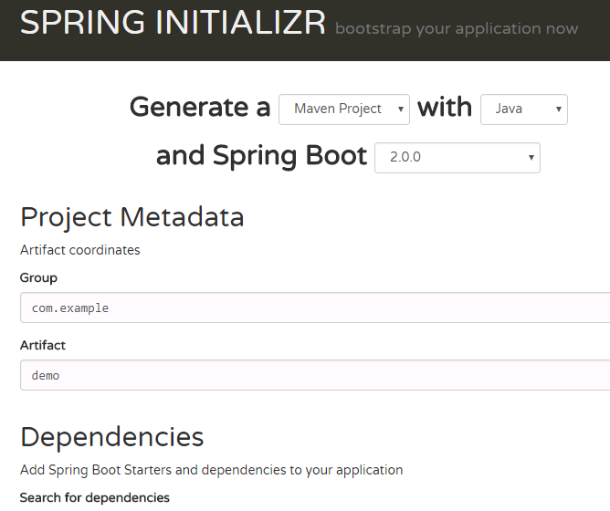
Spring Boot “Initializr”
Doesn’t require an IDE:
https://start.spring.io

Slide 11
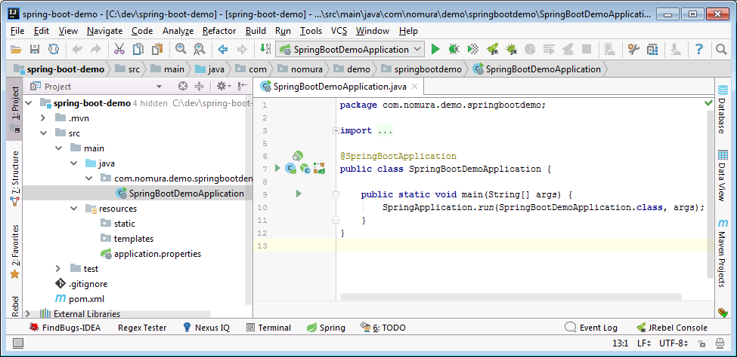
Spring Boot Initializr Generated Project

Slide 12
@SpringBootApplication
@Configuration – Designates this as a config class
@EnableAutoConfiguration – Configures using sensible defaults
@ComponentScan – Scans classpath for Spring classes

Slide 13

Questions

