Slide 1

By: Saurabh Kumar Sharma

Slide 2
Spring 2.5 Annotations
Provides complete set of configuration annotations.
@Autowired
@Qualifier
@Value
@Component, @Repository, @Service, @Controller, @Bean, @Configuration
@Resource,
@PostConstruct and @PreDestroy .

Slide 3
Spring Autowiring Collaborators
The Spring container can autowire relationships between collaborating beans.
Spring can “autowire” dependencies through introspection of the bean classes so that you do not have to explicitly specify the bean properties or constructor arguments.
Advantages :
It reduce the need to specify properties or constructor arguments.
It can update a configuration file as your objects evolve.

Slide 4
Auto-wiring modes In Spring.
no – Default, no auto wiring, set it manually via “ref” attribute
byName – Auto wiring by property name. If the name of a bean is same as the name of other bean property, auto wire it.
byType – Auto wiring by property data type. If data type of a bean is compatible with the data type of other bean property, auto wire it.
constructor – byType mode in constructor argument.

Slide 5
XML based configuration: byName
Autowiring by property name. This option will inspect the container and look for a bean named exactly the same as the property which needs to be autowired. For example, if you have a bean definition which is set to autowire by name, and it contains a master property (that is, it has a setMaster(..) method), Spring will look for a bean definition named master, and use it to set the property.

Slide 6
XML based configuration: byName
public class CustomerBean {
private String custName;
private String email;
private Address address;
//setter and getter methods
public class Address {
private String street1;
private int pin;
// setter and getter methods

Slide 7
Bean.xml
<bean id="cust1" class="com..CustomerBean" autowire="byName">
<property name="custName" value="scott"/>
<property name="email" value="scott@oracle.com"/>
</bean>
<bean id="address" class="com.Address" >
<property name="street1" value=“Delhi"/>
<property name="pin" value="562135" />
</bean>

Slide 8
@Autowired
The @Autowired annotation provides more fine-grained control over where and how autowiring should be accomplished. In last example, it will autowired the matched property of any bean in current Spring container. In most cases, we may need autowired property in a particular bean only.
In Spring, we can use @Autowired annotation to auto wire bean on the setter method, constructor or a field. Moreover, it can autowired property in a particular bean.

Slide 9
@Autowired on Setter Methods:
You can use @Autowired annotation on setter methods to get rid of the <property> element in XML configuration file. When Spring finds an @Autowired annotation used with setter methods, it tries to perform byType autowiring on the method.
public class CustomerBean { private String name; private String email; private Address address; @Autowired public void setAddress(Address address) { this.address = address; } public Address getAddress() { return address; } //setter and getter methods } | public class Address { private String city; private Integer pin; //setter and getter methods }

Slide 10
Bean.xml
<?xml version="1.0" encoding="UTF-8"?> <beans xmlns="http://www.springframework.org/schema/beans" xmlns:xsi="http://www.w3.org/2001/XMLSchema-instance" xmlns:context="http://www.springframework.org/schema/context" xsi:schemaLocation="http://www.springframework.org/schema/beans http://www.springframework.org/schema/beans/spring-beans-2.5.xsd http://www.springframework.org/schema/context http://www.springframework.org/schema/context/spring-context-2.5.xsd"> <context:annotation-config/> <bean name="customer" class="foo.CustomerBean"> <property name="name" value="Saurabh" /> <property name="email" value="mbacomp@gmail.com" /> </bean> <bean class="foo.Address" name="add"> <property name="city" value="Delhi" /> <property name="pin" value="110070" /> </bean> </beans>

Slide 11
@Autowired on properties::
We can use @Autowired on property to get rid of setter method. Spring container automatically assign values to corresponding attributes. We don't need setter methods for that. Make following changes to above code:
public class CustomerBean { private String name; private String email; @Autowired private Address address; public String getName() { return name; } public void setName(String name) { this.name = name; } public String getEmail() { return email; } | public void setEmail(String email) { this.email = email; } public void printCustomer() { System.out.println("Name="+name); System.out.println("Email="+email); System.out.println("city="+address.getCity()); System.out.println("PIN="+address.getPin()); } }

Slide 12
@Autowired on constructor:
You can apply @Autowired to constructors as well. A constructor @Autowired annotation indicates that the constructor should be autowired when creating the bean, even if no <constructor-arg> elements are used while configuring the bean in XML file. Let us check the following example.
If there is not exactly one bean of the constructor argument type in the container, a fatal error is raised.
public class CustomerBean { private String name; private String email; private Address address; @Autowired public CustomerBean(Address address) { this.address = address; } //setter and getter methods for name and Email | public void printCustomer() { System.out.println("Name="+name); System.out.println("Email="+email); System.out.println("city="+address.getCity()); System.out.println("PIN="+address.getPin()); } }

Slide 13
@Autowired on constructor:
You can apply @Autowired to constructors as well. A constructor @Autowired annotation indicates that the constructor should be autowired when creating the bean, even if no <constructor-arg> elements are used while configuring the bean in XML file. Let us check the following example.
public class CustomerBean { private String name; private String email; private Address address; @Autowired public CustomerBean(Address address) { this.address = address; } //setter and getter methods for name and Email | public void printCustomer() { System.out.println("Name="+name); System.out.println("Email="+email); System.out.println("city="+address.getCity()); System.out.println("PIN="+address.getPin()); } }

Slide 14
@Autowired with Arugments:
By default, the @Autowired annotation implies the dependency is required similar to @Required annotation, however, you can turn off the default behavior by using(required=false) option with @Autowired.
Now it will run even if you don't provide Address bean in XML configuration.
public class CustomerBean { private String name; private String email; @Autowired(required=false) private Address address; public String getName() { return name; } public void setName(String name) { this.name = name; } | public String getEmail() { return email; } public void setEmail(String email) { this.email = email; } public void printCustomer() { System.out.println("Name="+name); System.out.println("Email="+email); }

Slide 15
Now what will happen when you create more than one bean of the same type and want to wire only one of them with a property? For Example:
<beans ….> <bean name="customer" class="foo.CustomerBean"> <property name="name" value="Saurabh" /> <property name="email" value="mbacomp@gmail.com" /> </bean> <bean class="foo.Address" name="add"> <property name="city" value="Delhi" /> <property name="pin" value="110070" /> </bean> <bean class="foo.Address" name="add1"> <property name="city" value="Gurgaon" /> <property name="pin" value="122001" /> </bean> </beans>

Slide 16
@Qualifier annotation
in such case we can use @Qualifier annotation along with @Autowired to remove the confusion by specifying which exact bean will be wired.
public class CustomerBean { private String name; private String email; @Autowired @Qualifier("add1") private Address address; }

Slide 17
@Value annotation
To read the value from the properties file we use @Value annotation
Following are the steps for accessing the property file values in the Spring application :
Add the property file details to spring bean configuration file. You have to use the “classpath” prefix if you want to load the files from the classpath.
Create a properties file in the same name that is configured in the XML file and put it under the classpath folders. In most scenarios, source folders will be by default kept under the classpath.
Use @Value annotation to get the property value. @Value annotation takes the string parameter which is “key” used in the properties file. This annotation has to be used with variables to inject the value.
@Value has been available since Spring 3.0

Slide 18
Example: @Value annotation
public class CustomerBean { @Value("${name}") private String name; private String email; public String getName() { return name; } public void setName(String name) { this.name = name; } public String getEmail() { return email; } public void setEmail(String email) { this.email = email; } public void printCustomer() { System.out.println("Name="+name); System.out.println("Email="+email); }} | Application.properties name = Saurabh Sharma! Beans.xml <beans …> <context:property-placeholder location="classpath:application.properties"/> <bean name="customer" class="foo.CustomerBean"> <property name="email" value="mbacomp@gmail.com" /> </bean> </beans>

Slide 19
Spring Auto scanning components
Normally we declare all the beans in XML bean configuration file, so that Spring container can detect and register your beans. Actually, Spring is able to auto scan, detect and instantiate your beans from pre-defined project package, no more tedious beans declaration in in XML file.
Spring @Component, @Service, @Repository and @Controller annotations are used for automatic bean detection using classpath scan in Spring framework. @Component is a generic annotation. Difference of @Service, @Repository, @Controller with @Component is they are special cases of @Component and used for particular purposes. The difference is just classification only.
In a multitier application, we will have different layers like presentation, service, business, data access etc. When a class is to be annotated for auto-detection by Spring, then we should use the respective stereotype as below.
@Component – generic and can be used across application.
@Service – annotate classes at service layer level.
@Controller – annotate classes at presentation layers level, mainly used in Spring MVC.
@Repository – annotate classes at persistence layer, which will act as database repository.

Slide 20
Is @Component is equivalent to @Service, @Controller , @Repository?
They are almost the same - all of them mean that the class is a Spring bean.
You can choose to perform specific actions with them.
The three annotations are used to separate "Layers" in your application,
Controllers just do stuff like dispatching, forwarding, calling service methods etc.
Service Hold business Logic, Calculations etc.
Repository are the DAOs(Data Access Objects), they access the database directly.

Slide 21
Example:
CustomerDTO.java package dto; import org.springframework.stereotype.Component; @Component public class CustomerDTO { private String custID; private String name; private String phone; public String getCustID() { return custID; } public void setCustID(String custID) { this.custID = custID; } public String getName() { return name; } public void setName(String name) { this.name = name; } | public String getPhone() { return phone; } public void setPhone(String phone) { this.phone = phone; } }

Slide 22
Example(continued)
CustomerDAO.java package dao; import dto.CustomerDTO; public interface CustomerDao { public CustomerDTO createCustomer(); } | CustomerDaoImpl.java package dao; import org.springframework.stereotype.Repository; import dto.CustomerDTO; @Repository("customerDao") public class CustomerDaoImpl implements CustomerDao{ @Override public CustomerDTO createCustomer() { CustomerDTO obj=new CustomerDTO(); obj.setCustID("1001"); obj.setName("Suman"); obj.setPhone("9999596047"); return obj; }}

Slide 23
Example(continued)
CustomerService.java package service; import dto.CustomerDTO; public interface CustomerService { public CustomerDTO createCustomer(); } | CustomerServiceImpl.java package service; @Service("customerManager") public class CustomerServiceImpl implements CustomerService{ @Autowired CustomerDao dao; @Override public CustomerDTO createCustomer() { return dao.createCustomer(); } }

Slide 24
Example(continued)
Beans.xml <?xml version="1.0" encoding="UTF-8"?> <beans ..> <context:annotation-config/> <context:component-scan base-package="dao"/> <context:component-scan base-package="dto"/> <context:component-scan base-package="service"/> </beans> | CustomerMain.java public class CustomerMain { public static void main(String as[]) { ApplicationContext ctx = new ClassPathXmlApplicationContext("Bean.xml"); CustomerServiceImpl services=(CustomerServiceImpl)ctx.getBean("customerManager"); CustomerDTO obj=services.createCustomer(); System.out.println("CustID="+obj.getCustID()); System.out.println("Name="+obj.getName()); System.out.println("Phone="+obj.getPhone()); } }

Slide 25
@Resource Annotation
@Resource is quite similar to @Autowired and @Inject, but the main difference is the execution paths taken to find out the required bean to inject. @Resource will narrow down the search first by name then by type and finally by Qualifiers (ignored if match is found by name). @Autowired and @Inject will narrow down the search first by type then by qualifier and finally by the name.
@Resource annotation in spring can be applied on setter method or field. @Resource has a name attribute. We can assign a value to the name attribute. The bean with that name will be bound to the @Resource property. If nameattribute is not assigned with @Resource annotation then by default matching class type of property is bound.
@Resource – Defined in the javax.annotation package and part of Java

Slide 26
Example
<?xml version="1.0" encoding="UTF-8"?> <beans ..> <context:annotation-config/> <bean name="customer" class="foo.CustomerBean"> <property name="name" value="Saurabh" /> <property name="email" value="mbacomp@gmail.com" /> </bean> <bean class="foo.Address" name="address"> <property name="city" value="Delhi" /> <property name="pin" value="110070" /> </bean> <bean class="foo.Address" name="add1"> <property name="city" value="Gurgaon" /> <property name="pin" value="122001" /> </bean> </beans>

Slide 27
Example
public class CustomerBean { private String name; private String email; @Resource //@Resource(name=“add1”) private Address address; //..getter and setter method } | public class Address { private String city; private Integer pin; public String getCity() { return city; }

Slide 28
@Required Annotation
The @Required annotation applies to bean property setter methods and it indicates that the affected bean property must be populated in XML configuration file at configuration time otherwise the container throws a BeanInitializationException exception.

Slide 29
Example: @Required
public class Address { private String city; private Integer pin; public String getCity() { return city; } public void setCity(String city) { this.city = city; } public Integer getPin() { return pin; } @Required public void setPin(Integer pin) { this.pin = pin; } }
We must have to initialize the pin property in configuration file.

Slide 30
@Configuration & @Bean Annotations:
It is just an alternative of Spring beans using XML configuration file
Java based configuration option enables you to write most of your Spring configuration without XML but with the help of few Java-based annotations.
Annotating a class with the @Configuration indicates that the class can be used by the Spring IoC container as a source of bean definitions. The @Bean annotation tells Spring that a method annotated with @Bean will return an object that should be registered as a bean in the Spring application context.

Slide 31
Example
Address.java public class Address { private String city; private Integer pin; //..getter and setter method } AddressConfiguration.java @Configuration public class AddressConfiguration { @Bean public Address getAddress() { return new Address(); } }
This code will be equivalent to the following XML configuration:
<beans>
<bean id=“address" class="com.Address" />
</beans>

Slide 32
Example Continued
package dao; public class CustomerMain { public static void main(String[] args) { ApplicationContext ctx = new AnnotationConfigApplicationContext(AddressConfiguration.class); Address add12=ctx.getBean(Address.class); add12.setCity("Bangalore!!"); System.out.println(add12.getCity()); } }

Slide 33
Using JDBC with Spring

Slide 34
JDBC with Spring
JDBC support in the Spring Framework is part of the data access/persistence (also known as DAO) support provided by the framework.
The most important feature of DAO support is consistency.
1. Consistency in Exception Hierarchy
2. Consistency in Abstract classes

Slide 35
Consistency in Exception Hierarchy
The Spring Framework provides a translation from technology-specific exceptions such as Hibernate-related exceptions or JDBC-related exceptions by having its own hierarchy of data access-related exceptions.
The DataAcessException class forms the root of this hierarchy. These exceptions are runtime exceptions instead of checked exceptions (such as Hibernate's proprietary exceptions).
This helps the developer to handle the non-recoverable errors in the appropriate layer instead of handling them at DAO level.

Slide 36
Consistency in Exception Hierarchy
The Spring Framework provides a translation from technology-specific exceptions such as Hibernate-related exceptions or JDBC-related exceptions by having its own hierarchy of data access-related exceptions.
The DataAcessException class forms the root of this hierarchy. These exceptions are runtime exceptions instead of checked exceptions (such as Hibernate's proprietary exceptions).
This helps the developer to handle the non-recoverable errors in the appropriate layer instead of handling them at DAO level.

Slide 37
Consistency in Abstract classes:
The Spring Framework provides a set of abstract classes that one can extend (not implement).
The main abstract classes are:
JdbcDaoSupport, which is the super class for accessing data using JDBC. You must provide a DataSource instance to it. This class, in turn, provides the JdbcTemplate instance, created from the supplied DataSource instance, to the sub-class.
HibernateDaoSupport, which is the super class for Hibernate data access objects. One has to supply an instance of SessionFactory and in turn, it provides an instance of the HibernateTemplate class.

Slide 38
Core JDBC class:
Spring JDBC support is the JdbcTemplate class
JdbcTemplate allows you to work directly with instances of the Statement, PreparedStatement, and CallableStatement classes.
JdbcTemplate helps manage the connection and translates any SQLException to a Spring data access exception.

Slide 39
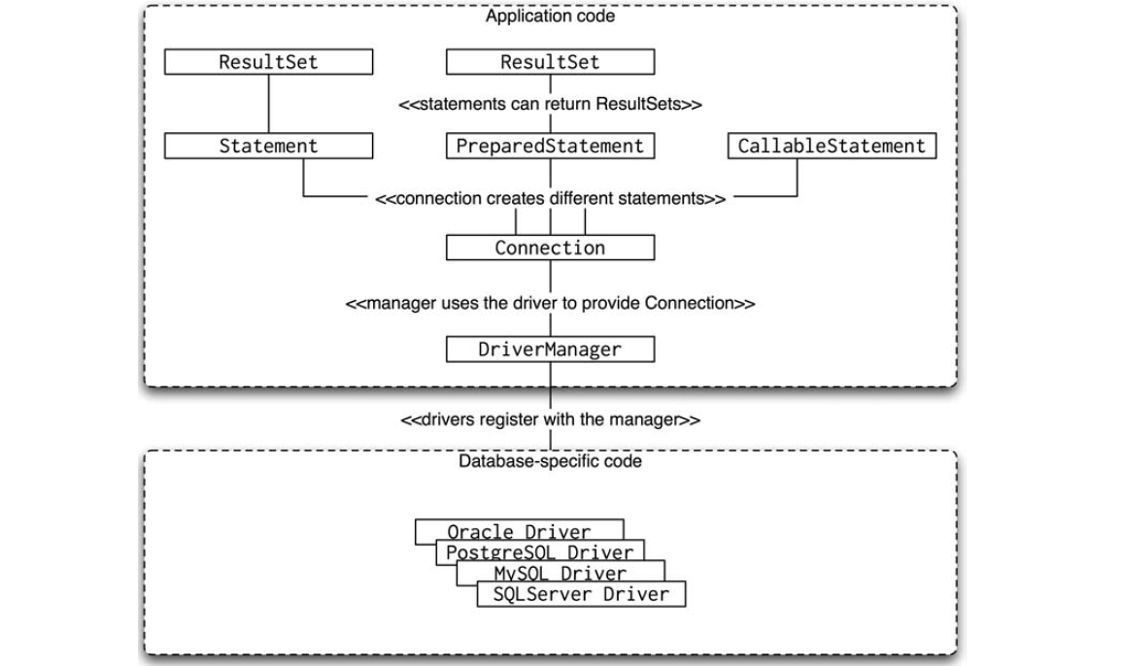
Class Diagram of JDBC:

Slide 40
Data Access Using Spring Framework JDBC - Using JdbcTemplate
The following are the steps required to make use of JdbcTemplate:
1. Develop the bean
2. Configure the bean and DataSource
3. Develop the client

Slide 41
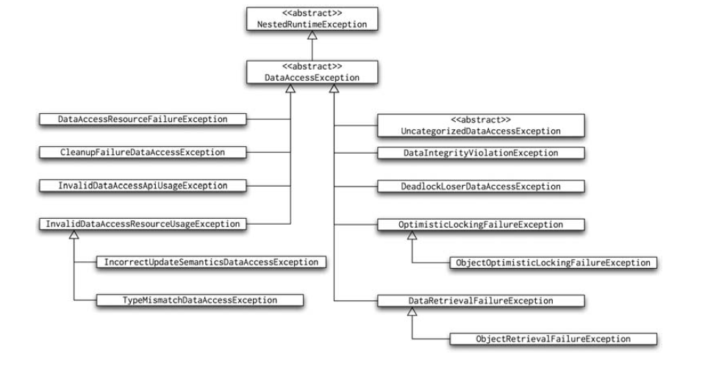
Exception hierarchy in Spring data support

Slide 42
Example: SpringJDBC
Employee.java package pojo; public class Employee { private int empId; private String name; private int age; private int salary; //….getter and Setter here } | EmployeeDao.java public interface EmployeeDao { public void setDataSource(DataSource ds); public void createEmployee(int id, String name, int age, int salary); public Employee getEmployee(Integer id); public List<Employee> allEmployee(); public void deleteEmployee(Integer id); public void updateEmployeeAge(Integer id, Integer age); }

Slide 43
Example: cont.. EmployeeMapper.java
package mapper; import org.springframework.jdbc.core.RowMapper; import java.sql.*; public class EmployeeMapper implements RowMapper<Employee> { @Override public Employee mapRow(ResultSet rs, int rowno) throws SQLException { System.out.println("=========="+rowno); Employee emp=new Employee(); emp.setEmpId(rs.getInt("id")); emp.setName(rs.getString("name")); emp.setAge(rs.getInt("age")); emp.setSalary(rs.getInt("salary")); return emp; } }

Slide 44
Example: cont.. EmployeeDaoImpl.java
public class EmployeeDaoImpl implements EmployeeDao { private DataSource dataSource; private JdbcTemplate jdbcTemplateObject; @Override public void setDataSource(DataSource dataSource) { this.dataSource = dataSource; this.jdbcTemplateObject = new JdbcTemplate(dataSource); } @Override public void createEmployee(int id, String name, int age, int salary) { String sql = "insert into employee (id, name, age, salary) values (?, ?, ?, ?)"; jdbcTemplateObject.update(sql, id, name, age, salary); System.out.println("Employee Record Name=" + name); }

Slide 45
Example: cont.. EmployeeDaoImpl.java
@Override public Employee getEmployee(Integer id) { String SQL = "select * from Employee where id = ?"; Employee emp = jdbcTemplateObject.queryForObject(SQL, new Object[] { id }, new EmployeeMapper()); return emp; } @Override public List<Employee> allEmployee() { String sql = "select * from Employee"; List<Employee> list = jdbcTemplateObject.query(sql, new EmployeeMapper()); return list; }

Slide 46
Example: cont.. EmployeeDaoImpl.java
@Override public void deleteEmployee(Integer id) { String SQL = "delete from Employee where id = ?"; jdbcTemplateObject.update(SQL, id); System.out.println("Deleted Record with ID = " + id); } @Override public void updateEmployeeAge(Integer id, Integer age) { String SQL = "update Employee set age = ? where id = ?"; jdbcTemplateObject.update(SQL, age, id); System.out.println("Updated Record with ID = " + id); } }

Slide 47
Example: cont.. Bean.xml
<?xml version="1.0" encoding="UTF-8"?> <beans xmlns="http://www.springframework.org/schema/beans" xmlns:xsi="http://www.w3.org/2001/XMLSchema-instance" xmlns:context="http://www.springframework.org/schema/context" xsi:schemaLocation="http://www.springframework.org/schema/beans http://www.springframework.org/schema/beans/spring-beans-3.0.xsd http://www.springframework.org/schema/context http://www.springframework.org/schema/context/spring-context-3.0.xsd"> <bean id="ds" class="org.springframework.jdbc.datasource.DriverManagerDataSource"> <property name="driverClassName" value="com.mysql.jdbc.Driver"/> <property name="url" value="jdbc:mysql://localhost:3306/test1"/> <property name="username" value="root"/> <property name="password" value="root"/> </bean> <bean id="employeeJDBC" class="dao.EmployeeDaoImpl"> <property name="dataSource" ref="ds" /> </bean> </beans>

Slide 48
SimpleJdbcTemplate
To use the SimpleJdbcTemplate you need to use JDK 1.5 or higher.
SimpleJdbcTemplate takes advantage of the Java 5 language features like varargs, autoboxing, generics and covariant returns.
In previous versions of Spring SimpleJdbcTemplate leveraged new features of Java 5, whereas JdbcTemplate maintained compatibility with pre-Java 5 environments. But now all features of SimpleJdbcTemplate have been added to JdbcTemplate.
SimpleJdbcTemplate will most likely be deprecated for 3.1.

Slide 49

Questions

