Slide 1
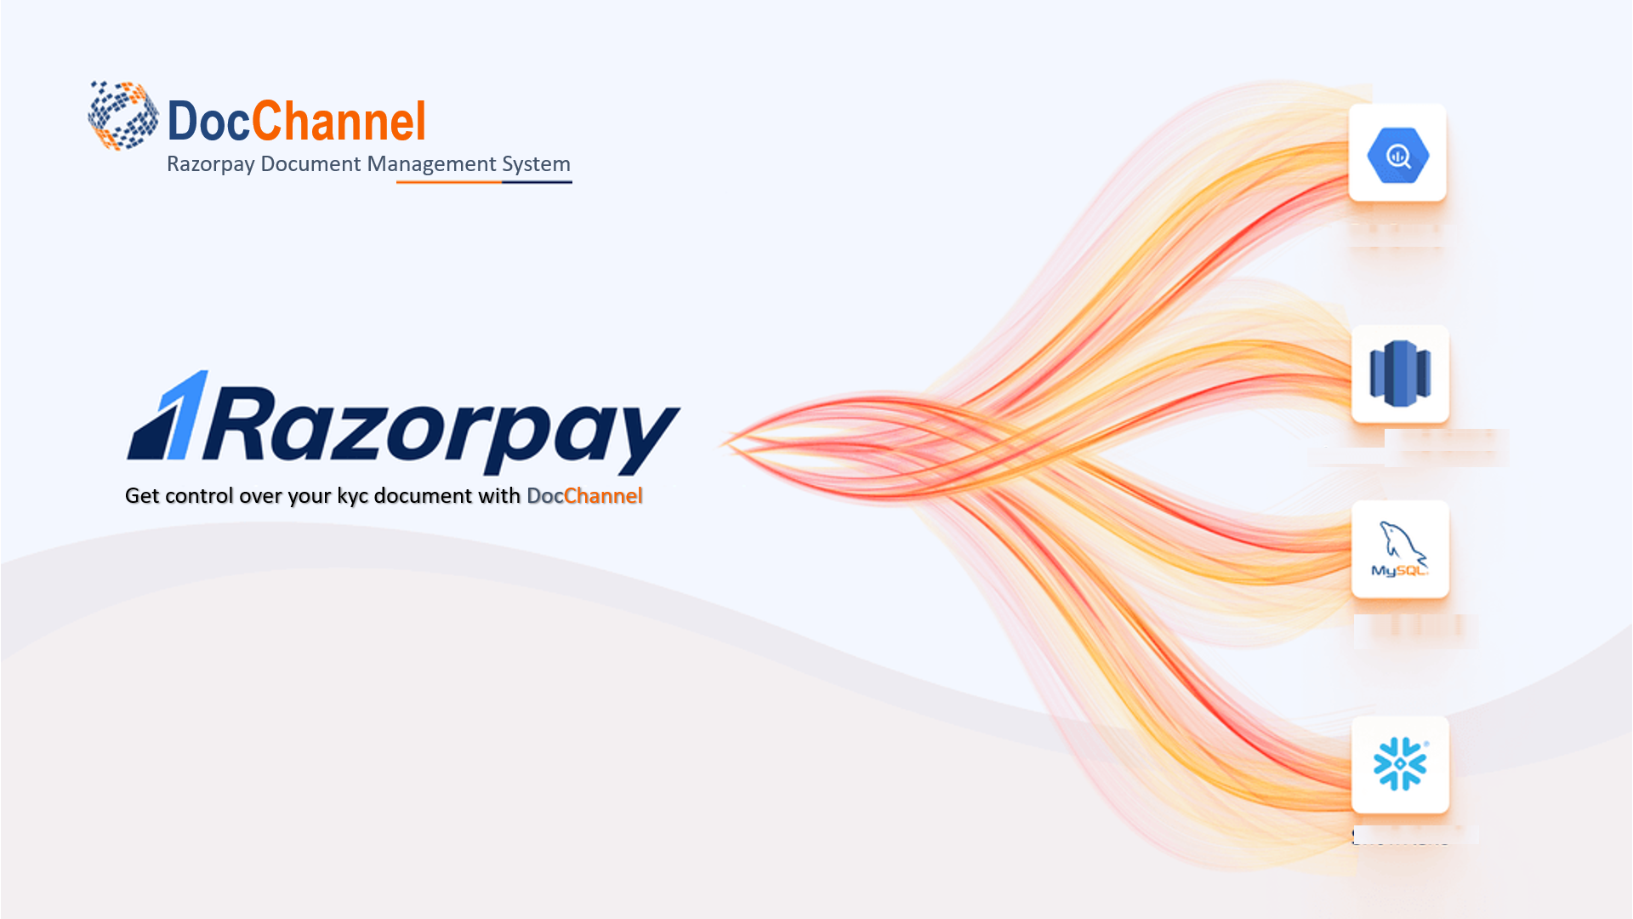
EvolveHQ
Razorpay PG
RazorpayX
External
Requester

Slide 2

Pobody is Nerfect
Participant :
  Swapnil Birkhede
  Sayali Sawant
  Saurabh Kure
  Rahul Bhingare

Slide 3
Problem Statement
Merchant uploads fresh documents every time while onboarding on any Razorpay platform.
Storage cost for encrypted documents is higher than the proposed compressing solution.

Slide 4



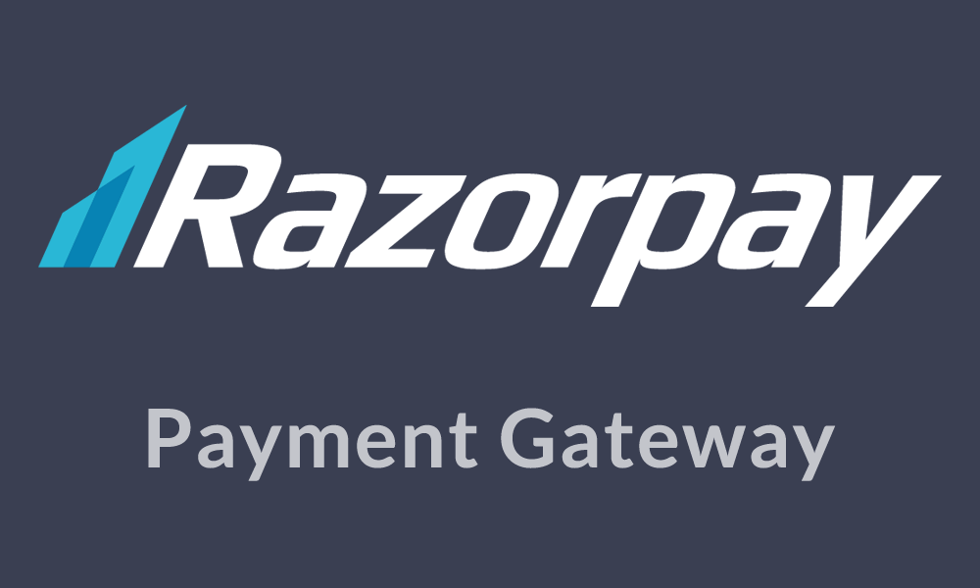

Why is this problem valid?
Decentralized Document Repository
High Document Maintenance Cost
User Experience is not seamless

Slide 5
Our Mission
Create a central repository of documents which can be accessed by merchants.
No need to upload documents every time while onboarding on any Razorpay platform.
Merchants can use this DocChannel to share his document with external partners.
Secure documents with the multi level encryption and authentication.
Compress document to save data storage.

Slide 6
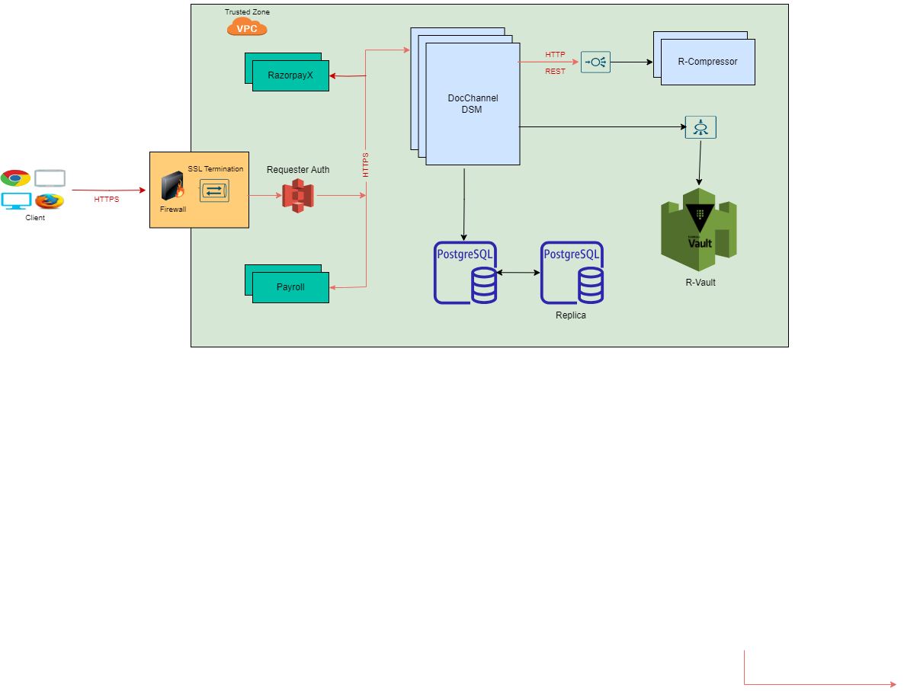
Solution architecture

Slide 7
Thank you !
We’re ready for questions!

