Slide 1
Virtual Auctions in Practice
From live cricket player drafts to gallery-led art salerooms
Virtual Cricket Auction (Google Play) • Atelier Gavel (Web Demo)

Slide 2
What we’ll cover
Session roadmap — two products, one narrative about digital auctions
Part 1 — Virtual Cricket Auction (mobile, mass-market, real-time play)
Product story, features, scale, and learning resources
Part 2 — Atelier Gavel (web platform for galleries)
Roles, architecture, tech stack, and buyer artist workflows
Synthesis — how each product serves its audience; takeaways

Slide 3
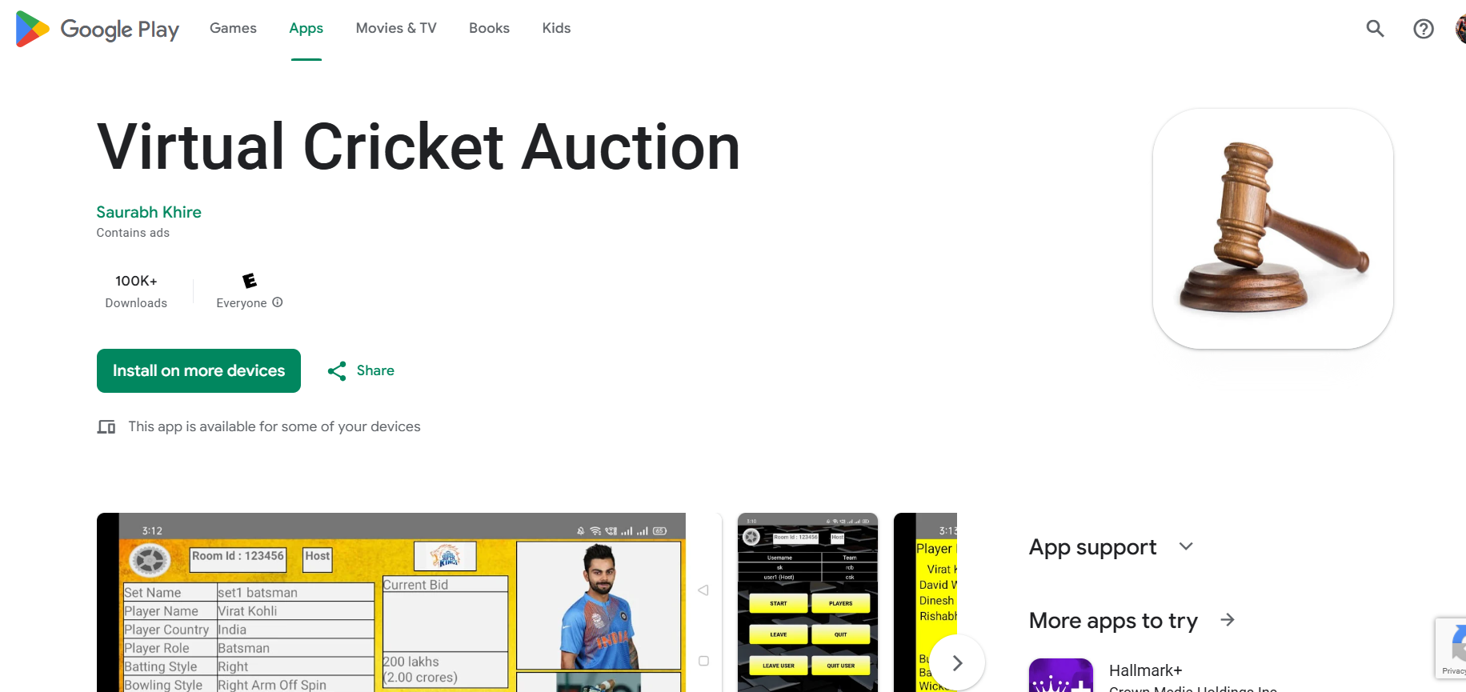

Slide 4
Part 1 — Virtual Cricket Auction
Consumer Android app on Google Play — sports & social gaming focus
Lets groups run live, competitive auctions to build fantasy / custom teams by bidding on cricket players
Developed by Saurabh Khire; strong traction signal with 100,000+ downloads
Monetization: contains ads; broad “Everyone” content rating
Positioning: friend-room multiplayer + optional solo play — low friction entry to auction mechanics
Source: Google Play listing — Virtual Cricket Auction

Slide 5
Virtual Cricket Auction — Feature depth
Live automatic bidding alongside friends — shared room energy, clock-driven tension
Manual bidding mode with a designated Manager — human auctioneer control
Curated roster of players — themed content for cricket fans
Polished, user-friendly UI — onboarding friction kept low for casual groups
Auto-save sessions — resume interrupted auctions without losing state
Configurable auction rules — adapt timing, flow, or house style
Single-player auctions with bots — practice or solo entertainment
Community posts — advertise upcoming rooms so members plan ahead

Slide 6
Virtual Cricket Auction — Tutorials & discovery
Structured video walkthroughs are published for every major workflow
Part 1 — Login & Register
Part 2 — Rooms (creating / joining spaces)
Part 3 — Automatic auction experience
Part 4 — Manual auction with a manager
Store link for install and updates:
https://play.google.com/store/apps/details?id=com.auction.virtualauctionclient
Reduces support load; excellent model for any auction product’s GTM.

Slide 7
Why this app matters — product lessons
Proves auction UX at scale: latency, fairness, and clarity under social pressure
Dual modes (auto vs manual) serve both casual parties and structured league nights
Persistence + bots widen the funnel — install → solo try → invite friends
Sports context makes abstract “bidding” instantly relatable worldwide

Slide 8
Part 2
Atelier Gavel
Web platform demo — art galleries & timed salerooms

Slide 9
Part 2 — Atelier Gavel (Art Auction Demo)
Full-stack web application for a boutique gallery / private sales context
Objective: credible preview of how a gallery could run timed, remote auctions with real calendar boundaries
Not a consumer game — a B2B-leaning operations tool with buyer-facing room
Brand layer: “Atelier Gavel” — editorial, calm UX (serif headings, restrained palette)

Slide 10
Atelier Gavel — Technology stack
Frontend: React 18 + Vite + React Router — fast dev, production-grade bundle
Backend: Node.js + Express (REST) — predictable integration for future mobile or ERP clients
Data: SQLite (local file) — zero-ops for pilot demos; path to Postgres later
Security baseline: JWT sessions, bcrypt passwords, role-gated routes
Assets: Multer file uploads — artwork photography stored server-side
Ops: single-command dev orchestration; documented DB reset for clean demos

Slide 11
Architecture — logical view
Browser SPA talks to REST API (Vite proxy in development)
Every API pass refreshes auction state from wall-clock time
Lifecycle: scheduled → live → ended → finalized (writes sales ledger)
Finalization is transactional: highest bid per lot, debit buyer, credit artist (virtual)
Separates presentation, orchestration, and persistence — easy to extend (e.g. Stripe webhooks)

Slide 12
Roles & responsibilities
Artist — portfolio up to 10 pieces; image + story; inventory states: available / in auction / sold
Admin (Curator) — ingest consignment, compose auction sessions, set opening bids, wall times
Buyer — virtual balance at signup; pre-register with session budget cap; bid only while live
Enforcement: bid increments, budget cap vs outstanding winning bids, optional legacy per-lot ceiling

Slide 13
Buyer journey (highlight reel)
Discover auctions from Saleroom, auction list, or deep link to a room
Pre-register before start_time — explicitly budget-bound commitment
Live room polls prices; raise, quick-bid, or custom amount with validation
Settlement runs automatically after end_time — purchases grouped by auction in “My purchases”
Placeholder path for future card billing — Stripe checkbox captured at registration today

Slide 14
Side-by-side — two products, two intents
Audience: Cricket app = broad consumer / sports clubs; Art demo = gallery staff + collectors
Surface: Native Android vs responsive web (deployable as PWA or packaged later)
Content: Player cards & fantasy framing vs consigned artworks & provenance narrative
Trust: Play Store social proof + tutorials vs JWT-secured B2C-lite saleroom controls
Shared DNA: time-boxed competition, clear hammer logic, explainable bid rules

Slide 15
Virtual Cricket Auction — Reach & trust signals
Category placement: Sports — aligns with seasonality, leagues, and fan events
Store visibility: installs and ratings build organic discovery for new hosts
Developer-declared data practices (per Play Console): plan communications accordingly
Support channel listed on store — reduces friction for schools, clubs, and creators
Ideal references when pitching “auction as a format” to non-technical stakeholders
Listing: play.google.com/store/apps/details?id=com.auction.virtualauctionclient

Slide 16
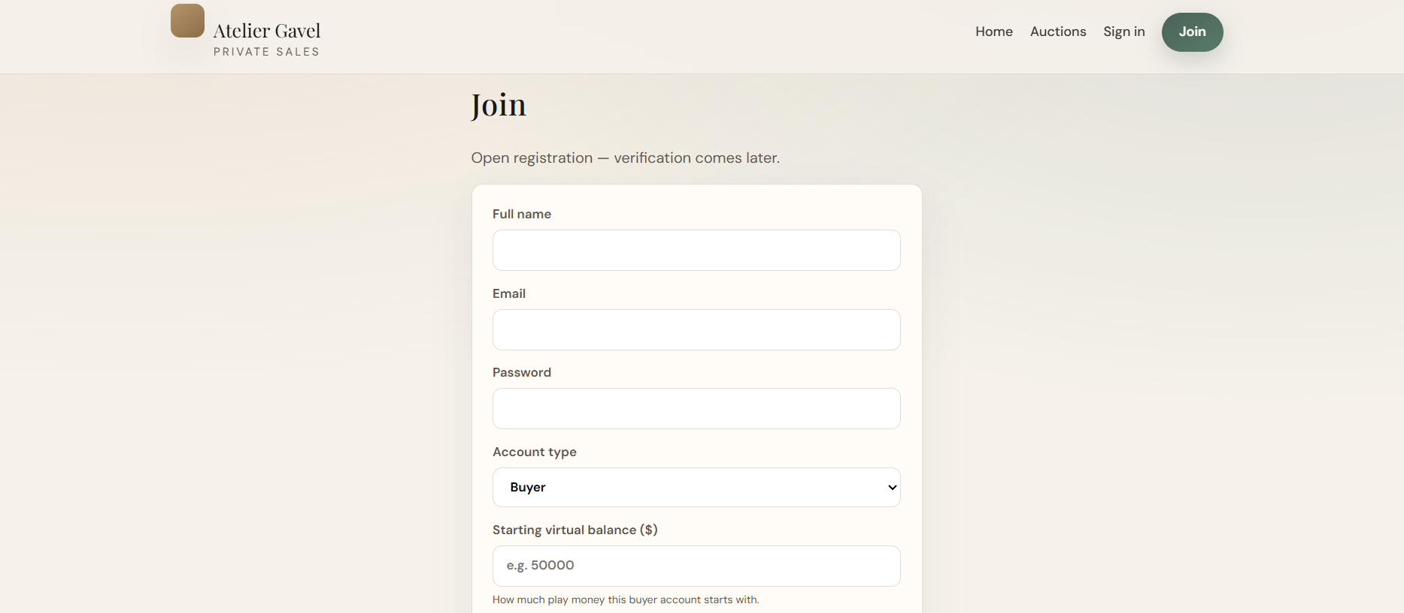

Slide 17
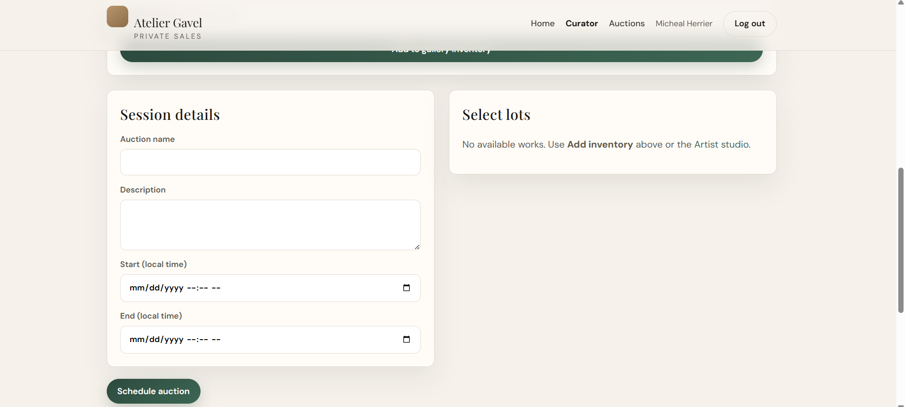

Slide 18
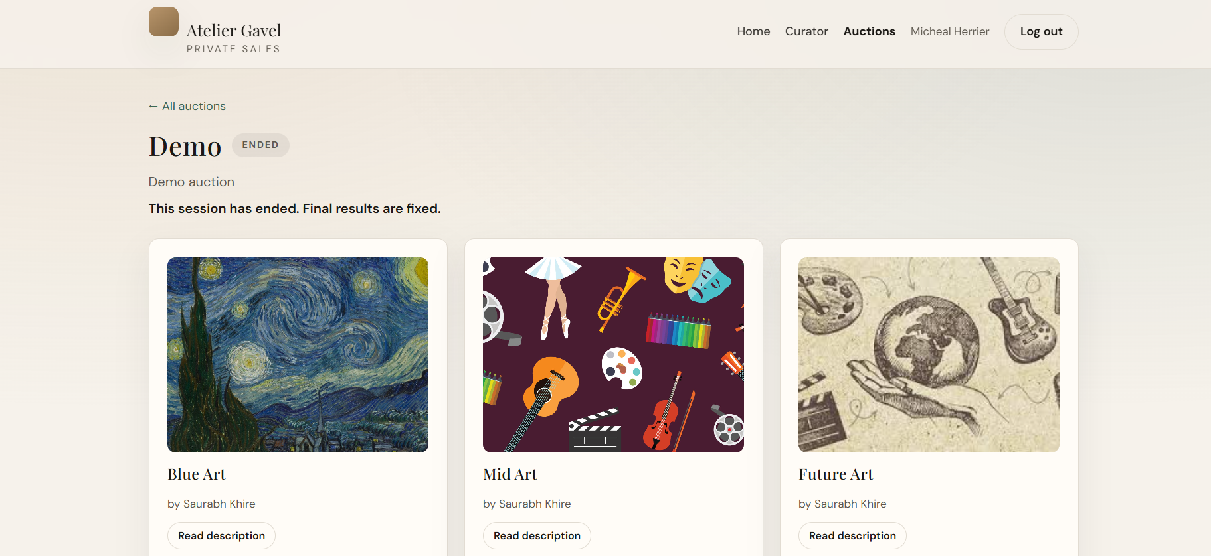

Slide 19
Atelier Gavel — Persistent data (why auditors care)
users — identity, role, virtual_balance, optional Stripe-interest flags
arts — consigned objects with status / availability machine
auctions + auction_arts — session contract: times, lots, opening bids, cap rules
auction_registrations — buyer commitment envelope before gavel
bids — append-only evidence trail for dispute review
art_sales — immutable settlement once hammer is formalized in software
SQLite today → portable SQL for gallery IT review tomorrow.

Slide 20
Roadmap ideas (both lanes)
Cricket: deeper analytics for hosts, premium ad-free tier, cross-promotion APIs
Gallery demo: PSP integration, KYC for hammer price, condition reports PDF
Shared: fairness monitors, anti-sniping policy toggles, replay exports for transparency
Shared: optional WebSocket layers on top of proven REST semantics

Slide 21
Strategic takeaway
Virtual Cricket Auction shows how auction mechanics scale socially on mobile with excellent onboarding
Atelier Gavel shows how the same mechanical clarity maps to high-trust cultural commerce on the web
Together they illustrate a spectrum: viral leisure rooms → curated institutional sales
Next investments for the web demo: WebSockets, payment capture, multi-tenant galleries, mobile wrapper

Slide 22
If you are looking for either of these do reach out to me Collaborate on this or any of projects Co founder Tech engineer

Slide 23


