Slide 1
EngageIQ Flight Deck
Real-Time Pilot Behavioral Safety Monitoring
Google DeepMind × InstaLILY On-Device AI Hackathon

Slide 2
Real-Life Problem
• Pilot fatigue causes ~15–20% of aviation accidents
• Biometric video (face) cannot leave the aircraft — privacy & security regulations
• Cloud round-trip latency at cruise (satellite): 600–800ms — too slow for &lt;500ms alerts
• Oceanic routes: zero connectivity for hours — system must work offline
• Continuous camera feed economics: per-call API pricing is impractical

Slide 3
Solving Use Case
• Two camera feeds + cockpit data → live Pilot Safety Index (PSI, 0–100)
• Escalating safety interventions: NOMINAL → MONITOR → CAUTION → WARNING → CRITICAL
• Fully on-device inference via Ollama (Gemma 3n, FunctionGemma) — no cloud
• Autonomous ActionAgent decides: trigger_alert, notify_copilot, suggest_rest_protocol, etc.
• Demo: upload drowsy video or inject scenarios; watch PSI drop and alerts escalate

Slide 4
Components
• PerceptionAgent (Gemma 3n) — face frame → pilot_state (perclos, yawn, head_drop, gaze)
• ActionAgent (FunctionGemma 270M) — pilot_state → function calls
• LandingAgent (Gemma 3n) — external/belly frame → landing_report (bounces, score)
• PSI Engine — composite score from fatigue, attention, procedural, landing
• Cockpit Error Classifier — 5 error types (wrong_button, omission, commission, reversal, sequence_error)
• React HUD — PSI ring, signals, agent feed, landing report, alert banner

Slide 5
Architecture
Camera 1 (Face) → OpenCV → PerceptionAgent (Gemma 3n) → pilot_state JSON
Camera 2 (External) → OpenCV → LandingAgent (Gemma 3n) → landing_report JSON
X-Plane / Replay → sim_bridge → phase + cockpit_errors
pilot_state + cockpit_errors → ActionAgent (FunctionGemma) → function calls
All outputs → PSI Engine → WebSocket (2Hz) → React HUD

Slide 6
What It Does: PerceptionAgent
Gemma 3n E4B
• Input: face frame (Camera 1) + flight phase
• Output: pilot_state JSON (state, perclos_est, yawn, head_drop, gaze_off_instruments)
• Runs every 2 seconds
• LoRA fine-tuned on NTHU drowsy driver dataset

Slide 7
What It Does: ActionAgent
FunctionGemma 270M (fine-tuned)
• Input: pilot_state stream + session context
• Output: function call strings (trigger_alert, notify_copilot, suggest_rest_protocol, log_fatigue_event, request_atc_advisory)
• Autonomous safety loop — decides when to escalate

Slide 8
What It Does: LandingAgent
Gemma 3n E4B
• Input: external/belly frame (Camera 2) during approach/landing
• Output: landing_report (bounce_count, on_centerline, contact_type, score)
• Scores: greaser 100, firm 80, hard 60, 4+ bounces 10

Slide 9
What It Does: PSI Engine
Composite 0–100 score
• Fatigue: perclos, yawn count, CRITICAL events (−40/−15/−30 pts)
• Attention: head drop, gaze off (−30 pts)
• Procedural: cockpit errors (−30 pts)
• Landing: penalty if last score &lt;40 (−10 pts)
• Alert bands: 85+ NOMINAL, 70–84 MONITOR, 55–69 CAUTION, 35–54 WARNING, 0–34 CRITICAL

Slide 10
What It Does: React HUD
Live dashboard
• PSI ring (animated score)
• Signal grid (yawns, head drops, gaze %)
• Agent feed (FunctionGemma decisions)
• Landing report (bounces, score)
• Alert banner (escalating colors)
• PSI timeline (Recharts)
• Video panel (upload Cam 1/2), Simulator panel (inject scenarios)

Slide 11

Warning Scenarios
• Drowsy — elevated perclos, gaze drift → trigger_alert(WARNING), suggest_rest_protocol(15)
• Fatigue onset — perclos rising → log_fatigue_event, trigger_alert(WARNING)
• Gaze drift — gaze off instruments → trigger_alert(WARNING)
• Yawn series — 4+ yawns/10m → suggest_rest_protocol(20)

Slide 12
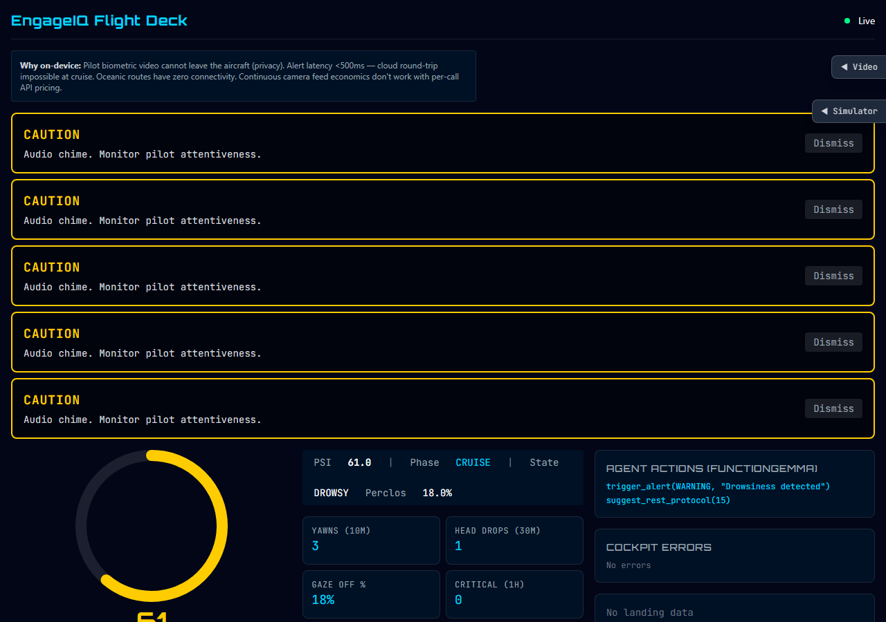

Slide 13
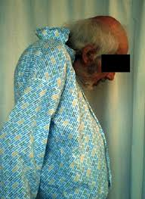
Critical Scenarios
• Critical — micro-sleep risk, head drop → notify_copilot, trigger_alert(CRITICAL)
• Micro-sleep — eyes closed &gt;3s → notify_copilot, request_atc_advisory
• Head drop severe — eyelids drooping → notify_copilot
• Cockpit reversal — throttle opposite → trigger_alert(CRITICAL)

Slide 14
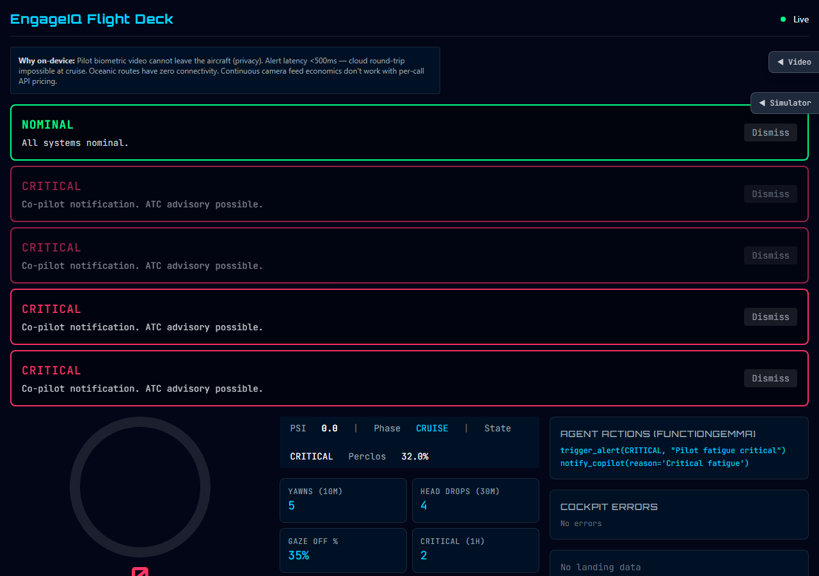

Slide 15
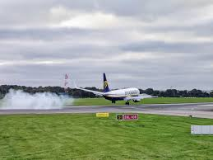
Takeoff & Landing Scenarios
• Takeoff smooth — nominal climb
• Approach nominal — stable approach
• Landing greaser — score 100, 1 contact
• Landing hard — score 60, G&gt;1.8
• Landing bounce — score 10, 4+ bounces, runway excursion risk
• Go-around — initiated

Slide 16
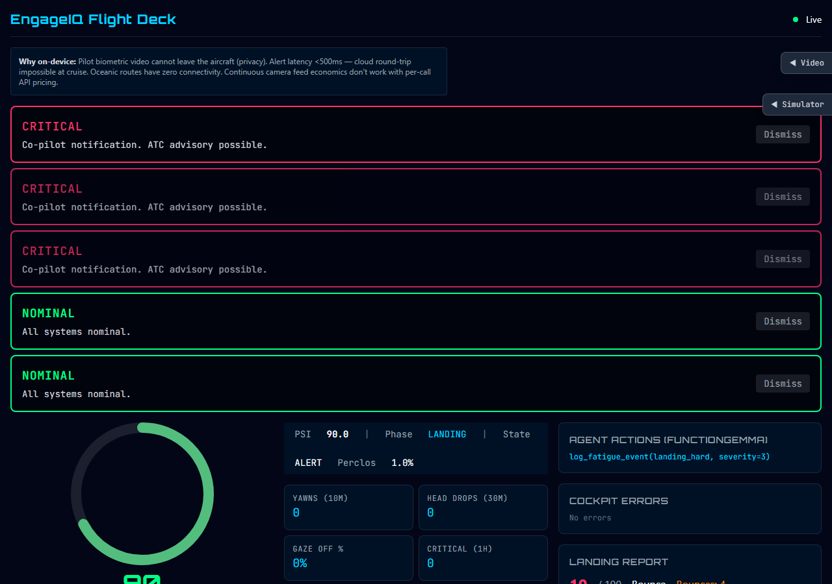

Slide 17
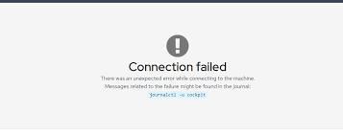
Cockpit Error Scenarios
• Gear omission — gear not down by 1000 ft AGL (−8 pts)
• Wrong button — wrong flap setting (−20 pts)
• Reversal — throttle opposite (−20 pts)
• Sequence error — checklist out of order (−2 pts)
• Cockpit multi — fatigue + procedural errors combined

Slide 18
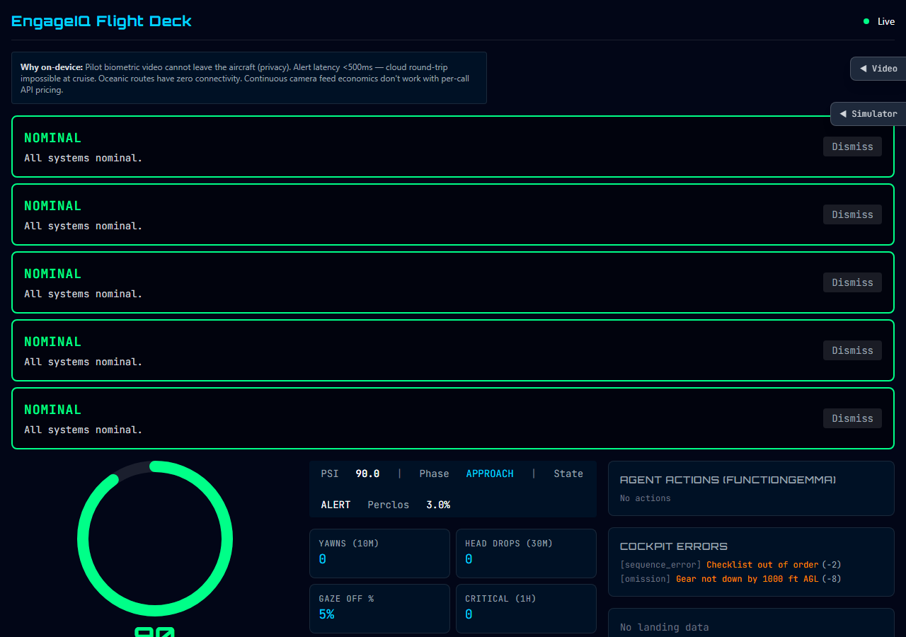

Slide 19
Key Claims
• All inference on-device; no cloud API calls
• Pilot biometric video never leaves the aircraft
• Alert latency &lt;500ms; cloud impossible at cruise
• Fully offline capable for oceanic routes
• Gemma 3n reasons over frames; not hardcoded thresholds
• FunctionGemma autonomously decides alerts
• Fine-tuned models improve accuracy
• Prototype; real deployment requires DO-178C, FAA/EASA

Slide 20
Demo Flow
1. Cold HUD — PSI 95, NOMINAL
2. Inject drowsy / upload NTHU video → PSI drops, WARNING
3. Inject critical → CRITICAL, notify_copilot
4. Inject landing_bounce → score 10, runway excursion risk
5. Inject cockpit_errors → procedural deductions
6. Turn off WiFi — system keeps running

Slide 21
Thank You
EngageIQ Flight Deck
Real-time pilot safety — fully on-device.
Questions?

