Slide 1

Team Name: Maximas Team leader name: Saurabh kure
Problem Statement: Investors struggle to connect real-time market data with financial news, leading to missed opportunities and unexplainable trading decisions.

Slide 2

StratifyAI 🚀 Signal Extraction & Backtesting Platform
🔹 Problem
News drives markets: Stock prices often react instantly to financial news, earnings updates, and global events.
But unstructured news data is messy — it’s hard to process, quantify, and connect to market signals.
Traders and analysts struggle to quickly test how news sentiment impacts stock performance, slowing decision-making.
🔹 Solution Overview
We implemented a real-time signal extraction platform that ingests stock prices and financial news, analyses sentiment and topics, and generates actionable trading signals with explainable links to their originating events. Users can also receive instant alerts via email for important signals.

Slide 3
🔎 Meaning Behind “StratifyAI”
🔹 Stratify
Means to organize into layers, categories, or levels.
Solution does exactly that:
Raw → structured data
Price data + news → features
Features → signals
Signals → backtesting → insights
Basically, the system stratifies complex, messy financial data into actionable trading layers.
🔹AI
Highlights the NLP sentiment analysis, feature engineering, and intelligent automation parts.
Signals are not just rule-based — they are enriched with AI-driven insights

Slide 4
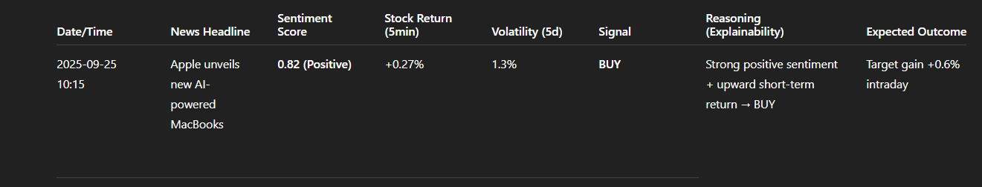
🌟 What Customers Can Expect
Date/Time: 2025-09-25 10:15 News Headline: “Apple unveils new AI-powered MacBooks” Sentiment Score: 0.82 (Positive) Stock Return (5min): +0.27% Volatility (5d): 1.3% Generated Signal: BUY Reasoning (Explainability): → Strong positive news sentiment (+0.82) + upward short-term return (+0.27%) triggered a BUY signal.
Expected Outcome: Position opened, target gain +0.6% intraday. Email: Alerts for important signals

Slide 5

🔑 Features of the StratifyAI
🔹 Automated Data Ingestion
Real-time integration with Alpha Vantage API for stock prices and News API for Articles.
Unified schema design to link events, sentiments, and stock movements.
🔹 NLP & Sentiment Analysis (via Snowflake Cortex)
Sentiment scoring for each news article.
Topic extraction and relevance scoring.
Ticker/Stock-level sentiment association.
🔹 Feature Engineering
Provides Stock features, Sentiment features and combined features for signal generation.
🔹 Backtesting Framework
Records signals, positions, PnL, cumulative returns.
Enables validation of trading rules before production use.
🔹 Explainability and Traceability
Each trading signal linked to originating events (stock price movement or specific news article).

Slide 6

🔑 Features of the StratifyAI
🔹 Orchestration via n8n
Automated workflows for API calls, data transformations, and Snowflake inserts..
Error handling, retries, and scheduling included.
Modular design (separate workflows for ingestion, analysis, feature creation, backtesting).
🔹 Scalability & Extensibility
New data sources (e.g., alternative datasets, Twitter feeds) can be plugged in easily.
Topic extraction and relevance scoring.
Additional models (ML-based signal generation) can extend beyond rule-based signals.
🔹 Visualization, Alerts & Reporting
Final outputs (PnL, signals, sentiment trends) can be exposed to BI dashboards.
Monitoring of model performance over time.
Alerts on the email for important signals.

Slide 7

🔵 Benefits of StratifyAI
🚀 Speed & Automation
Automated ingestion of stock + news data (no manual tracking).
Real-time analysis → faster decision-making.
🎯 Accuracy & Intelligence
AI-driven sentiment & topic extraction improves signal precision.
Combined features (price + sentiment) → smarter strategy validation.
🔍 Transparency & Explainability
Each signal linked back to articles, prices, and features.
Full audit trail for compliance & debugging.
📈 Scalability & Extensibility
Cloud-native (Snowflake) → handles large datasets without infra headaches.
New data sources (Twitter, alt-data) can be plugged in seamlessly.
💰 Business Value
Reduce time-to-market for new strategies.
Boost returns by integrating news-driven signals into trading models.

Slide 8
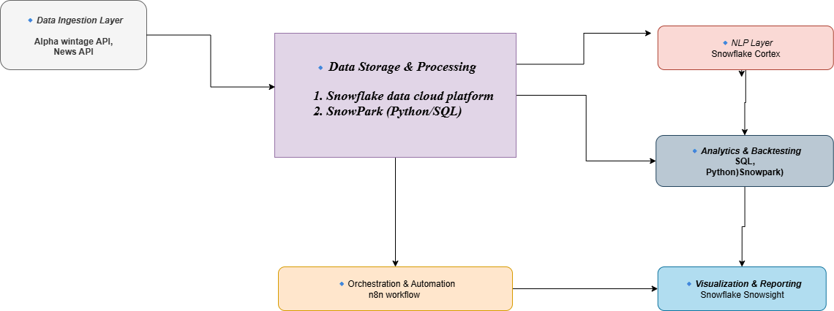
⚙️ Technical Stack – StratifyAI

Slide 9
🏗️StratifyAI System Architecture 1️⃣ Data Integration
How:
Collect real-time stock prices from Alpha Vantage API.
Gather financial news via free APIs or web crawlers.
Orchestrate ingestion, scheduling, and retries using n8n.
Store raw data in Snowflake.
Why Unique:
Unified ingestion of structured + unstructured data in one platform.
Automated, scalable, and cloud-native → minimal manual intervention.

Slide 10
🏗️StratifyAI System Architecture 2️⃣ Signal & Feature Engineering
How:
Apply Snowflake Cortex for NLP: sentiment scoring, topic extraction, ticker relevance.
Compute stock features: returns, volatility, volume patterns.
Generate combined features: interactions like sentiment × return (FEATURES_PER_INTERVAL).
Store enriched features in Snowflake tables for analysis.
Why Unique:
Integrates market data + news sentiment in a structured, time-aligned feature set.
Produces rich, predictive signals that go beyond simple price-based rules.

Slide 11
🏗️StratifyAI System Architecture 3️⃣ Backtesting & Traceability
How:
Run strategies on historical enriched features to generate signals (Buy/Sell/Hold).
Track positions, PnL, cumulative returns in BACKTEST_RESULTS.
Each signal links back to source articles and feature vectors for full auditability.
Why Unique:
End-to-end explainability: every signal is traceable to raw data.
Validates strategies before deployment → reduces risk and ensures reliability.

Slide 12
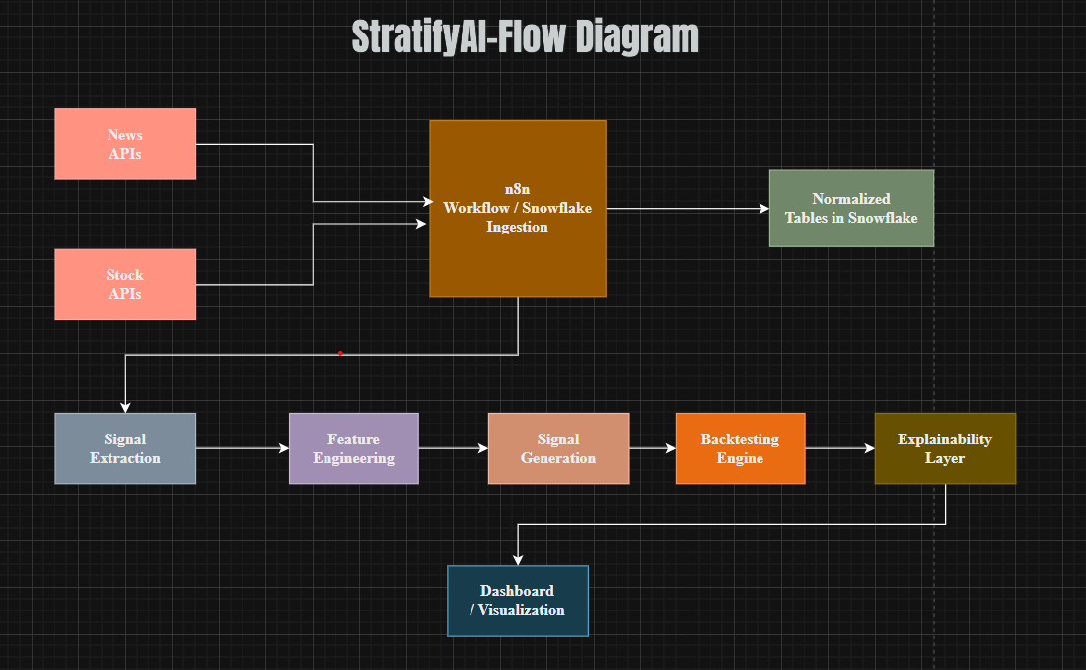
Pipeline Overview
Our pipeline is automated, scalable, explainable, and extensible — combining AI + financial data into a production-ready decision engine.”

Slide 13
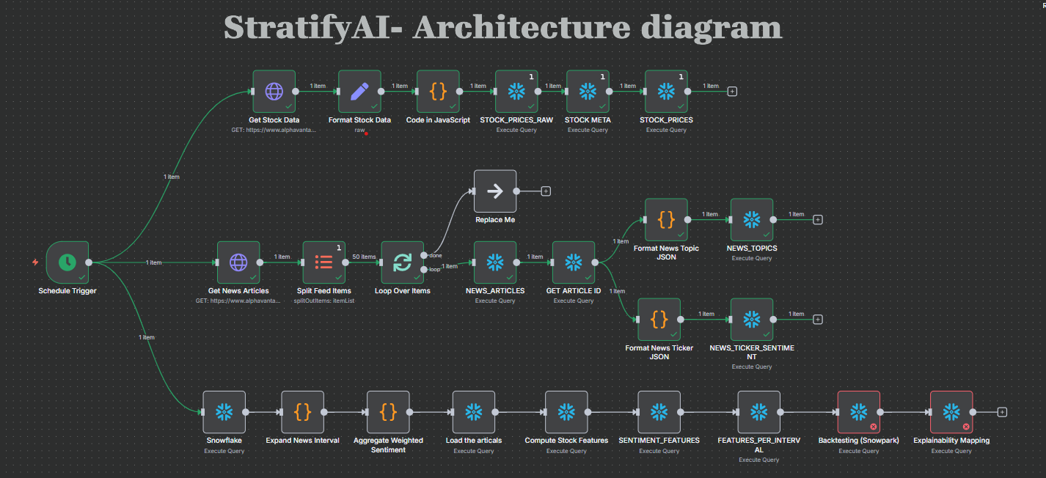
Snapshot of the StratifyAI n8n Automation workflow

Slide 14

🚀 Future Development
“Future versions will expand StratifyAI into a multi-source, ML-driven, real-time platform with advanced explainability and enterprise integrations.”
1️⃣ Advanced Data Sources
Integration of Twitter/X feeds, Reddit sentiment, and alternative datasets (satellite, ESG, supply chain).
Real-time event detection (earnings calls, regulatory filings).
3️⃣ Real-Time Streaming
Streaming pipelines with Kafka/Snowpipe for ultra-low latency data ingestion.
Instantaneous signal updates for intraday trading.
4️⃣ Portfolio-Level Optimization
Multi-asset strategy support (stocks, ETFs, crypto).
Portfolio rebalancing, risk-adjusted allocations, and optimization tools.
6️⃣ Enterprise Integrations
API endpoints for plugging StratifyAI into existing trading platforms.
Alerts/notifications via Slack, Teams, or email.

Slide 15
📌 To explore StratifyAI in depth:
GitHub Public Repository : https://github.com/Saurabhkure/StratifyAI-.git

