Slide 1
PEHCHAAN
Face Recognition Based Attendance App

Slide 2
INTRODUCTION
Everyday actions are increasingly being handled digitally , instead of pencil, paper or face to face.
This growth in digital transactions results in great demand for fast and accurate user identification and authentication.
Time consumption is more while handling the work manually as compared to digitally.

Slide 3
Advantages of Proposed System
​Time saving.
Highly automated process as it uses facial recognition.
Highly scalable as it uses cloud technology.
Attendance can be taken repeatedly in every lecture.
Less chances of error and automatic improvements through machine learning.
No proxy attendance by students.

Slide 4
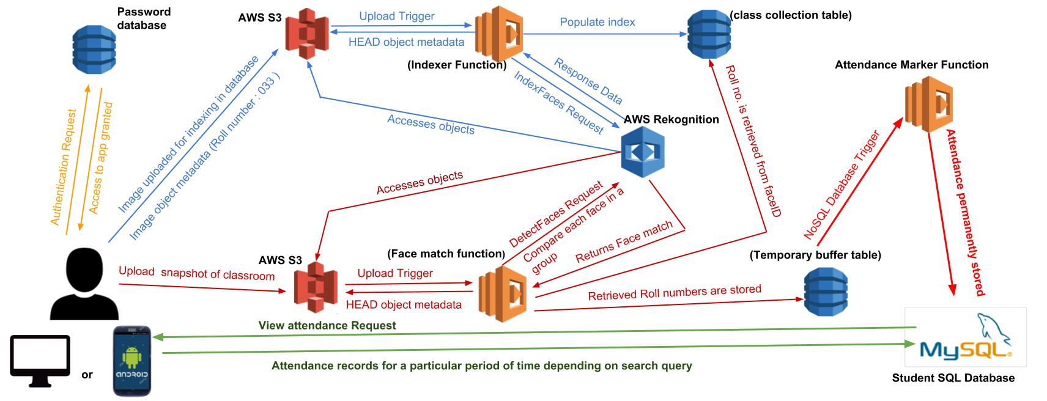
Architecture

Slide 5
Overview of Application
The app usage starts with user authentication.
Two way snapshot processing:
1. Upload from the local file system
2. Take snapshot from device camera
The uploaded image is processed for facial recognition in the following 4 ways:
1. Find the face in image - Viola Jones Algorithm
2. Analyse facial features - Face Landmark Estimation
3.Encoding Faces - Embedding with 128 features for each face
4. Comparison

Slide 6
Future Enhancements
Replacement of Viola Jones algorithm by more recent algorithms like HOG can be used to improve efficiency.
Implementation of chatbot feature to solve the queries of parents/ students.
Can be extended to hardware like CCTVs to act as an attendance system in Offices.

