Slide 1
TOKEN2049 ORIGINS · CHAINLINK CRE
KRIYA
Autonomous Capital Protocol. Stop programming transactions. Start programming financial objectives.
kriya-beta.vercel.app · github.com/Saurabhnage/kriya · Live on Ethereum Sepolia
Notes:
Today we program money transaction by transaction. KRIYA lets us program money around objectives. I'm going to show you capital that understands a goal, stays inside hard limits, and rebalances itself — live on Sepolia.

Slide 2
Onchain capital still makes you decide every transaction yourself
THE PROBLEM
01
02
03
04
05
06
07
Find
Compare
Assess risk
Execute
Monitor
Rebalance
Exit
Automation today runs predefined actions. AI can reason, contracts can enforce, oracles can verify — but nothing combines them into one bounded loop around a financial objective.
Notes:
Every DeFi user is their own portfolio manager: find, compare, assess, execute, monitor, rebalance, exit — by hand. Bots automate fixed actions, not outcomes. The missing layer is combining AI reasoning, verifiable data and contract enforcement into one bounded loop.

Slide 3
THE PRIMITIVE
Programmable Financial Objectives
Objective + constraints
Decision
Verification
Enforcement
Continuous optimization
Not “if X, execute Y”. The human defines the mandate; KRIYA runs the decision loop; contracts enforce the boundaries.
Notes:
This is the core idea. Instead of programming the transaction, you program the outcome and the limits. KRIYA handles the loop; smart contracts make sure the loop can never step outside your limits.

Slide 4
THE PRODUCT
KriyaMandate · demo
A capital mandate, not a transaction
$1,000 USDC
Maximize risk-adjusted yield
Max risk (strategy & portfolio) | 40
Max strategy exposure | 40%
Min USDC reserve | 25%
Max drawdown | 5%
Autonomous rebalance | ON
One wallet flow: mint test USDC, approve, KriyaVault.openMandate. Capital and its objective are programmed in a single transaction, and the limits live onchain.
Notes:
The user creates a mandate: capital, objective, risk limit, exposure cap, liquidity reserve, drawdown floor, allowed strategies, and whether KRIYA may rebalance on its own. That mandate becomes the control layer for the capital.

Slide 5
Five layers, each with one job
ARCHITECTURE
Layer | Responsibility | In KRIYA
Intent | What the user wants | KriyaMandate: objective + hard limits
Intelligence | How KRIYA decides | Claude decision engine → typed allocation
Verification | What reality says | Chainlink CRE: HTTP consensus + EVM reads
Enforcement | What is permitted | KriyaExecutor.validateAllocation, reverts
Execution | What happens onchain | KriyaVault ⇄ allowlisted strategy vaults
Notes:
The separation of responsibilities is the design. Intent lives in the mandate contract. Intelligence proposes. Chainlink CRE checks external and onchain reality. The executor contract enforces. The vault moves capital, and only between itself and allowlisted strategies.

Slide 6
One cron-triggered workflow closes the loop, every run
THE DECISION LOOP · CHAINLINK CRE WORKFLOW
OBSERVE
VERIFY
DETECT
DECIDE
CONSTRAIN
EXECUTE
Risk feed via HTTP, DON consensus
Changed risk → signed report onchain
Mandate health under verified risk
Claude returns a typed allocation
Policy re-checked inside the workflow
Report → KriyaExecutor.onReport
One rulebook (policy.ts) is shared by the agent and the CRE workflow, compiled to WASM, and mirrored in Solidity. A server keeper runs the identical loop as a fallback path.
cre/kriya-workflow/main.ts · TypeScript → WASM · reports routed through the Keystone forwarder
Notes:
This is the Chainlink CRE workflow. It observes the external risk feed with DON consensus, writes verified risk changes onchain, detects mandates at risk, asks Claude for a proposal, re-validates it with the same rules, and writes a signed rebalance report to the executor contract.

Slide 7
The agent never holds user funds. Its key can only call executeAllocation, which runs the same onchain checks as CRE reports. Funds move only vault ⇄ allowlisted strategies.
SECURITY BOUNDARY
AI proposes.
Rules constrain.
CRE verifies.
Contracts enforce.
An allocation outside the mandate reverts with a typed error:
ExposureExceeded
StrategyRiskExceeded
PortfolioRiskExceeded
ReserveBelowMinimum
StrategyNotAllowed
DrawdownExceeded
Human override: pause mandate · emergency exit · withdraw.
Notes:
The AI must never directly control unrestricted funds. Even if the decision engine proposes something reckless, the executor contract reverts it. The user can pause the agent, pull everything back to the reserve, or withdraw at any time.

Slide 8
Strategy B gets riskier. KRIYA rebalances itself.
THE DEMO · REALITY CHANGES
1 · Initial allocation
2 · Reality changes
3 · Autonomous rebalance
B risk 34 → 48
B 40% · A 35% · Reserve 25%
Chainlink CRE verifies the score and writes it onchain. B now breaks the max risk of 40.
A 40% · C 35% · Reserve 25%
Risk 21 / 40
Risk 14 / 40
✓ Mandate safe
⚠ Mandate at risk
✓ Mandate restored · 0 violations
Notes:
Here is the live scenario. Initial allocation: B 40, A 35, reserve 25 — risk 21 of 40. Then we change reality: Strategy B's risk jumps from 34 to 48. The verified score breaks the mandate. KRIYA detects it, Claude decides, the workflow validates, and the contract rebalances: A 40, C 35, reserve 25 — risk 14, mandate restored. The user never chose a transaction.

Slide 9
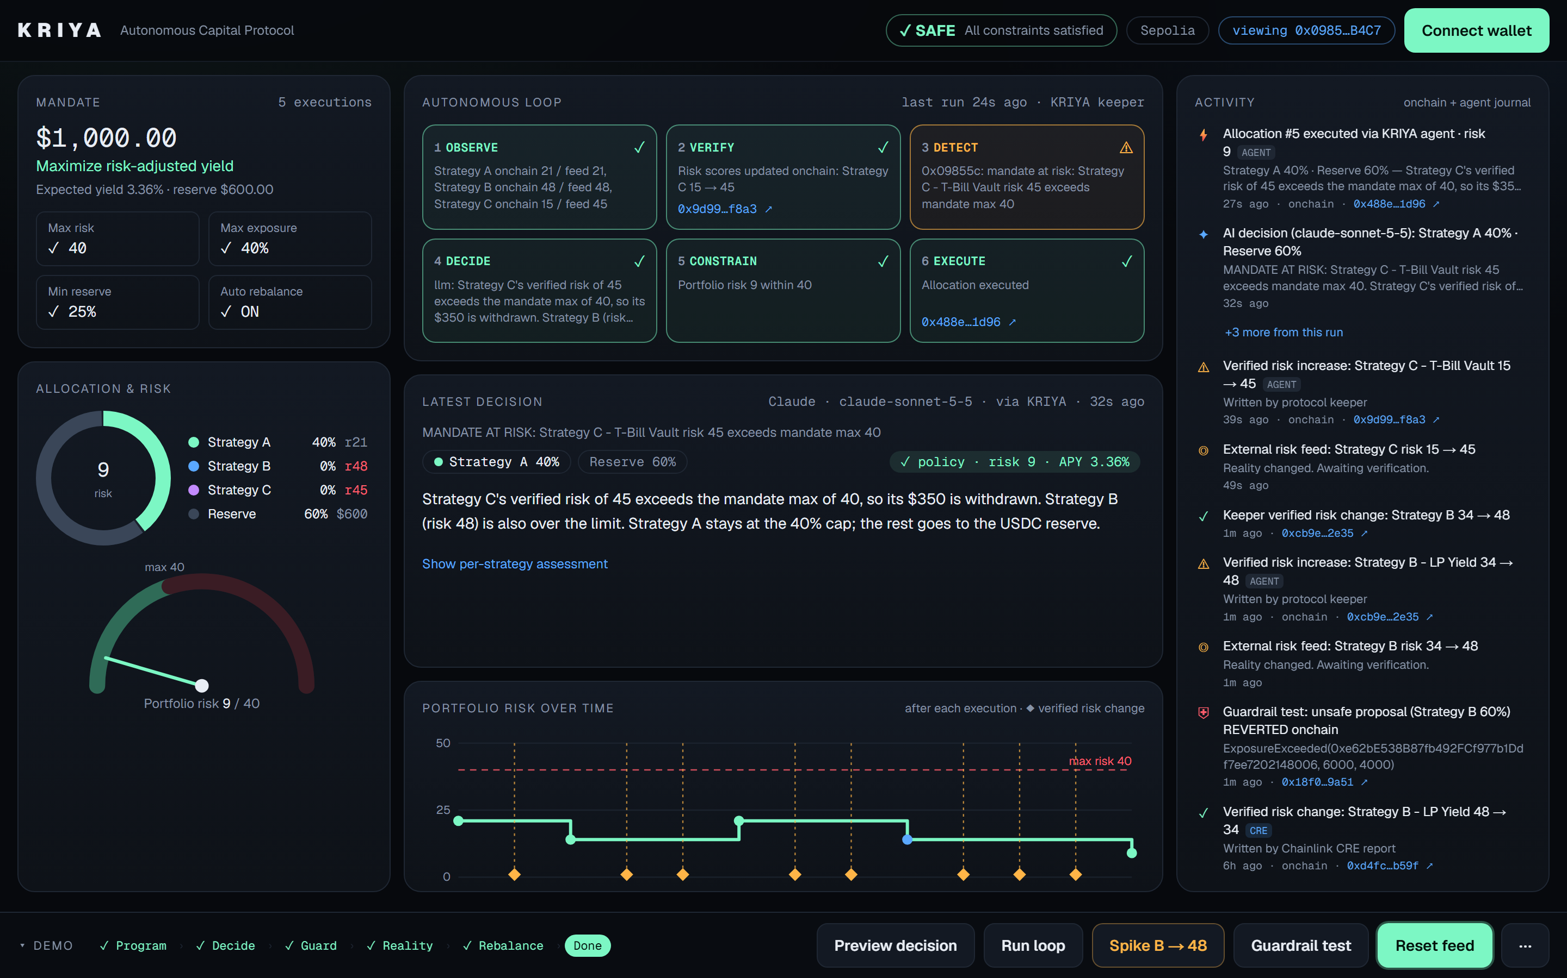
LIVE DASHBOARD · SEPOLIA
Mission control
Live loop
Each of the six steps streams in as it lands, with its transaction
Claude's decision
Rationale, allocation and the policy check, side by side
Stage bar
Walks judges through the five demo acts, one click each
Live on Sepolia · kriya-beta.vercel.app · right after Claude exited a strategy that breached the mandate
Notes:
This is the real product, live on Sepolia, captured right after an autonomous rebalance. Strategy C's verified risk jumped to 45, over the mandate's limit of 40. The loop verified it onchain, Claude decided to exit C, the policy check passed, and the executor rebalanced: portfolio risk is now 9 of 40. Every step in the pipeline links to its transaction, and the stage bar shows the demo is complete.

Slide 10
Real transactions, real reverts, real CRE reports
PROOF · ETHEREUM SEPOLIA
Step | Transaction
Open $1,000 mandate | 0x7b0fd91d…554f
Unsafe 60% proposal · reverted (ExposureExceeded) | 0x6eee86fd…77b9
CRE VERIFY · risk report, B 34 → 48 | 0x66deb846…36b9
CRE EXECUTE · Claude’s rebalance A 40 · C 35 · R 25 | 0x2d8a4366…41d5
CRE VERIFY · risk restored, B 48 → 34 | 0xd4fc8b94…b59f
CRE reports delivered via the Keystone forwarder to KriyaExecutor 0x9c5f…656A · logged onchain as source = CRE
Notes:
Everything here is onchain. The mandate; the unsafe proposal that reverted; then the Chainlink CRE workflow: it verified Strategy B's risk jump, Claude proposed the rebalance, the workflow re-checked it, and the signed report executed through the forwarder. The executor logs that execution with source CRE. Click any hash.

Slide 11
One vertical slice, end to end
WHAT WE BUILT
01
02
03
04
Contracts
Chainlink CRE
Decision engine
Live app
Vault, Mandate, Executor, Registry. 23 Foundry tests, incl. 1,000-run fuzz.
TypeScript workflow → WASM. HTTP consensus, EVM reads, signed reports.
Claude Sonnet 5.5, schema-bound output, validated three times.
Next.js on Vercel. 12 unit + 15 end-to-end tests, all in CI.
Notes:
We built one polished vertical slice rather than five disconnected integrations: contracts with 23 tests including fuzzing, the Chainlink CRE workflow, a Claude decision engine whose output is always validated, and a live app on Vercel against Sepolia.

Slide 12
Not another AI trading bot
WHY IT’S DIFFERENT
Typical DeFi bot | KRIYA
Executes predefined strategies | Optimizes toward an objective
User specifies transactions | User specifies a mandate
Static automation | Adaptive decision loop
AI may hold broad authority | AI bounded by onchain constraints
Manual strategy changes | Verified, autonomous reallocation
Notes:
KRIYA is not a bot, a dashboard or a chatbot. The primitive is the programmable objective: the user states the outcome, and the protocol keeps capital pointed at it inside hard limits.

Slide 13
From an autonomous vault to an autonomous capital network
WHERE IT GOES
DAO treasury mandates
Protocol-owned liquidity
Strategy reputation
Paid research via x402
Cross-chain capital routing
Agent-to-agent capital markets
Notes:
The same primitive scales up: treasuries, protocol-owned liquidity, agents paying for research with x402, routing across chains, and eventually capital allocated between autonomous agents. As agents act independently, capital management is the missing capability.

Slide 14
TEAM
SN
One builder, every layer
Smart contracts | 4 contracts · 23 tests incl. fuzzing
Chainlink CRE | TypeScript workflow compiled to WASM
Decision engine | Claude, checked by one shared policy
Product | Live app · 15 end-to-end checks in CI
Saurabh
Solo builder
github.com/Saurabhnage
Notes:
KRIYA is a solo build. I designed and built every layer: the contracts and their tests, the Chainlink CRE workflow, the Claude decision engine with its shared policy, and the live app on Sepolia.

Slide 15
The user didn’t tell KRIYA what transaction to make. They told it what outcome they wanted.
App kriya-beta.vercel.app
Code github.com/Saurabhnage/kriya
KRIYA · capital that understands an objective, stays inside its limits, and optimizes itself.
Notes:
The user didn't tell KRIYA what transaction to make. They told KRIYA what outcome they wanted. KRIYA turns capital from something humans operate into something humans can program. Thank you.

