Slide 1

Planetary Climate Monitoring Dashboard
+
+
+
An Interactive Experience to Visualize and Understand Climate Data Across Our Solar System
+
+
+

Slide 2



Table of content
01
Introducting the Planetary Climate Monitoring Dashboard
02
Understanding Climate Data Integration
03
User-Friendly Interface and Features
04
Real-World Impacts and Applications
05
Thank You for Your Attention

Slide 3

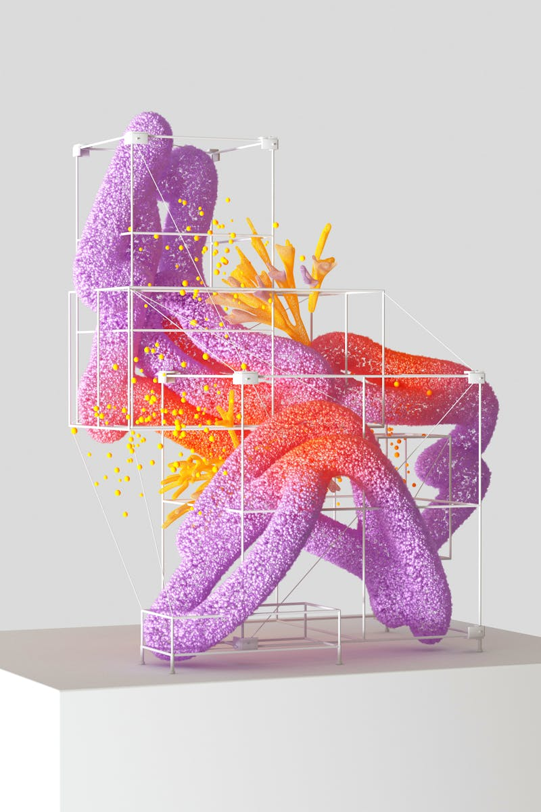
Introducting the Planetary Climate Monitoring Dashboard
Explore the revolutionary interactive dashboard that visualizes climate data from various planets, including our own Earth.
This tool connects users with satellite data, unlocking insights into planetary climates and their evolution.
The dashboard serves scientists, educators, and enthusiasts alike, fostering a collaborative environment for climate monitoring.
Join us on a journey to understand how different planets experience climate change and what we can learn from them.
Photo by Pexels

Slide 4
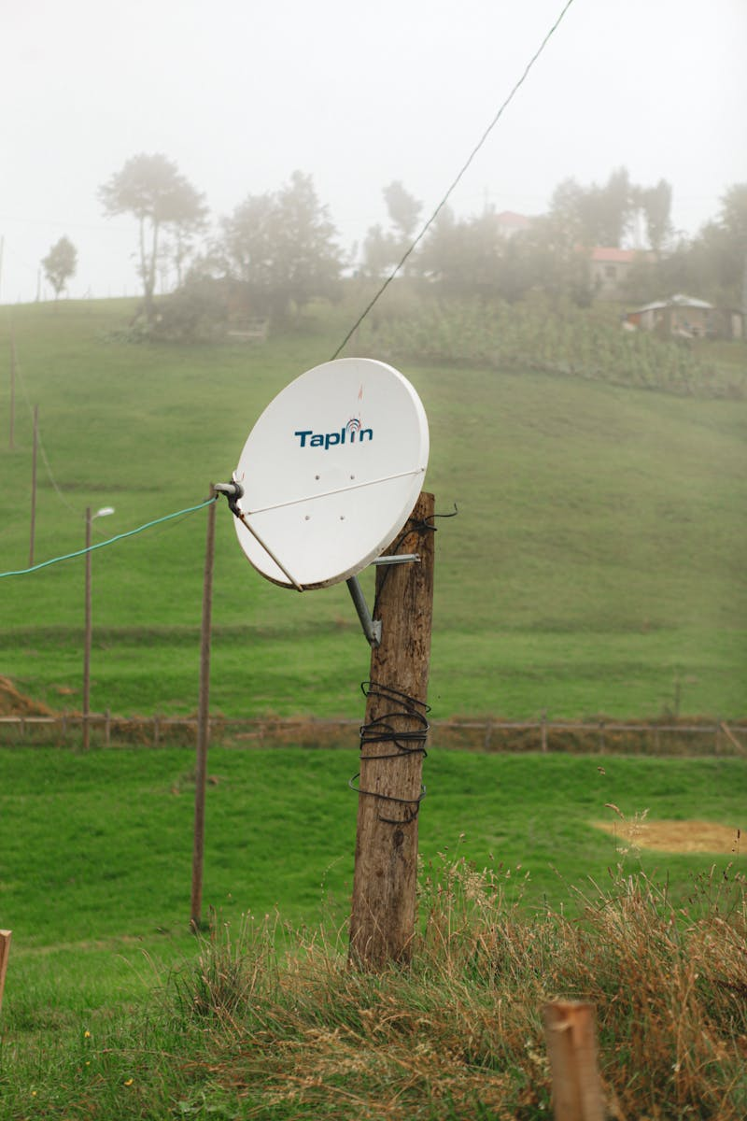
Understanding Climate Data Integration
The dashboard integrates diverse satellite data, ensuring real-time updates and accurate climate tracking.
Users can analyze weather patterns, temperature changes, and other vital statistics from multiple celestial bodies.
Engaging visuals make complex data accessible, translating information into comprehensible insights for all.
Enhanced features allow for comparisons between Earth and other planets, illuminating the uniqueness of our climate.
Photo by Pexels

Slide 5

User-Friendly Interface and Features
An intuitive design invites users of all backgrounds to explore climate data effortlessly without any technical knowledge.
Interactive elements allow users to manipulate data visualizations, enhancing user engagement and understanding.
Customizable views enable users to focus on specific data points, preferred planets, or particular timeframes.
Contextual help guides also provide insights, making learning seamless and enjoyable.
Photo by Pexels

Slide 6

Real-World Impacts and Applications
This dashboard can be a pivotal educational tool in schools, promoting environmental awareness among students of all ages.
Researchers can use the data for climate studies, helping develop insights into climate change trends across the solar system.
Businesses can leverage the information for trends in agricultural practices, resource management, and sustainability planning.
The dashboard supports global initiatives, fostering collaboration in climate monitoring and research.
Photo by Pexels

Slide 7
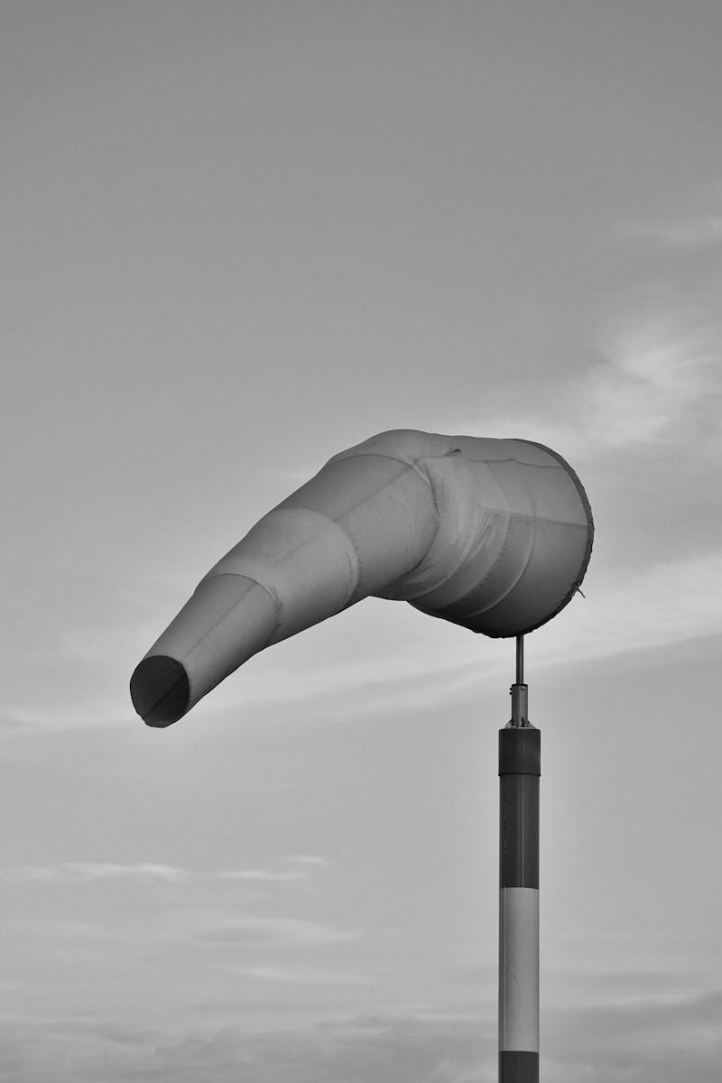
Thank You for Your Attention
Thank you for exploring the Planetary Climate Monitoring Dashboard with us today!
Let's harness this innovative tool to understand our universe and protect our planet better.
We invite you to engage with the dashboard and share your insights with others in the community.
Together, we can make informed decisions that positively impact our world and beyond.
Photo by Pexels

