Slide 1
Segmentation & Clustering of Neighborhoods in London & Paris
Saurav Menon M

Slide 2
INTRODUCTION
Travel has been a part of our lives for a long time. Travel Experiences give our travelers the ability to experience the local culture while traveling in a relaxed way. Traveling is one of the best way to enhance personal growth.
It enables you to do things different from your daily routine activities. When you travel, you step out from your comfort zone to a different environment which makes you become more responsible and gives a sense of independence.
The aim is to help tourists choose their destinations depending on the experiences that the neighbourhoods have to offer and what they would want to have.
This also helps people make decisions if they are thinking about migrating to London or Paris or even if they want to relocate neighborhoods within the city.
Our findings will help stakeholders make informed decisions and address any concerns they have including the different kinds of cuisines, provision stores and what the city has to offer.

Slide 3
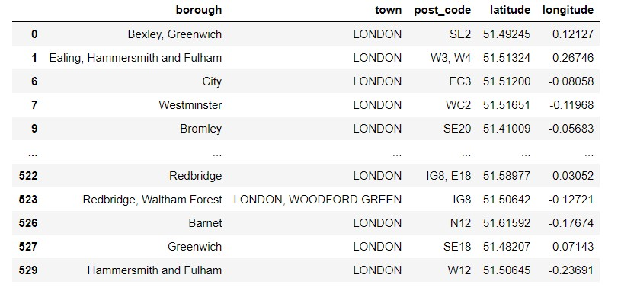
NEIGHBORHOOD CAPACITY
London-

Slide 4
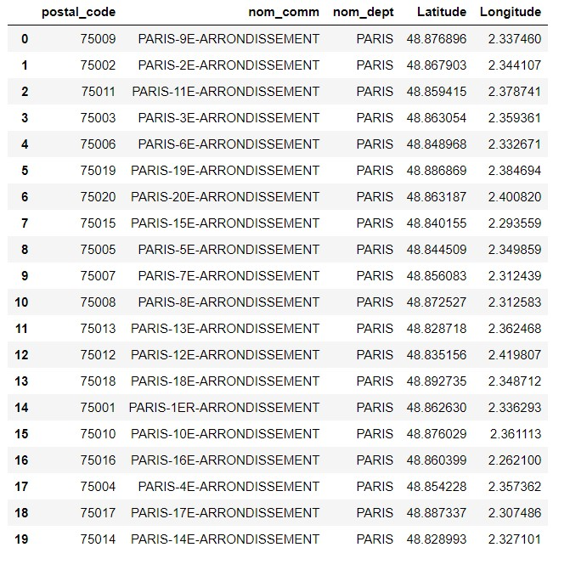
Paris-

Slide 5
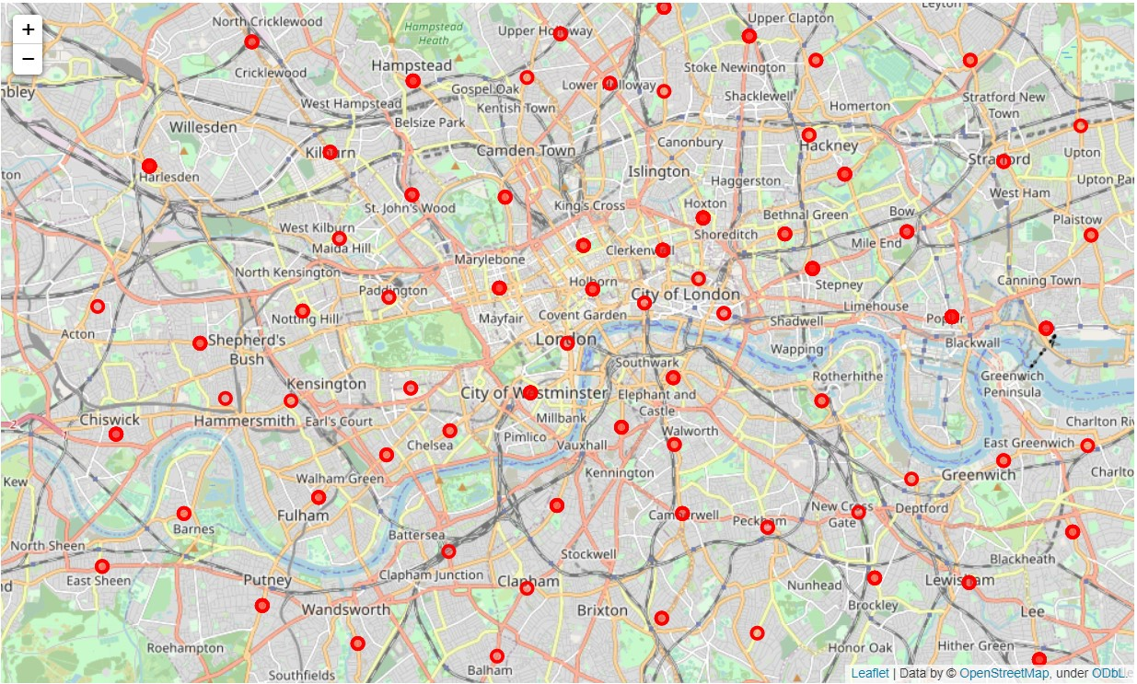
VISUALIZATION
London-

Slide 6
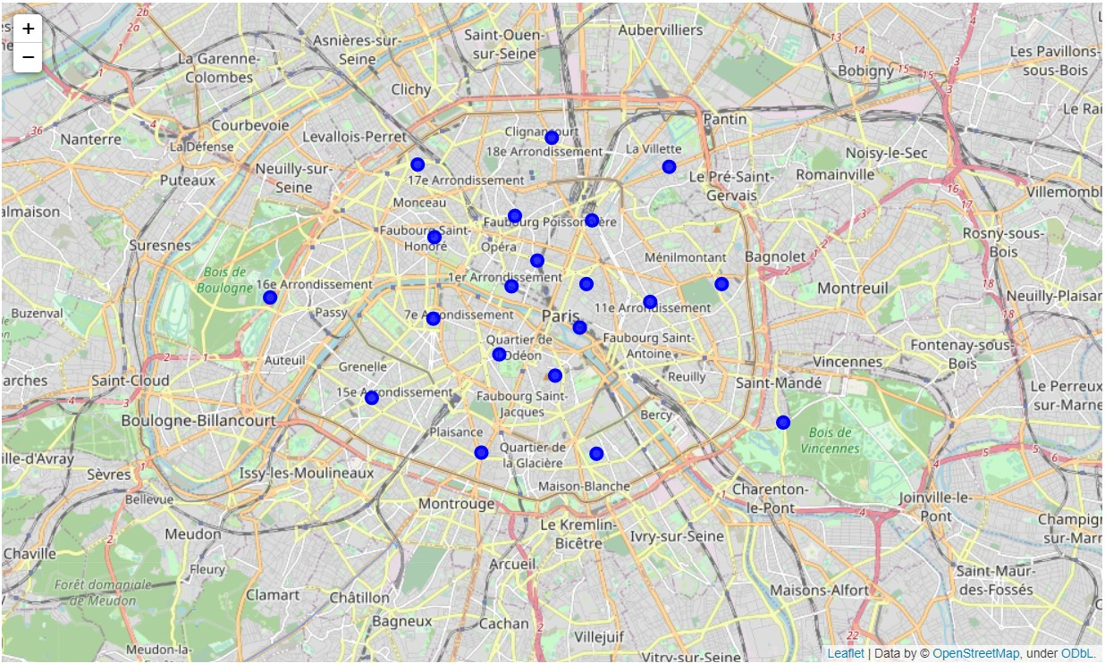
Paris-

Slide 7
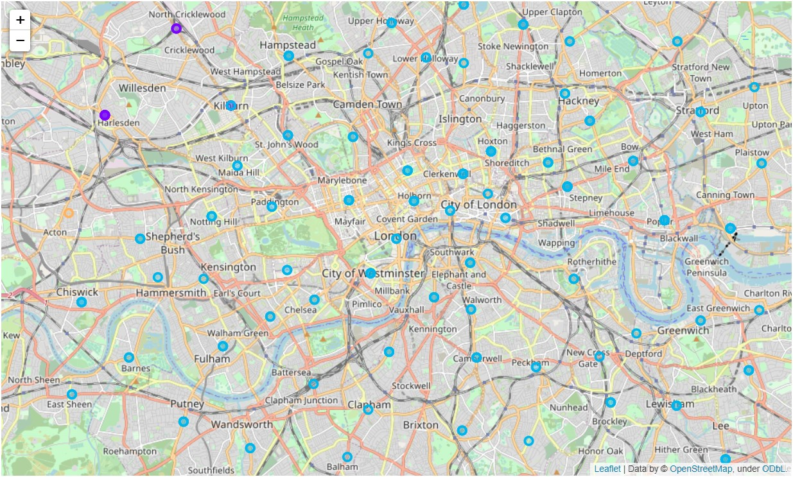
CLUSTERING
London after Clustering-

Slide 8
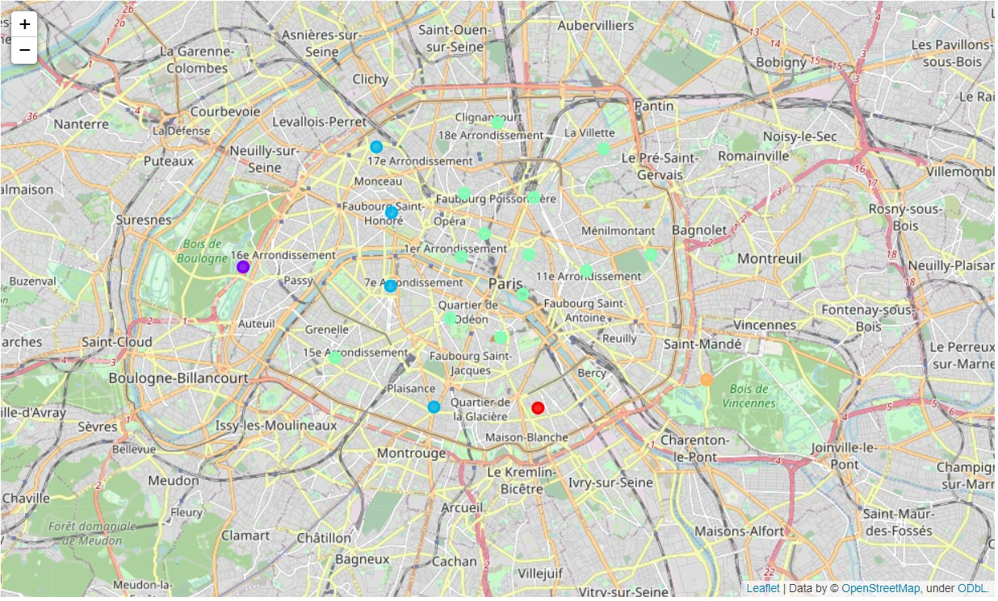
Paris after Clustering-

Slide 9
RESULT
The neighborhoods of London are very multicultural. There are a lot of different cuisines including Indian, Italian, Turkish and Chinese. London seems to take a step further in this direction by having a lot of Restaurants, bars, juice bars, coffee shops, Fish and Chips shop and Breakfast spots. It has a lot of shopping options too with that of the Flea markets, flower shops, fish markets, Fishing stores, clothing stores. The main modes of transport seem to be Buses and trains. For leisure, the neighborhoods are set up to have lots of parks, golf courses, zoo, gyms and Historic sites.
Overall, the city of London offers a multicultural, diverse and certainly an entertaining experience.
Paris is relatively small in size geographically. It has a wide variety of cuisines and eateries including French, Thai, Cambodian, Asian, Chinese etc. There are a lot of hangout spots including many Restaurants and Bars. Paris has a lot of Bistro's. Different means of public transport in Paris which includes buses, bikes, boats or ferries. For leisure and sight seeing, there are a lot of Plazas, Trails, Parks, Historic sites, clothing shops, Art galleries and Museums.
Overall, Paris seems like the relaxing vacation spot with a mix of lakes, historic spots and a wide variety of cuisines to try out.

