Slide 1
Cyclistic Bike Sharing
A Comparative Study of Members and Casual Bikers.

Slide 2
Business Task: To analyse how annual members and casual riders use Cyclistic bikes differently.
Business Goal: To maximize the number of annual members of Cyclistic bikes.

Slide 3
Data Source And Licence.
Data Source: Lyft Bikes and Scooters, LLC (“Bikeshare”)
Data weblink: https://divvy-tripdata.s3.amazonaws.com/index.html
Data License: Open data freely available on the web.
Data license weblink: https://www.divvybikes.com/data-license-agreement

Slide 4
Data Summary. Period: Year 2022
Ride Length (duration in seconds) Analysis.
Mean: 1232.143
Median: 630
Max: 2483235
Min: 0

Slide 5
Data Summary. Period: Year 2022
Ride Length (duration in seconds) Analysis.
Maximum:
Casual: 2483235 Member: 93594
Mean:
Casual: 1901.10 Member: 770.28

Slide 6
Basic Summary:
The ride length durations of casual bikers are much larger then member bikers.

Slide 7
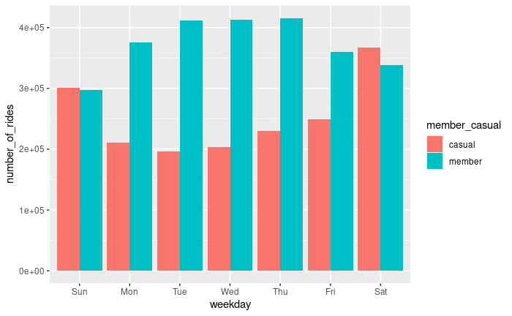
Analysis: Average number of rides of casual vs member bikers binned by weekdays.

Slide 8
Analysis Conclusions: Average number of rides of casual vs member bikers binned by weekdays.
Member bikers use their bikes mostly to commute to work in weekdays.
Casual bikers use bikes with low frequency in weekdays.
In weekends both casual and members use bikes for relaxation or exercising purposes with equal frequency.

Slide 9
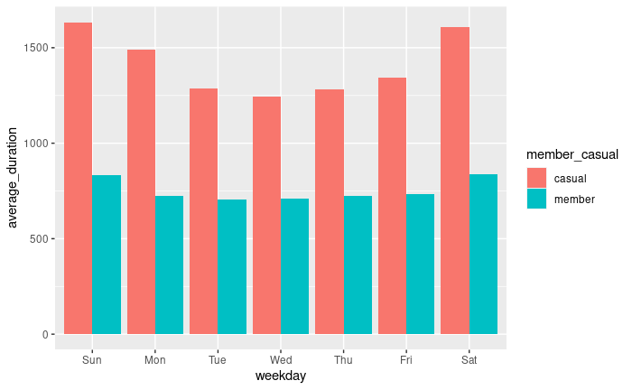
Analysis: Average trip duration of rides of casual vs member bikers binned by weekdays.

Slide 10
Analysis Conclusions: Average trip duration of rides of casual vs member bikers binned by weekdays.
Member bikers use their bikes mostly to commute to work in weekdays and use bikes for a much shorter period then casual bikers.
In weekends casual bikers use bikes for long durations but members use bikes for short durations.

Slide 11
Executive Recommendations:
Levy a small penalty / excess fee for weekend casual bikers, or impose other restrictions on casual bikers in weekends. This will free up more bikes for members in weekends and generate more revenue and may increase member numbers.
Impose a general restriction on the duration of rides of casual bikers. This will free up more bikes for members and generate more revenue and may increase member numbers.

Slide 12
Thank You.
Created By: Saurav Das.
As the final google data analytics capstone project february 2023.

