Slide 1
Physical Education Art and Integrated Project
on
“Yoga”
tenured at “Oceanatech TECHNOLOGIES India Pvt ltd”
Submited By
Ankita
Submited To:-Manoj
Roll no.:- 12
Section:-E

Slide 2
Content
Introduction
History Og Yoga
A detailed look at different forms of yoga
Type Of Asnas

Slide 3
Introduction To Yoga:
Yoga is a mind and body practice. Various styles of yoga combine physical postures, breathing techniques, and meditation or relaxation. ... It involves movement, meditation, and breathing techniques to promote mental and physical well-being. There are several types of yoga and many disciplines within
the practice.
Yoga is basically a spiritual discipline which is based on an extremely subtle science that concentrates on bringing harmony between mind and body. It is a science and an art of healthy and sound living. The word 'Yoga' is derived from the Sanskrit word 'Yuj', signifying 'to join' or 'to combine' or 'to unite'. Both Yoga and Ayurveda are historically closely related and have developed in tandem with each other since ancient times. According to Yogic sacred writings the act of Yoga prompts the union of individual consciousness with that of the Universal Consciousness, showing an ideal congruity between the mind and body, Man and Nature.

Slide 4
History Of Yoga.
The science of Yoga has its origin some thousands of years ago long before any religion and belief systems were born and the practice of Yoga is believed to have started with the very dawn of the civilization. In the yogic legend, Shiva is viewed as the main yogi or Adiyogi, and the principal Guru or Adi Guru.
A few thousand years back, on the banks of the lake Kantisarovar in the Himalayas, Adiyogi poured his significant knowledge into the legendary Saptarishis or "seven sages". The sages took this effective yogic science to various parts of the world, including Asia, the Middle East, Northern Africa and South America. Intrestingly, present day researchers have noted and wondered about the nearby parallels found between ancient societies over the globe. However, it was in India that the yogic framework discovered its complete expression. Agastya, the Saptarishi who travelled across the Indian subcontinent, made this culture around a core yogic lifestyle.
The Number of seals and fossil remains of Indus Saraswati valley civilization with Yogic thought processes and figures performing Yoga Sadhana propose the presence of Yoga in ancient India. The phallic symbols, seals of idols of mother Goddess are suggestive of Tantra Yoga. Presence of Yoga is accessible in Folk traditions, Indus valley civilization, Vedic and Upanishadic heritage, Buddhist and Jain customs, Darshanas, sagas of Mahabharat and Ramayana, mystical customs of Shaivas, Vaishnavas, and Tantric customs. Furthermore, there was a primordial or unadulterated Yoga which has been showed in mystical customs of South Asia.

Slide 5
A detailed look at different forms of yoga:
Pre-classical Yoga:
The beginnings of Yoga were developed by the Indus-Sarasvati civilization in Northern India more than 5,000 years back. The word yoga was initially mentioned in the old sacred texts, the Rig Veda. The Vedas were a collection of writings containing songs, mantras and rituals to be utilized by Brahmans, the Vedic priests. Yoga was gradually refined and enhanced by the Brahmans and Rishis (spiritualist diviners) who archived their practices and convictions in the Upanishads, an immense work containing more than 200 sacred scriptures. The most famous of the Yogic sacred texts is the Bhagavad-Gita, composed around 500 B.C.E. The Upanishads took the idea of ritual sacrifice from the Vedas and internalized it, teaching the sacrifice of the ego through self-knowledge, action (Karma Yoga) and wisdom (jnana Yoga).
Classical Yoga:
In this era, Yoga was a combination of various ideas, beliefs and techniques that contradicted and conflicted with each other. The Classical period is defined by Patanjali’s Yoga-Sutras, the first systematic presentation of yoga. This text narrates the way of Raj Yoga, wasdocumented sometime in the second century and is often called "classical yoga". Patanjali organized the practice of yoga into an "eight limbed path" containing the steps and stages towards obtaining Samadhi or enlightenment. Patanjali is known as the father of yoga and his Yoga-Sûtras still strongly influence most styles of modern yoga.

Slide 6
Post Classical Yoga:
A few centuries after Patanjali, yoga masterscreated a system of practices designed to rejuvenate the body and prolong life. They dismissed the lessons of the old Vedas and held onto the physical body as the way to achieve enlightenment. They created Tantra Yoga, with radical methods to purify the body and mind to break the knots that bind us to our physical existence. Theexploration of these physical- spiritual connections and body focused practices prompted the formation of what we fundamentally consider yoga in the West: Hatha Yoga.

Slide 7
TYPE OF YOGA ASANAS
ARDHA CHAKRSANA (HALF WHEEL POSTURE) This posture resembles half wheel in final position, so it’s called Ardha Chakrasana or half wheel posture.
TADASANA (PALM TREE POSE) In Sanskrit ‘Tada’ means palm tree. In the final position of this posture, the body is steady like a Palm tree, so this posture called as ‘Tadasana’.
TRIKONASANA(TRIANGLE POSTURE) The final position of this posture looks like a 'triangle' in shape, so it’s called Trikonasa or triangular stretch pose.
VEERABHADRASANA -2
‘Veera Bhadra' is one of the Gana (can call as Soldier) of Lord Shiva. This pose dedicated to him, so this posture is called as Veerabhadrasana. This posture also called as Warrior pose.
PARSHWA KONASANA (SIDE ANGLE POSTURE) In Sanskrit ‘Parshwa’ means Side, ‘Kona’ means angle. In the final position of this posture, the body forms a side angle, so this posture called as Parshwa Konasana.
BHUJANGAASANA The final position of this posture emulates the action of cobra raising itself just prior to striking at its prey, so it’s called cobra posture or Bhujangasan.
PADAHASTASANA "Pada" means foot, "hasta" means hand. So the exact English translation is the foot hand pose. This asana widely called as the forward bending posture.
USTRASANA The final position of this posture looks like Camel, so its called camel posture or Ustrasana.
MARJARASANA 'Marjara' means Cat, this posture imitates the periodical upward and down word stretching of the Cat, so it’s called Marajarasana.

Slide 8
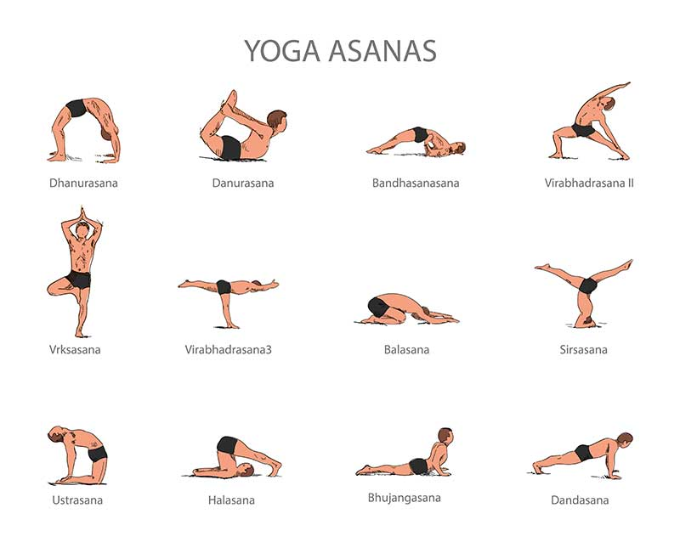

Slide 9
PASCHIMOTTANASANA Paschima means back or west, 'uttana' means to stretch, in this posture back stretches nicely, so-called back stretching pose. This posture also called as Ugrasana.
ARDHA MATSYENDRASANA (HALF-SPINAL TWIST POSE) Great yogi Matsyendra Nath did meditation in this posture. So this posture called as Ardha Matsyendrasana.
PADMASANA 'Padma' means lotus, the final position of this posture looks like lotus, so it is called Padmasana.
ANANTA SHAYANASANA ‘Ananta shayana’ refers to Lord Vishnu. During ‘maha pralaya’ Lord Vishnu slept above ‘Adishesha’(1000 headed serpent) in this position. So this posture called as Ananta Shayanasana.
PAVANA MUKTASANA In Sanskrit ‘Pawan’ means wind, ‘Mukta’ means release. This posture is very useful in removing wind from the intestines and stomach. So this posture called as "Pawan muktasana".
PURVAUTTANASAN ‘Purva’ refers to the front part of the body.‘Uttana’ means raising. The front part of the body is rising in the final position of this posture, so it’s called "Purvottanasana".
VRKSHAASANA(TREE POSTURE) 'Vrksha' means tree, the final position of the posture resembles a tree. So it is called Vrkshasana or one leg stand.
GARUDASANA (EAGLE POSE)
Garuda is the vehicle of Lord Vishnu. This posture resembles garuda or eagle so it’s called as Garudasana.

Slide 10
ThankYou

