Slide 1

Cloud Computing Topic: Group Portfolio Group Members: Amol Gautam Div A, Roll No-48 Rajesh Gowda Div A, Roll No-52 Saurav Gupta Div A, Roll No-55

Slide 2
Problem Statement
1) Many organizations have multiple projects or initiatives running simultaneously, which can make it difficult to effectively manage and track progress across the entire portfolio. This lack of visibility can lead to resource inefficiencies, missed opportunities, and strategic misalignment.
2) Additionally, individual project managers may not have a comprehensive understanding of how their projects fit into the larger portfolio and how they impact each other. As a result, organizations may struggle to make informed decisions about which projects to prioritize and allocate resources to, leading to delays in project delivery or even project failure.
3) Therefore, there is a need for a robust group portfolio management system that provides a comprehensive view of the entire portfolio and facilitates effective decision-making.

Slide 3
Objectives
Improve visibility and transparency: A key objective of a group portfolio management system would be to provide a comprehensive view of all projects and initiatives within an organization, allowing stakeholders to easily track progress and understand how each project contributes to the larger portfolio.
Prioritize projects strategically: With a better understanding of the entire portfolio, organizations can make informed decisions about which projects to prioritize based on their strategic alignment, potential impact, and resource requirements.
Foster collaboration and communication: A group portfolio management system can facilitate collaboration and communication between project teams, enabling them to share knowledge and best practices, identify dependencies, and avoid conflicts.
Increase efficiency and productivity: By streamlining portfolio management processes and providing real-time visibility into project status and resource utilization, a group portfolio management system can help organizations improve efficiency and productivity.

Slide 4

Technology Stack
1) HTML
2) CSS
3) JavaScript
4) Web Server: Xampp

Slide 5
Proposed System
User Interface Aws Services:
Login Page & AWS EC2
Registration page using Aws RDS
HTML Aws S3
CSS

Slide 6
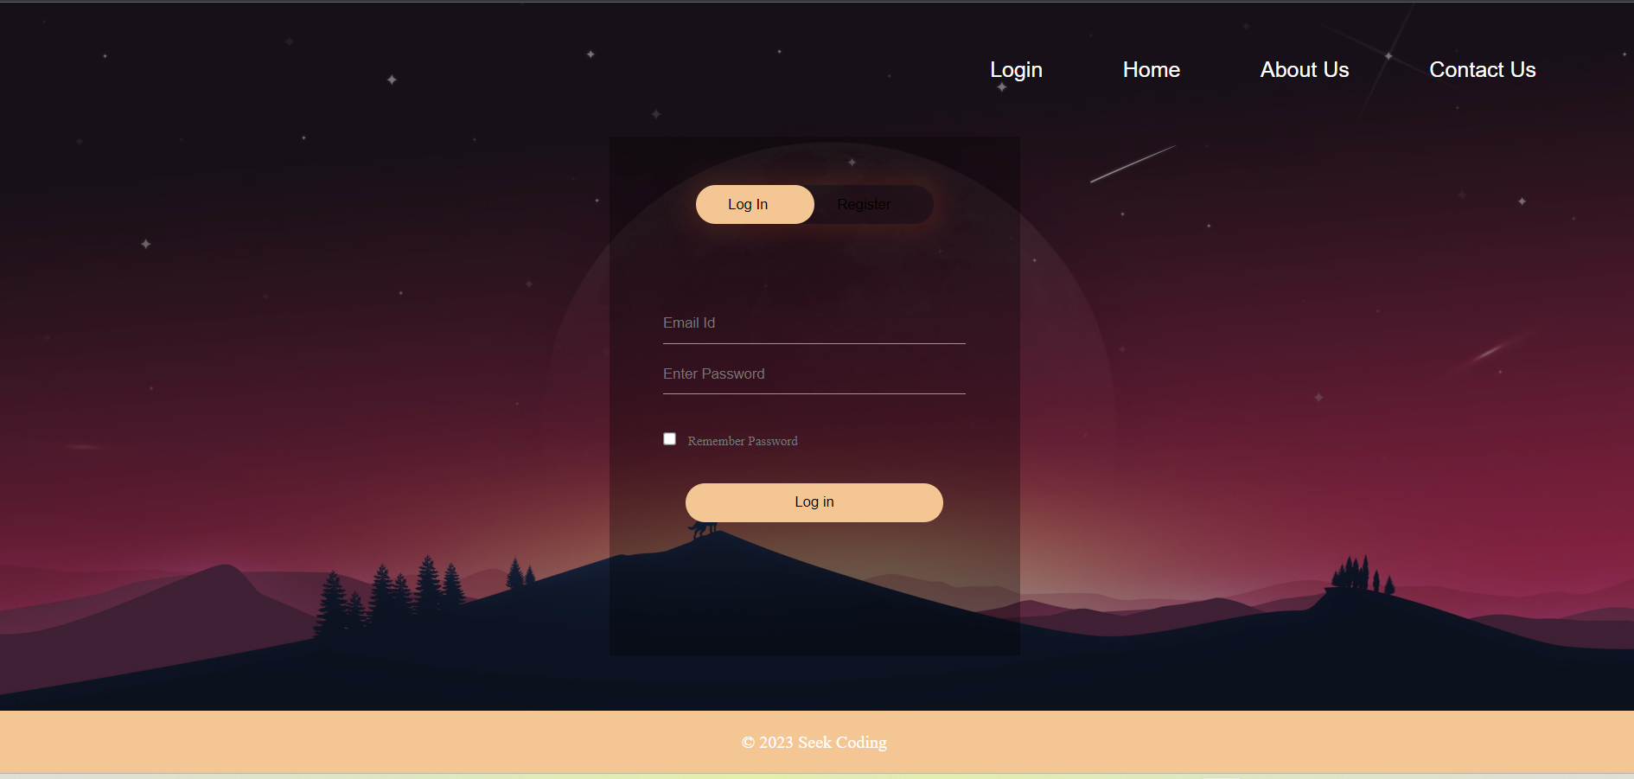
Screenshots
Login Page

Slide 7
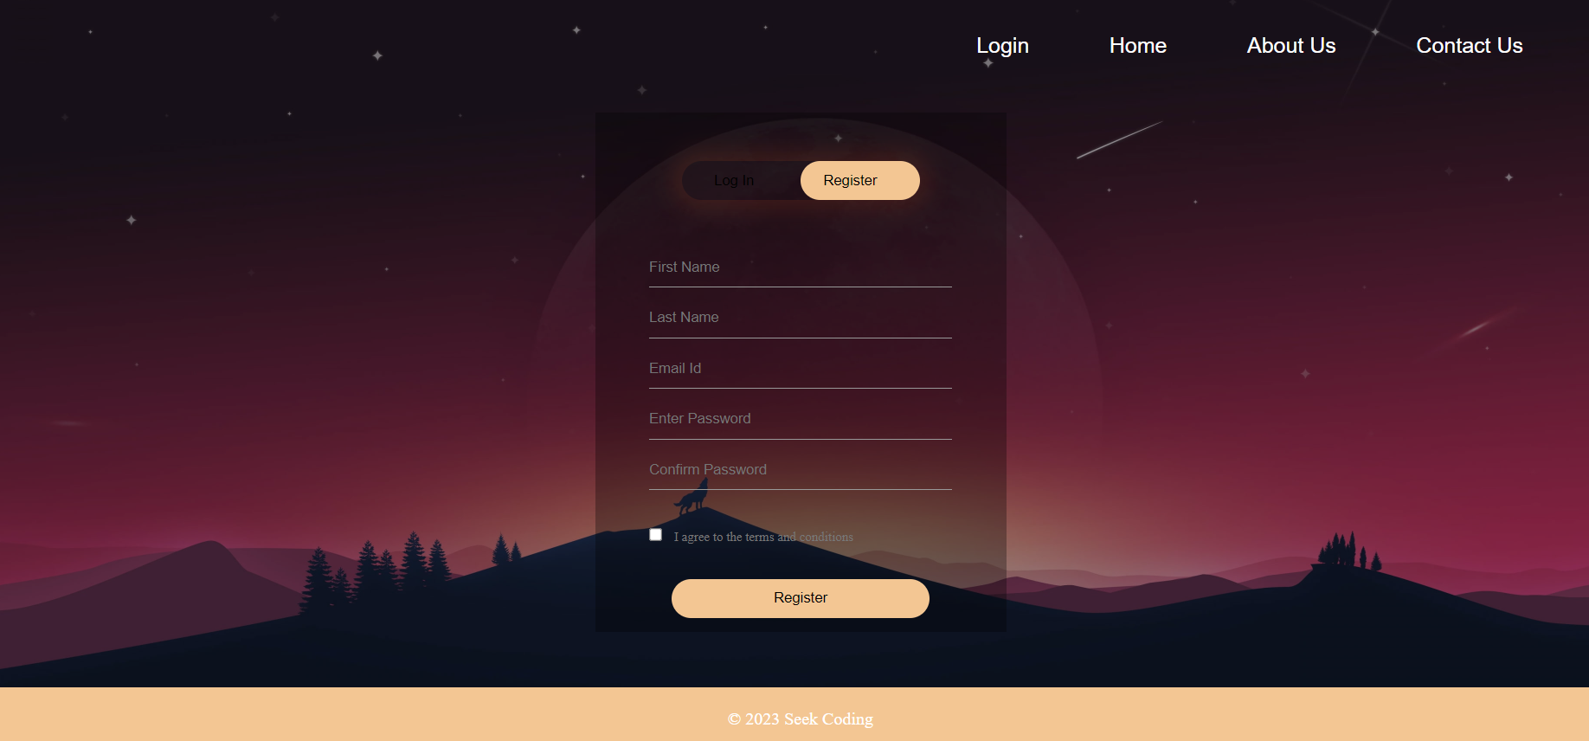
Screenshots
Register Page

Slide 8
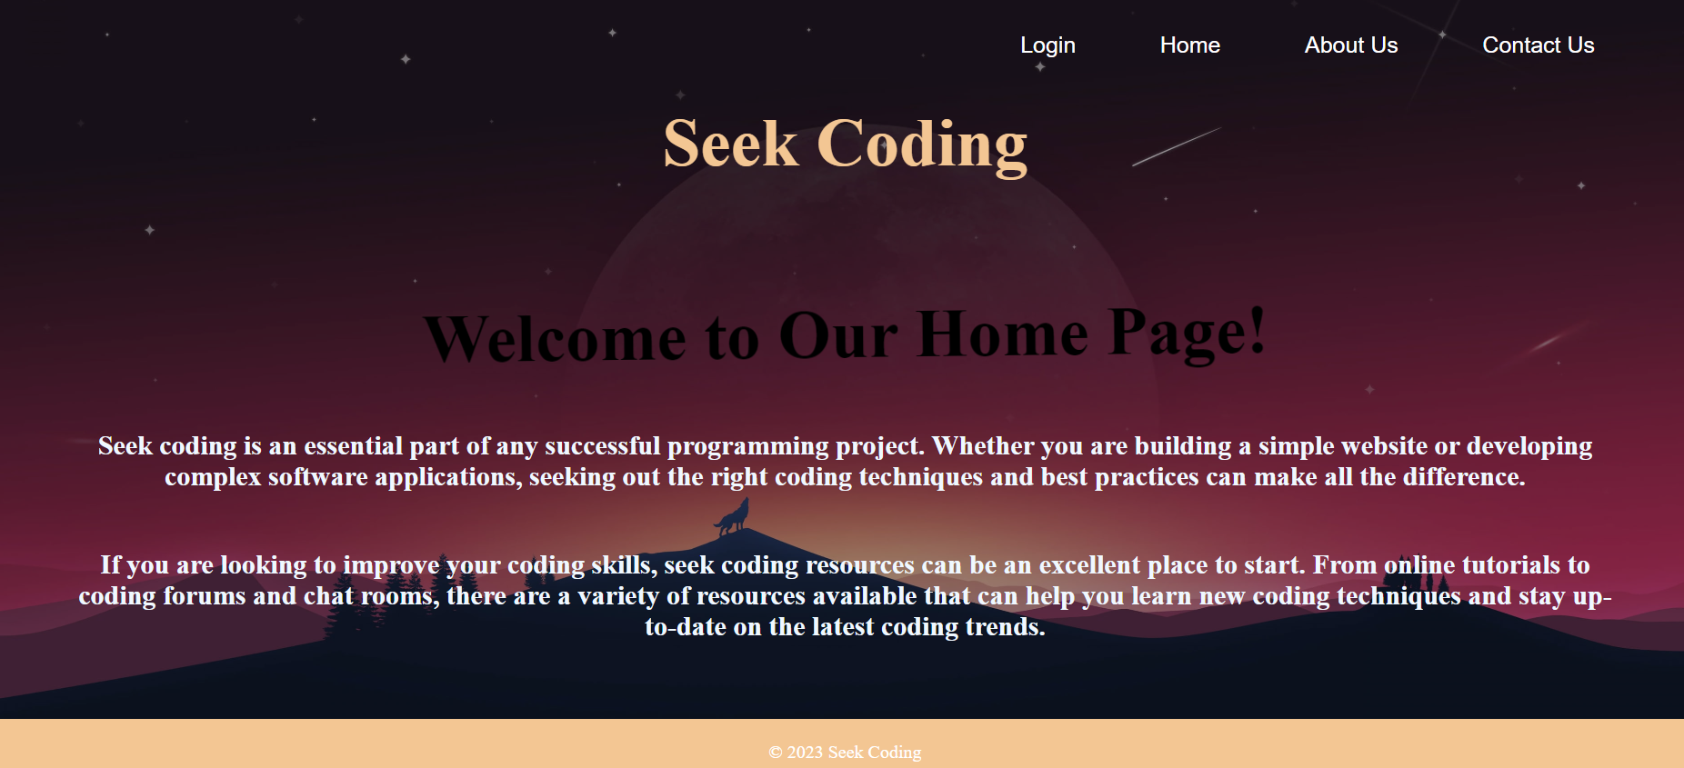
Screenshots
Home Page

Slide 9
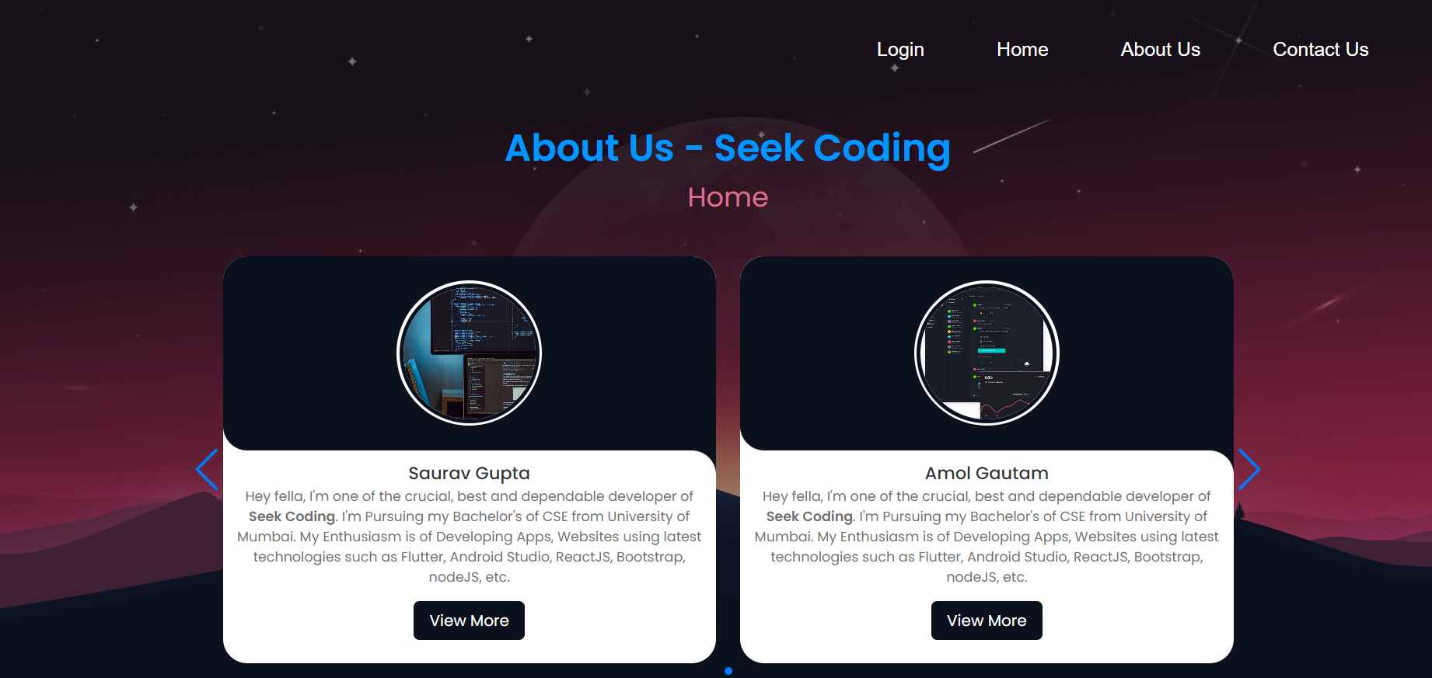
Screenshots
About Us

Slide 10
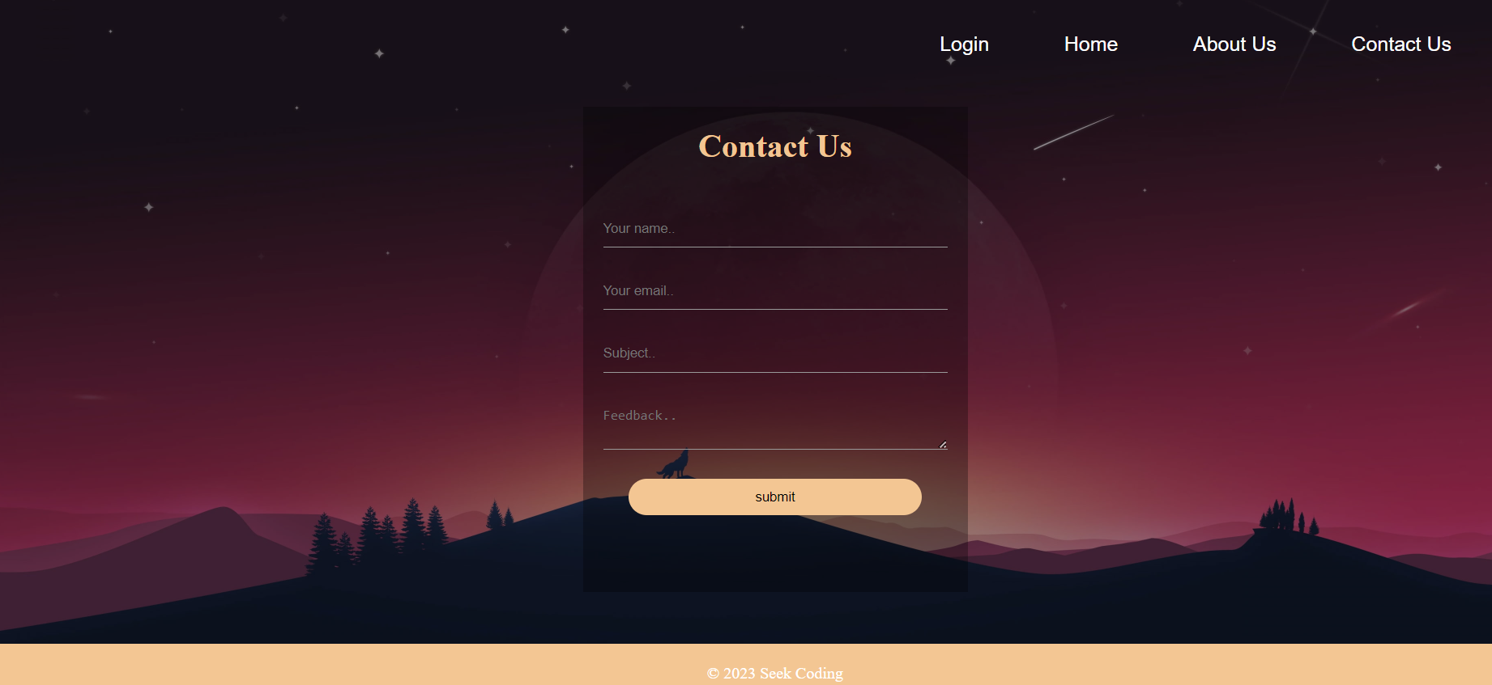
Screenshots
Contact Us

Slide 11
Thank You

