Slide 1
JusticeCast
A Comparative Study of Text Representations
for Predicting Supreme Court Justice Votes from Oral-Argument Questions
Course: BAX 453
Team: [team members — fill in]
Date: 2026-05-28

Slide 2
THE HYPOTHESIS
For 200 years, litigators have read the bench by gut.
Can a model do it from the words alone?
Litigator intuition is real. Senior partners spend hours after every argument inferring the bench's leanings from the texture of the questioning. Junior associates absorb this as a craft.
Citizens United v. FEC, 2009
Argued twice — March 2009 (Stewart for the FEC) and re-argued September 2009 (Kagan for the FEC). Justices peppered both sides with questions about corporate personhood, statutory limits on issue ads, and stare decisis.
Decided 5–4 in January 2010.
Legal-tech firms monetize adjacent products — Lex Machina, Bloomberg Law, Westlaw Edge, SCOTUSblog all sell judge-by-judge ruling history and motion-success rates.
But no widely-available product converts oral-argument transcripts into per-Justice vote forecasts. We tested whether one could.
Could a litigator have read this 5–4 split from the questions on the bench? Could a model?
JusticeCast
2 / 11

Slide 3
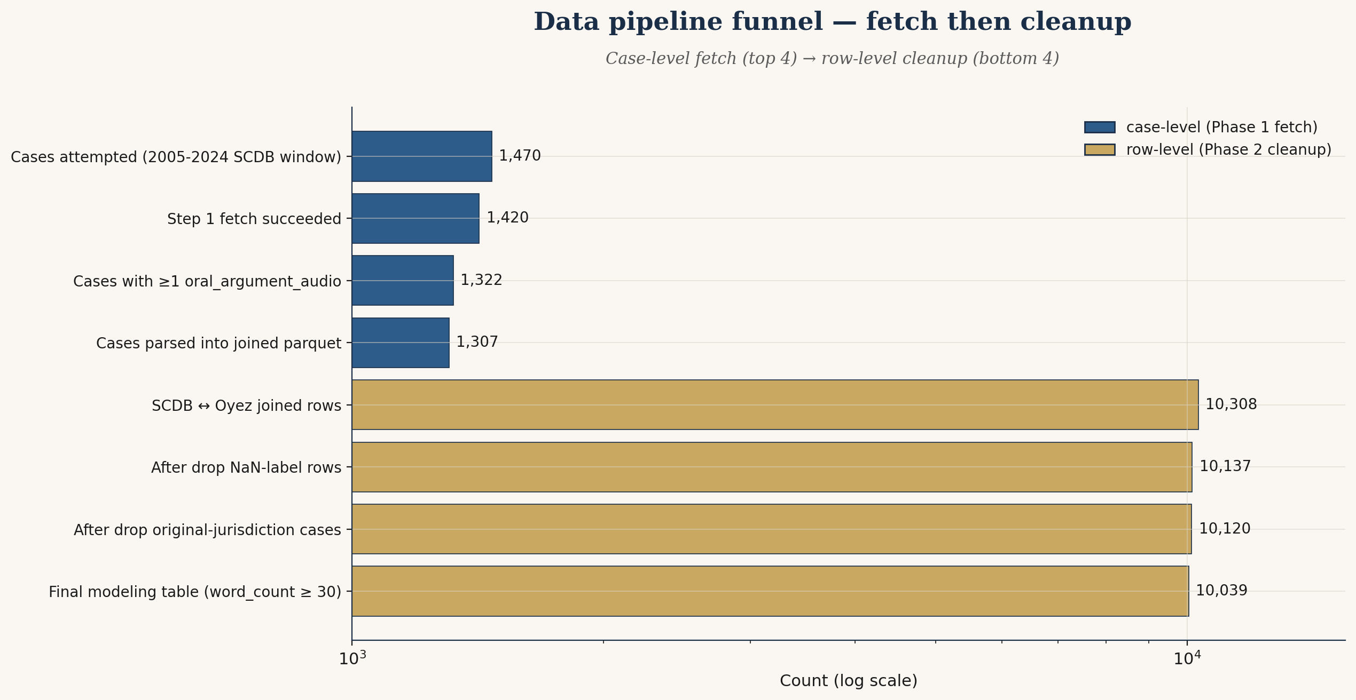
THE DATA
Two free public sources, joined at the case docket
Twenty SCOTUS terms, sixteen Justices, ten thousand utterance rows
SCDB (Supreme Court Database, Wash. U.) — release 2025_01, Justice-Centered file, 83,644 vote rows × 61 columns. Latin-1 encoded. Provides every recorded SCOTUS vote with petitioner/respondent winner, majority/dissent flags.
Oyez.org REST API — two-step fetch (case metadata → transcript audio JSON). Polite limit ≤ 1 request/sec.
No leakage: StratifiedGroupKFold(n_splits=5, random_state=42) with groups=case_id — all of a case's Justices stay in the same fold.
Custom calibrated stopword list preserves thematic legal vocabulary while filtering case-identity terms.
JusticeCast
3 / 11

Slide 4
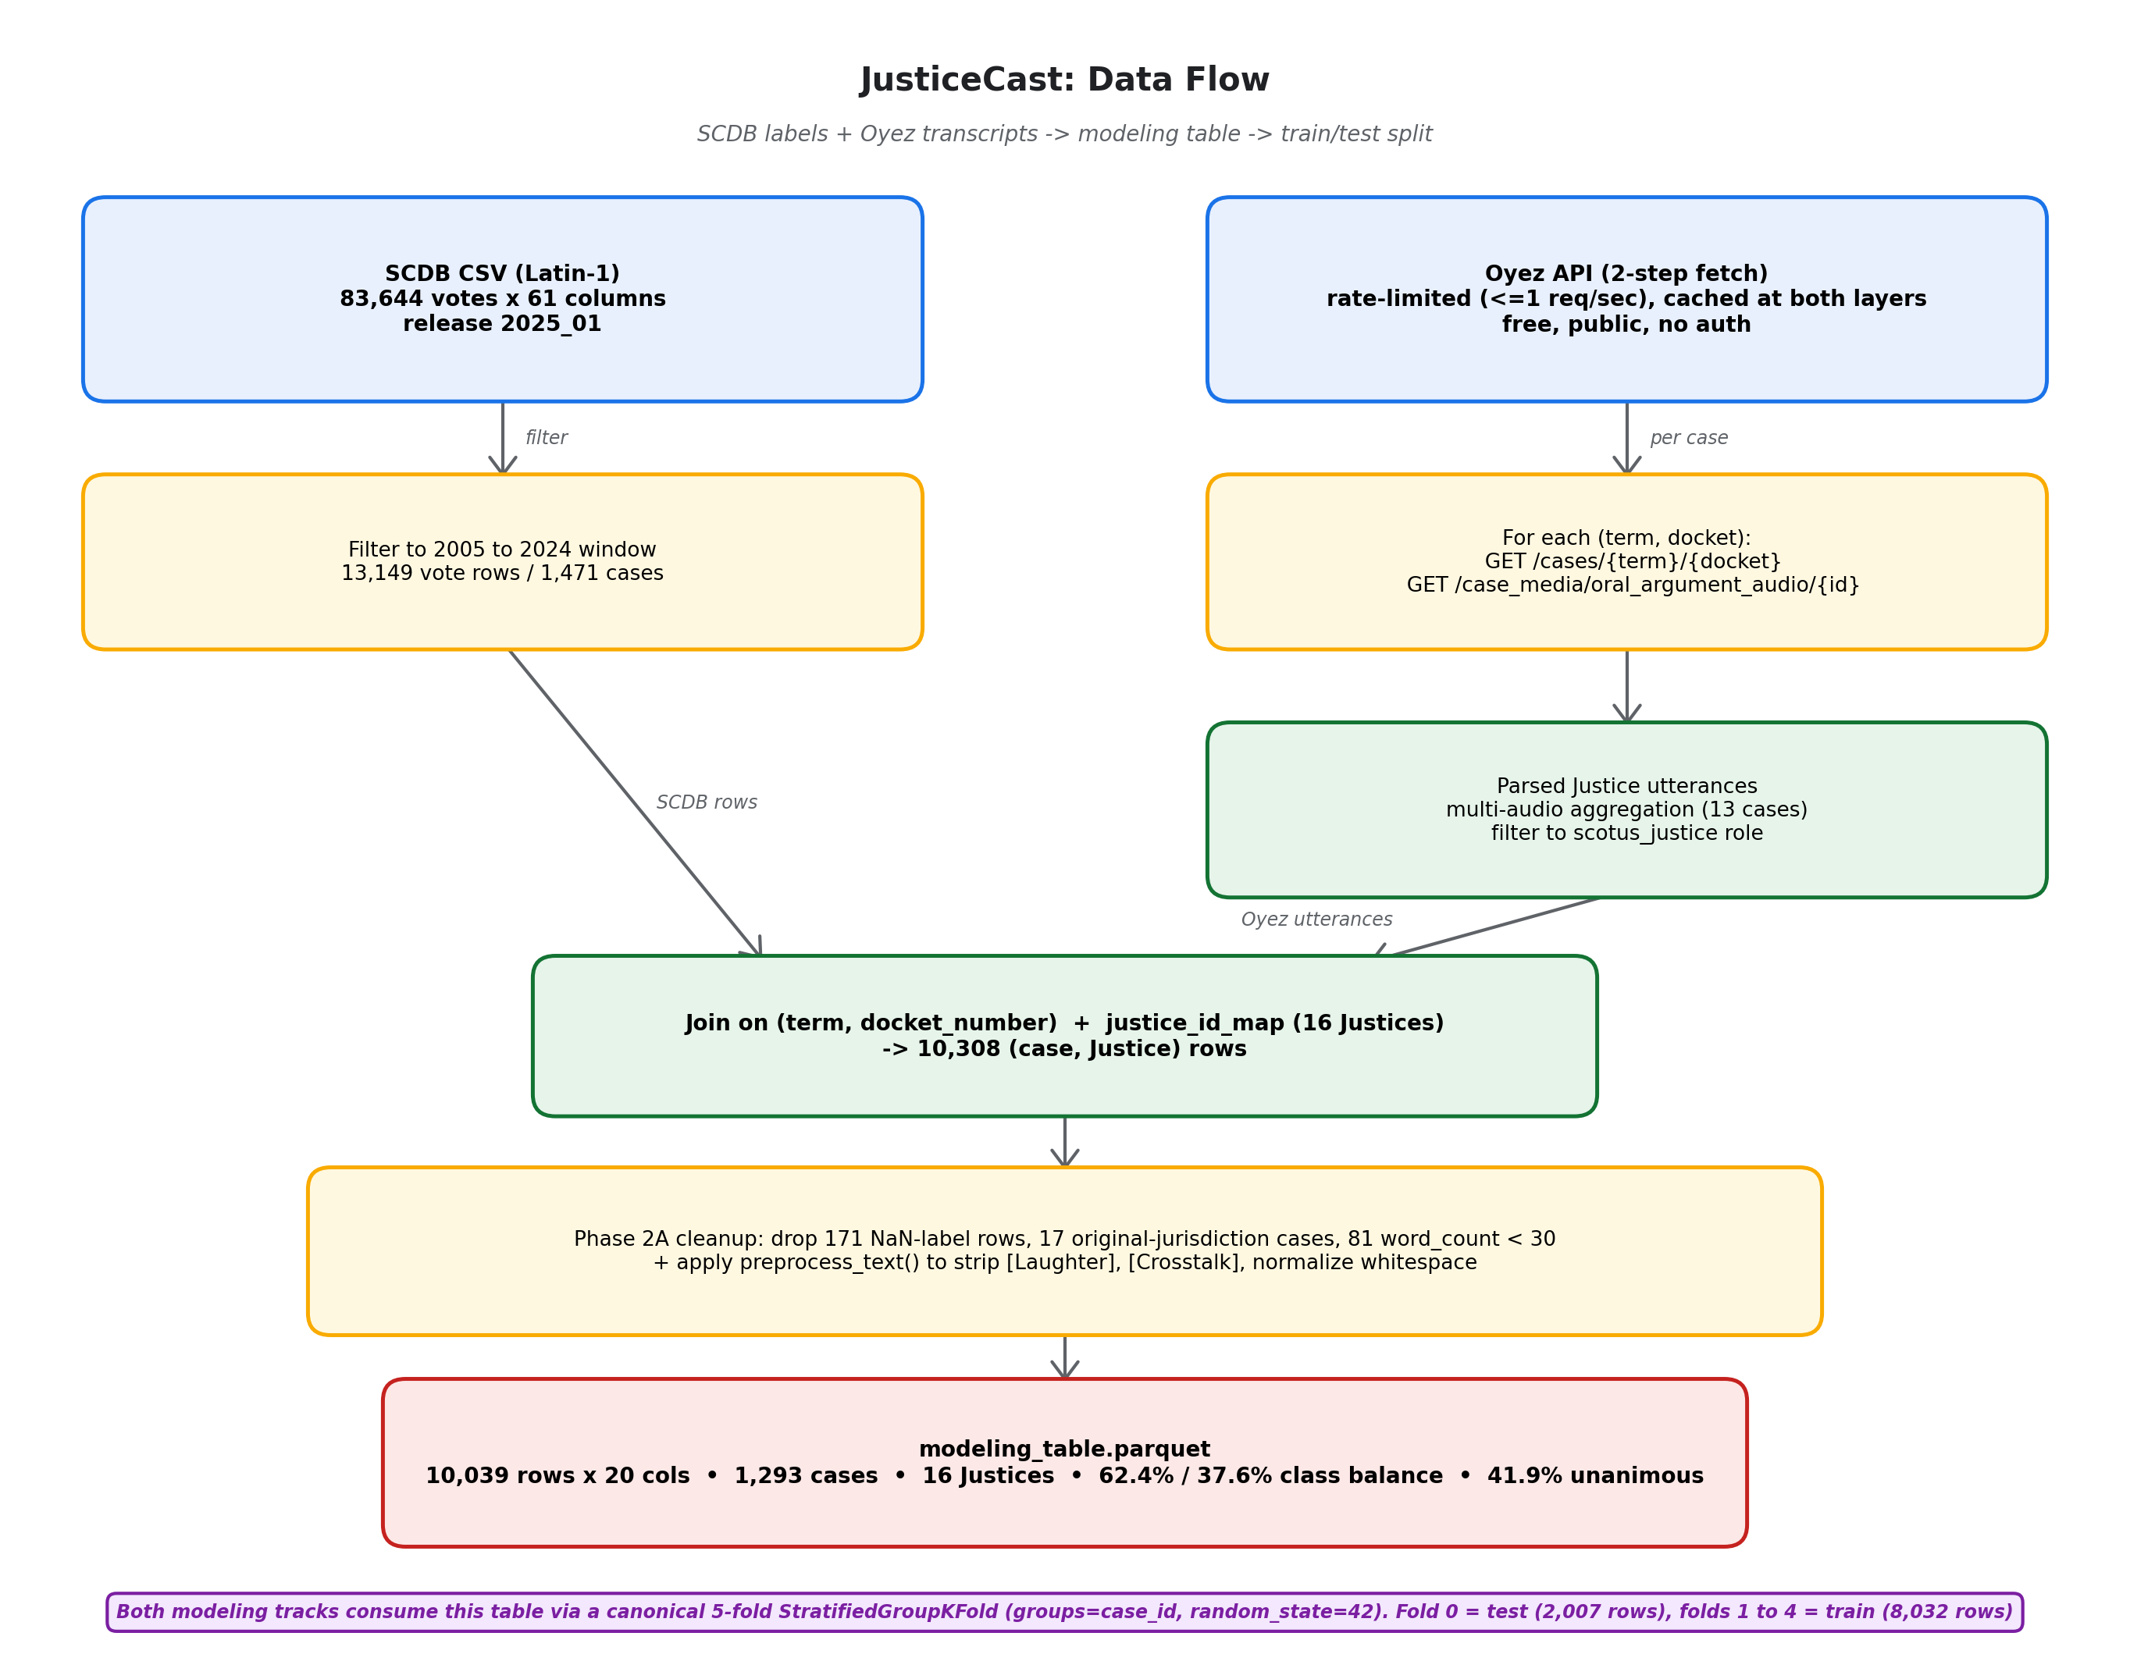
THE COMPARATIVE DESIGN
Two parallel tracks, identical evaluation harness
Track 1 — BoW (rubric-required)
3 vectorizers (Count, TF-IDF unigram, TF-IDF bigram) × 3 classifiers (LogReg, LinearSVC, RandomForest) + GridSearchCV.
Track 2 — Embeddings
Pre-trained all-MiniLM-L6-v2 and all-mpnet-base-v2, no fine-tuning, same three classifier families + GridSearchCV.
Identical fold-0 test rows
Same 2,007 rows, 258 cases. Apples-to-apples comparison (Non-Negotiable #15).
JusticeCast
4 / 11

Slide 5
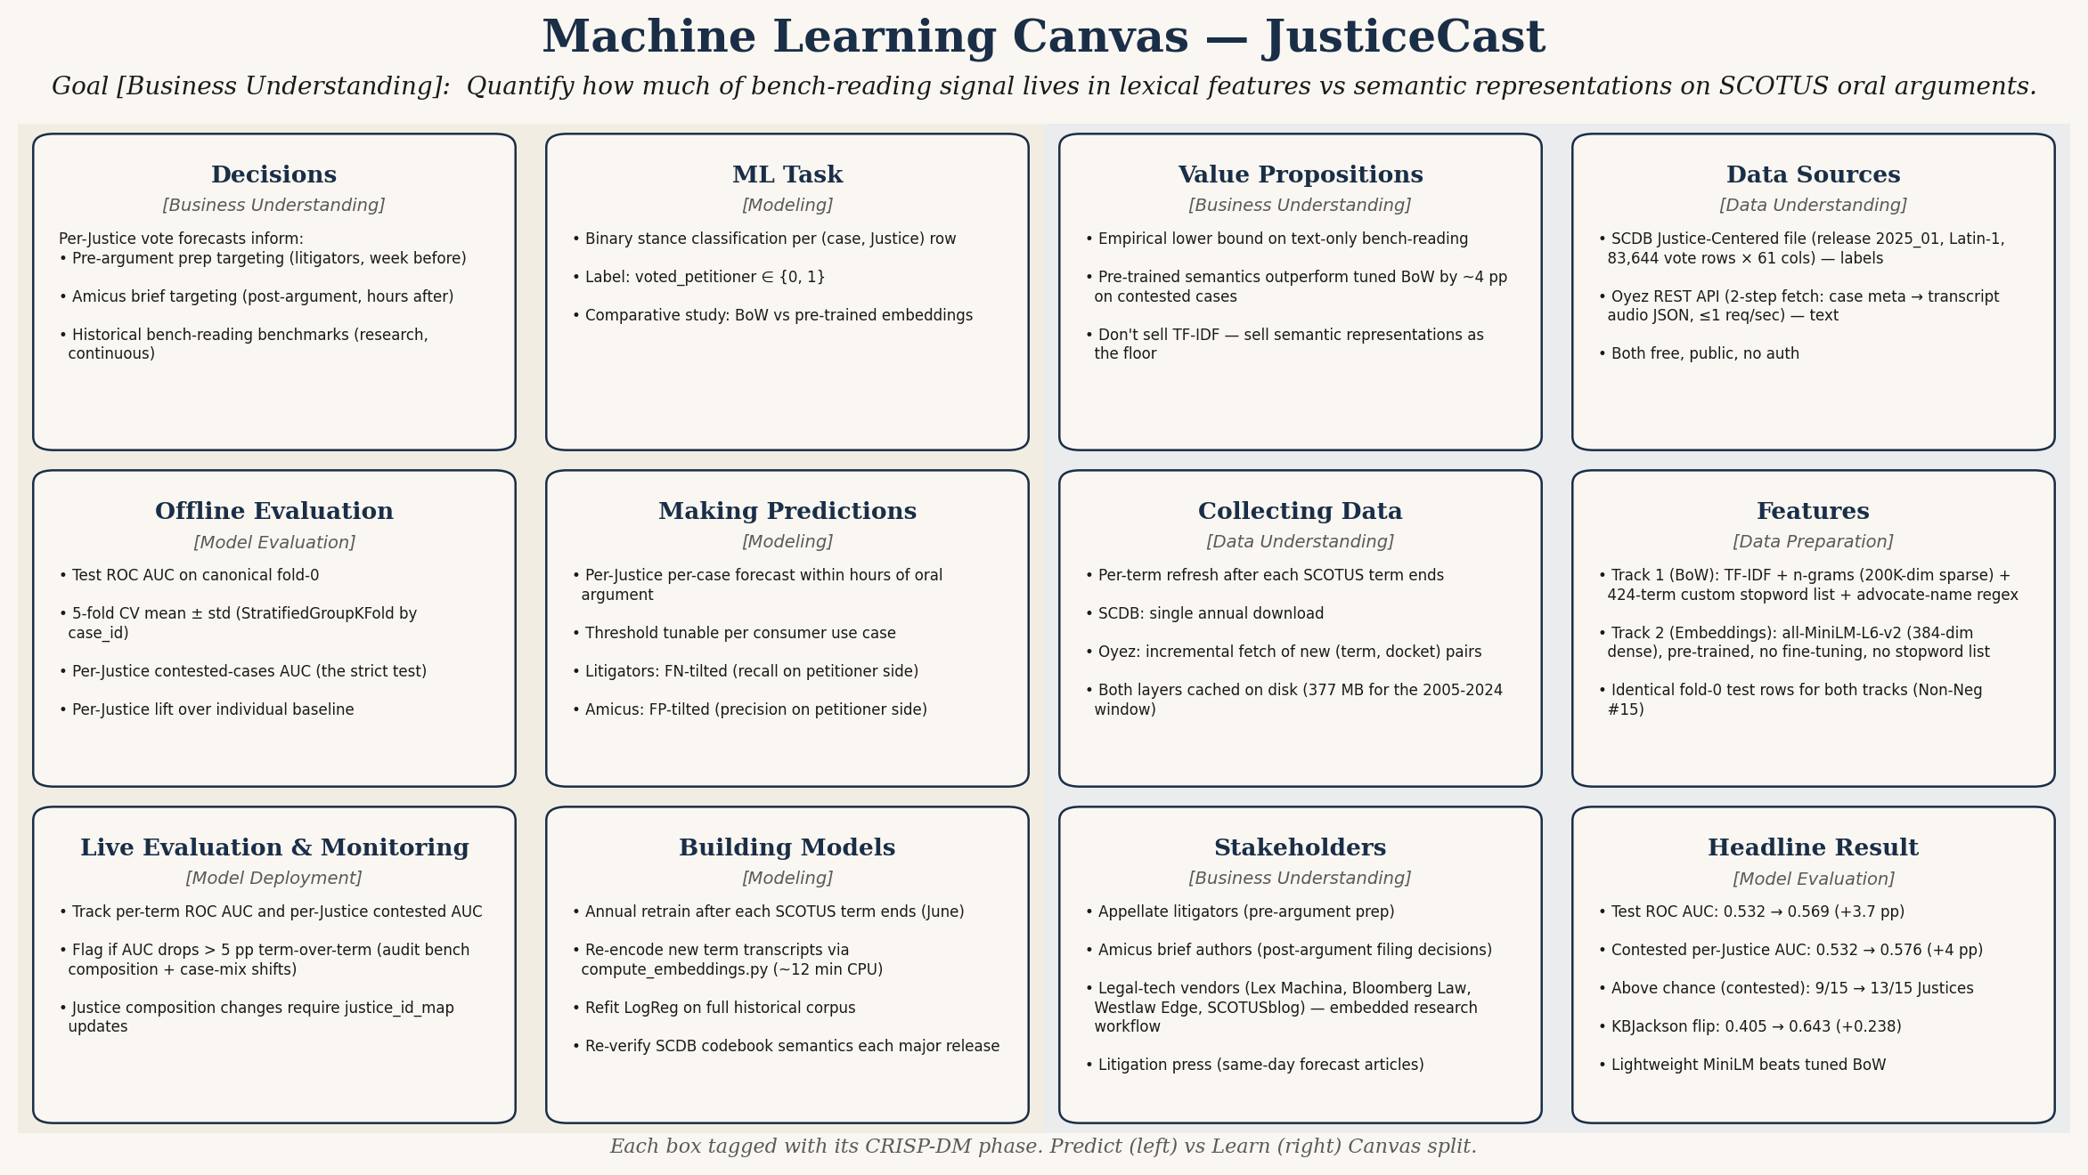
THE PRODUCT FRAMING
Machine Learning Canvas, CRISP-DM-tagged
Each box tagged with its corresponding CRISP-DM phase (Business Understanding / Data Understanding / Data Preparation / Modeling / Model Evaluation / Model Deployment). Predict (left two columns) and Learn (right two columns) Canvas split visible in the background panels.
JusticeCast
5 / 11

Slide 6
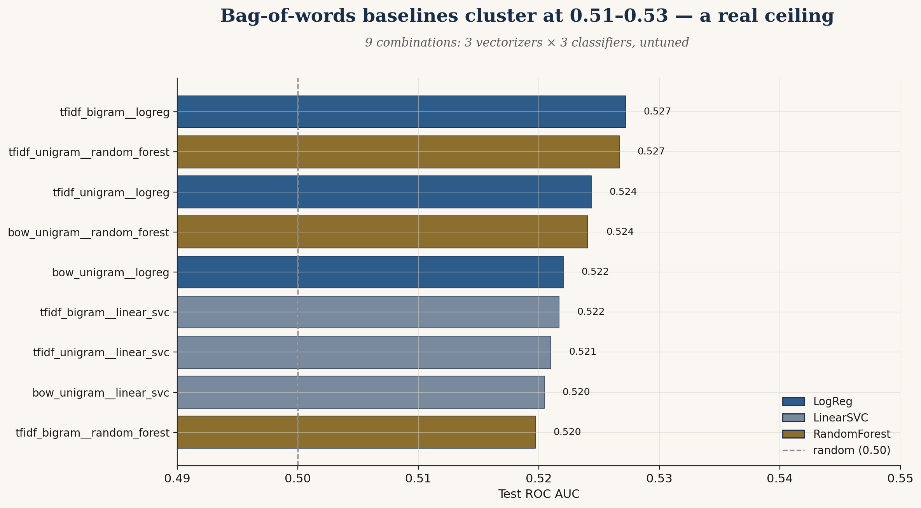
TRACK 1 — BAG OF WORDS
Tuning the standard toolkit hits a ceiling at AUC 0.532
Tuning lift was +0.4 pp. Bigrams and trigrams added nothing.
All 9 baseline (vectorizer × classifier) combinations land 0.51–0.53.
Tuning lifted AUC from 0.528 → 0.532 (+0.4 pp). The cai-plan's predicted ceiling.
Best vectorizer: unigrams, min_df=5, max_df=0.9. Bigrams and trigrams added nothing — signal is in individual words, not phrases.
Best classifier: LinearSVC with C=0.01 (heavy regularization). On 200K features, almost any flexibility overfits.
Only 2 of 15 Justices (Kennedy, Alito) had a bootstrap 95% CI lower bound above 0.5.
Top features after tuning: thematic legal vocabulary (officer, jury, sentence, religious, fraud), not stance markers.
JusticeCast
6 / 11

Slide 7
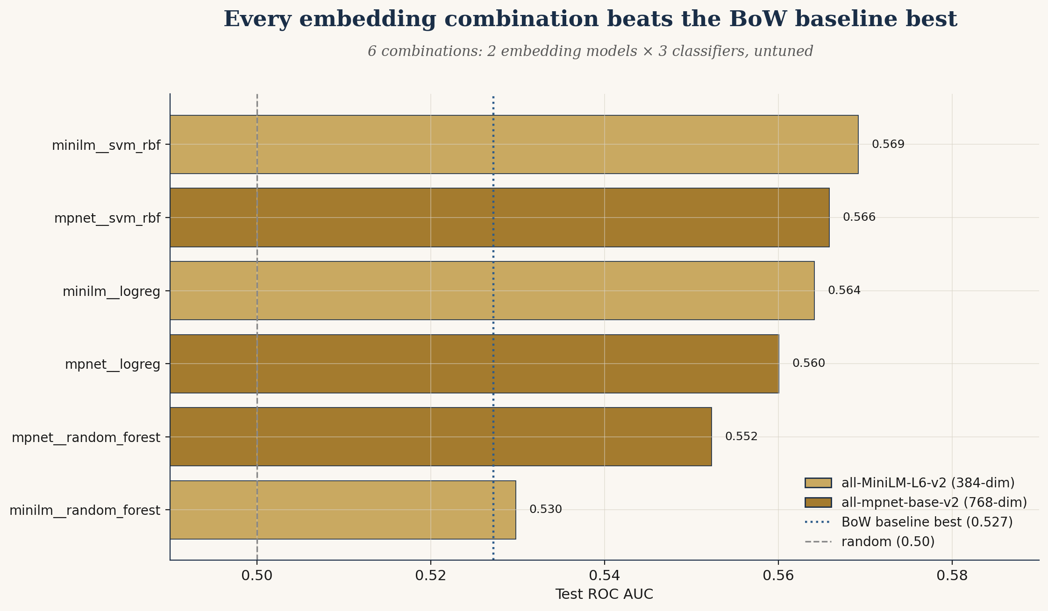
TRACK 2 — SENTENCE EMBEDDINGS
Lightweight MiniLM beats tuned BoW by 3.7 pp
384-dim, 80 MB, no fine-tuning — and it wins on the same test rows
Best classifier × encoder: LogReg + MiniLM-L6-v2, C=100, l1_ratio=1.0 (= L1).
Test ROC AUC 0.5691. Tuning lift on the embeddings track was small; the encoding itself is most of the work.
Lightweight wins: MiniLM (384-dim, ~80 MB) edged MPNet (768-dim, ~420 MB) by 0.003 — within noise but selected for the 10× encoding-speed advantage.
Every embedding combination beats the BoW baseline best. Even the worst-performing emb combo lands above the dotted BoW reference line.
JusticeCast
7 / 11

Slide 8
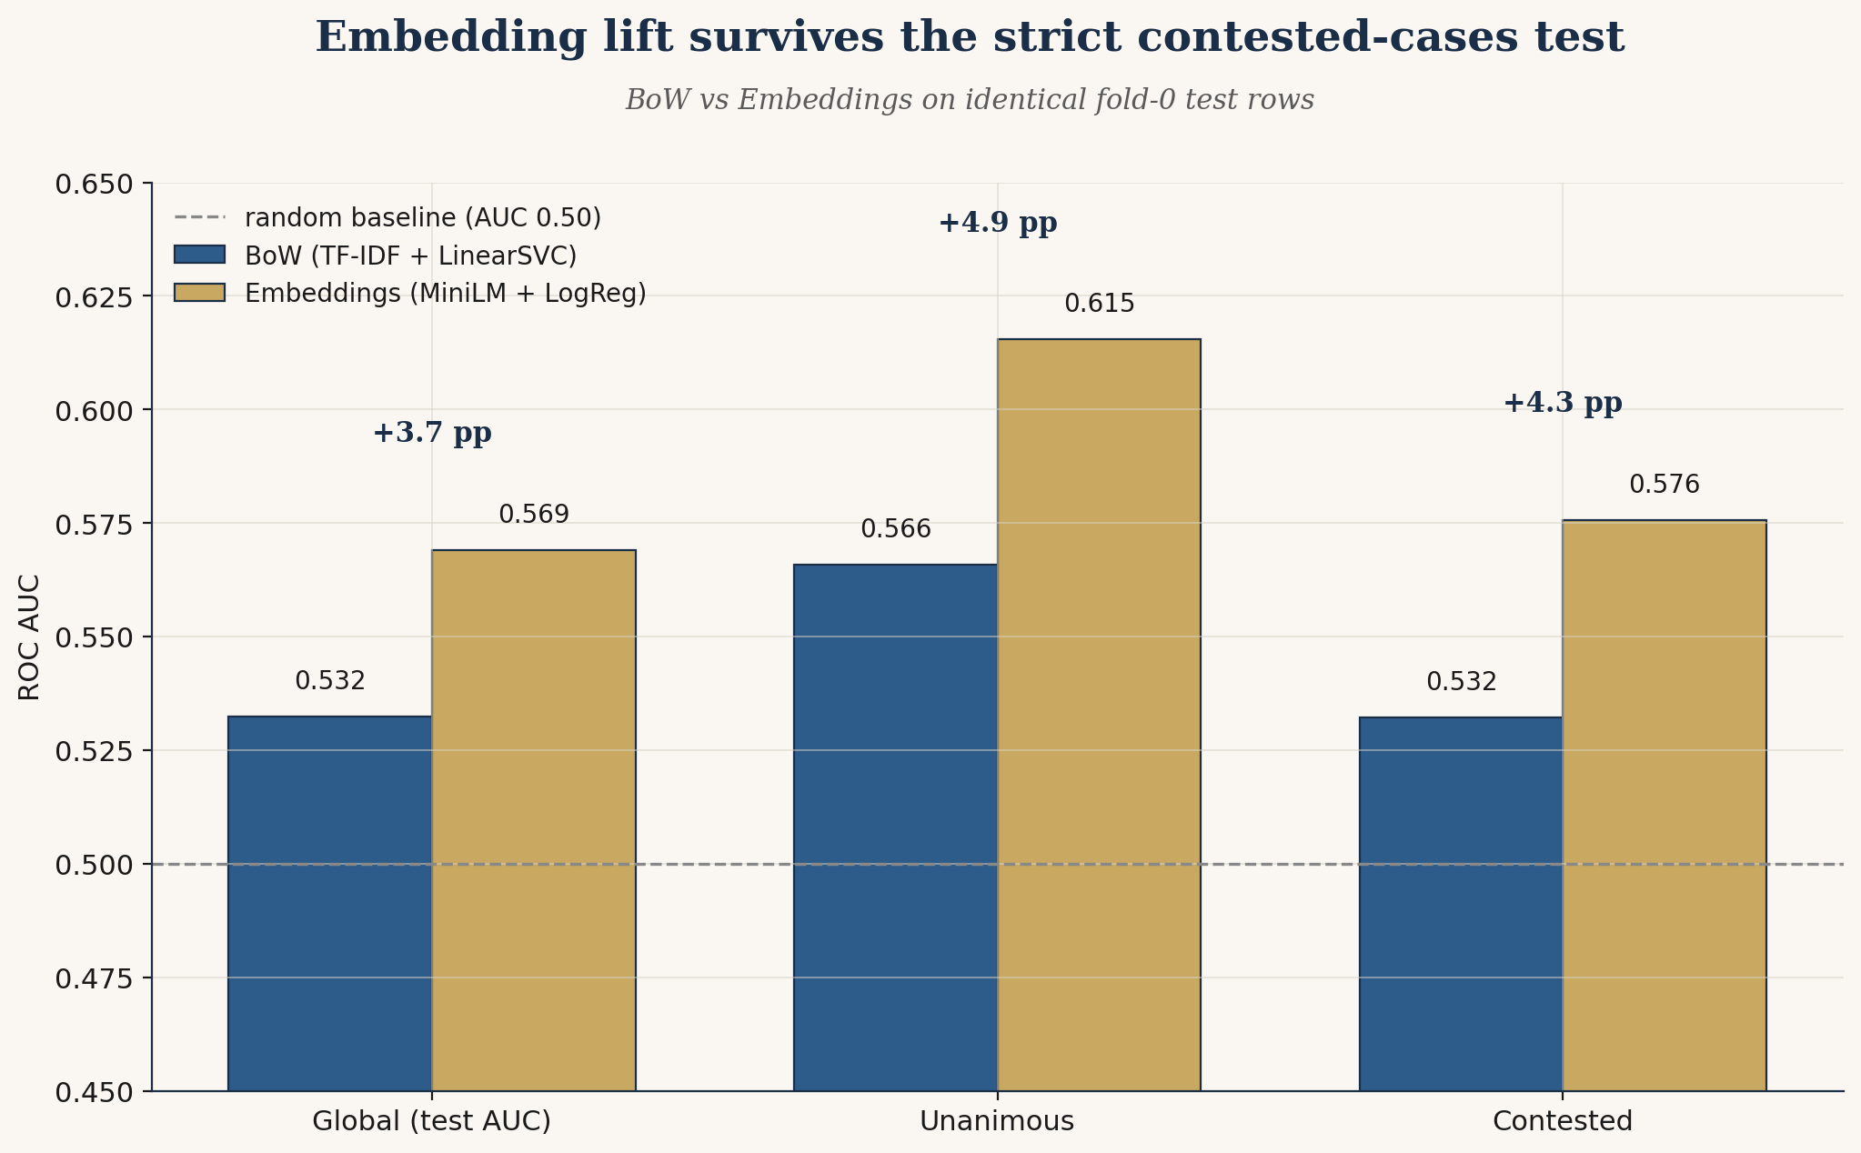
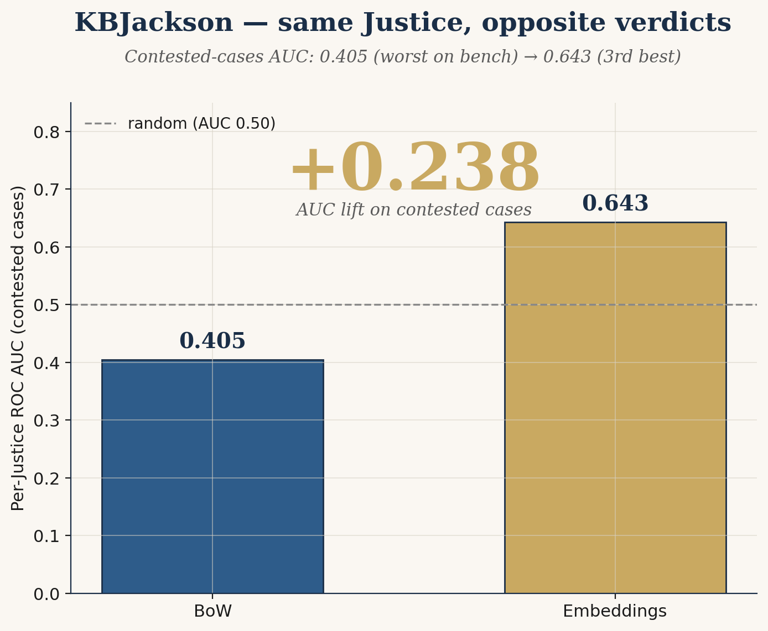
THE COMPARATIVE FINDING
The embedding lift survives the strict contested-cases test
Same fold-0 test set. Same Justices. The gap is real bench-questioning signal, not author-identity recovery.
+3.7 pp
+4 pp
13 / 15
80 MB
Test ROC AUC, embeddings
over tuned BoW
Per-Justice mean AUC
on contested cases
Justices above chance with
embeddings (BoW: 9 / 15)
MiniLM encoder size —
no fine-tuning required
KBJackson — most-engaged questioner on the bench (median 1,205 words/case) — is the centerpiece anecdote. With BoW her contested AUC is 0.405 (worst on bench). With embeddings: 0.643 (third best). Same Justice, same data, opposite verdicts.
Stevens and Kennedy regress — not every Justice improves with embeddings. We report the mixed pattern honestly.
JusticeCast
8 / 11

Slide 9
PRODUCT IMPLICATIONS
Don't sell a TF-IDF question-classifier
Three concrete recommendations for legal-tech product strategy
1
Pre-trained semantic embeddings are the necessary baseline.
The BoW ceiling is real and replicable. Any legal-tech product in this space that ships with TF-IDF + linear classifiers as its foundation is leaving 3-4 percentage points of AUC on the table. In a domain where 3-4 pp translates to material business decisions, that gap is product-defining.
2
The marginal cost over BoW is small. The payoff is access to semantic structure.
Encoding the modeling-table corpus with all-MiniLM-L6-v2 takes ~12 minutes on CPU. The model file is 80 MB. There's no fine-tuning, no GPU dependency, no architectural complexity. The bar to ship a semantically-aware version is low.
3
Tone, sequence, and audio are the next product frontier.
The Oyez .mp3 files contain the signal litigators actually pick up on — how a question is asked, not just what words appear in the transcript. Sequence-aware models on full transcripts (turn-taking, who interrupts whom) and multimodal audio features are unambiguous next steps. We've established the empirical baseline they need to beat.
JusticeCast
9 / 11

Slide 10
RECOMMENDATIONS & CAVEATS
A lower bound, with concrete next directions
What we can honestly claim
What we cannot claim — yet
Pre-trained sentence embeddings extract more vote-relevant signal than the standard TF-IDF/linear-classifier toolkit (+3.7 pp ROC AUC overall, +4 pp on contested cases).
The per-Justice gain is broadly distributed but concentrated in specific personalities (Thomas +0.193, Barrett +0.118, KBJackson +0.229 globally).
The KBJackson flip — same Justice, same data, opposite predictability conclusions — is the project's sharpest single finding.
Stevens and Kennedy regressions are real and reported. Not every Justice improves with embeddings.
Absolute AUC of 0.569 is modest. We're reporting a lower bound on bench-reading from text alone. Out-of-scope frontiers worth pursuing:
Fine-tuned Legal-BERT on a SCOTUS oral-argument corpus (+3-5 pp plausible)
Sequence-aware transformers on full transcripts — capture turn-taking, who interrupts whom (+2-4 pp plausible)
Multimodal audio features from Oyez .mp3s — tone, pace, hesitation (potentially substantial)
Structured case features — issue area, lower-court holding, prior voting record (+1-3 pp plausible)
JusticeCast
10 / 11

Slide 11
Citizens United, again
Citizens United, January 2010 — five Justices voted with the petitioner, four voted against. Litigators read those nine personalities through the questions they asked at oral argument. They were right.
Litigators have read the bench by gut for two hundred years.
We tested two computational approaches: the standard one, and the methodologically-appropriate one.
The gap between them tells us where the real signal lives.
That's the actionable finding.

