Slide 1
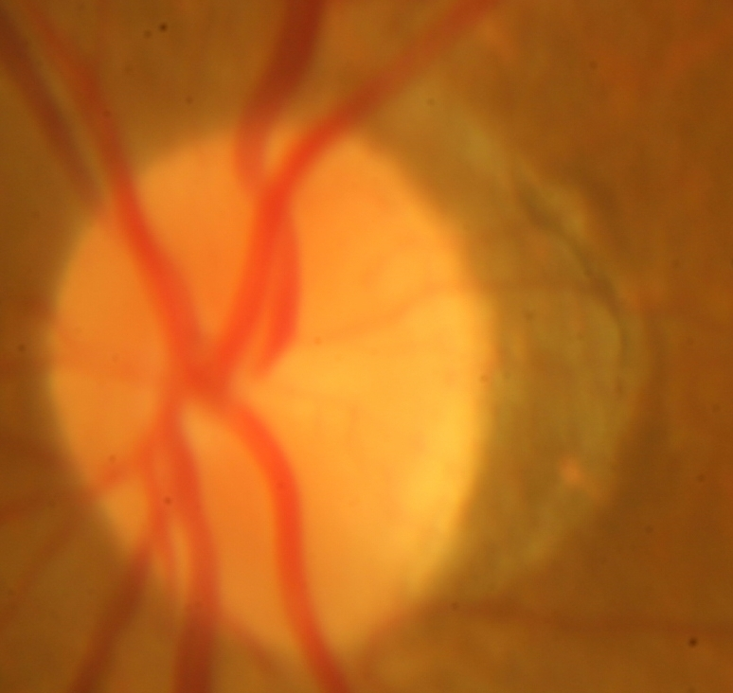
This image part of the retinal fundus image. Retina is the back portion of the eye.
Task: This is an image segmentation problem where you are required to come up with an algorithm which will segment the image into 3 different regions as shown background class, Atrophy class and optic disc class. The final results should look like as shown in next slide
Timeline: 3 days that is 3rd of June 2017
Background Class
Atrophy Class
Optic Disc Class

Slide 2
Background Class
Atrophy Class
Optic Disc Class

