Slide 1

Geant4 simulation of the response of a veto detector with various beam energies for the measurement of charge-changing
cross-section (CCCS) of ¹²C on a carbon target
By Saurav Mittal
Thesis guide – Prof. Soumya Bagchi
Department of Physics, IIT(ISM), Dhanbad

Slide 2
Outline
Charge-distribution radius
Charge-changing cross section
Glauber model
Experimental setup
Threshold on veto energy
Ionization chamber
Results and conclusion
Future work

Slide 3
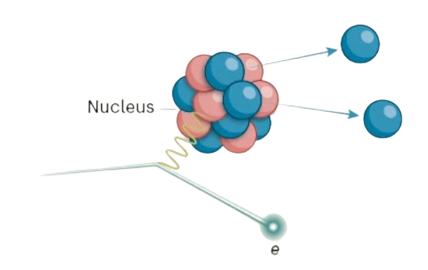
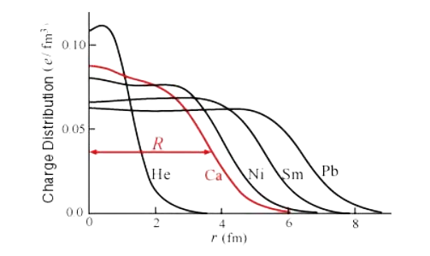
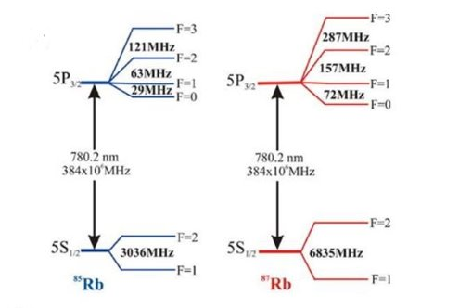
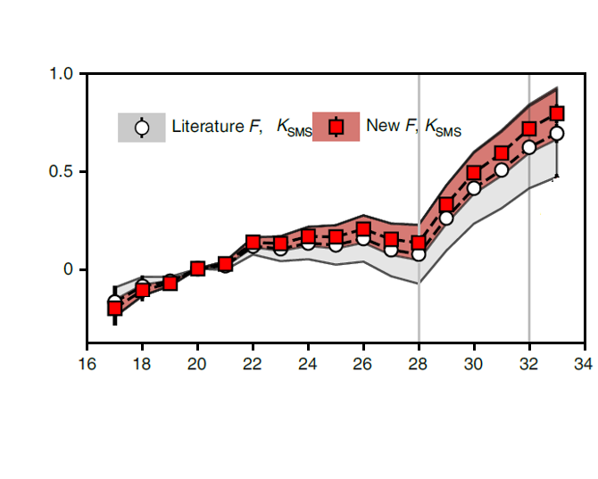
Charge-distribution radius
Change in mean squared charge radii (fm²)
Neutron Number
₁₉K isotopes

Slide 4
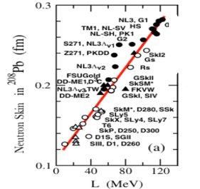
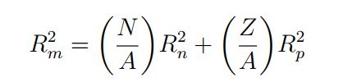
Neutron skin thickness = R_{n} - R_{p}
In the equation of state of asymmetric nuclear matter, symmetry energy term is poorly constrained.
Density derivative of symmetry energy (L) has linear relationship with the neutron skin thickness in medium heavy and heavier nuclei.
M. Centelles et al., PRL 102, 122502 (2009)

Slide 5
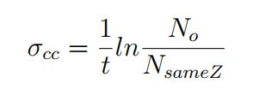
Charge-changing cross section (CCCS)
The cross section of change in atomic number is called charge-changing cross section.

Slide 6
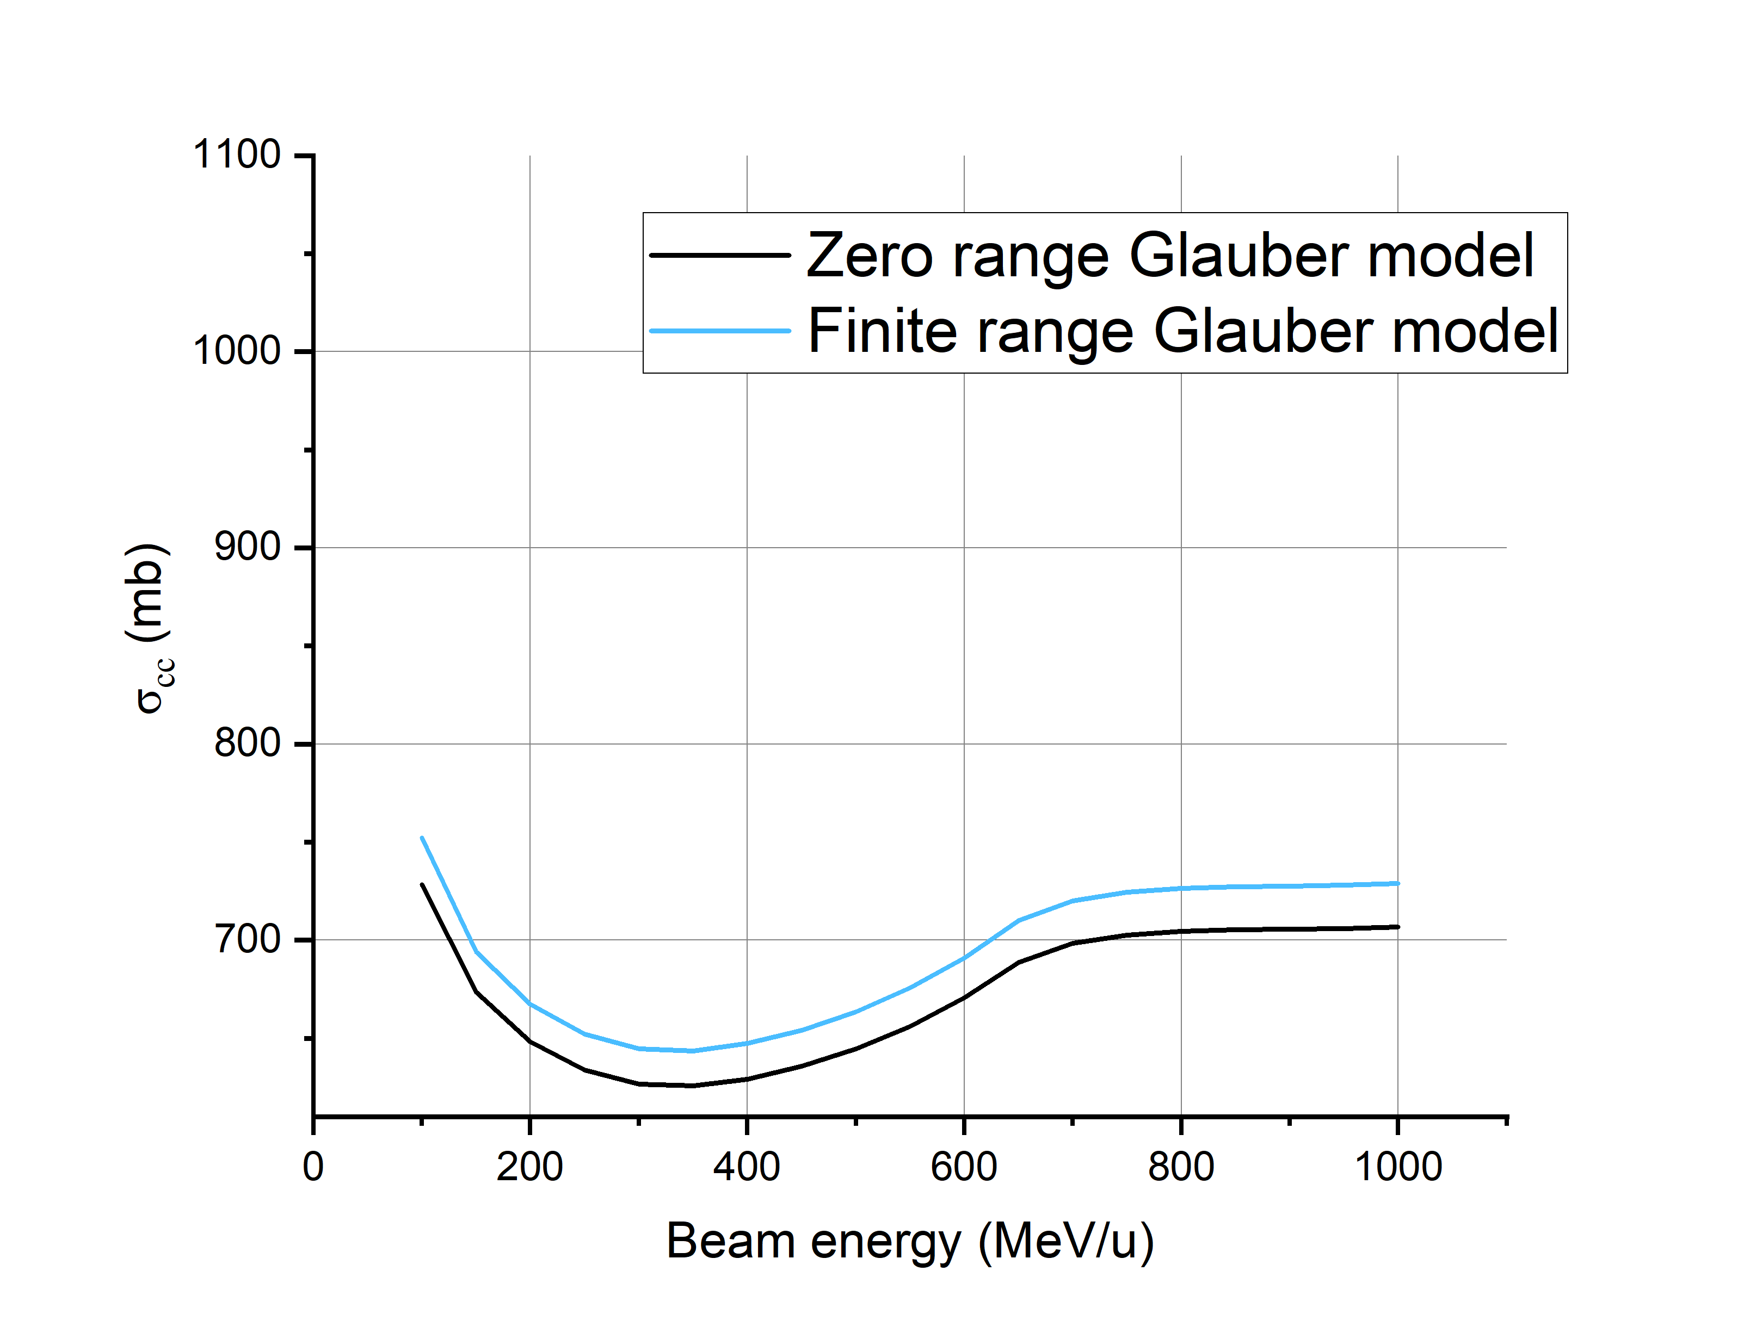

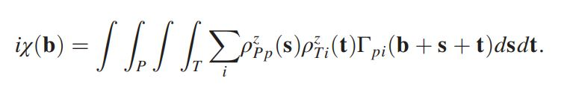
Glauber Model
We implement Glauber model on CCCS values to obtain the charge distribution radius.
Data is taken from Nurex - C++ library for Glauber model type calculation charge changing cross section.

Slide 7
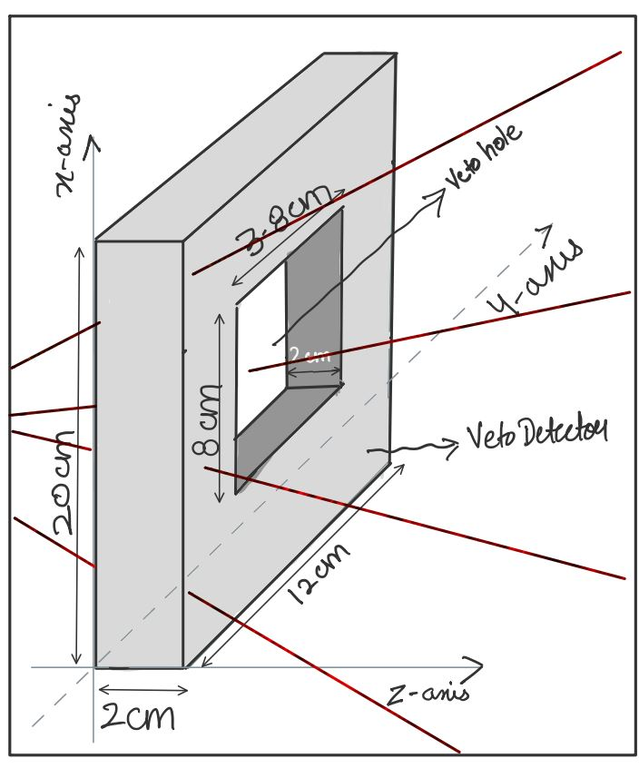
Simulation setup
Beams are generated with randomized angle along x and y axis.
Veto detector is a plastic scintillator with a hole in middle.
Schematic of veto detector

Slide 8
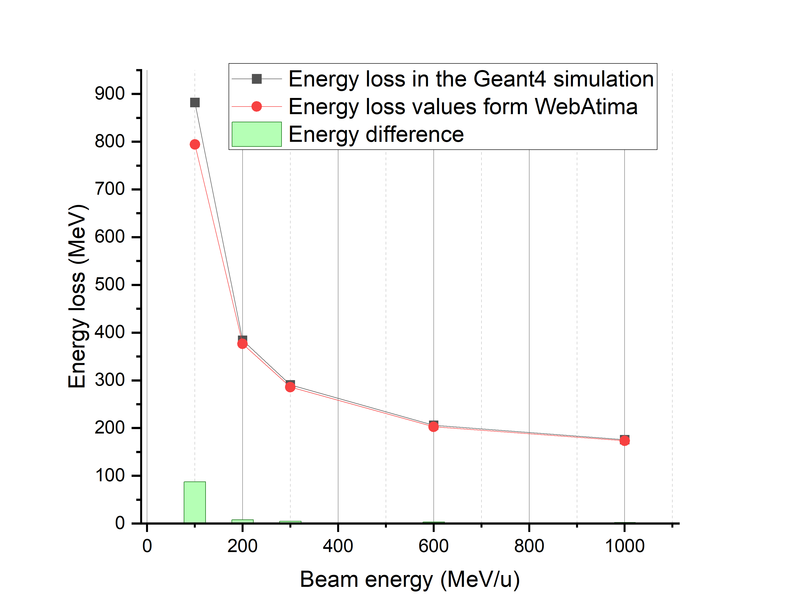
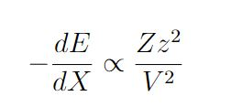
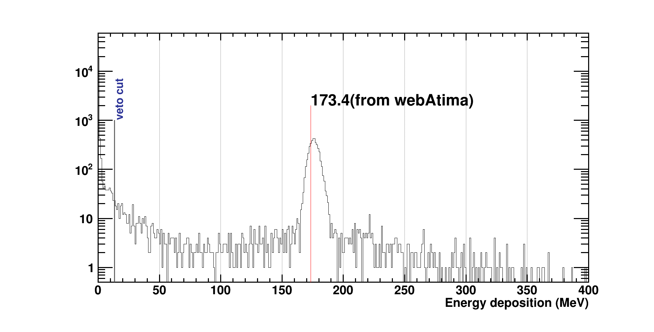
Threshold of veto energy
Bethe Bloch formula
Z is atomic number of target
And z is for projectile.
WebAtima - C++ library for calculation of energy deposition
of the particle passing through a matter.

Slide 9
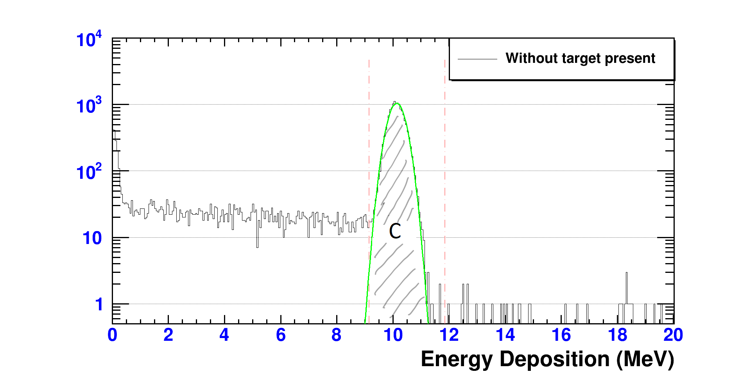
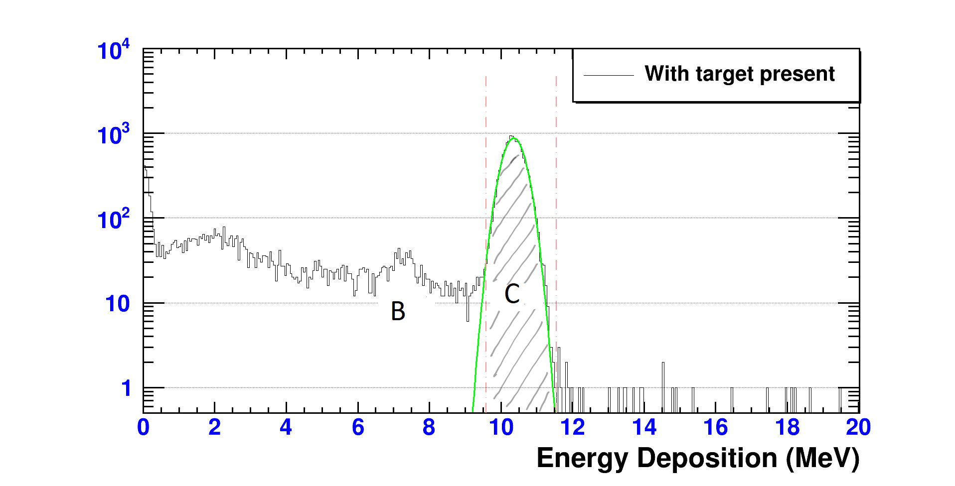
Ionization chamber
Bethe Bloch formula

Slide 10
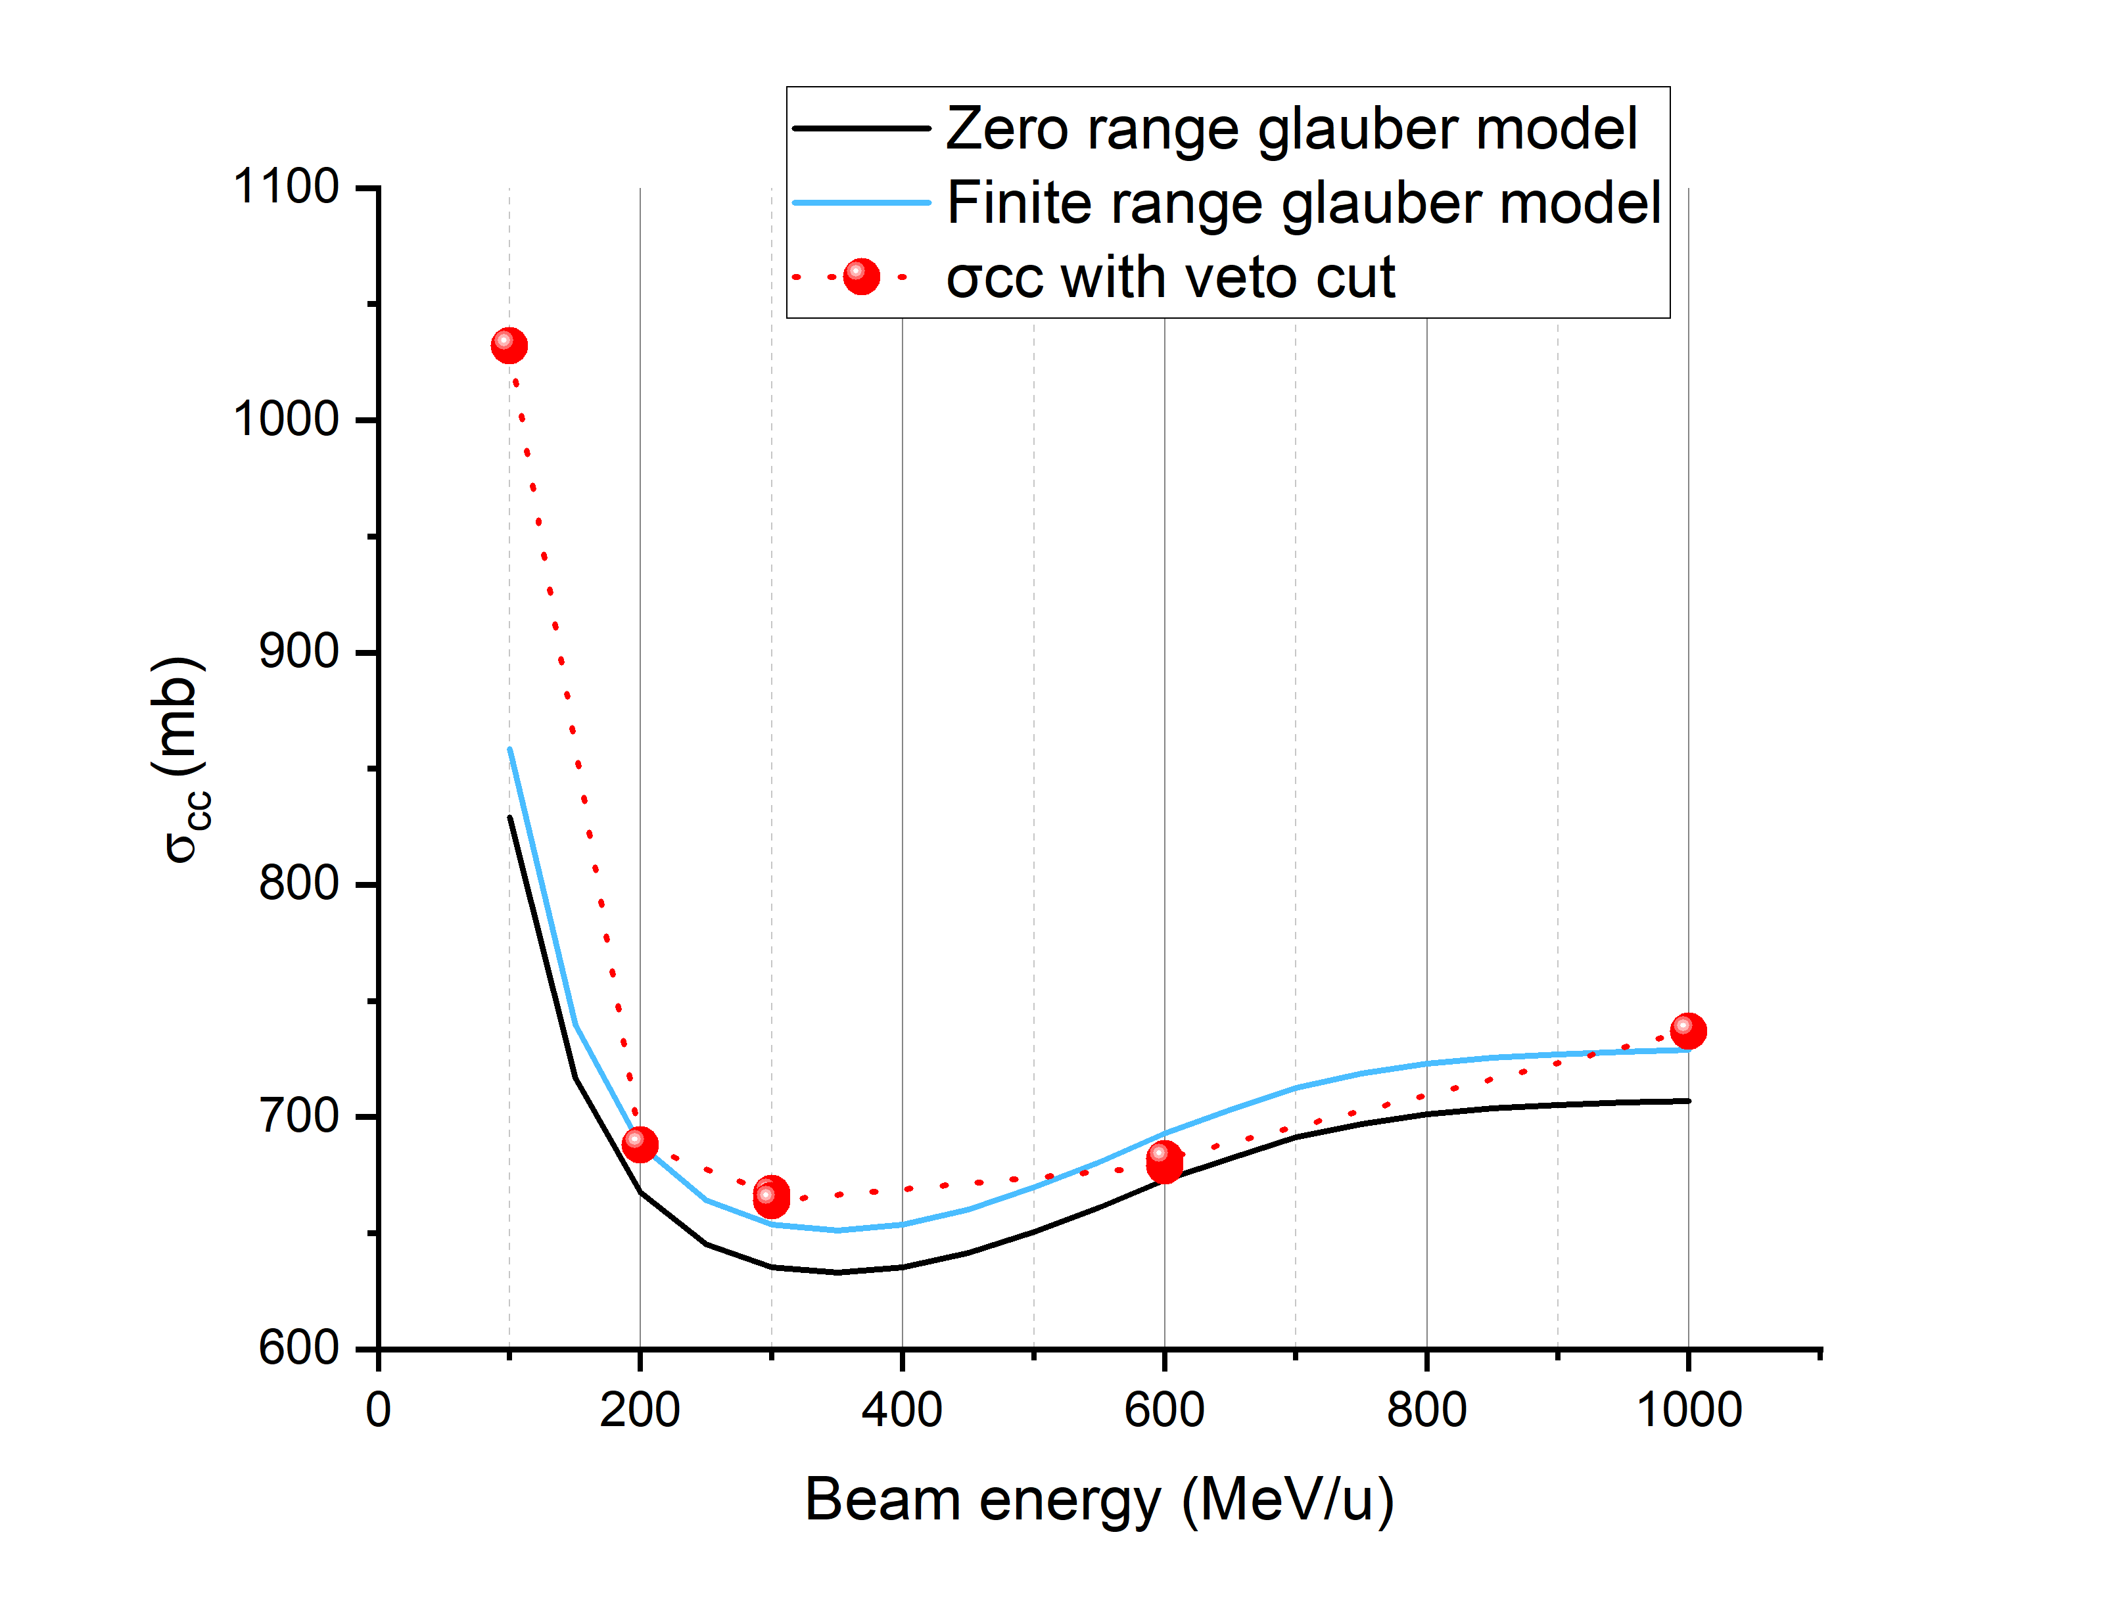
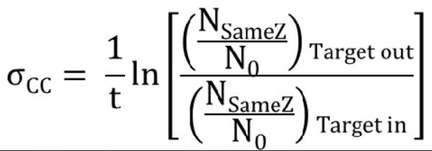
CCCS Results – with veto cut

Slide 11
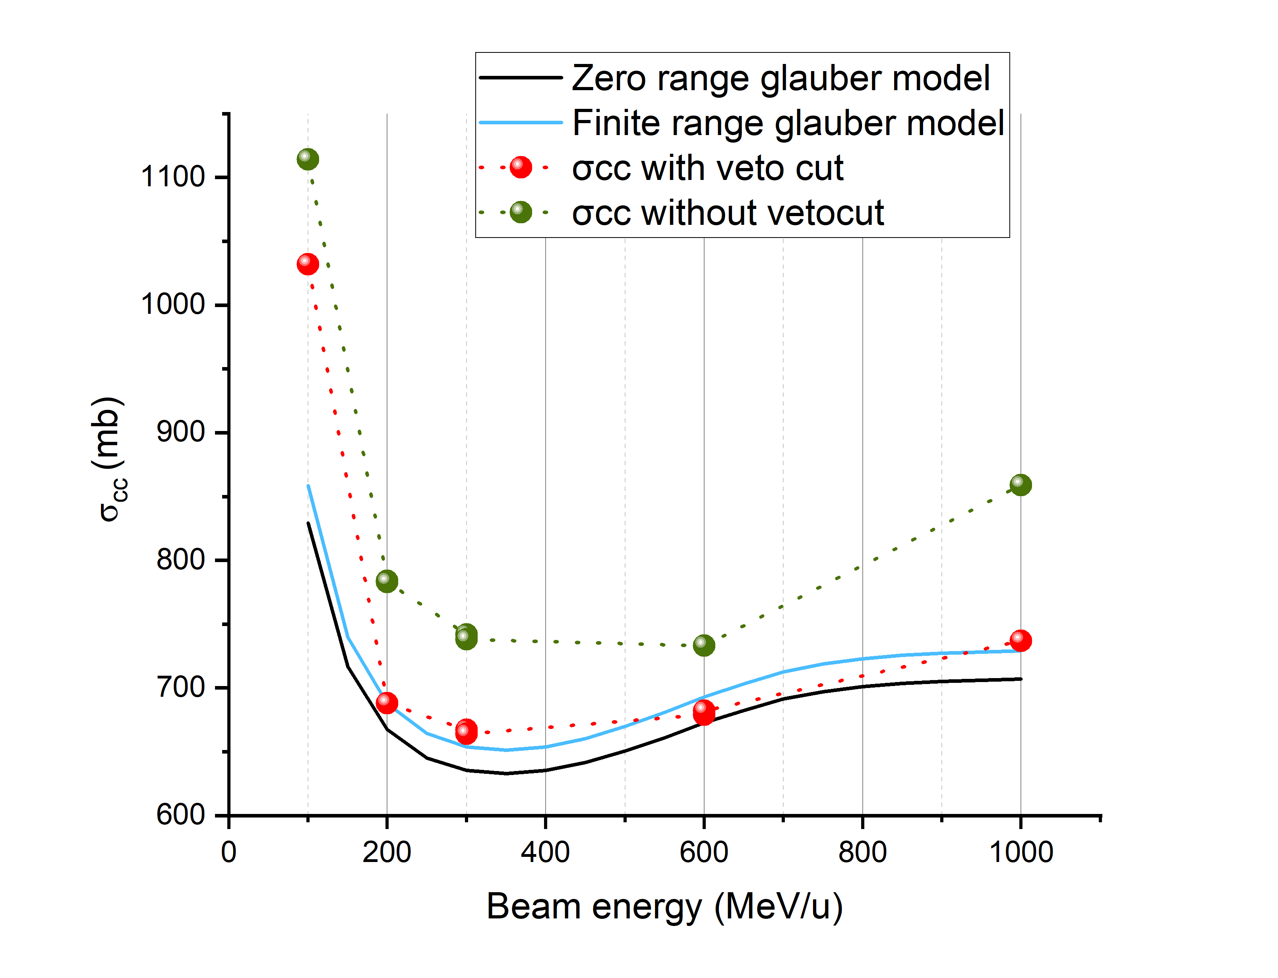
CCCS Results – without veto cut

Slide 12
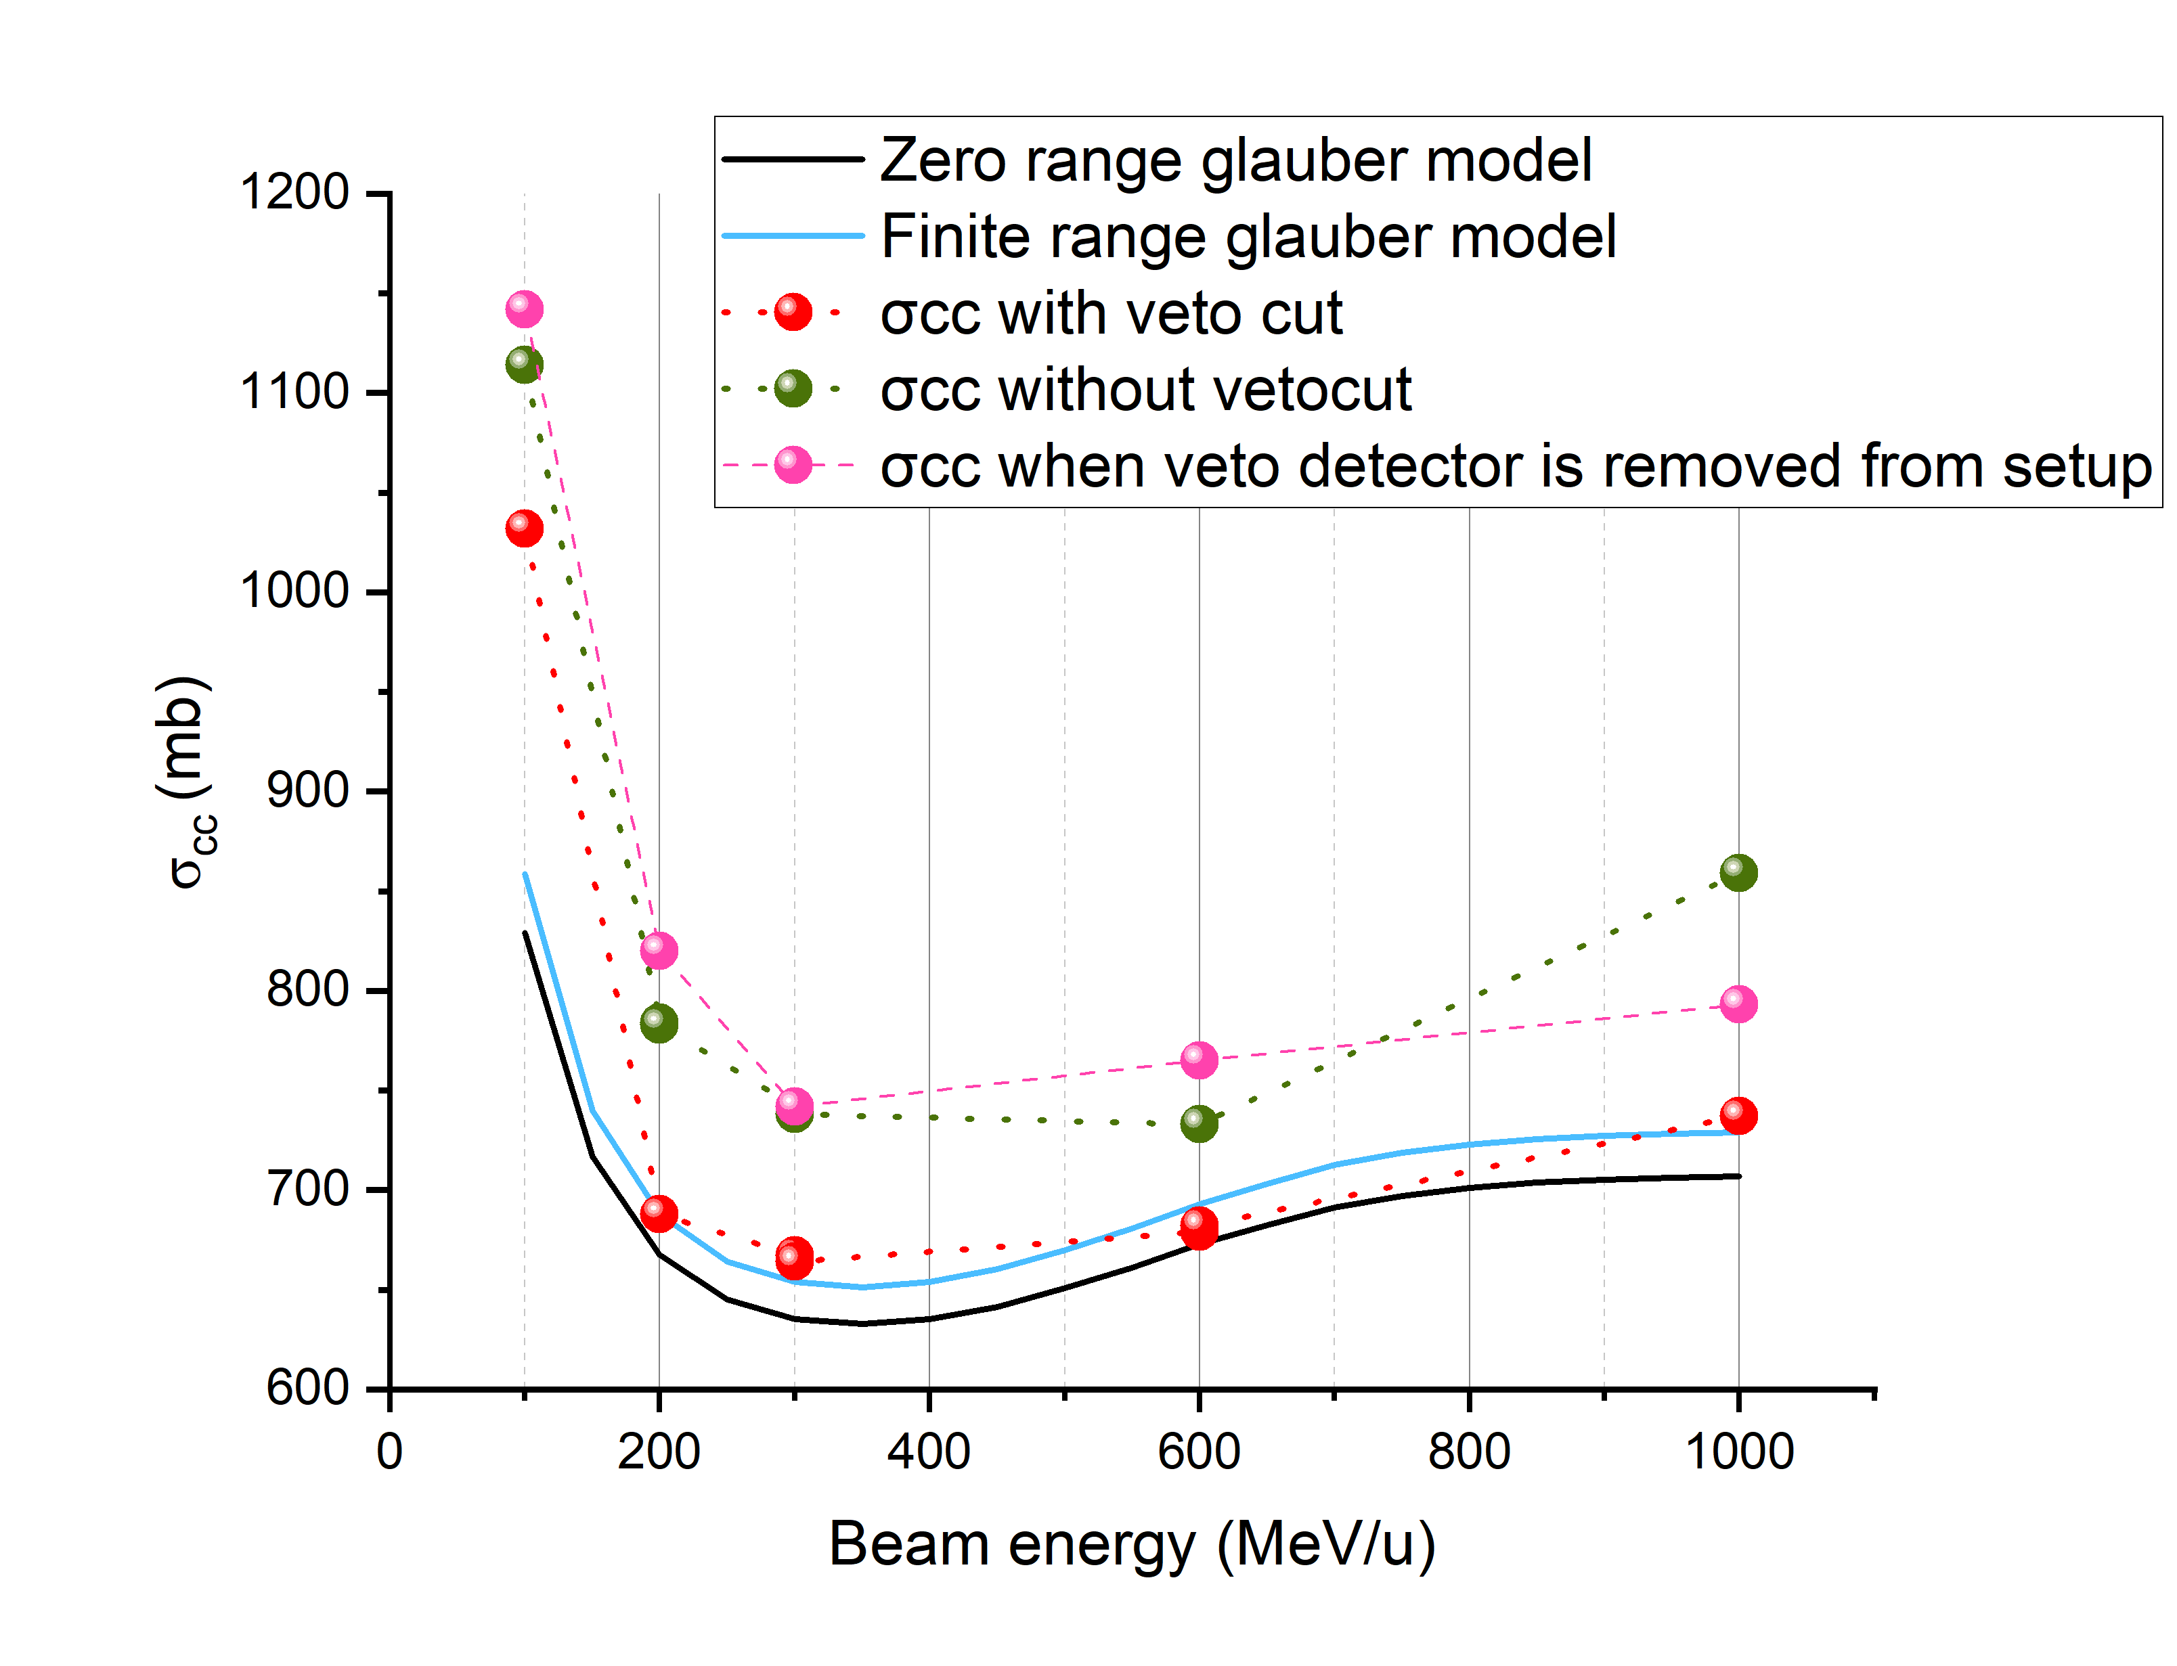
CCCS Results – veto detector taken out
We can see that when veto detector is present CCCS values are matching with the Glauber model.

Slide 13
Conclusion
The presence of veto detector is necessary because it can remove the beam with large angles and improve our calculation. We will be applying this technique to radioactive nuclei.

Slide 14
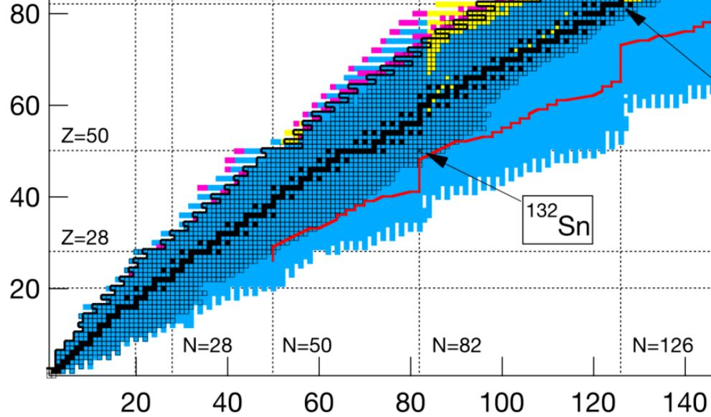

Future work
We are applying this technique on different radioactive isotopes of different elements examples ³¹F, ¹⁹B, whose charge-distribution radius is unknown
We will also determine the neutron skin thickness and the density derivative of symmetry energy.
Thank You​

