Slide 1
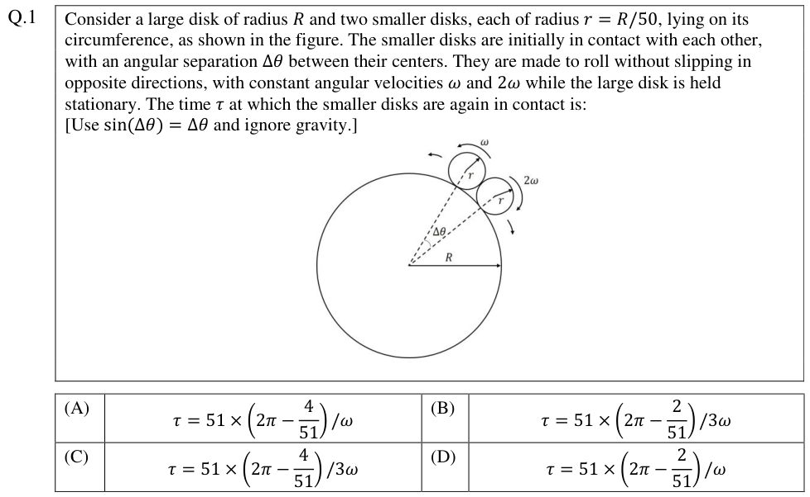
FINAL SUBMISSION · TEAM ERDŐS
Improving Scientific Reasoning of Vision-Language Models on JEE Advanced
A code sandbox, agentic correction, a learned answer selector and retrieval around a frozen 8B model on one GPU, tested on an exam the model has never seen.
A question from our clean test set: JEE Advanced 2026, Paper 1. The model sees only this image.
Arpit Kumar
Saurav Gupta
Roll No. 12340350
Roll No. 12341940
Retrieval module · code sandbox module
Agentic correction module · learned verifier
IIT BHILAI · MACHINE LEARNING
Base paper: Mukherjee & Ghosh, mmJEE-Eval, Findings of IJCNLP-AACL 2025

Slide 2
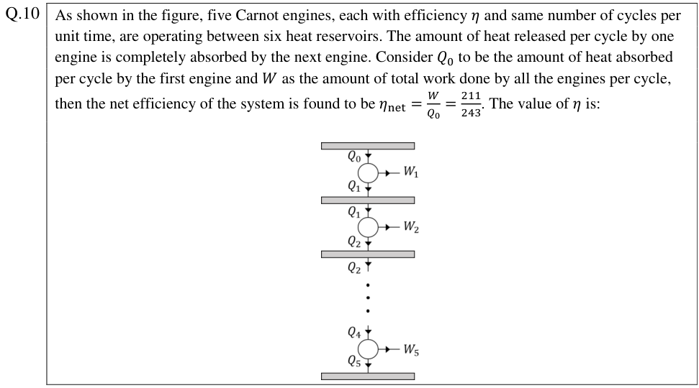
Open models still fail most JEE Advanced problems
mmJEE-Eval tests vision-language models on 1,460 JEE Advanced questions (2019–2025) in English and Hindi. Each question is an image: text, formulas, options and often a diagram.
37–45%
44.7%
1.1–5.2%
of the 2025 questions solved by open models; the best closed models solve 77–84%
of the benchmark is numerical questions, where small calculation slips cost the whole answer
of their own errors fixed by models, although they notice an error in 21–73% of cases
JEE Advanced 2026, Paper 1, Q.10 (numerical, with a diagram): one of the 204 questions in our clean test set.
OUR GOAL
Help a free, open model solve more of these questions without retraining it, and test this fairly on exams it has never seen.
Statistics on this slide are from the base paper.
02 / 32

Slide 3
Why this problem is worth solving
01
A measured gap, not yet fixed
02
Fits real hardware
The base paper only diagnoses. Two of its gaps are concrete and measurable: detecting vs. fixing errors, and weak numerical accuracy.
Test-time methods need engineering and careful evaluation, not large-scale training. A frozen 4-bit model runs on one 12 GB lab GPU.
03
Free labels for learning
04
A fair test is possible
Gold answers let us mark every sampled solution right or wrong automatically: thousands of training examples at no annotation cost.
Exams are dated, so we can test on a paper written after the model was released, with the paper's own scoring code.
03 / 32

Slide 4
Five steps, each one prompted by the last
PHASE 1
PHASE 2
STEP 3
STEP 4
STEP 5
Proposal
Build and test
Clean test
Better selection
Diagnose
Four modules planned
around a frozen model
Reproduce the paper, pilot,
7 fixes, full run on 2025
New 2026 exam, rules fixed
in advance, stronger system
Six ideas, each with a
pass rule set first
Where does the gain
really come from?
SOP
65.3%
58.8%
0 of 6
pool
on 2025
on unseen 2026
passed
not selection
Phase 2 worked, but 2025 had shaped the design, so we tested on 2026. There the selector stopped helping, so we tried better selectors. None helped, so we measured where the gain comes from.
04 / 32

Slide 5
A fair test needs strict rules
HOW WE SPLIT THE EXAMS
2019
216 questions
2020
212 questions
2021
228 questions
2022
210 questions
2023
200 questions
2024
204 questions
2025
190 questions
2026
204 questions
Training and development: 1,270 questions (2024 = dev year)
Phase-2 test
Clean final test
1
Same scorer
2
Same compute
3
Honest intervals
The paper's own answer-extraction and scoring code, copied unchanged.
Our baseline is a majority vote over plain answers with as many generated tokens as our system.
English and Hindi twins are near-duplicates, so intervals treat each pair as one unit (cluster bootstrap).
4
No leakage
5
Choices on old years
6
Rules before runs
No test question or near-copy in any training data or retrieval base.
Every design choice uses 2019–2024 only; the final system is frozen before the 2026 run.
Later ideas and their pass rules are committed to GitHub before they are run.
05 / 32

Slide 6
One frozen model, four modules, one trained part
ANSWERING ONE TEST QUESTION
2 Agentic correction, ≤ 3 rounds
Question image
English or Hindi
Read the question
topic tag + English
transcript
4 Retrieval
top-2 similar solved
problems, if close
1 Code sandbox
Python for every
calculation; 8 answers
Critic
names the first
wrong step
Corrector
redoes from
that step
Final answer
marked by the paper's scorer
3 Learned verifier
scores every answer; the best score wins
16 candidate answers
8 original + 8 corrected
Numbers 1–4 mark the four modules (next four slides).
PREPARED IN ADVANCE FROM 2019–2024 ONLY
Labelled answers
Knowledge base
Verifier training
1,270 past questions × 8 answers, marked right or wrong by the scorer
verified correct solutions (+ JEEBench 2016–2018), test years removed
logistic regression vs. XGBoost, chosen by leave-one-year-out
06 / 32

Slide 7
Module 1 · Code makes the arithmetic exact
loop: at most 3 code blocks and 8 model calls per answer
TECHNICAL DETAILS
Solver
writes Step k and a
Python code block
Safety check
parse the code; allowed
modules only
Isolated run
python -I · 10 s · 1 GB
≤ 2,000 output chars
Output back
added as an output block;
the solver continues
MODEL
Qwen3-VL-8B, 4-bit AWQ, frozen; 8 answers per question, temperature 0.7
ALLOWED
math, sympy, numpy, scipy, fractions, statistics, itertools …; no files, no network, no parsers
Earlier blocks of the same answer are replayed first, so variables carry over (this fixed 47 NameErrors in the pilot).
LIMITS
10 s, 1,024 MB and 2,000 output characters per block
Final answer
one \boxed{} answer
CoT fallback
if no boxed answer
BUDGET
4,096 tokens; the final system continues a cut-off answer once (+4,096)
RESULT (2025, PHASE 2)
WHAT THE MODEL WRITES (FORMAT EXAMPLE FROM OUR PROMPT)
40→50%
+5.0
Step 1: <which law / concept applies and the equation to use>
```python
import sympy as sp
x = sp.symbols('x')
print(sp.solve(2*x - 6, x))
```
```output
[3]
```
Step 2: <interpret the printed result, check the options> \boxed{<answer>}
numerical questions
solved
points over one answer
(p = 0.012)
07 / 32

Slide 8
Module 2 · A second model points at the first wrong step
revised answer, checked again (≤ 3 rounds)
TECHNICAL DETAILS
CRITIC
InternVL3.5-8B, 4-bit, greedy; short check, up to 1,536 tokens
Solver answer
Steps 1 … n
(8 per question)
Critic
InternVL3.5-8B:
a different model
ERROR in
Step k
Corrector
keeps Steps 1 … k−1,
redoes from Step k
WHY TWO
a different model family reduces shared blind spots
CORRECTOR
the solver itself, with the same code rules and the critic's explanation
A cut-off critic reply gets a short cue to force a verdict, so every check ends with a decision.
GATE
final system: keep a fix only if the verifier score rises (δ = −0.08)
Stop
CORRECT, or the answer
is unchanged twice
Answer pool
8 original + 8 corrected
RESULT (2025, PHASE 2)
14–19%
87 / 39
HOW EVERY CRITIC REPLY MUST END (FROM OUR PROMPT)
VERDICT: CORRECT or ERROR
FIRST_ERROR_STEP: <step number, or NONE>
EXPLANATION: <one or two sentences: what is wrong and how to fix it>
If the reply is cut off, we append:
"I must stop checking now and give my decision. VERDICT:"
of detected errors fixed
(paper: 1.1–5.2%)
wrong→right vs.
right→wrong flips
08 / 32

Slide 9
Module 3 · A small classifier picks the final answer
TRAINING, ON 2019–2024 ONLY
TECHNICAL DETAILS
1,270 past
questions
8 answers each
+ corrected ones
Auto-label
paper's scorer
vs. gold answer
Features
simple signals
per answer
XGBoost ranker
chosen by leave-
one-year-out
DATA
10,160 labelled answers in Phase 2 (45.5% right); 12,096 incl. corrected later
MODELS
logistic regression vs. XGBoost; final: pairwise ranker, 400 trees, depth 4
AT TEST TIME, FOR EVERY QUESTION
SPLIT
by exam year, so answers to one question never sit on both sides
16 candidates
8 original +
8 corrected
Score each
probability
of being right
Pick the best
highest score
wins
PICK
highest score among the 16 candidates
RESULT
+11.8
62.0%
FEATURES (ONE ROW PER CANDIDATE ANSWER)
length · number of steps · code ran OK · cut off at the limit
hedging words · valid answer format
agreement with the other answers (whole pool and each half)
is the majority answer · critic flagged it · rounds · answer changed
Phase 2 also: a sentence embedding of the answer (bge-small, 32 dims)
points: biggest single
step (2025, Phase 2)
pick accuracy vs. 53.7%
for majority vote (LOYO)
09 / 32

Slide 10
Module 4 · Solved past problems as worked examples
TECHNICAL DETAILS
Question
image
Concept tagger
one line: subject,
topic, method
Embed
bge-small-en-v1.5
Search the KB
FAISS, same
subject only
Similar enough?
cosine ≥ τ
QUERY
the model's own tag, greedy, ≤ 160 tokens (no OCR needed)
KB
Phase 2: 454 verified entries; later + JEEBench and tag + text matching
Verified solutions
2019–2024 answers marked right
(+ JEEBench 2016–2018 later)
Remove test overlap
cosine ≥ 0.90 to any
2025 / 2026 question
Yes: add top 2
worked solutions
as method examples
THRESHOLD
τ tuned on old years for 70% proxy precision (Phase 2: 0.885)
COVERAGE
final recipe 11.7% vs. 8.4% of questions on old years
No: prompt unchanged, so weak matches add nothing
RESULT (2025, PHASE 2)
30 / 190
30→38%
TAGGER OUTPUT AND EXEMPLAR HEADER (FROM OUR PROMPTS)
SUBJECT: <Physics/Chemistry/Mathematics> | TOPIC: <2-6 words>
| METHOD: <key concept or technique, at most 15 words>
"Below are worked solutions of earlier JEE Advanced problems that
use a similar method. Use them only as guidance on the method.
They are DIFFERENT problems: do not copy their numbers or answers."
questions found a close
example
accuracy on those
questions (code solver)
10 / 32

Slide 11
First, prove that our measuring tool is right
13.8%
12.4%
OUR SOLVER BEFORE ANY MODULE
43.4%
Qwen3-VL-8B, one answer (16 runs)
the paper's Qwen2.5-VL-7B, run
through our code (10 runs)
the same model, as reported
in the paper
53.7%
majority vote over 16 answers: the strong rival
The paper's value lies inside our 95% interval (10.7–17.3), so prompts, image handling and scoring match the original.
−10 / −18
points for Hindi / for questions that need the diagram
Our tool matches the paper, and the baseline to beat is already strong.
40%
of answers cut off at 4,096 tokens
11 / 32

Slide 12
A 40-question pilot: every module adds accuracy
Pilot setup (40 test questions) | Accuracy | 95% CI
Single answer (CoT) | 29.5 | 17.8–41.6
Majority vote, same compute | 35.0 | 20.0–52.5
+ Code sandbox | 41.2 | 28.1–54.4
+ Correction, same-model critic | 46.6 | 32.8–60.3
+ Correction, cross-model critic | 43.1 | 29.7–56.2
+ Learned verifier | 50.0 | 32.5–67.5
Full framework | 57.5 | 40.0–72.5
WHY A PILOT FIRST
The full run costs about 54 GPU-hours, so mistakes are expensive.
Full framework vs. majority vote: +22.5 points (interval +7.5 to +37.5). With 40 questions this is only a first signal.
Its real value: reading 1,520 solution traces and 640 correction chains showed us what was broken.
Seven problems found and fixed before the 54-hour full run.
12 / 32

Slide 13
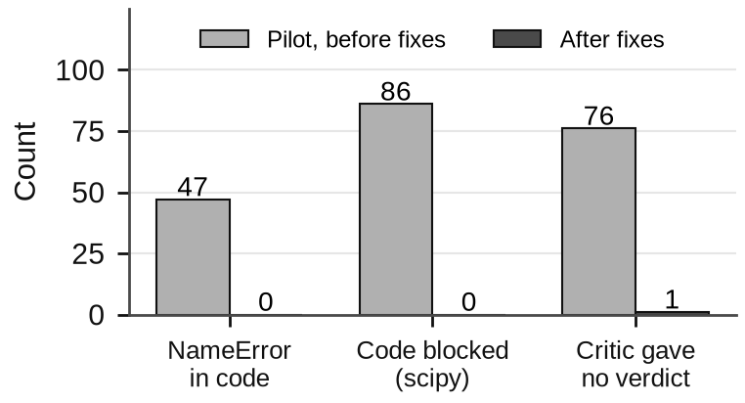
Seven problems found in the pilot, fixed before the full run
Problem | Evidence | Fix and effect
Code state lost | 47 NameErrors: each block ran fresh | replay earlier blocks → 0
Library blocked | 86 blocks needed SciPy | allow SciPy, no file I/O → 0
No critic verdict | 76 replies cut off while re-solving | short check + forced verdict: 1 of 501 left; detection 35→56%
Many fallbacks | 480 of 539 were long reasoning loops | forcing an answer tested: 21.9% vs. 30.0% → rejected
Baseline too small | system used ≈ 18 answers' tokens, only 16 drawn | draw 20 answers for a fair vote
Selector = vote | dev pick equal to majority vote | reported honestly; 8× more data
Batch aborted | one 12,303-token prompt | retry request by request
Same 40 questions, before vs. after the fixes.
A three-person code review also found 11 bugs before any GPU run, e.g. a verifier crash, a train/test feature mismatch and intervals that were too narrow.
13 / 32

Slide 14
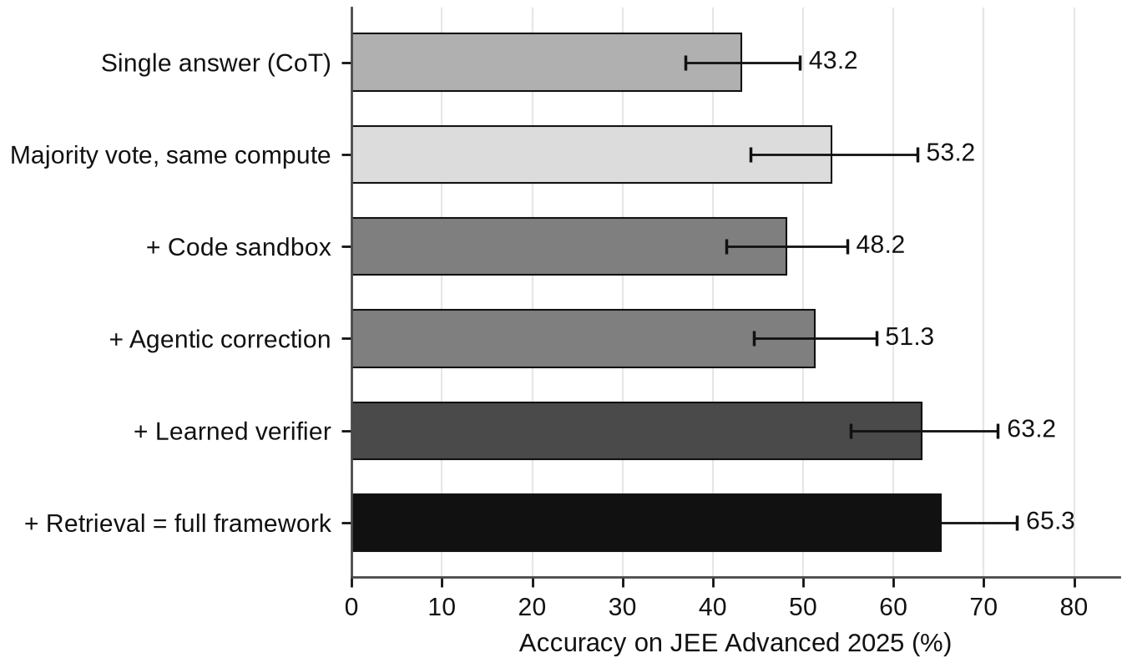
Phase 2 on the 2025 exam: 65.3%, +12.1 over majority vote
65.3%
full system, up from 43.2% for one answer
+12.1 points over majority vote at equal compute (interval +4.2 to +20.5, p = 0.001).
Numerical questions: 40.2% → 50.4% with the code sandbox.
Learned verifier: the biggest single step, +11.8.
Retrieval: +2.1, not significant.
No memorisation sign: 43.9% on 2019–24 vs. 42.6% on 2025.
190 questions, English + Hindi. Bars show 95% intervals; each “+” row adds one module.
14 / 32

Slide 15
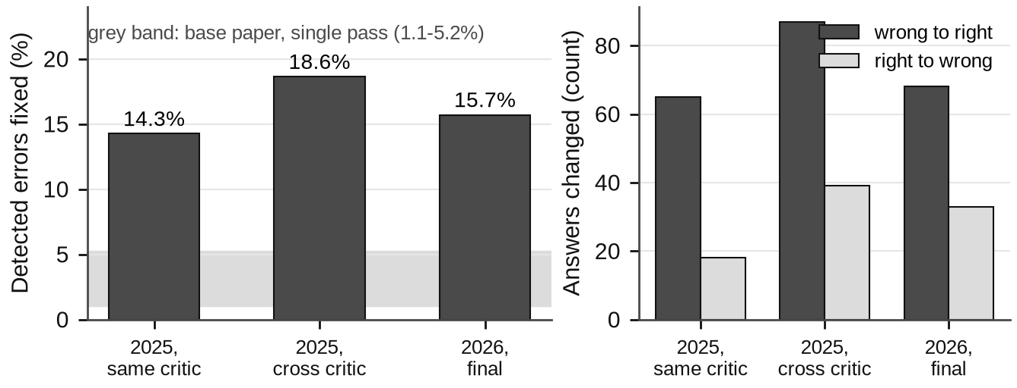
What Phase 2 left open
1
Picking
The verifier picked 65.3%, about the same as a plain vote over the same 16 answers (65.8%). The gain came from the varied pool.
2
Retrieval
Only 30 of 190 questions found a close example.
3
Budget
Left: detected errors that end correct after up to 3 rounds (grey band: the paper's single-pass rate). Right: answers flipped by correction.
36% of solutions fell back to plain reasoning, mostly at the token limit.
Our loop fixes 14–19% of the errors it detects, well above the paper's 1.1–5.2%: the critic points at one step and the solver can run code.
But the critic also flags 19–26% of correct answers, so some right answers turn wrong.
4
Fairness
2025 had been used for the pilot, and the model may have seen it.
15 / 32

Slide 16
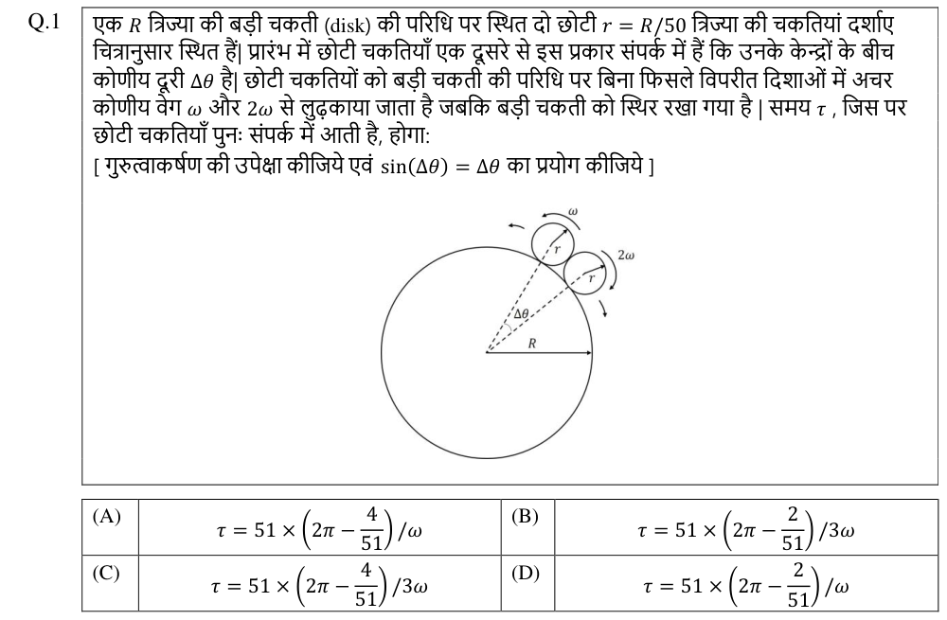
A clean test: the 2026 exam, in two languages
ENGLISH · FROM THE DATASET
HINDI · CROPPED BY US FROM THE OFFICIAL PAPER
Held after Qwen3-VL was released, so the model cannot have seen it. The dataset had only the 102 English questions.
We built the 102 Hindi twins: matched by paper, subject and number, answers from the English key, automatic checks on every pair, 14 crops checked by hand.
16 / 32

Slide 17
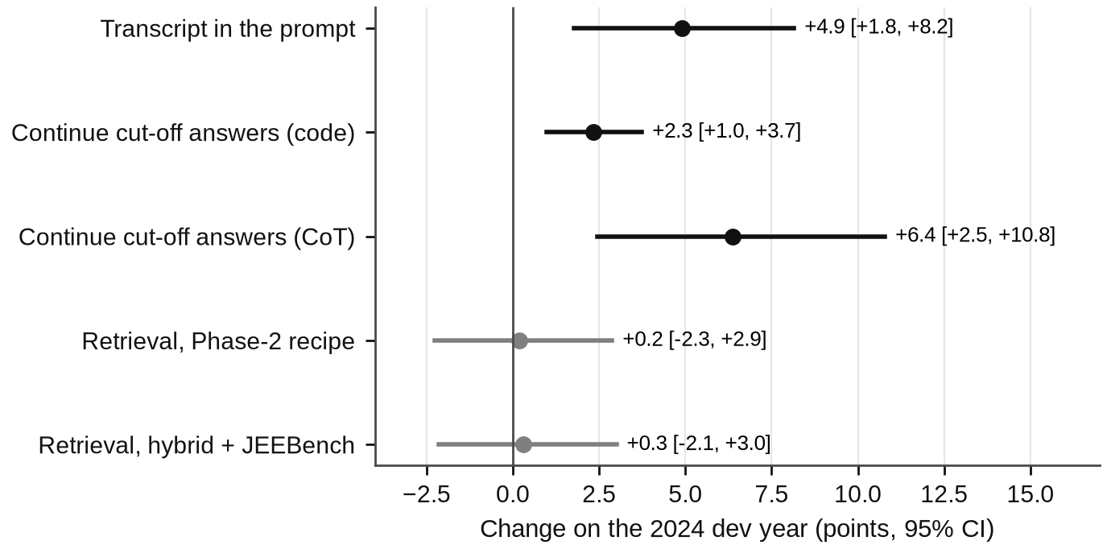
Every improvement was chosen on old exams only
WHAT WENT INTO THE FINAL SYSTEM
Transcript
the model writes the question out in English first (Hindi gain +8.7)
Continuation
a cut-off answer continues once for 4,096 more tokens, in every row
Hybrid retrieval
tag + problem text, + JEEBench: coverage 8.4 → 11.7%
Ranking verifier
XGBoost ranker on pools with corrected answers: 62.0% vs. 53.7% for a vote
2024 dev year, 204 questions. Rule fixed in advance: keep a change only if it gains and the lower end of its 95% interval is above zero (black = passed).
Correction gate
keep a fix only if the verifier score rises
17 / 32

Slide 18
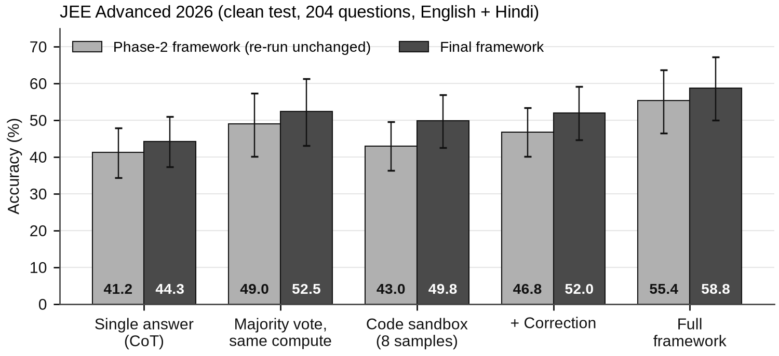
58.8% on an exam the model has never seen
58.8%
final system; one answer: 44.3%
+6.4
points over majority vote at equal compute
(+1.5 to +10.8, p = 0.011)
The Phase-2 system, re-run unchanged, also beats its vote by +6.4 (p = 0.015).
Stronger solver: +6.8 over the Phase-2 solver (p < 0.001).
Final vs. Phase-2 system: +3.4, not significant on 204 questions.
Bars with 95% intervals. Majority vote gets as many generated tokens as the full system (18 answers).
Our main claim holds on unseen data.
18 / 32

Slide 19
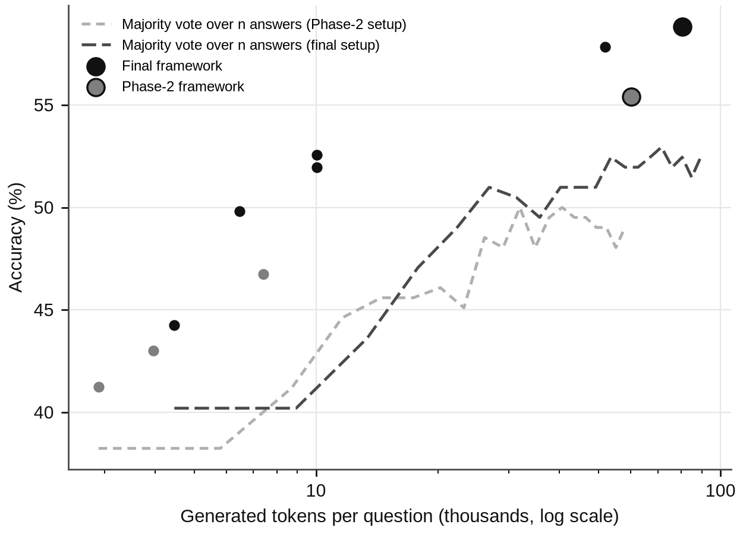
The gain is not just more compute
HOW TO READ IT
Dashed lines: majority vote over n plain answers as n grows. This is what extra compute buys without our modules.
Dots: our rows (small) and full systems (large). Every dot lies above the dashed line at its cost.
58.8%
52.5%
final system,
80k tokens / question
majority vote with
the same tokens
19 / 32

Slide 20
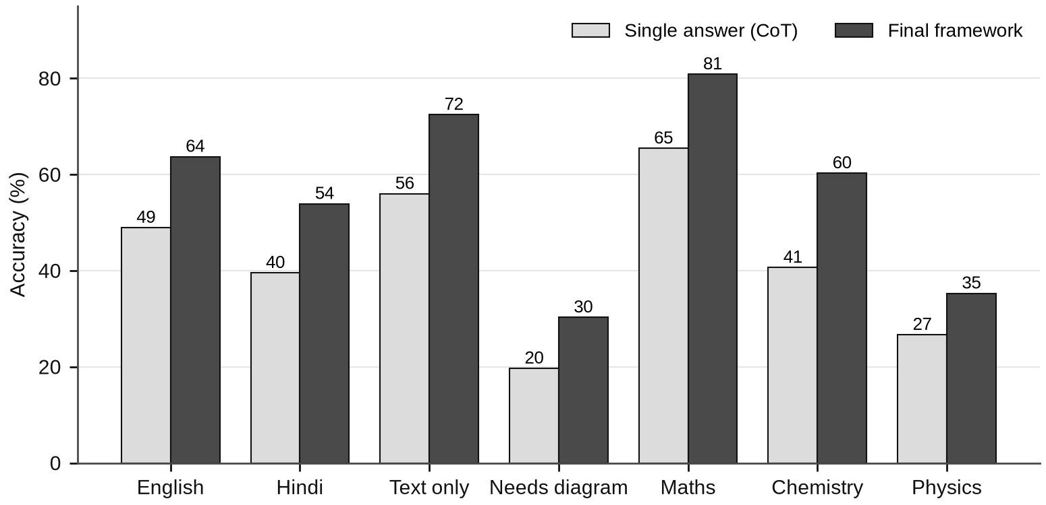
Gains everywhere, but diagrams stay hard
30% vs. 72%
diagram vs. text-only questions,
final system, 2026
Physics, which has the most diagrams: 35%; Maths: 81%.
Hindi 54% vs. English 64%; part of this may come from our own crops.
Reasoning and code help; they do not fix reading the figure.
20 / 32

Slide 21
Correction still works on unseen data
Final system, 2026 (1,632 chains) | Value
Wrong answers flagged by the critic (round 1) | 52.9%
Flagged errors fixed in round 1 | 13.2%
Correct answers wrongly flagged | 19.9%
Accuracy per chain, before → after | 49.8 → 52.0%
Correction gate, 2026 | No gate | Gate
Right → wrong flips | 33 | 9
Wrong → right flips | 68 | 54
Accuracy per chain | 52.0% | 52.6%
The gate keeps a correction only if the verifier score rises.
Base paper, single pass: 1.1–5.2% of detected errors fixed.
Pointing at the first wrong step keeps working; the gate removes most harmful flips (33 → 9) but also blocks good fixes, so accuracy moves only +0.6.
21 / 32

Slide 22
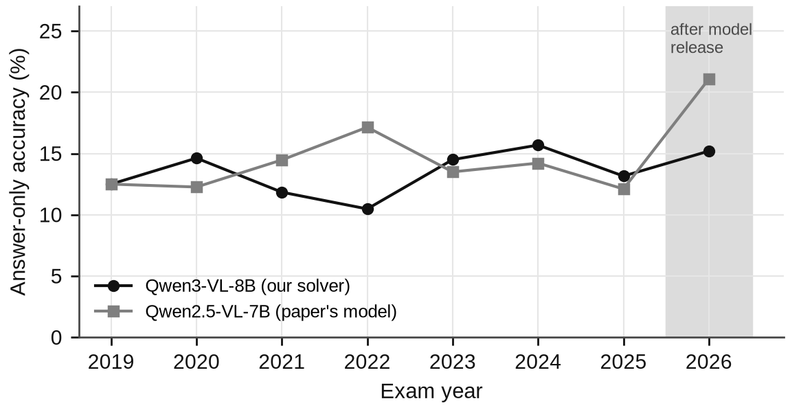
No memorisation, and the method needs a capable solver
WITH THE PAPER'S WEAKER MODEL (2025)
Qwen2.5-VL-7B | Accuracy
Single answer | 14.0%
Majority vote, same compute | 16.3%
Full framework | 15.3%
No gain: when only ~14% of answers are right, agreement, critique and verification carry little signal.
2025, used during design, shows bigger gains than 2026 (+13.7 vs. +6.4 over a vote), consistent with some optimism on a seen year.
Answer-only probe (no reasoning). If old papers were memorised, old years would score higher than 2026. They do not.
22 / 32

Slide 23
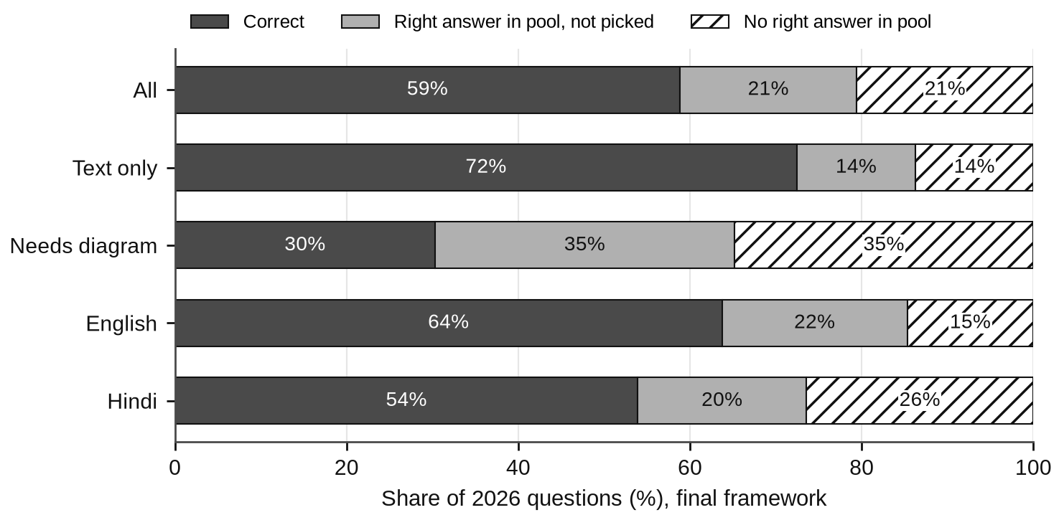
Where the remaining errors are
42
42
right answer in the
pool, not picked
no right answer
in the pool
120 of 204 questions solved.
In the missed pools only 17% of answers are right: the right answer is a small minority.
Diagram questions: 35% missed by the selector, 35% never solved.
Longer answers are not the main cause: they are longer in both years, yet the verifier helps only on 2025.
23 / 32

Slide 24
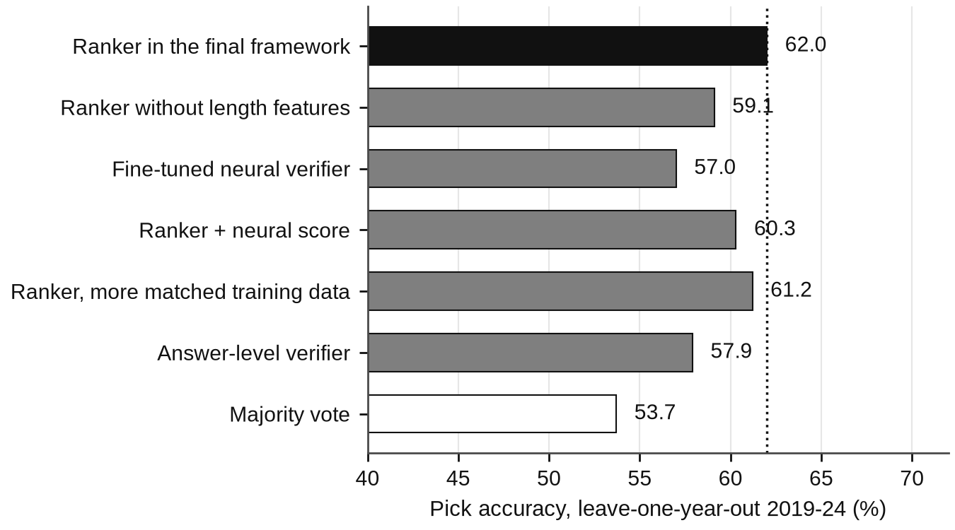
Six fixes for selection and retrieval, none passed its rule
SELECTORS
Fine-tuned neural verifier (ModernBERT): learns a signal (AUC 0.79), ranks worse.
3,184 new training answers matching the test pools (≈ 30 GPU-hours): 61.2%, within noise.
RETRIEVAL
Method cards (method, plan, key equations, common mistake): +3.6 where retrieval fires (−0.8 to +8.5), so not adopted.
207 open-licensed OlympiadBench solutions: coverage 15.0 → 13.5%, 2026 accuracy unchanged.
Pick accuracy, leave-one-year-out over 2019–2024 (no test data). Rule set in advance: beat the current ranker on every pool type. Ranker noise ≈ 1 point.
24 / 32

Slide 25
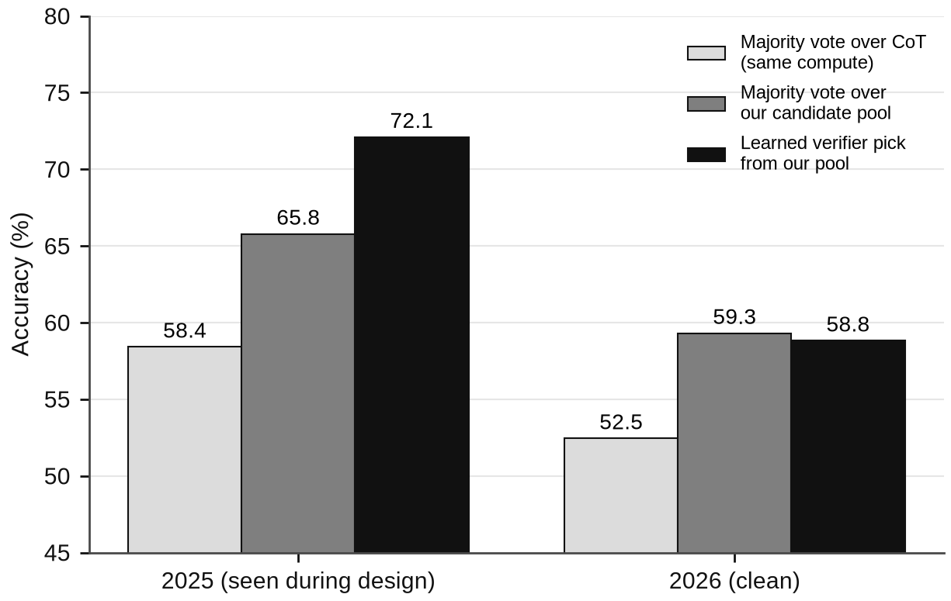
The gain comes from the pool, not the picker
 | 2025 | 2026
Pool gain (vote on our pool − plain vote) | +7.4 | +6.9
Selection gain (verifier pick − vote) | +6.3 | −0.5
Verifier AUC, all answers | 0.87 | 0.90
AUC inside mixed pools | 0.80 | 0.75
The overall AUC rises on 2026 because it mostly separates easy questions from hard ones. Inside pools with both right and wrong answers, the only place picking matters, it falls.
A high AUC is not proof of good selection.
25 / 32

Slide 26
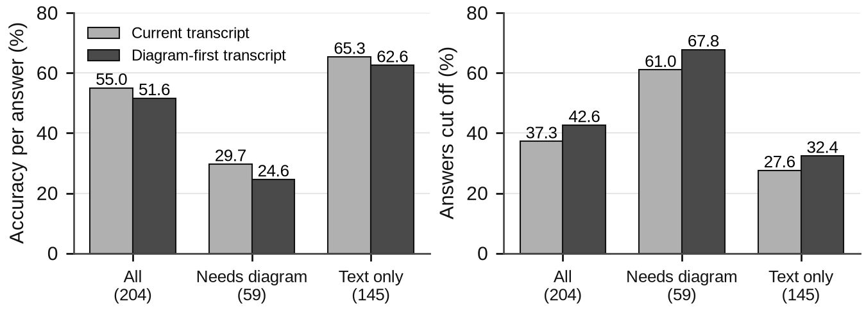
Two last ideas, two clear answers
A · ANSWER-LEVEL VERIFIER
B · DIAGRAM-FIRST TRANSCRIPT (2024 DEV)
57.9%
vs. 62.0% for the current ranker
(worst year 50.0 vs. 52.5)
One row per distinct answer, not per solution; pick the most likely answer.
5,335 answer rows from 15,280 solutions; model chosen by its worst year.
Beats voting (53.7%) but loses the detail of single solutions.
A second, itemised reading of the figure for half of each pool, same seeds.
Majority vote −2.0 (−5.4 to +1.0); per answer −3.4, worst on diagram questions.
Longer prompt, more cut-offs (37.3 → 42.6%): the solver misreads the figure whichever description it gets.
26 / 32

Slide 27
Everything we learned, in one table
Idea | Result | Why (from our analysis)
Code sandbox | numerical 40 → 50% (2025) | exact arithmetic instead of mental maths
Agentic correction | fixes 14–19% of detected errors | critic names one step; but flags 19–26% of right answers
Learned verifier | +11.8 on 2025; ±0 vs. vote on 2026 | ranking inside mixed pools got worse on the new year
Retrieval | +0.2 to +2.1, not significant | fires for only 15–16% of questions
Transcript | +4.9 on dev (Hindi +8.7) | writing the question out helps reading, most of all in Hindi
Continue cut-off answers | +2.3 (code), +6.4 (plain) on dev | many answers were cut off at 4,096 tokens
Correction gate | bad flips 33 → 9, accuracy +0.6 | blocks good fixes as well as bad ones
New selectors (4) | all below 62.0 (LOYO) | right answer is a small minority in missed pools
Method cards / open KB | +3.6 (not sure) / +0.0 | too few questions where retrieval fires
Diagram-first reading | −2.0 on dev | longer prompt, more cut-offs; solver misreads figures
Weaker solver (7B) | no gain (15.3 vs. 16.3) | too few right answers for voting or checking
27 / 32

Slide 28
Running 8B models on one shared 12 GB GPU
Problem | What happened | What we did
Model did not fit | only 0.36 GB left for the attention cache | smaller images, 8-bit cache, batch limit: 1.9× faster
Runs killed silently | out-of-memory daemon killed a session (10.5 h lost) | detached supervisor, 3 retries per stage, quiet watcher
Three lab shutdowns | PC powered off; driver missing after reboot | driver installed, auto power-on; resumed with identical results
GPU crash at start | out of memory, then a CUDA error in a forked worker | embedding model on CPU; workers started with spawn
Second PC unusable | no GPU driver; campus proxy blocked downloads | packages copied over LAN; pre-compiled kernel installed
One prompt, whole batch lost | a 12,303-token prompt crashed hours of work | catch the error, retry request by request
Sandbox could eat RAM | a printing loop used 8 GB in a test | output written to size-capped files
No Hindi 2026 questions | the dataset had English only | cropped 102 Hindi questions from official papers
28 / 32

Slide 29
Optimisations that made it fit, and kept it honest
4-bit models
Fast batched inference
Cache every call
AWQ weights let two 8B models share one 12 GB GPU, one at a time.
vLLM batching, 8-bit attention cache, capped image size: 1.9× throughput.
each answer stored with a fixed seed: crashes and re-runs cost nothing; samples reused across experiments.
Cached embeddings
Matched seeds
Extend only what is cut off
knowledge-base rebuild: 38 min → 1.8 min.
with and without retrieval share seeds, so only questions where it fires can change.
instead of doubling every answer's budget (≈ 55 GPU-hours).
TESTING AND REPRODUCIBILITY
115
automated tests
11
bugs found in review
before the first GPU run
3
freeze / pre-registration
files, committed first
240+
hours of logged
GPU runs
29 / 32

Slide 30
What this project achieved
+14.6
+6.4
14–19%
POINTS ON AN UNSEEN EXAM
POINTS AT EQUAL COMPUTE
OF DETECTED ERRORS FIXED
44.3% → 58.8% on JEE Advanced 2026 with a frozen 8B model, no retraining.
beats majority voting with the same tokens (p = 0.011), for both of our systems.
vs. 1.1–5.2% reported by the base paper for single-pass correction.
102
8
13.8%
HINDI 2026 QUESTIONS BUILT
IDEAS TESTED AND REPORTED
VS. 12.4% REPRODUCED
a clean bilingual test year that did not exist in the dataset.
pre-registered negative results show what does not help, and why.
the paper's own number, matched before we built on it; open repository with 115 tests.
30 / 32

Slide 31
Conclusion
On an exam the model cannot have seen, our framework lifts a frozen 8B model from 44.3% to 58.8% and beats majority voting at the same compute by 6.4 points.
The gain comes from a richer pool of candidate answers, and it is stable across years. Picking the best answer is the fragile part, and diagrams remain the main open problem.
LIMITATIONS
one solver, one clean year of 204 questions (intervals ≈ ±8 points)
Hindi 2026 crops are our own; results after the freeze are post-hoc
NEXT STEPS
better perception for diagrams and Hindi, to put the right answer into more pools
larger dev sets to settle method cards
Every claim was tested against a fair baseline, with rules fixed in advance, and every negative result is reported.
31 / 32

Slide 32
FINAL SUBMISSION · TEAM ERDŐS
Thank you
Questions and discussion are welcome.
The Hindi twin of the title slide's question, cropped by us from the official 2026 paper.
Arpit Kumar
Saurav Gupta
Roll No. 12340350
Roll No. 12341940
Code, results and pre-registrations: github.com/Saurav1375/erdos-mmjee-reasoner
IIT BHILAI · MACHINE LEARNING

