Slide 1
Flappy Bird in Pygame
Project on Flappy Bird in Python using Pygame Module
Submitted by:
Submitted to:
Mr. Uttam Sir
Ritika Kumari 00635304421
Saurav Gupta 02911604421

Slide 2
Introduction
Flappy Bird is an arcade based mobile game developed by Dong Nyugen in 2013 May.
It was released in May 2013 but got sudden rise in popularity in 2014.
It was designed for iOS at first but was adapted as android game also due to rise in popularity.
●
●
●

Slide 3
Objective(s):
To apply Computer Graphics to get familiar with drawing pixels, image processing, etc.
To re-create the popular arcade game “Flappy Bird” using pygame module.
●
●

Slide 4
Scopes
●
Flappy Bird was originally a mobile game, but it can be adapted as desktop game too.
Pygame module, we used for the project can be used to design arcade based 2D games like Super Mario Bros., Rainbow Island, and many more besides Flappy bird.
●

Slide 5
Algorithm:
Step 1: Start
Step 2: Run the main Loop Step 3: Run the game
If loaded:
●
●
●
Draw Bird
Draw Background Draw Pipes
●
●

Slide 6
Contd...
Step 4: While running:
If Collision Detected:
Go to Step 6
●
Else:
Go to Step 3 Step 5: While paused:
Display Score
If resumed:
Go to step 3 Step 6: EXIT
●
●

Slide 7
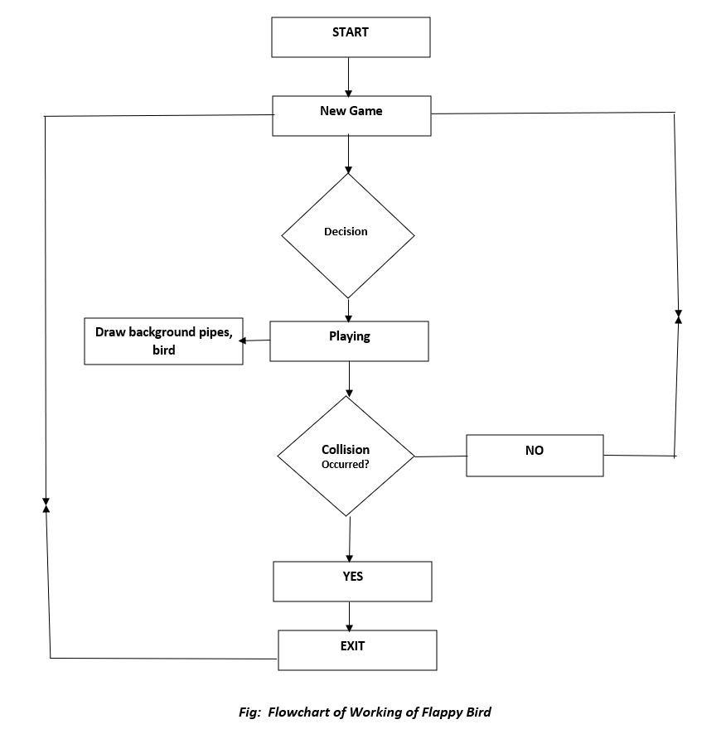
Flowchart of Flappy Bird

Slide 8
Working Principle
●
Flappy Bird is a side-scroller game meaning that it works on left to right order.
The player controls the bird by pressing space bar.
Random height vertical pipes are generated from top and bottom of the screen with little gap in between.
The player needs to control the bird such that it won’t collide with the vertical pipes.
The bird falls at a given acceleration if space bar is not pressed.
●
●
●
●

Slide 9
Contd..
The score gets increased when the bird passes the pipes.
If the bird collides with any of the pipes, then the game is over.
If the game is over, pressing “ANY” key will start a new game.
●
●
●

Slide 10
Issues faced during development
●
It was hard for us to manipulate the background images, the bird image according to our needs.
When expanding the screen size, the images seem to be distorted.
The game is platform dependent, we couldn’t make it cross-platform.
While making it executable on one OS, it won’t work on another OS.
●
●
●

Slide 11
Future plans
●
The current version of our project is offline, we are planning to make it online.
We are planning to add the global leader boards functionality so that players can compete online.
●

Slide 12
Conclusion
Flappy Bird can be created using any programming language. We chose the Python language, pygame module because it is easy to use and is easy to implement game logic in pygame.
Our project is 2D game, as pygame is specifically made for 2D games it was easy for us to create flappy bird with its user-friendly modules and methods.
●
●

Slide 13
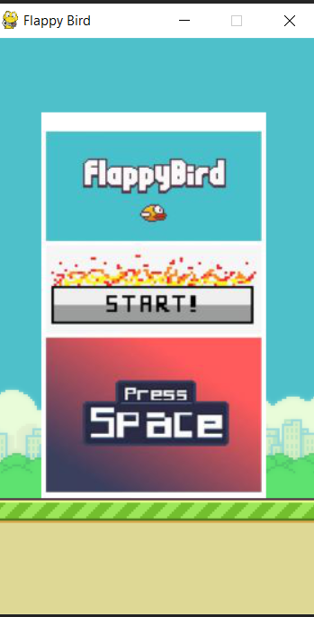
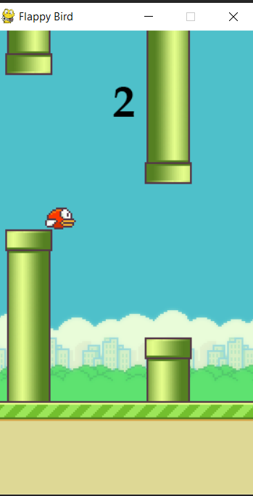
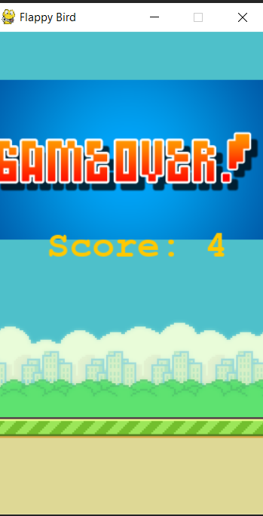
Project Snapshots

Slide 14
References
https://pygame.org/
Learning pygame by making flappybird – Clear Code
https://www.youtube.com/watch?v=UZg49z76cLw&t=1215 s
Tech with Tim – Pygame programming tutorials
https://www.youtube.com/watch?v=i6xMBig-pP4&list=PLz McBGfZo4-lp3jAExUCewBfMx3UZFkh5
Code with Harry - Pygame programming tutorials
https://youtu.be/itB6VsP5UnA
●
●
●
●
●
●
●

