Slide 1
PROJECT ON ANALYTICS
Presented By – Saurav dhangar

Slide 2
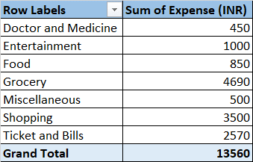
Project 1 - Part 1 1)How much is spent for each category (Pivot Table)

Slide 3
Task 1.1 Visually represent the amount spent against each category is what percentage of the total expense amount (Pivot Chart)

Slide 4
Task 2 How much is spent on different items of each category (Pivot Table)

Slide 5
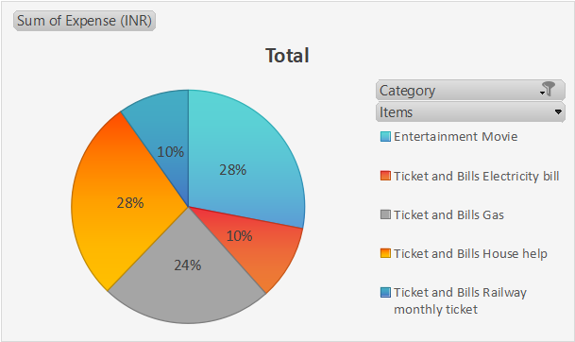
Task 2.1 Visually represent the amount spent on different items of Entertainment and Tickets and bills category (Pivot Chart)

Slide 6
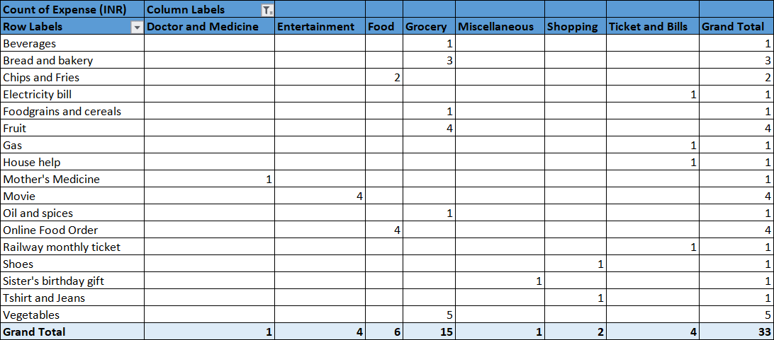
Task 3 How many times money has been spent against different items of each category (Pivot Table)

Slide 7
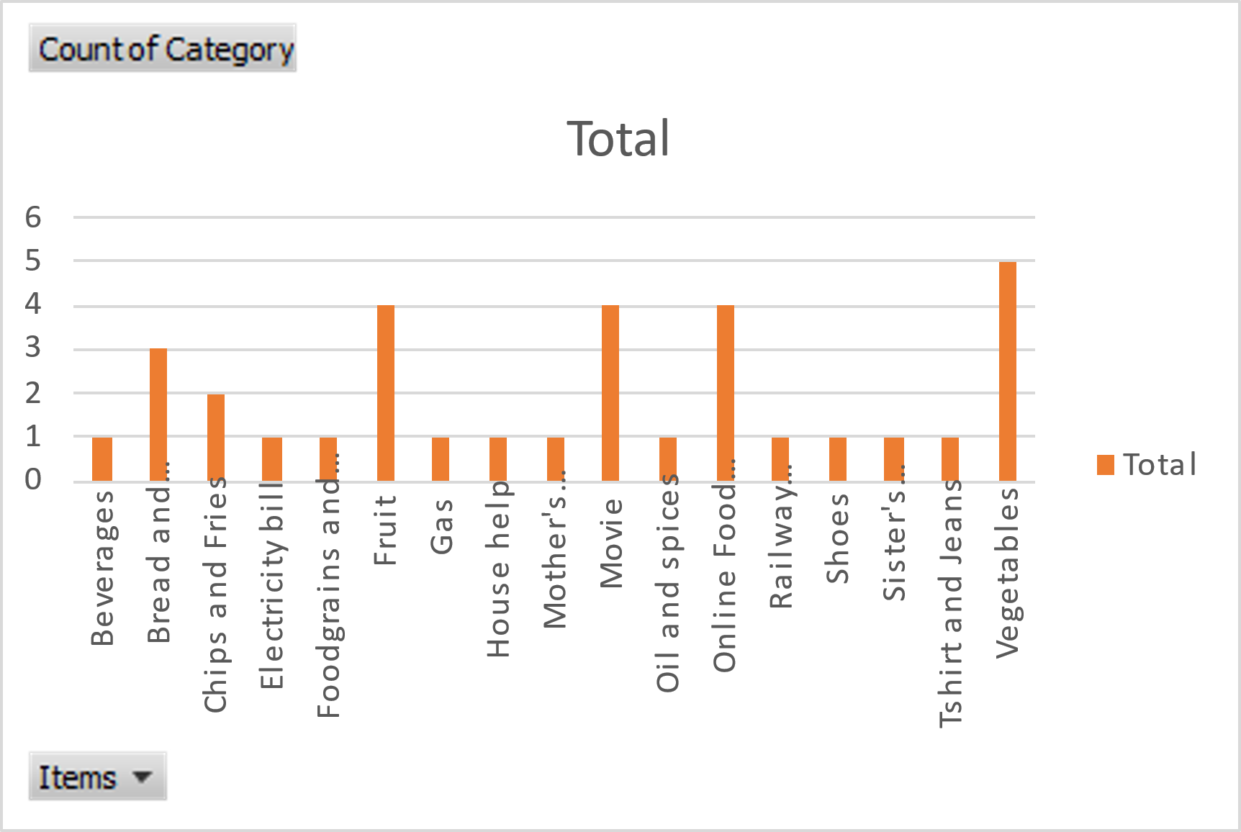
Task 3.1 Filter the data to display the data for Grocery items and Shopping items

Slide 8
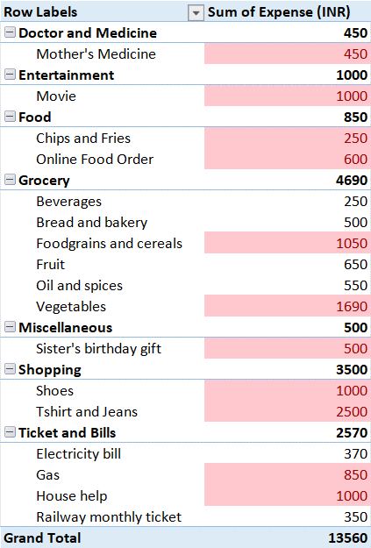
Task 4 What amount is spent on each item of the categories with highest and 2nd highest expense amount (Pivot Table)

Slide 9
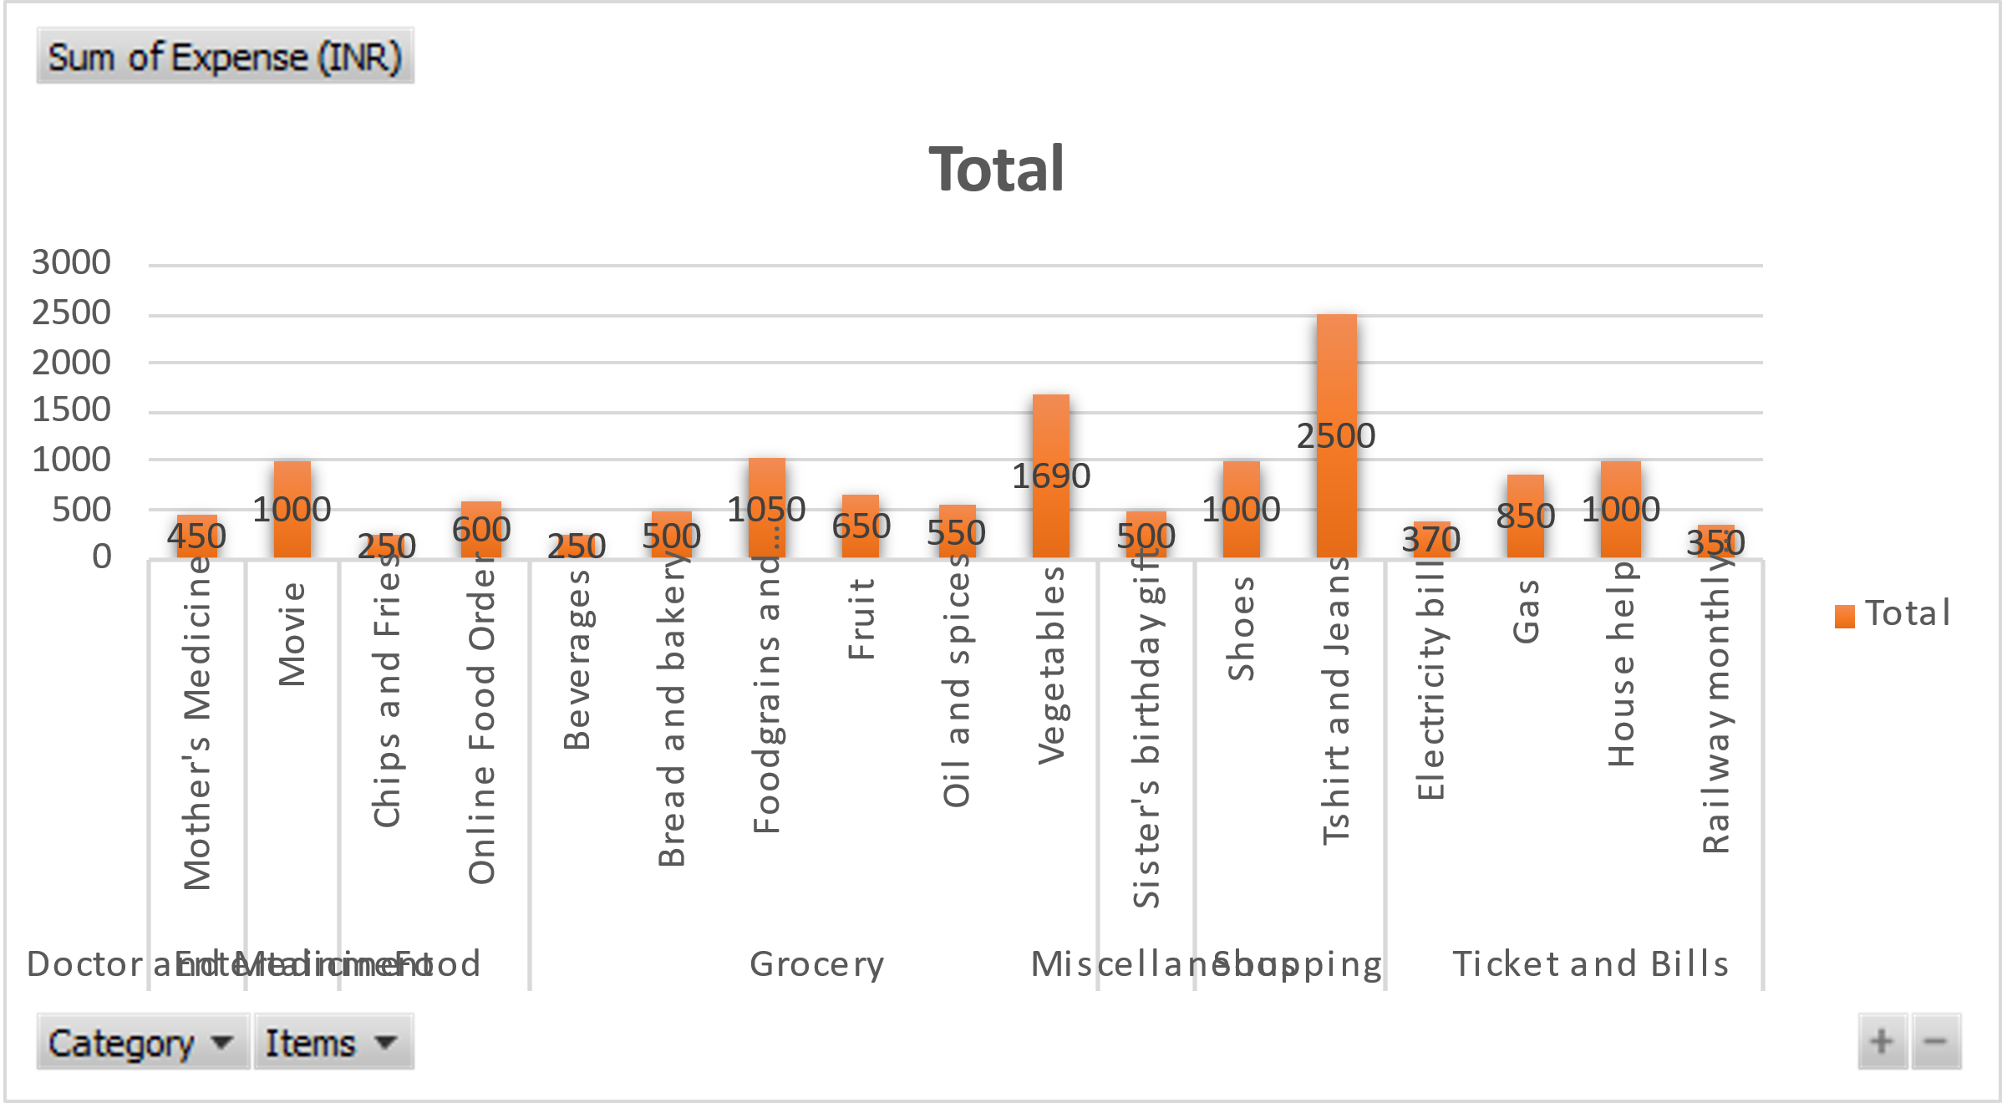
Task 4.1 Visually represent the data with data bars (Conditional formatting)

Slide 10
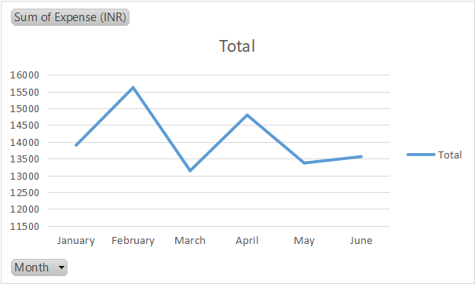
Part 2 - Task Responsibilities Task 1 Month-wise trend of expenses (Pivot table and chart). Find out the month Nitin spent the most .

Slide 11
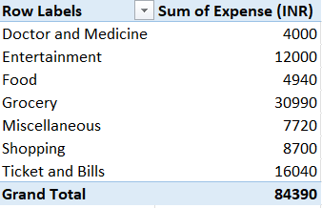
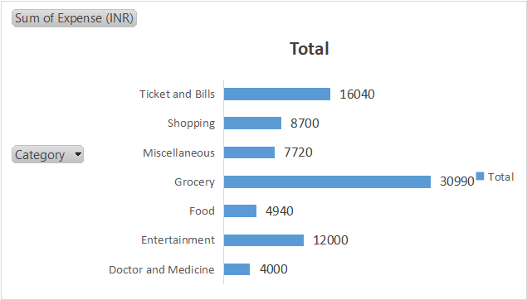
Task 2. Category wise expenses (Pivot table) Visually represent it with data bars to display categories with the highest and lowest expense amount

Slide 12
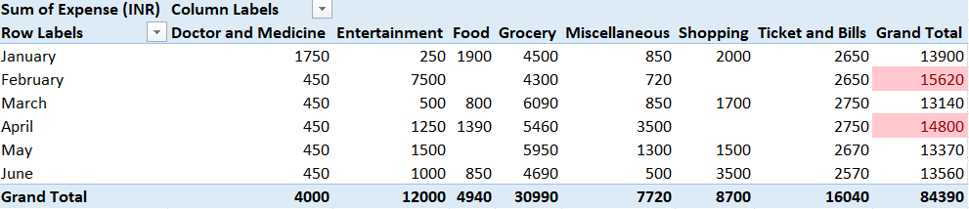
Task 3. Month-wise expense of each category (Pivot table)

Slide 13
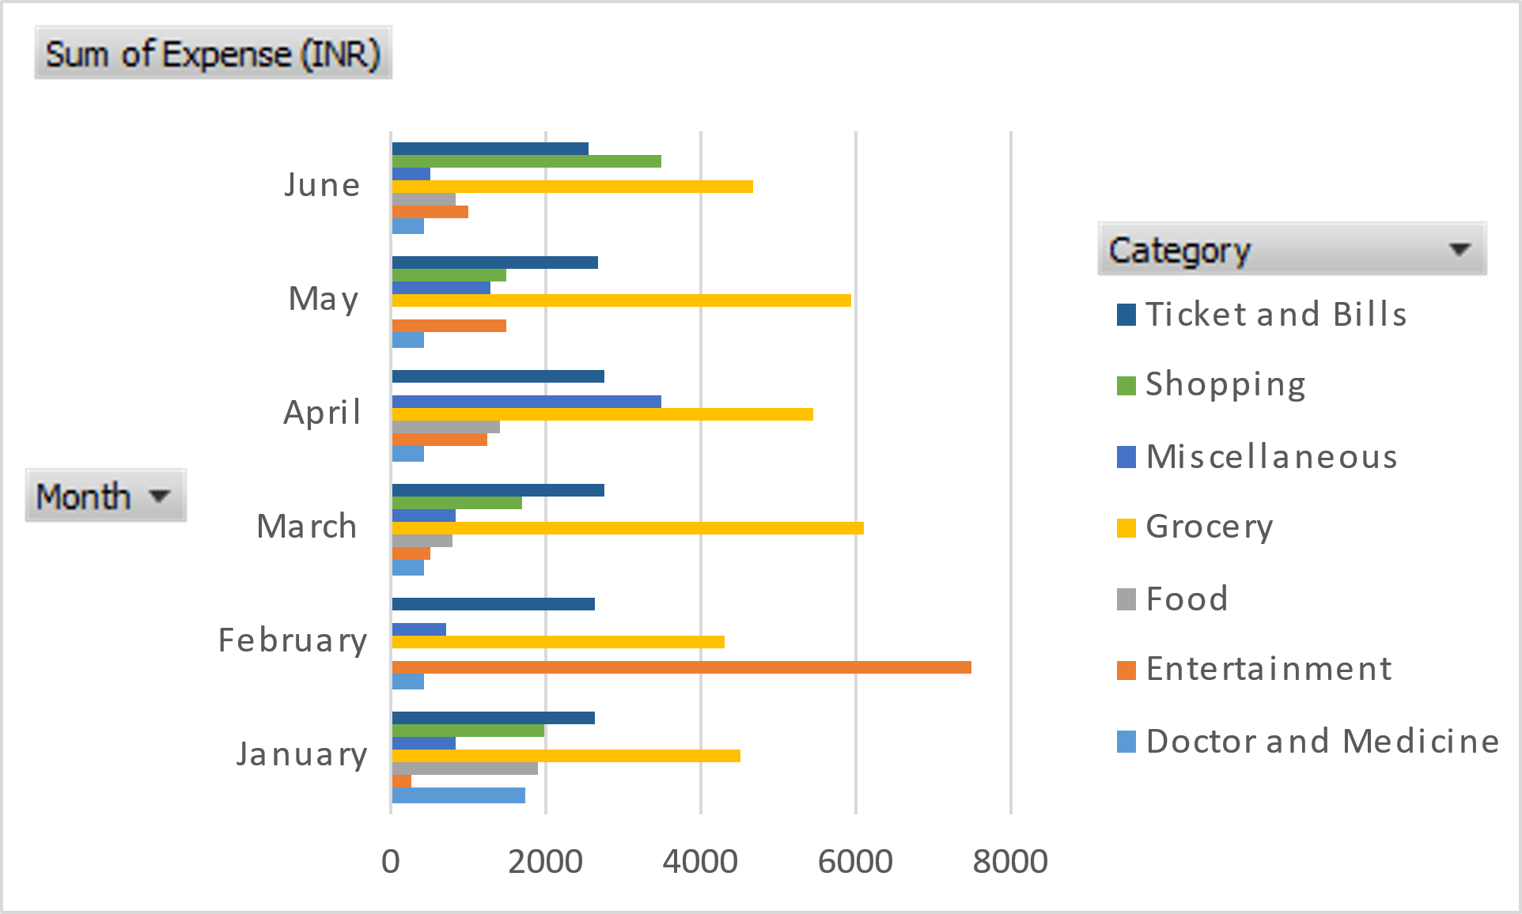
Task 3.1 Find out 2 categories with higher expenses for each of the 6 months

Slide 14
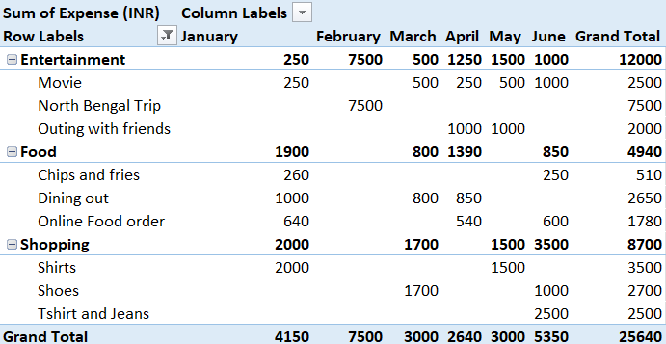
Task 4. How much is spent in each month against different items of Entertainment, Food and Shopping categories (Pivot table)

Slide 15
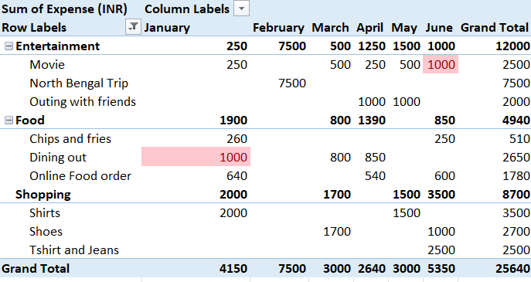
Task 4.1 •Find out which months have the highest amount spent for movies and dining out

Slide 16
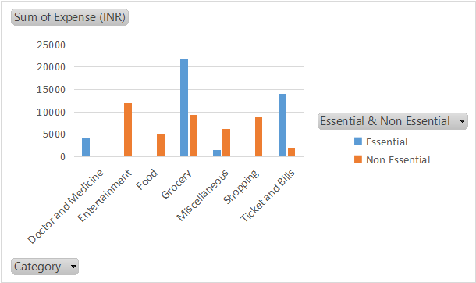
Task 5 Decide on the essential and less essential items and analyse the expenses

Slide 17
Task 5.1 Recommend how can Nitin increase his savings
Plan and budget for trips and look for more affordable travel options.
Make a grocery list and stick to it, buy in bulk, and look for discounts.
Review miscellaneous expenses and cut down on non-essential items.
Limit shopping for clothes and other non-essential items.
Cook at home instead of dining out or ordering food.
Budget for entertainment and look for free or low-cost alternative.

Slide 18
THANK YOU

