Slide 1
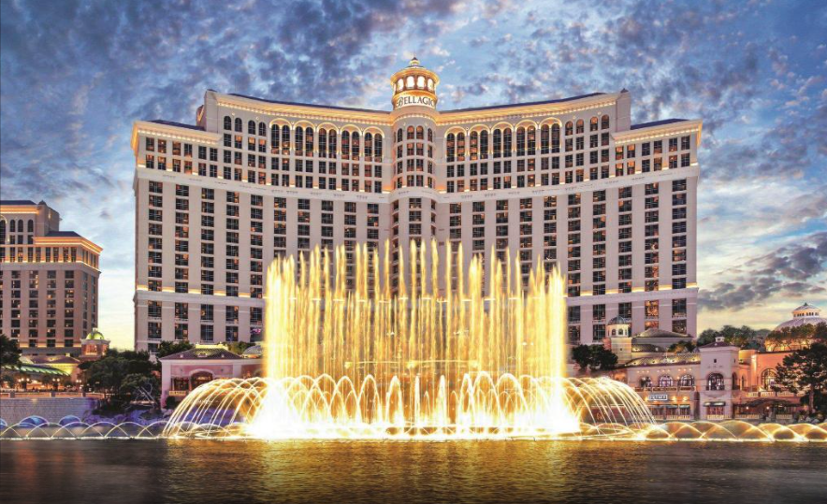
Hotel Booking Exploratory Data analysis
By - Saurabh Kumar

Slide 2
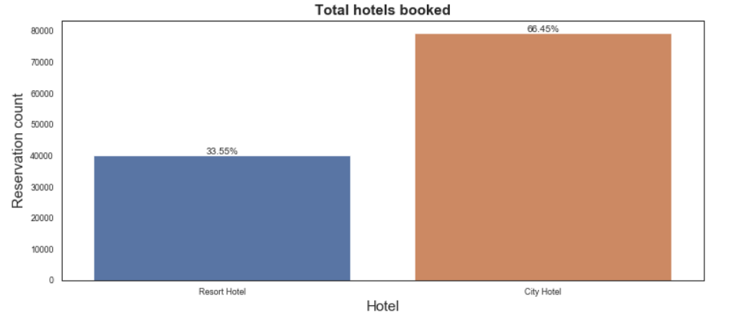
Total hotels booked
From above graph it can be depicted that people are more biased towards City Hotels (66%).

Slide 3
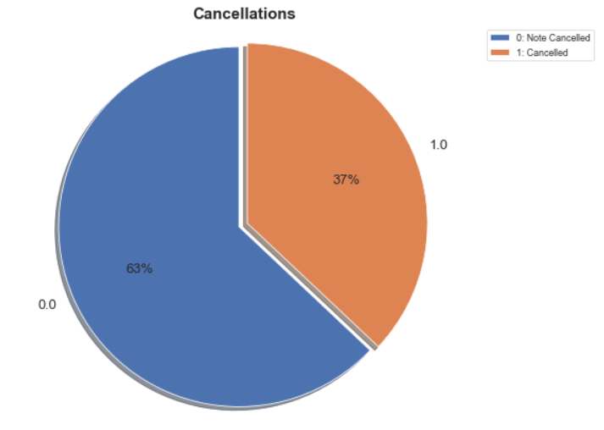
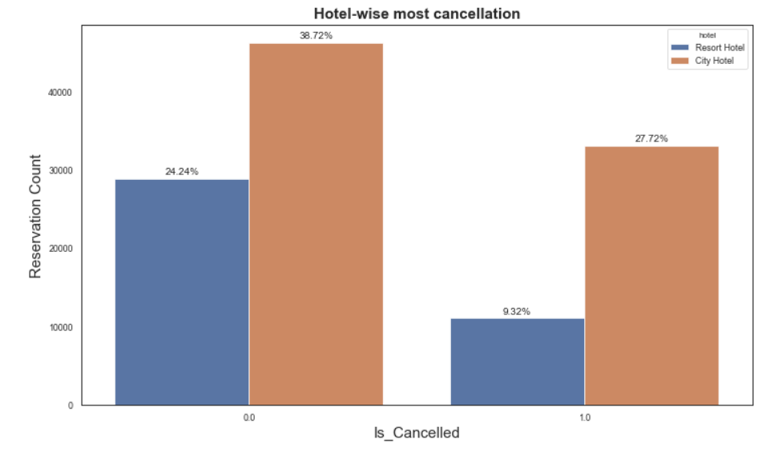
Cancellation status by Hotel type
Overall of 37% booked reservations were cancelled over these years in which 27% were mostly City Hotels

Slide 4
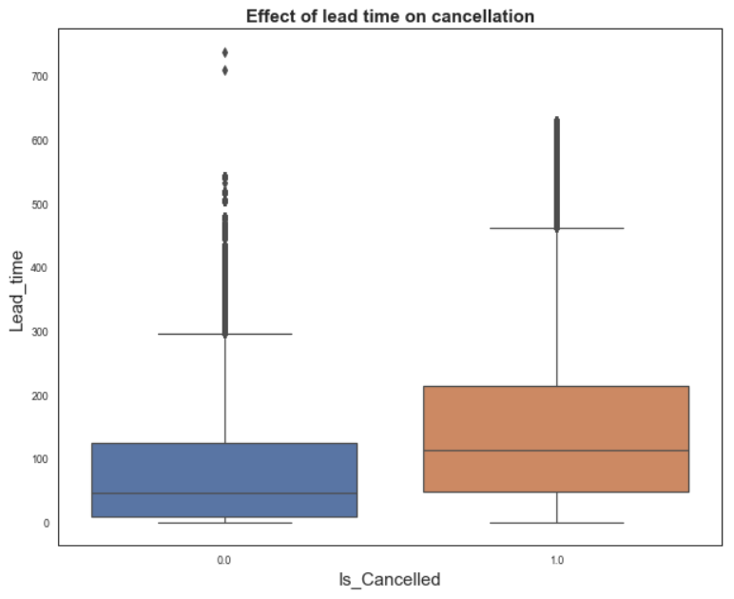
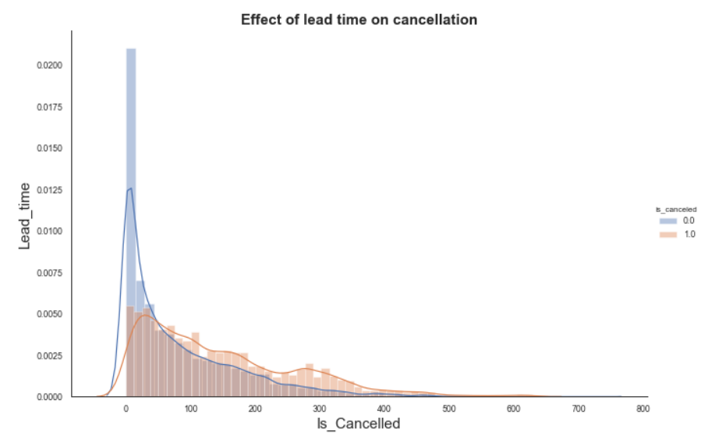
Effect of lead time in hotels and cancellations
From above it is quite apparent that more lead time caused more cancellations
Lead time of more than 150 has led to many cancellations regardless of hotel types.

Slide 5
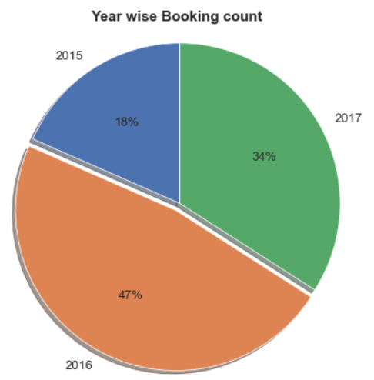
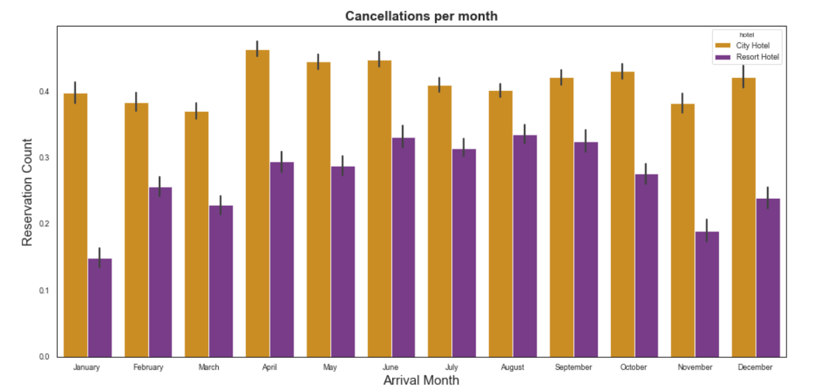
Booking Pattern: Year and month wise
Most of the bookings happened in 2016 where it increased by 29% from previous year but decreased by 13% a year later.
August has been the most favourite months for booking in both hotel types

Slide 6
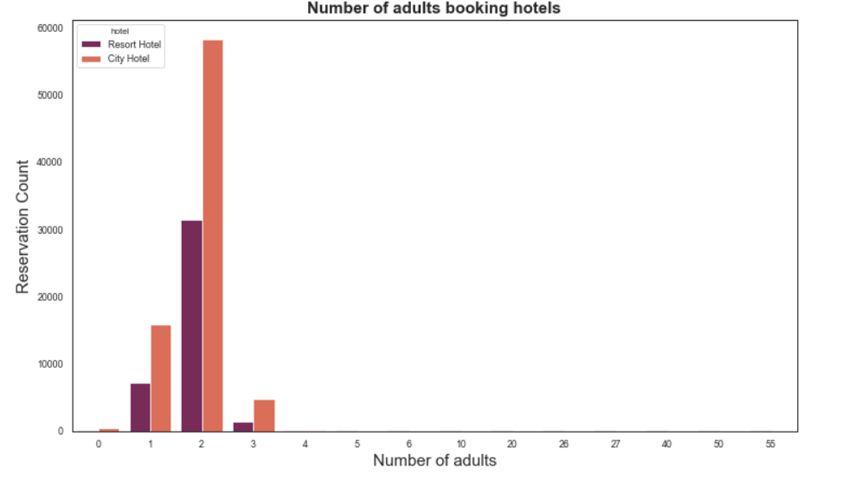
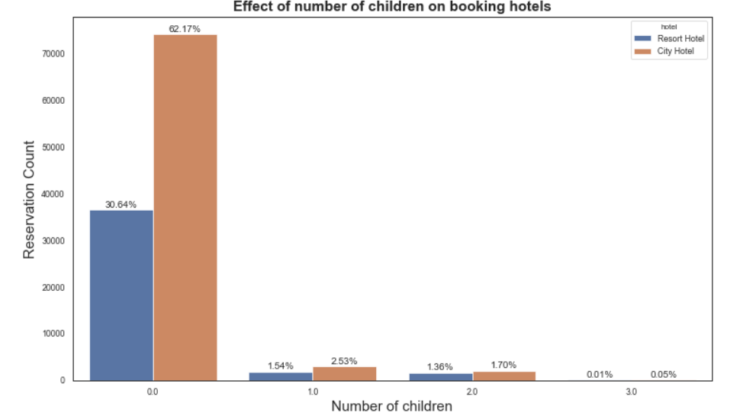
Effect of number of adults and children on hotel bookings
Couples (2) or individuals having no children seems to have booked more reservations for obvious reasons.
Almost 93% of all bookings were done where adults did not have children and overall of 62% booked City hotel

Slide 7
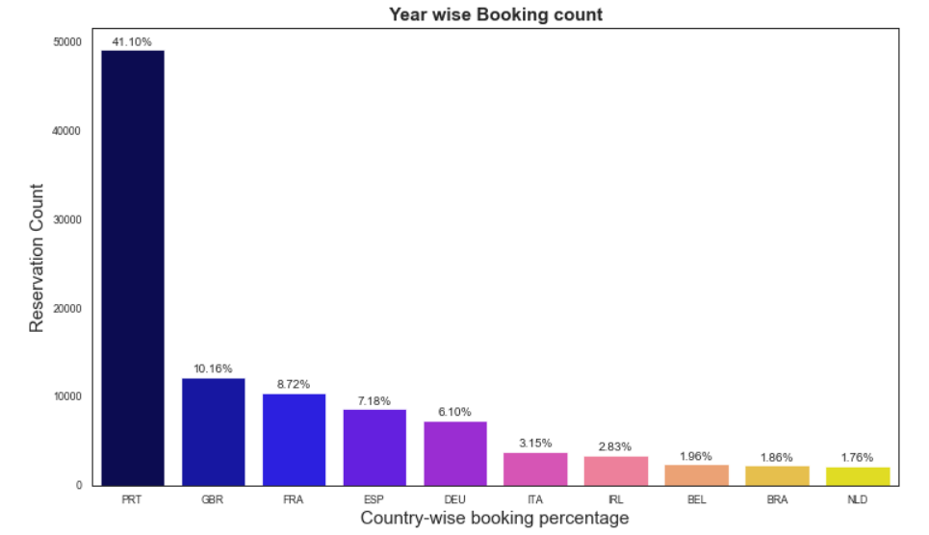
Country wise most bookings
About 40% of all bookings were found from Portugal followed by Britain (10%) and France 8%.

Slide 8
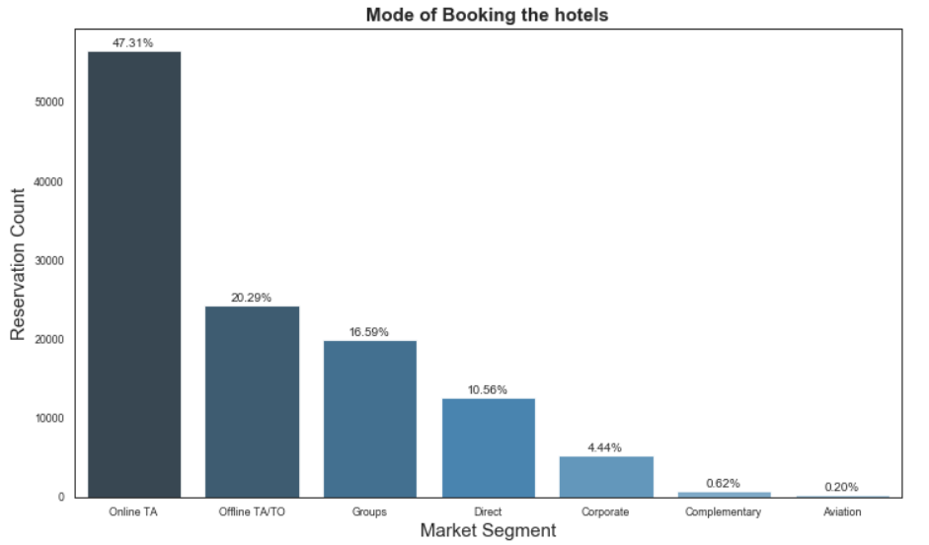
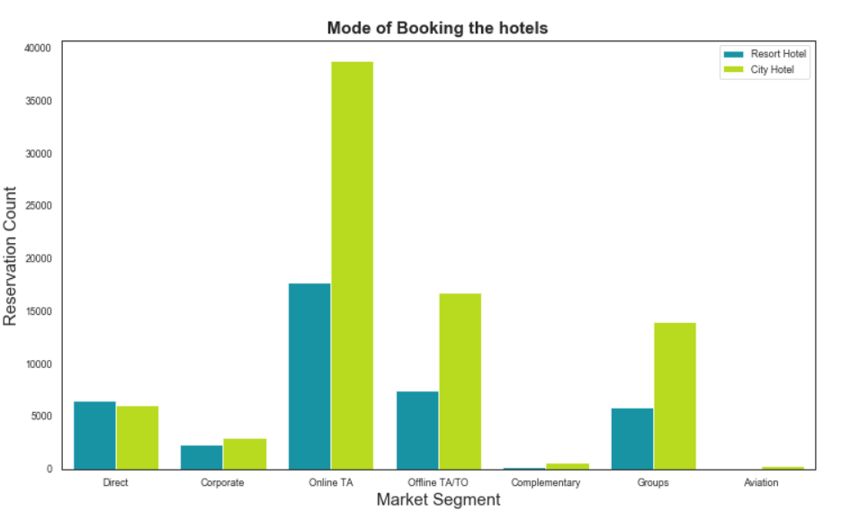
Mode of booking the hotels
47% of bookings are made via Online Travel Agents
10% of bookings were made directly
Complementary and people from aviation do not book resort hotels.

Slide 9
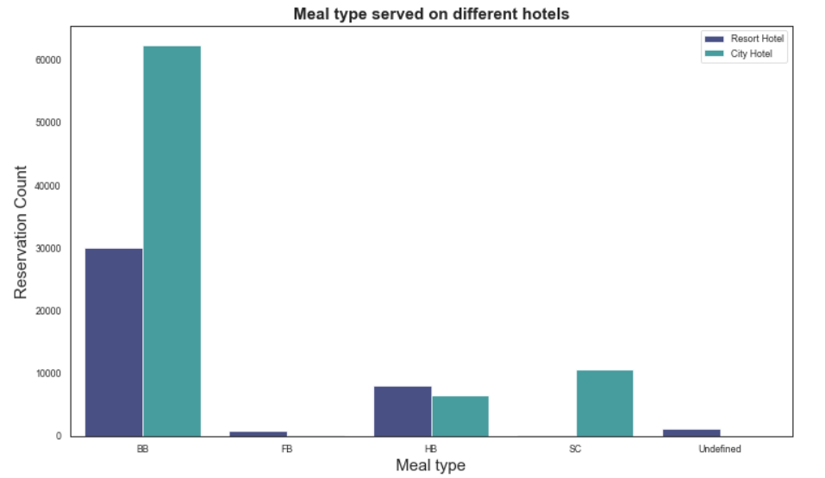
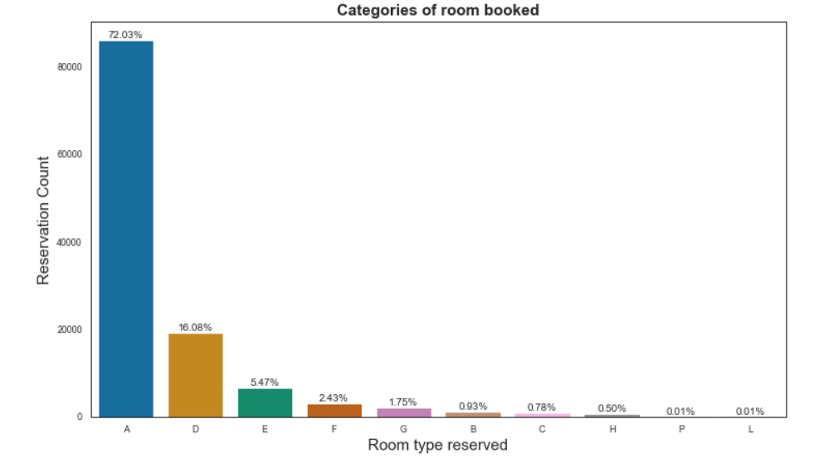
Types of food and accommodation provided
People across hotels tend to book “A” type rooms (72%) may be due to lower price.
Around 77% of all bookings of "BB“ meal type were done and in that almost 50% were from City Hotels.

Slide 10
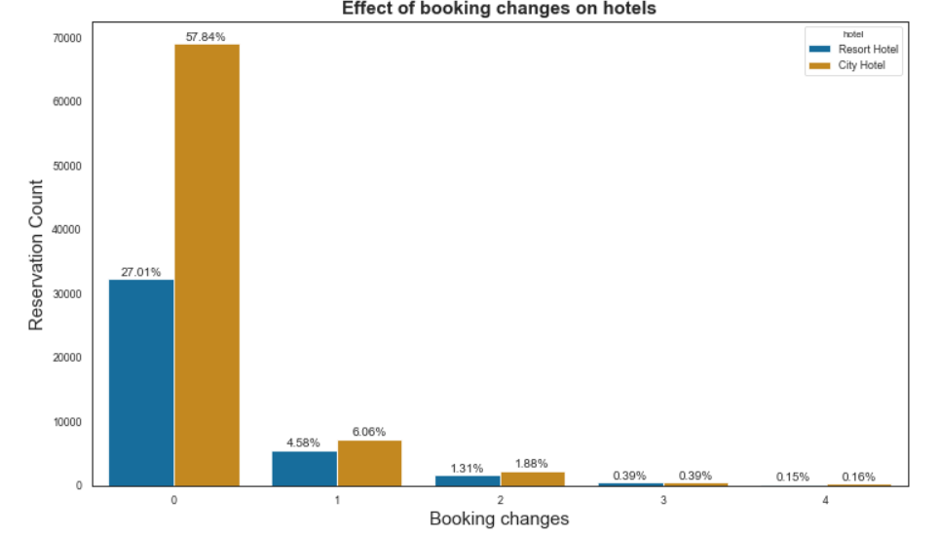
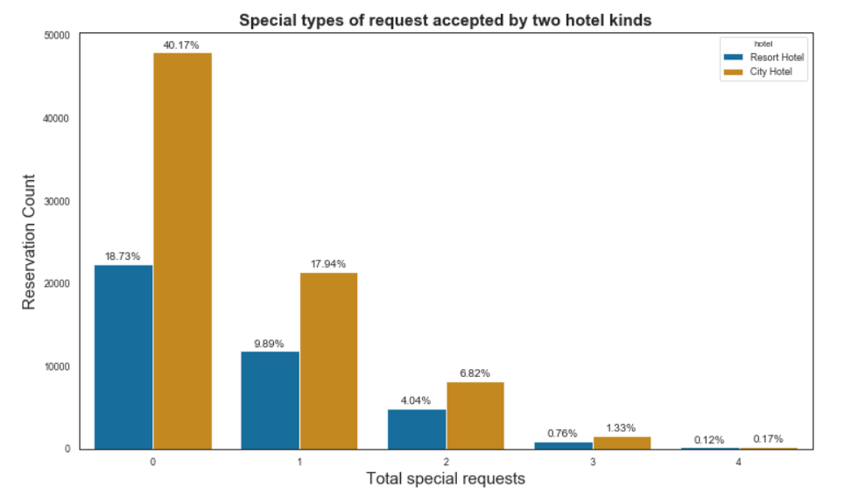
Special changes leveraged by two hotels
Almost 84% people did not request for booking changes and 60% did not have any special requests.
City hotels accepted more booking changes and special requests comparatively that might have left good impression on customers so that they repeat their bookings and do not cancel.

Slide 11
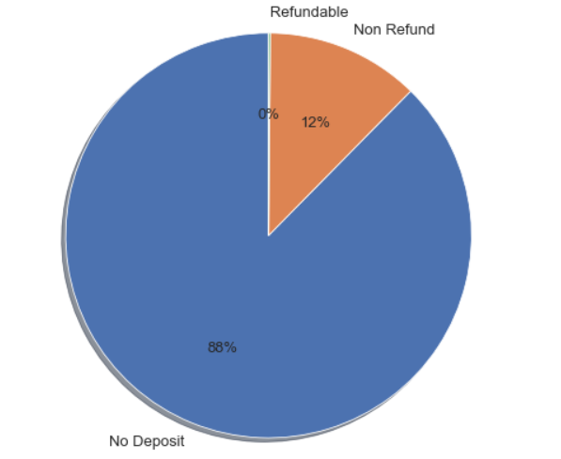
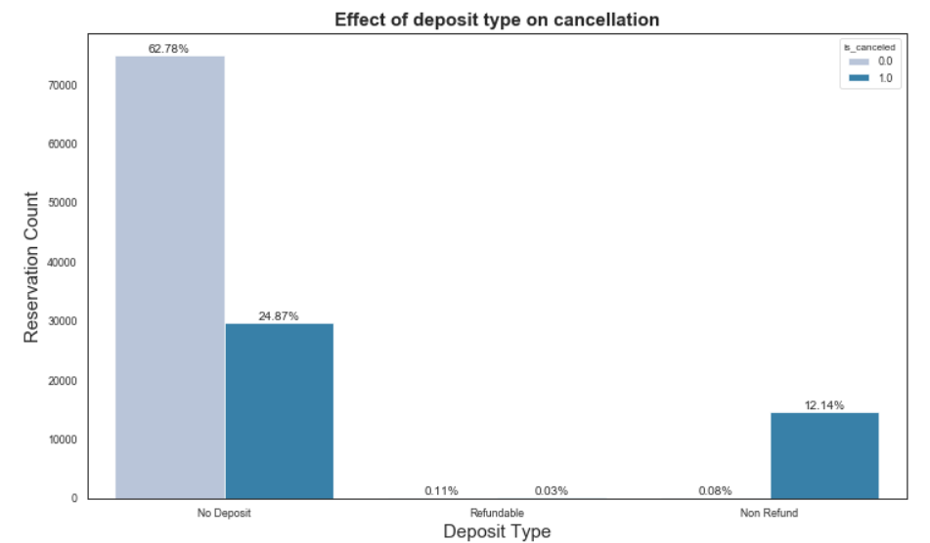
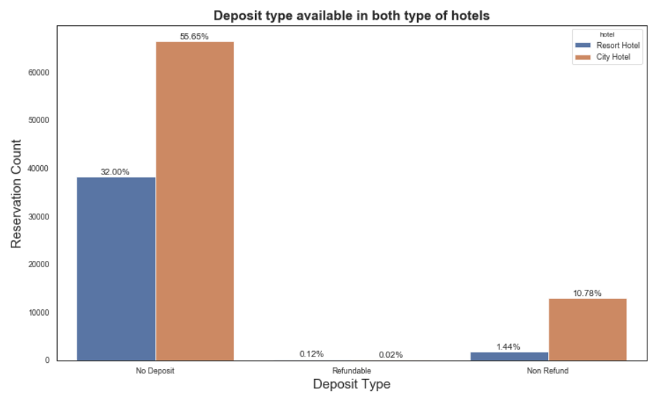
Effect of deposit type on hotel bookings and cancellations
24% bookings were cancelled by guests with no deposit, followed by 12% bookings were cancelled which are with Refundable policy
And it is very obvious that people who did not pay any deposit while booking were likely to book more reservations and also cancel more.

Slide 12
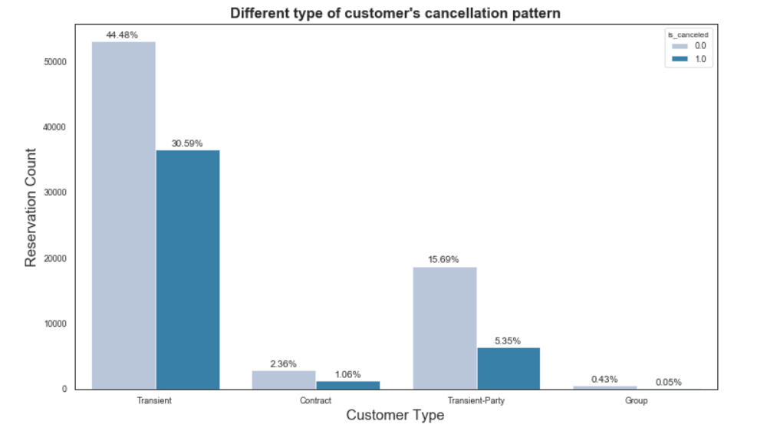
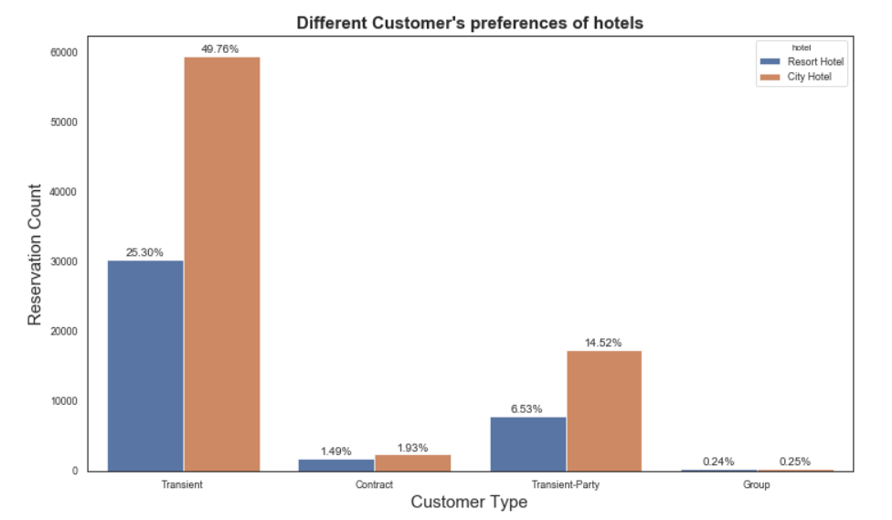
Effect of customer type on hotel bookings and cancellations
Around 50 % City hotel bookings were transient bookings and 25% for Resort hotels
Around 30% of transient bookings were cancelled.

Slide 13
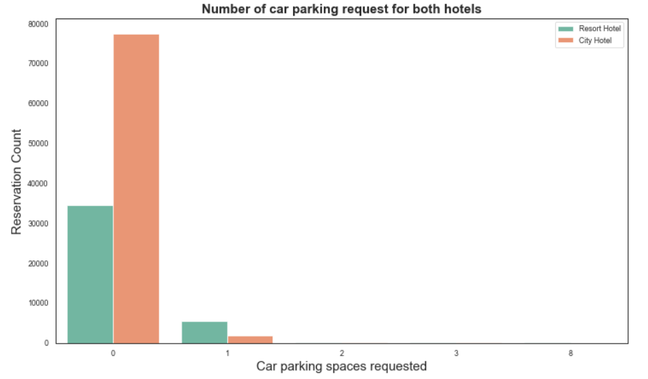
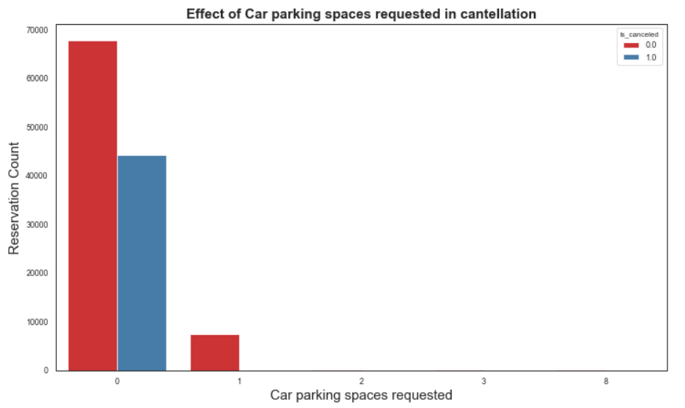
Parking space requested for each hotel types
Around 38% bookings were cancelled by people who did not choose for Car parking at the time of booking

Slide 14
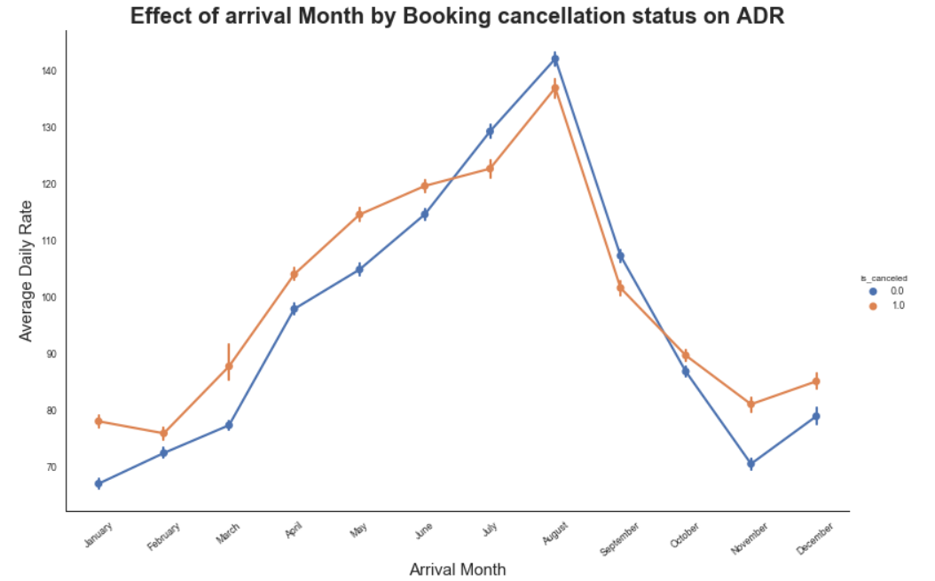

Effect on Average daily rate (monthly basis)
"August" month is the most busiest month for booking across the hotels.
The highest Arrival Daily Rate occurred in August obviously. And due to highest ADR in August may be it could be one of the reasons for more canceled bookings in August.

Slide 15
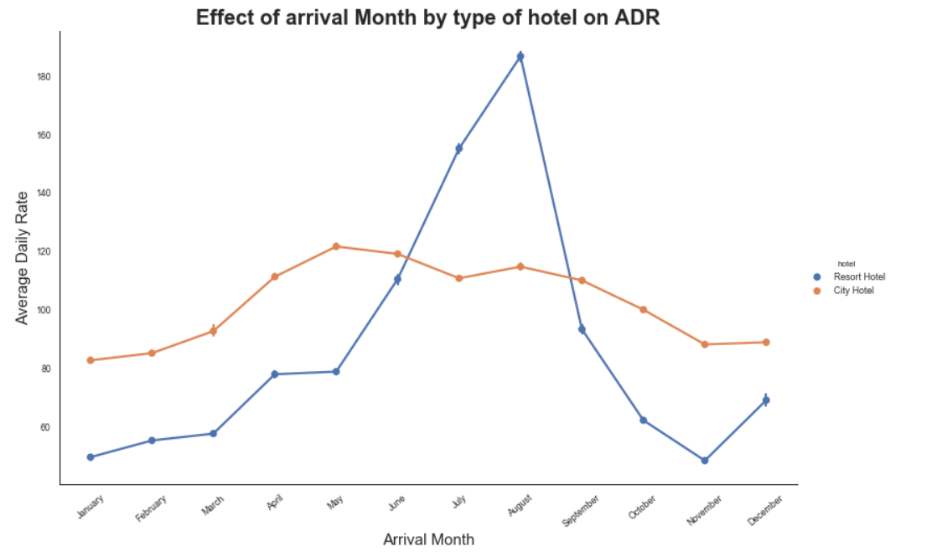
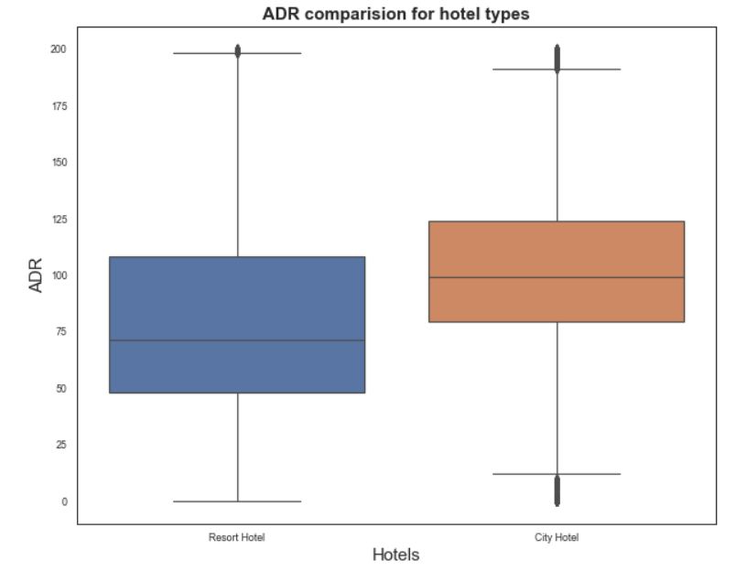
Effect on Average daily rate (monthly basis)
Resort hotels have higher price for peak months of June, July and August.
For City Hotel prices almost remains same throughout the year and in months of Jan to May, prices remain higher than resort hotels.
The price drop of resort hotels after “August” tells us that bookings in resort hotels are very seasonal in nature.

Slide 16
Key Findings:
Almost 37% of bookings were canceled and more than 66% of the population booked the City hotel.
Year 2016 had most number of bookings comparatively.
July and August are the months where booking peaks up so hotels should plan and target their audience accordingly.
Portugal, UK, France, Spain and Germany are the top countries from most guests come so hotel companies can target these countries to expand their business.
Couples with no children tends to have more bookings due to obvious reasons. So hotels can make arrangement and plans accordingly.
Hotels can decrease their lead time to avoid many cancellations.
Resort hotels should be more focused on attracting more guests in months of July and August as EDA suggests us that booking in these hotels are very seasonal.

Slide 17
Thanks

