Slide 1
Rent price recommender
Prediction model project using UCI Data.
-Saurav Anand

Slide 2
Business Goals
Optimizing Rental Income to maximize occupancy rates with competitive pricing
Ensure fair and transparent pricing to build tenant trust
Set prices that attract tenants quickly to reduce vacancy times
Offer personalized rental recommendations to potential tenants
Gain insights to position properties effectively in the market
Continuously refine the model based on user feedback and market changes

Slide 3
Dataset
The dataset is the part of UCI ML repository. Below is the link to access it (https://archive.ics.uci.edu/dataset/555/apartment+for+rent+classified)
The dataset contains two files each containing 10000 and 100000 rows respectively
Both the files have 22 columns
The target column for this regression usecase is price

Slide 4
Data Dictionary
price = rental price of apartment
price_display = price converted into display for reader
price_type = price in USD
square_feet = size of the apartment
address = where the apartment is located
cityname = where the apartment is located
state = where the apartment is located
latitude = where the apartment is located
longitude = where the apartment is located
source = origin of classified
Time = when classified was created
id = unique identifier of apartment
category = category of classified
title = title text of apartment
body = body text of apartment
amenities = like AC, basketball,cable, gym, internet access, pool, refrigerator etc.
bathrooms = number of bathrooms
bedrooms = number of bedrooms
currency = price in current
fee = fee
has_photo = photo of apartment
pets_allowed = what pets are allowed dogs/cats etc.

Slide 5
Data Exploration
There are 14 categorical and 8 numerical columns in the dataset files
After comparing both the larger and smaller file , we found that both the datasets are different
Combined both the datasets to get sufficient data for analysis and training purpose
The text columns in the dataset are “body” and “title”. Both contains mostly the information related to the location, no of bedrooms , price range which details are already present in the other columns respectively. They are removed from the dataset along with the “id ”column

Slide 6
Data Quality Issues
There are columns like address, amenities, cityname , state and source which has higher no of unique values greater than 20
The currency column has one value only which is USD
The price_display is under catgorical column but it should be a numerical column
Time Field is in the Unix Timestamp, needs to be converted to the datetime format
Note :- The above issues are handled during the experiment

Slide 7
Data Quality Issues (cont..)
There are duplicates in the data (10100 rows).The duplicates are removed from the datasets
The features “bathrooms”, “bedrooms”, “latitude” and “longitude” have very small percentage of missing values. They are being replaced by median
The feature “pets_allowed” has a lot of missing values ,imputing with a new category (Unknown)
The price column has only one value missing , so it is dropped
The missing values in columns like amenities, address, cityname and state will be handled afterwards, as these columns have high cardinality

Slide 8
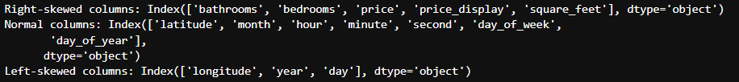
Descriptive Statistics
After the calculation of the five point summary , we got the idea about the distribution of the data.
Most of the features are right skewed . Time features are normal distributed except year.

Slide 9
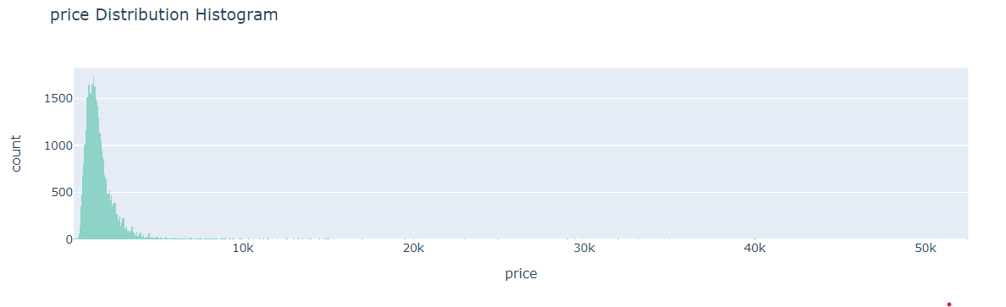


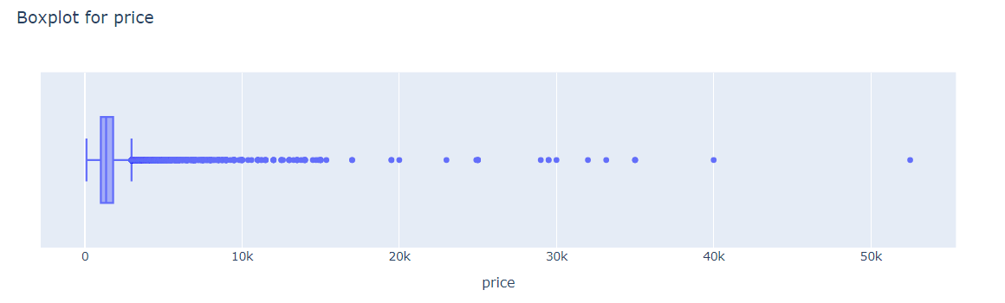
Univariate Analysis
Target Analysis
There are Outliers in our Target
variable ( outside the InterQuartile range).-
We need to handle the Outliers.

Slide 10
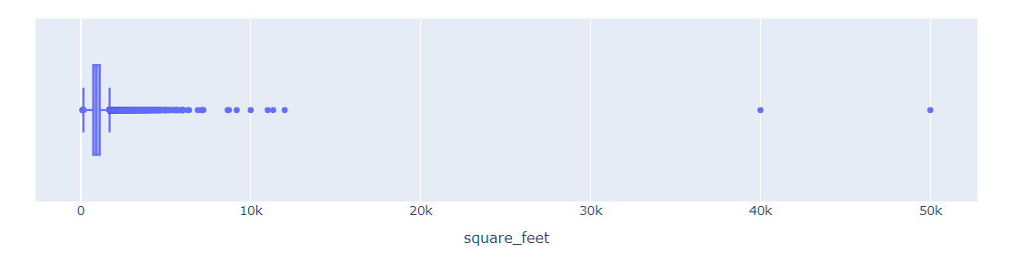
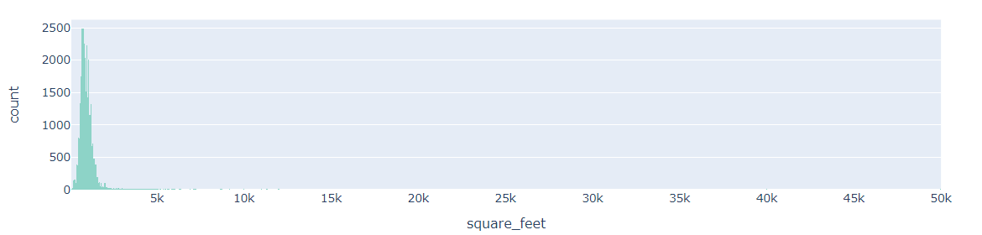
Univariate Analysis – numerical columns

Slide 11
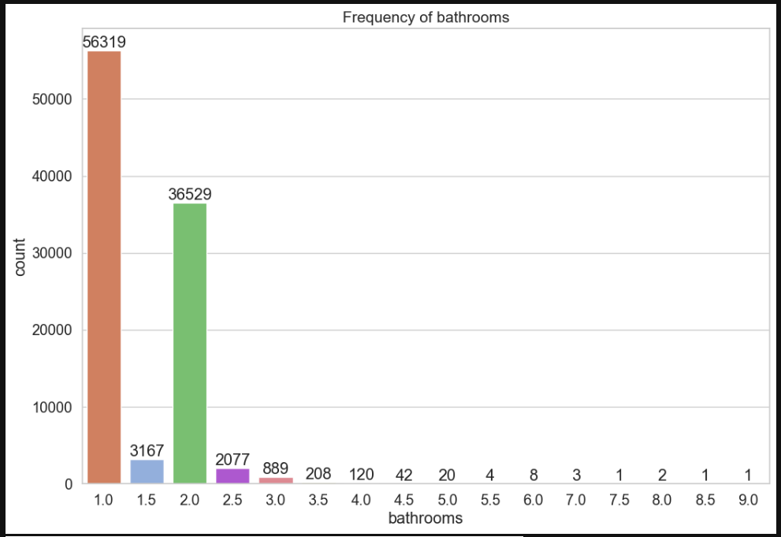
Univariate Analysis –categorical columns

Slide 12
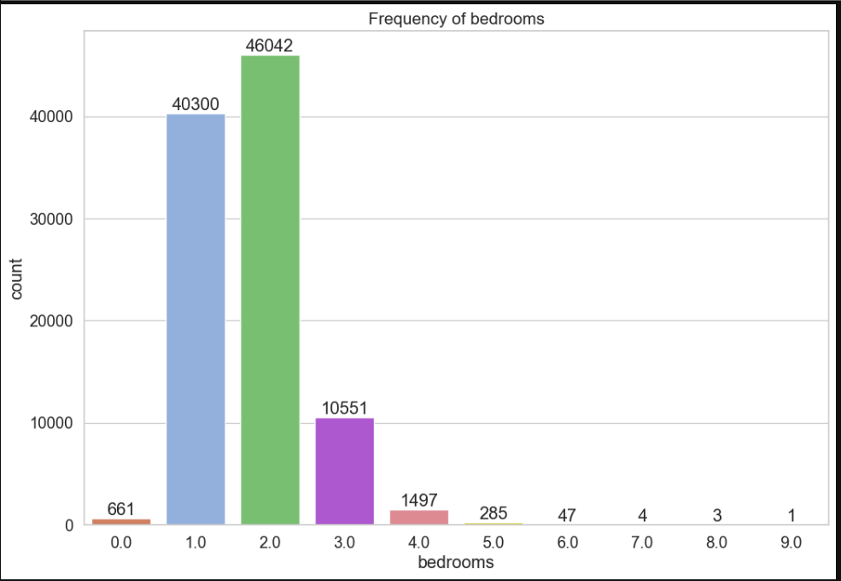
Univariate Analysis –categorical columns (cont..)

Slide 13
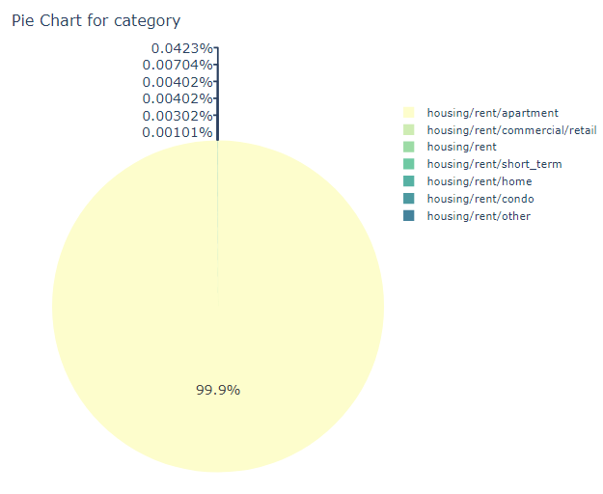
Univariate Analysis –categorical columns (cont..)

Slide 14
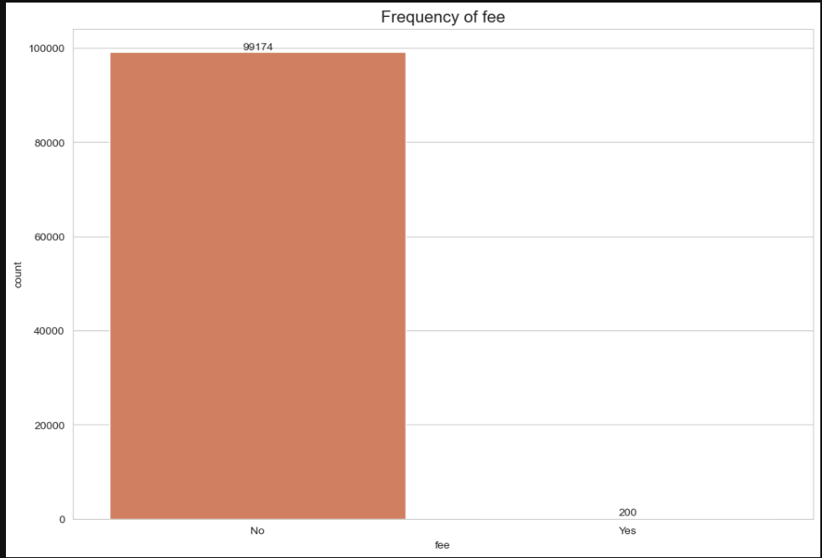
Univariate Analysis –categorical columns (cont..)

Slide 15
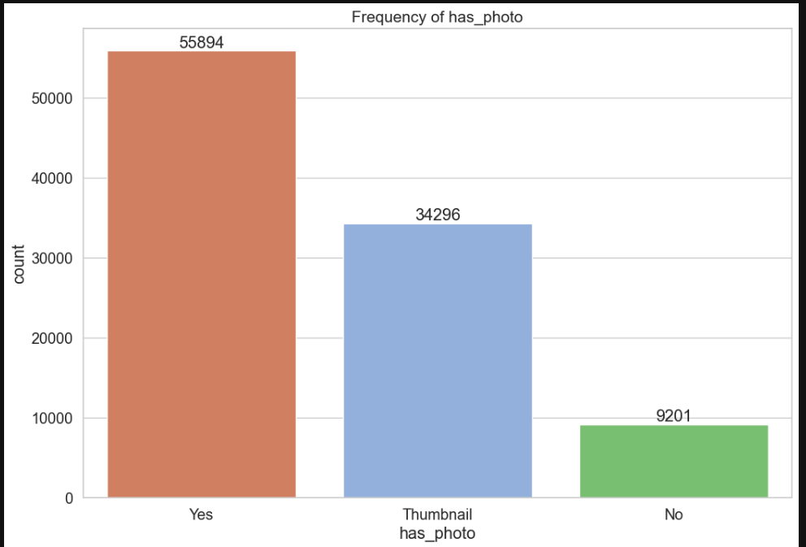
Univariate Analysis –categorical columns (cont..)

Slide 16
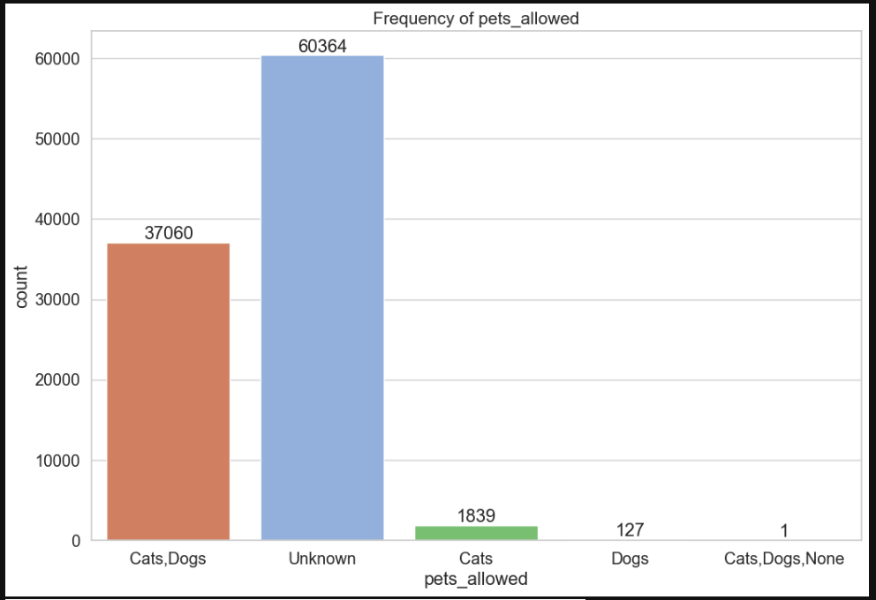
Univariate Analysis –categorical columns (cont..)

Slide 17
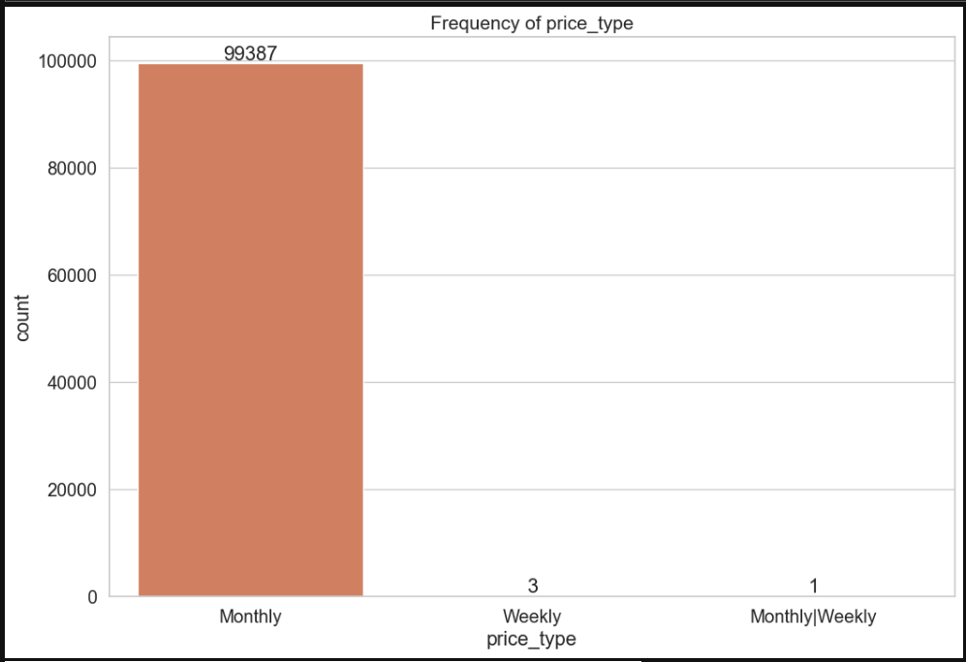
Univariate Analysis –categorical columns (cont..)

Slide 18
Univariate Analysis –categorical columns (cont..)

Slide 19
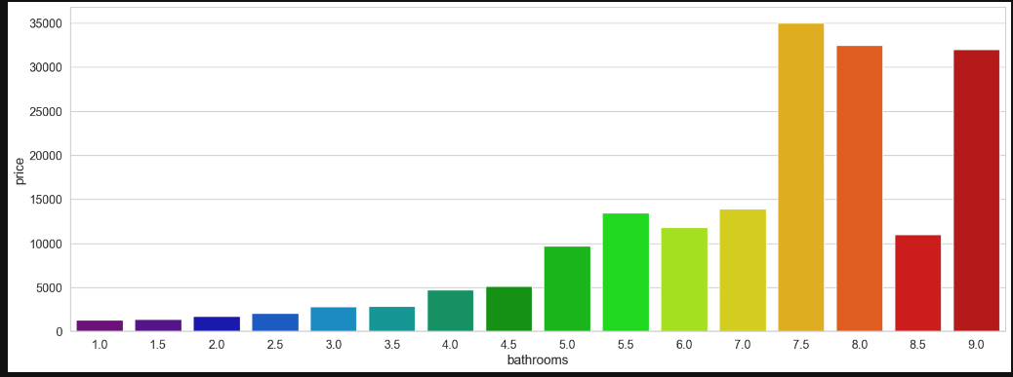
Bivariate Analysis wrt Target (cont..)
Higher the no of bathrooms , higher the price.
Overall price of no of bathrooms 7.5 > 8 >9

Slide 20
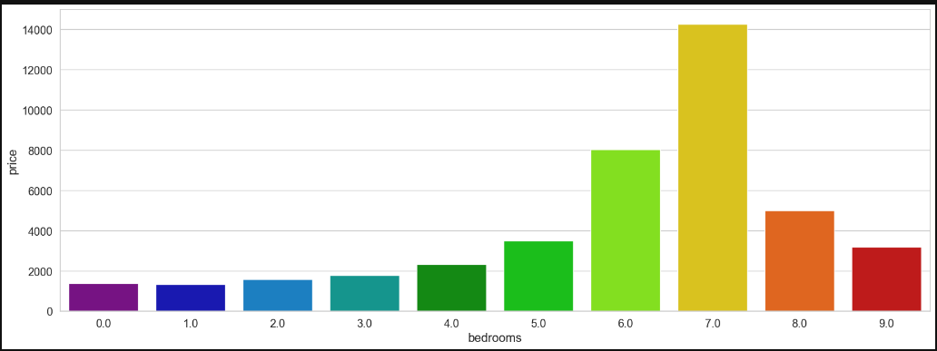
Bivariate Analysis wrt Target (cont..)
Overall price of 7-bedroom house is highest.
Price of house with 6 bedroom is more than 8- and 9-bedroom house.

Slide 21
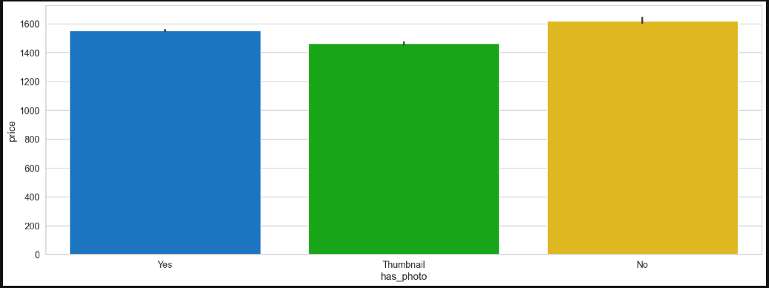
Bivariate Analysis wrt Target (cont..)
There are more houses with no photos with overall high price.

Slide 22
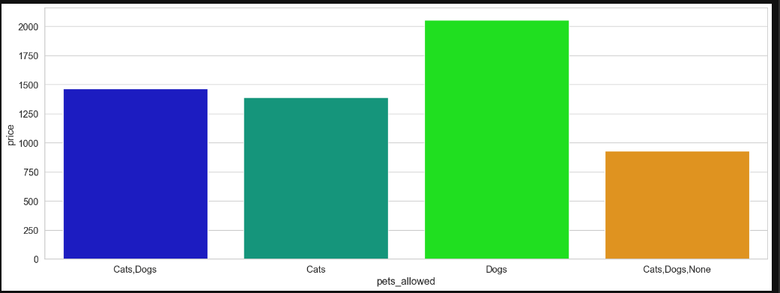
Bivariate Analysis wrt Target (cont..)
More Apartments with Dogs have more overall higher price.

Slide 23
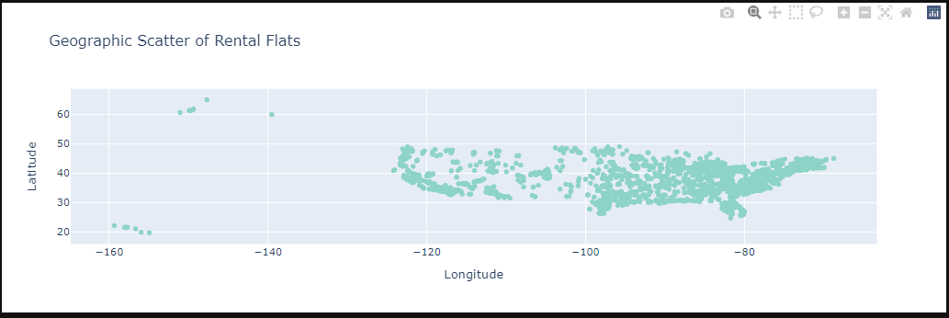
Location of Rental Apartments
More Apartments location are within the specific region

Slide 24
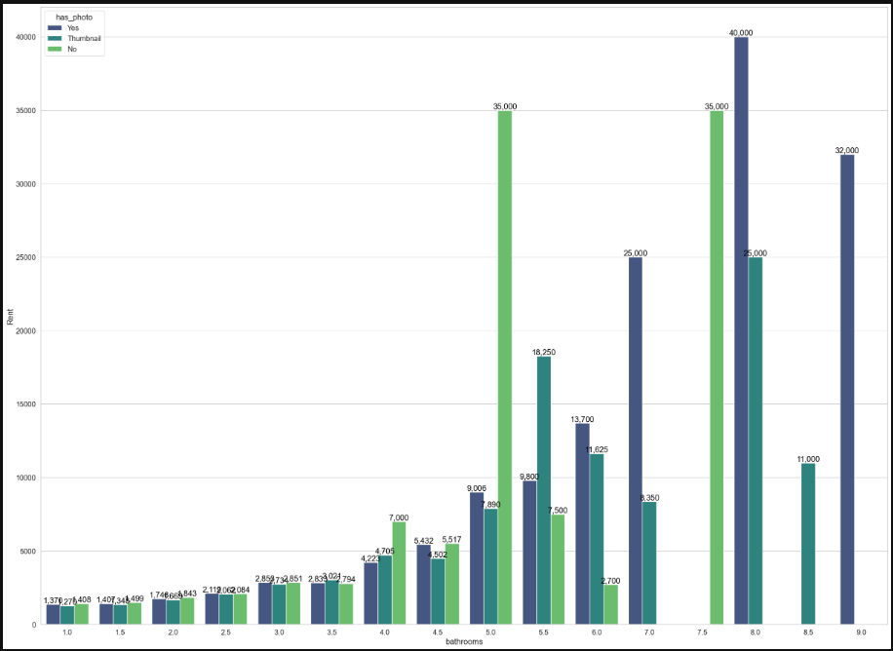
Multivariate Analysis
7-bedrooms apartment has no photos
9-bedrooms apartment has photos.
5-bedrooms apartment with no photos
have more Overall price
Apartment with higher number of
bedrooms with photo and thumbnail

Slide 25
Multivariate Analysis (cont..)
Apartments with > 7.5 bathrooms
along with 5.5 doesn’t allow pets(Unknown).
Apartments with bathrooms <= 4 allow
all types of pet conditions.

Slide 26
Multivariate Analysis (cont..)
9-bedroom apartment has only thumbnail.
8-bedroom apartment has either photos or Thumbnail.

Slide 27
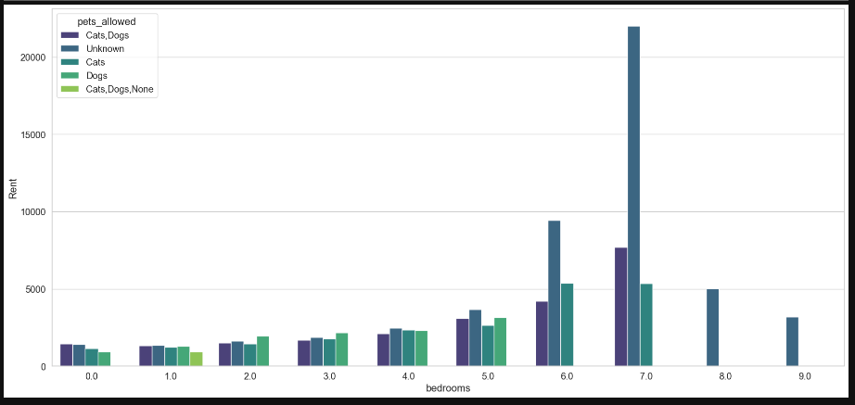
Multivariate Analysis (cont..)
Apartments with 8 or 9 bedrooms doesn’t allow Pets.

Slide 28
Multivariate Analysis (cont..)
Apartments with 8 or 9 bedrooms doesn’t allow Pets.

Slide 29
Variance Threshold technique to remove constant features
There are no numerical columns with constant features.
There are few categorical columns with constant features.
Categorical columns with constant or quasi constant values are dropped.
Categorical column currency contains 100 % same value.
Categorical columns like category, fee and price_type have 99 % of same value in the data.

Slide 30
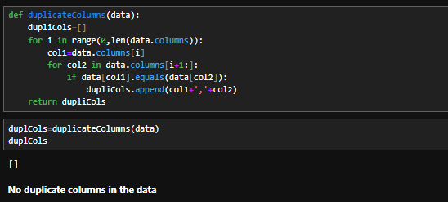
Checking for Duplicate columns
There are no duplicate columns in the datasets

Slide 31

Removing the Features with High Cardinality
This is done because of the following reasons :-
Reducing the dimensionality of data.
Avoid excessive use of memory.
Better interpretation of data due to reduce feature space.
Columns with greater than 20 unique values are selected during experiment. They are ['amenities', 'address', 'cityname', 'state', 'source']
They are removed accordingly.

Slide 32
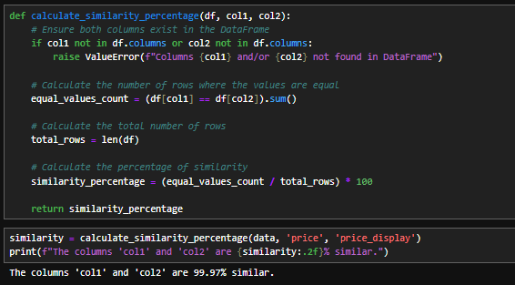
Feature Relationships
Bathrooms and Bedrooms column have higher correlation wrt to price with 0.32 and 0.23
Price and price type column has 99.9 % similar data, so price type was dropped

Slide 33
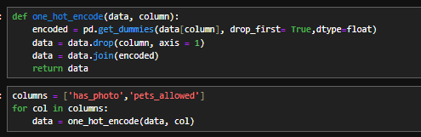
Converting categorical features to numerical
This is important as ML algos only understand the data which is numerical in nature.
get_dummies method is used for this

Slide 34
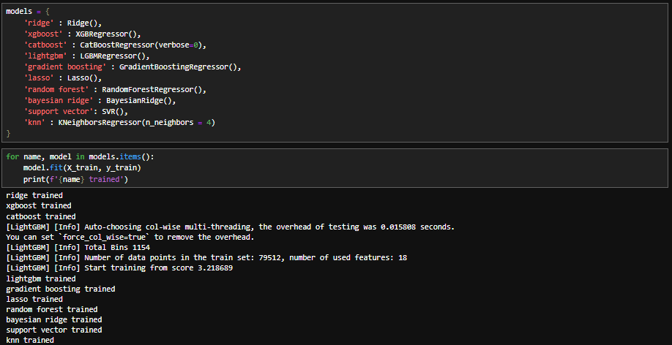
Model Training
In the below code , the list of ML algorithms are initialised and are fitted to the training data

Slide 35
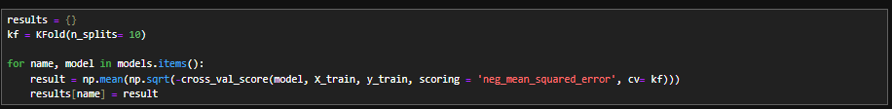
Cross Validation
Cross validation is a technique to prevent overfitting .
Here kFold technique is used with 10 splits and the all the ML algorithms are applied

Slide 36
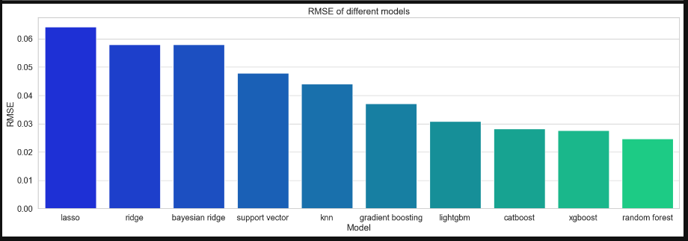
Model Results Comparison
The statistic metric used here is RMSE ( Root Mean Square Error) .
Here is the comparison chart . Top 3 algorithms are catboost, xgboost and random_forest

Slide 37
Ensemble the Top 3 models
In the below code ,
we are considering the top 3 models with lowest RMSE
Calculating the inverse RMSE and normalizing to get the weights.
Combining the predictions with weights
Calculating the RMSE and R2 for the combined predictions
We are getting RMSE as 355.77 and a good R-Square value of 0.82

Slide 38
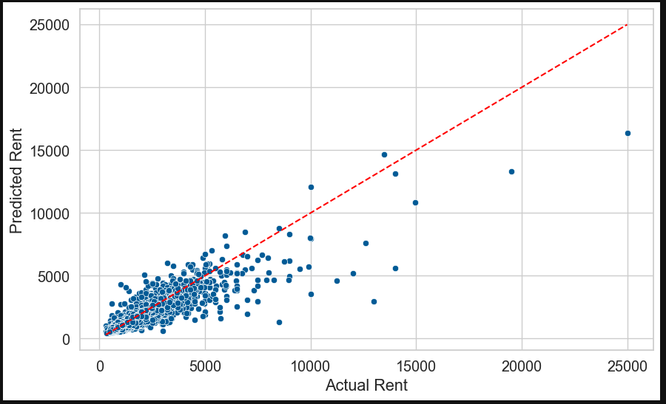
Actual Vs Predicted values
Most of the data points are close to the diagonal which represents perfect predictions.
Tight clustering of points along the diagonal indicates high accuracy.
There are few Outliers.
There’s some bias ( points below or above the diagonal)

Slide 39
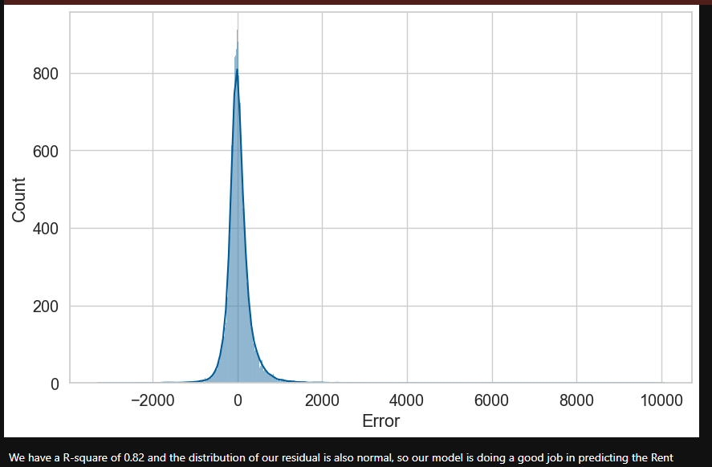
Distribution of Error

Slide 40
Distribution of Error (cont..)
The errors (residuals) follow an approximately normal distribution suggests that the model is capturing the variability in the data well.
An R-squared of 0.82 indicates that ourmodel explains 82% of the variance in the dependent variable (rent prices in our case). This is a relatively high R-squared value, suggesting that our model is doing a good job of explaining the variability in the data.

Slide 41
Model Improvements
More in-depth analysis of data to improve the quality related to missing values
Additional external data with relevant features.
More detailed tuning of hyperparameters of alogirthms using Optuna, GridSearch or RandomSearch.
Blending the detailed tuned model together.
Continuous model monitoring and retraining it when required.

Slide 42
Business Improvements
Continuous feedback from users.(surveys, feedback buttons)
AB testing on User interface to validate the changes.
Monitoring the market data, eye on the competitors' pricing strategies.
Integrate the business rules from the product owners and analysts.

Slide 43

Questions

