Slide 1
Network Asset Classification &Data Quality Analysis
Data Enrichment, Anomaly Detection, and Quality Scoring for Assets.
-Saurav Anand

Slide 2
Business Goals
Improve Asset Visibility for better tracking and management
Enhance Data Quality to reduce inconsistencies and incorrect classifications
Enable reliable Insights for accurate reporting and decision making
Build scalable framework to handle (~ 90K devices) efficiently.
Data Enrichment with derived attributes(e.g. category, device_type)
Threat Detection and asset-level risk visibility

Slide 3
Dataset
The raw dataset contained 2 columns: id and encoded(Base64 format)
Encoded columns was decoded from Base64 into structured JSON format and identified invalid/failed decoding row(~1 row).
Extracted multiple attributes contain id, Asset ID,MAC Address, OS, Function, DHCP Options Fingerprint etc.
There are total 88513 records with 10 columns

Slide 4
Data Dictionary
DHCP Request Fingerprint = DHCP request pattern used to identify device behavior
DHCP Vendor Class = Vendor specific DHCP classification string
DHCP Device Class = Device type classification based on DHCP data
id = unique record identifier from raw dataset
Asset ID = unique identifier assigned to each network asset
MAC Address = hardware address used to identify devices on the network.
OS = Operating system of the device(e.g. Windows,Android,iOS)
Function = Role of the device(e.g. Workstation, Switch, IP Phone)
Vendor and Model = Manufacturer and model information of the device
DHCP Options Fingerprints = DHCP options used for device fingerprinting

Slide 5
Data Exploration
There are high null percentage for certain columns like DHCP Device Class(55.8 %),DHCP Vendor Class (45.1%), OS (35.3 %), DHCP Options Fingerprint(29.4 %),DHCP Request Fingerprint(29.4%)
Detected unique values for Asset ID(88513),OS(32),Function(83),Vendor and Model(314), DHCP Options Fingerprint(162), DHCP Request Fingerprint(135), DHCP Vendor Class(121), DHCP Device Class(14)
The majority of the devices run on the Top OS - Apple Desktop OS(16.68 %), Linux (16.10%), Embedded Firmware(15.22 %), Chrome OS(11.59%).
Most Devices are classified as Top Function- IP Phone (33.72%), Workstation(20.92 %), Switch(10.49%),Computer(7.30 %)

Slide 6
Data Exploration (cont..)
Vendors which account for large no of devices are Cisco IP Phone 7942(14.71%), Cisco IP Phone 7692(8.41%), Cisco IP Phone(7.67%),HP(7.51 %), Intel(7.22%)
Valid Mac Address should be 12 hexadecimal characters or 17 characters with separators. We found multiple inconsistent format too short (2,3,4..) , Too long (20-29) and mixed formatting issues.
The data has multiple low frequency OS and vendor categories (<0.1%). Need for category consolidation.

Slide 7
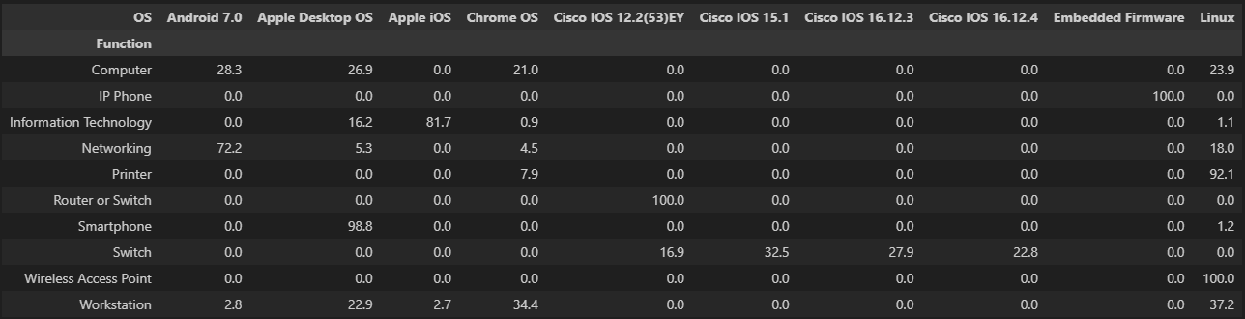
Data Exploration (cont..)
This cross-tab shows how different device types (Functions) are distributed across various Operating Systems.
Strong OS-Device Alignment :- Routers/Switches 100 % on the Cisco IOS variants.
Smartphones are highly concentrated :- ~99% on Apple Desktop OS(mislabelling for iOS).
Data Quality :- Apple Desktop OS showing for Smartphones.
Computers Have Mixed OS Distribution :- a diverse OS distribution, indicating multiple device types grouped together.
Printers Mostly Linux-Based :- ~92% Linux
Networking Devices Pattern :- Mostly Android (72%), Some Linux (18%).
Embedded Devices Are Specialized :- IP Phone has 100% Embedded Firmware.
Wireless Access Points :- 100 % Linux

Slide 8
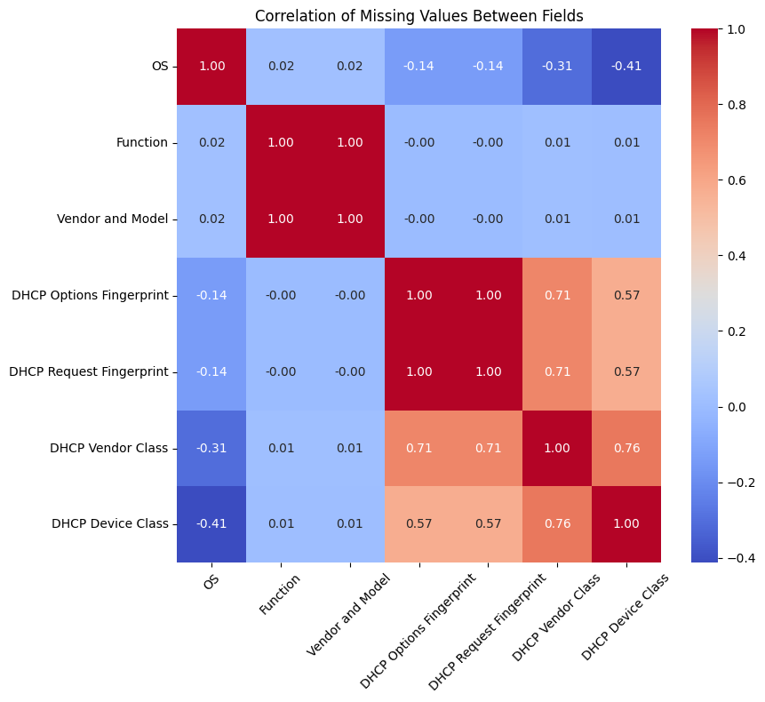
Data Exploration (cont..)
Certain fields exhibit correlated missing patterns, indicating that data is often missing together, likely due to shared data collection limitations
Strong correlation observed among DHCP-related fields (up to 1.0), indicating shared data availability patterns.
Highly correlated missing patterns suggest upstream data ingestion dependencies, where DHCP-related attributes are either fully captured or entirely absent. So the missing data is not random but occurs in groups, especially for DHCP-related features.

Slide 9
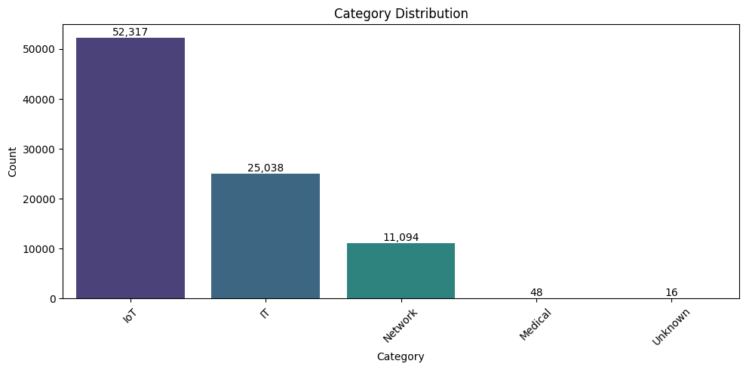
Feature Engineering – Device Categorization
Device categorization was made based on rule-based mapping from the Function column
Keywords in the function were used to assign categories:
IT → Workstation, Computer, Server
Network → Switch, Router, Firewall
Medical → CT, MRI, X-ray, Scanner
OT (Operational Technology) → PLC, HMI, RTU
IoT → Phones, Smart devices, others
Device category distribution

Slide 10
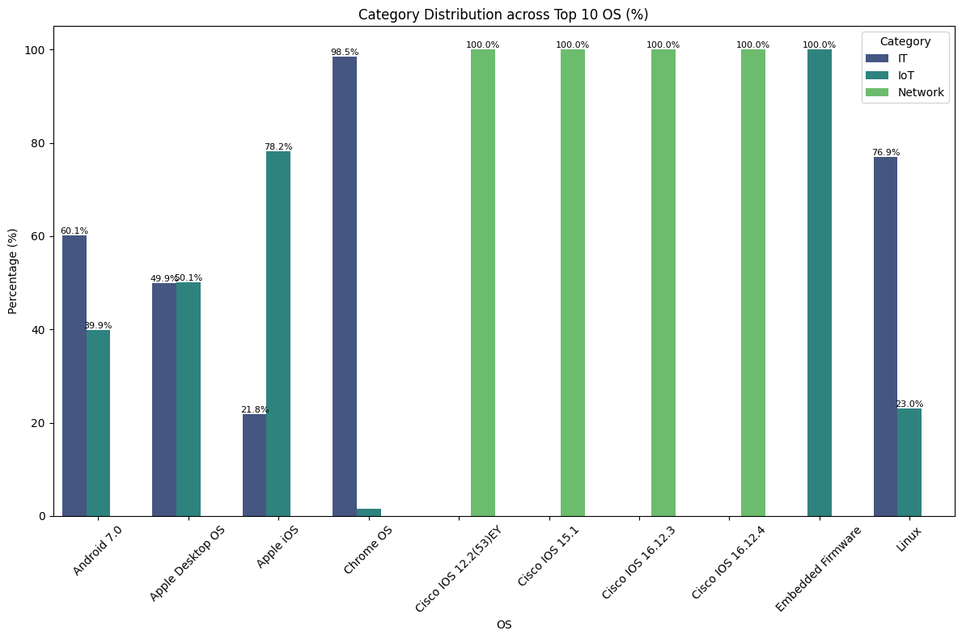
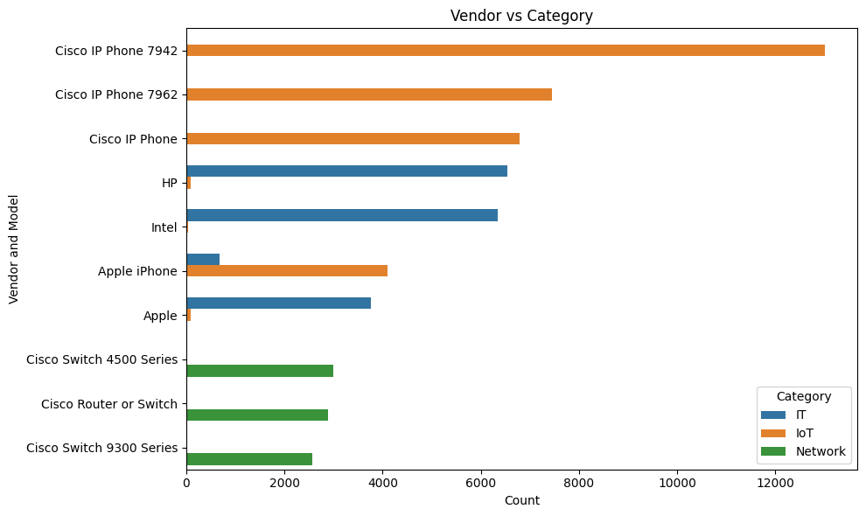
Feature Engineering – Device Categorization Vs OS and Vendor(top 10) (cont..)
Each category exhibits a distinct OS distribution, with following insights

Slide 11
Feature Engineering – Vendor /OS Normalization
Vendor column in the data contains not just “vendor names” – it is multi-level taxonomy.
Each value contains:
Pure vendors → Dell, Apple, Cisco.
Vendor + product → Cisco Router 2900 Series.
Vendor + function → HP Printer, Cisco IP Phone.
Medical Devices → GE MRI Scanner, Siemens SOMATOM CT Scanner
IOT/OT Systems → Johnson Controls, Rockwell Automation
Mixed Naming conventions.
After normalization using (entity extraction + fuzzy matching),we get the normalized values :
['Other', 'Apple', 'Dell', 'HP', 'Cisco', 'LG', 'Siemens', 'Samsung', 'GE', 'Sony', 'Unknown', 'Philips', 'IBM', 'Oracle', 'Roche', 'Aruba', 'VMware', 'Microsoft', 'Honeywell', 'Netgear', 'Fortinet', 'Palo Alto Networks', 'Juniper', 'Panasonic', 'Avaya']

Slide 12
Feature Engineering – Vendor /OS Normalization (cont..)
OS column in the data contains not just “OS names” – it is mix of multiple OS layers and system types.Each value contains:
Version numbers embedded in the OS field (Cisco IOS 15.3,Android 7.0,Windows Kernel 6.0)
Hardware/device context included in OS field
Cisco IOS (used in routers/switches, not general OS)
APC AOS (UPS power systems OS)
VxWorks 6.5 (real-time industrial systems)
Vendor prefix included in OS name (Cisco IOS 15.0, Apple iOS)
After normalization using (entity extraction + fuzzy matching),we get the normalized values :
['Android', 'macOS', 'Linux', 'Other', 'Embedded/RTOS', 'iOS', 'Chrome OS', 'Windows', 'Network OS']

Slide 13
Feature Engineering – Risk Level Classification
From Security and Data Quality lens , we have created an Risk Level attribute which contain High, Medium and low value
Risk Scoring Logic
High Risk :-
Outdated OS: Windows 7, Android 7, Cisco IOS 12.x/15.x
Embedded /RTOS system: VxWorks, Embedded Firmware
Missing DHCP fingerprints fields
Unknown OS values
Medium Risk :-
Partial metadata missing
Unclassified or ambiguous devices
Low Risk :-
Modern OS : Windows 10,Linux,Android(recent versions)
Complete fingerprint visibility

Slide 14
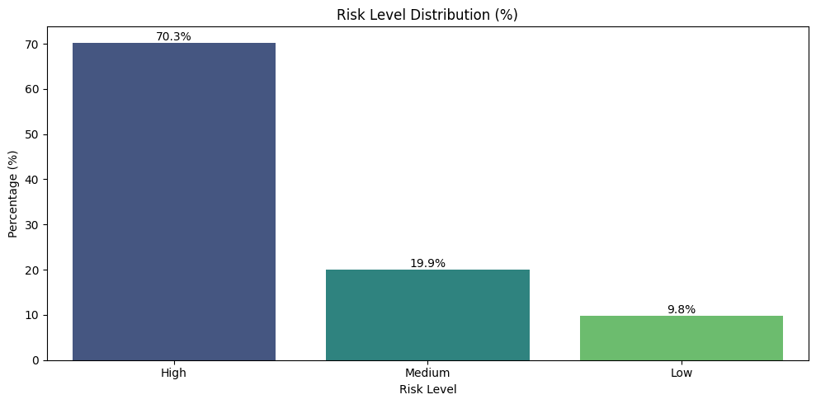
Feature Engineering – Risk Level Classification (cont..)
Risk Level Distribution

Slide 15
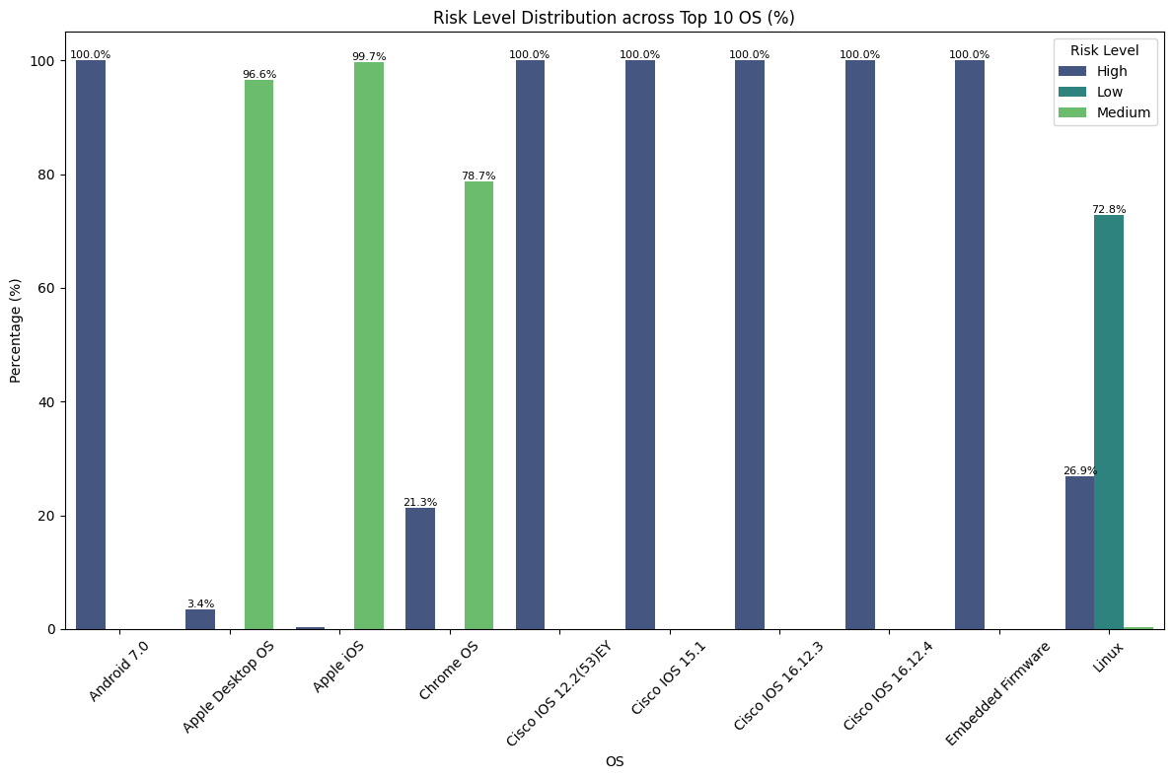
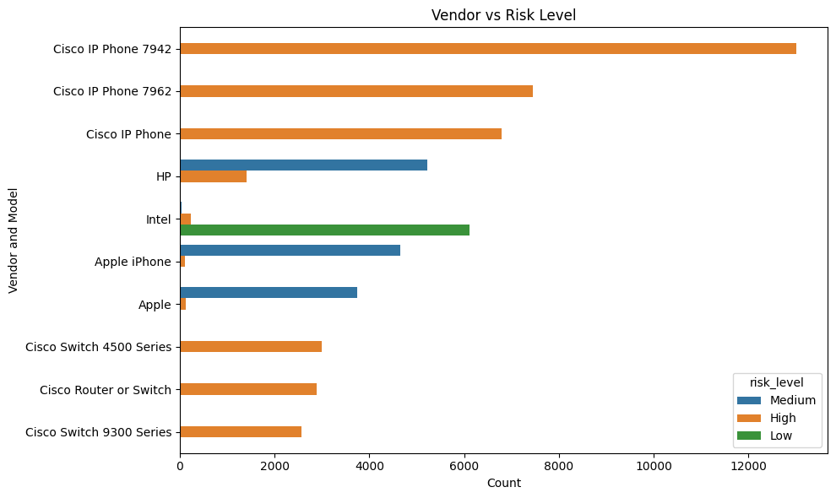
Feature Engineering – Risk Level Classification (cont..)
Risk Level Distribution across top 10 OS and Vendor

Slide 16
Feature Engineering – Fingerprint Integrity Score
This metric evaluate the completeness and reliability of device fingerprinting data. There are 4 key fingerprints fields DHCP Options Fingerprint, DHCP Request Fingerprint, DHCP Vendor Class, DHCP Device Class.
For each asset:
FP Integrity Score = Number of non-null fingerprint fields (0–4)
0 → No Visibility (Critical)
1 → Very Low Visibility
2 → Partial Visibility
3 → Good Visibility
4 → Full Visibility (Best Case)
“Fingerprint completeness directly impacts asset classification quality and security visibility. Assets with low scores represent blind spots in the network.”

Slide 17
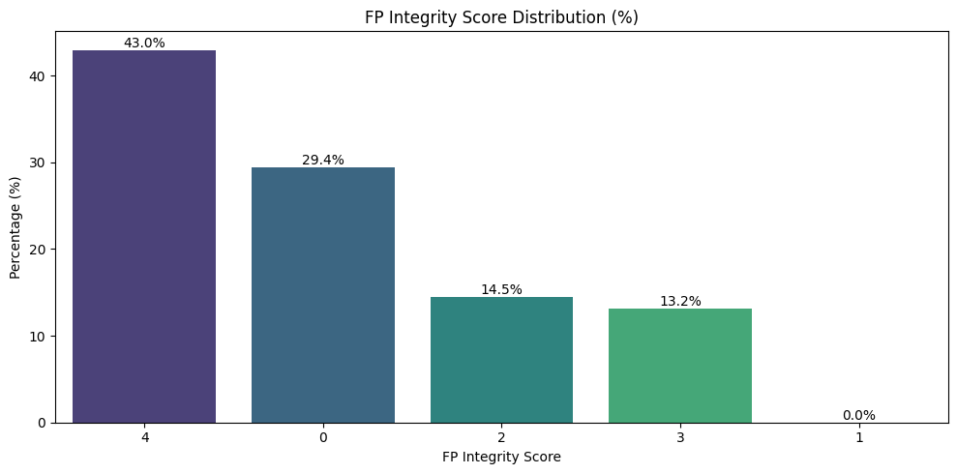
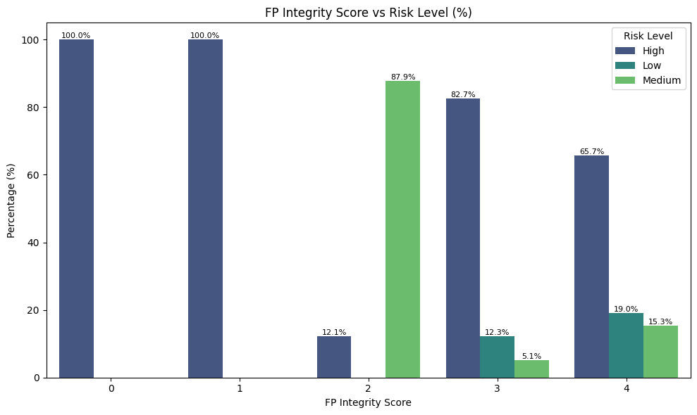
Feature Engineering – Fingerprint Integrity Score (cont..)
Distribution of FP Integrity Score and Integrity score Vs Risk Level

Slide 18
Feature Engineering – Model Type classification
Classify assets into meaningful categories:
Laptop, Smartphone, Network Device, Medical Device, IoT, etc.
We use a multi-signal rule-based model combining:
Vendor & Model (device keywords)
Function (device role)
OS (system-level signal)
Key Enhancements
OS-aware classification : Cisco IOS → Network Device ,VxWorks → IoT / Embedded
Domain-specific detection: Siemens / GE → Medical Devices ,Cisco / Aruba → Network Devices
Reduced ambiguity:- Fallback using OS when vendor unclear
“Combining Vendor, OS, and Function enables more accurate and context-aware classification, especially in mixed environments containing IT, network, medical, and IoT assets.”

Slide 19
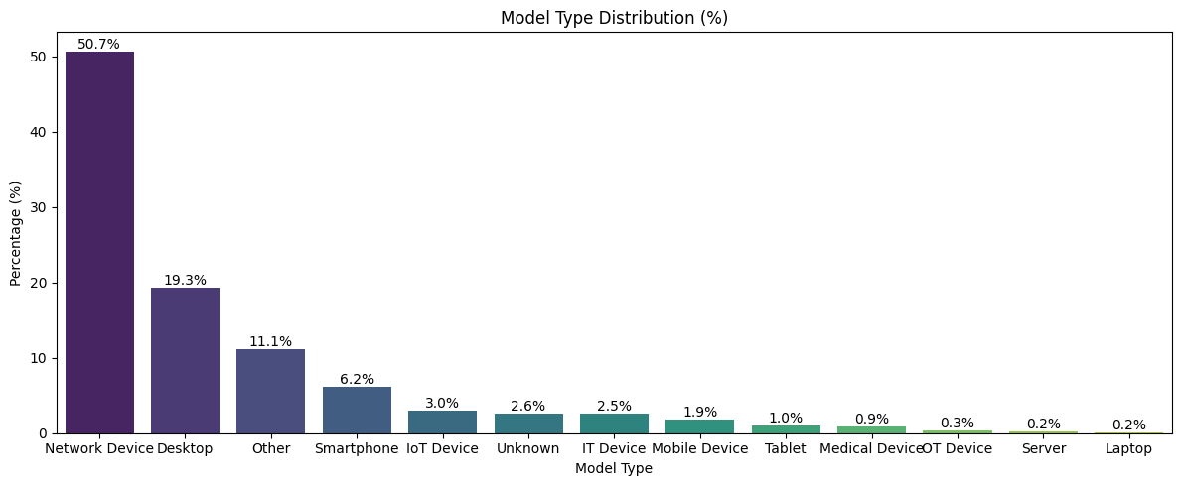
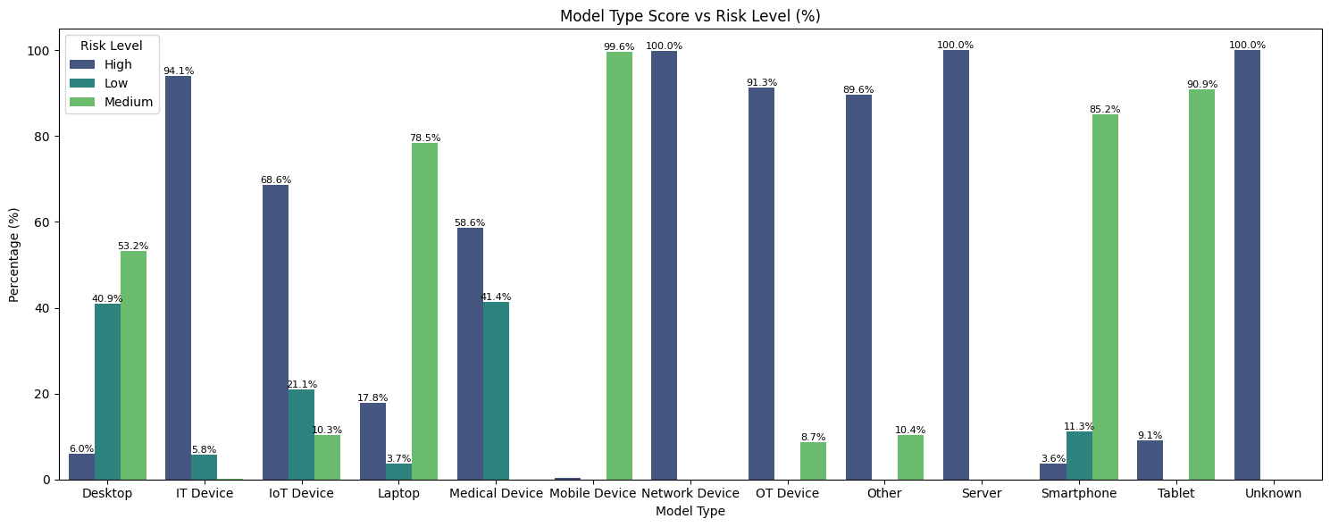
Feature Engineering – Model Type classification (cont..)
Model Type Distribution per asset and Model Type Vs Risk Score

Slide 20
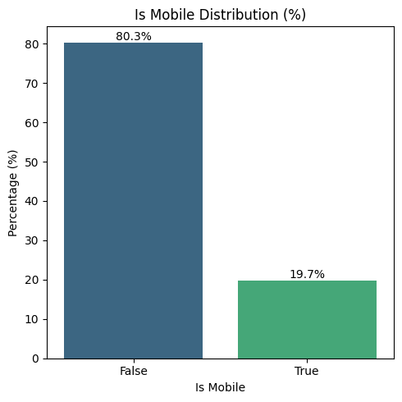
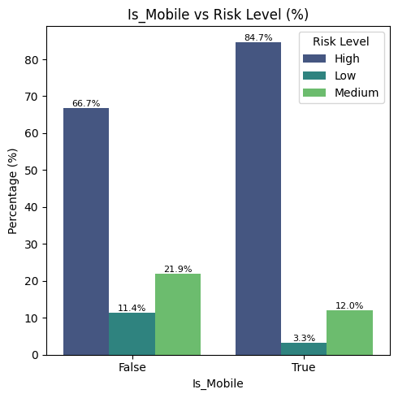
Feature Engineering – Mobile Device Identification
Identify mobile devices to enable device-type based risk segmentation.
Used model_type and OS attribute.
Mobile Device distribution and it’s relationship with Risk Level

Slide 21
Data Quality Assessment – Cross-field consistency check
Each vendor is expected to operate with specific set of OS families. Any deviation is a mismatch. A rule-based validation was implemented to identify inconsistencies between a device’s Operating System (OS) and its Vendor/Model.
Example Rules:
Apple devices → should run iOS / macOS
Samsung devices → should run Android
Cisco devices → should run Cisco IOS / AireOS
Embedded/IoT devices → should run Firmware / VxWorks / Embedded OS
Output:
Binary Flag :- True(mismatch Detected)/False(Valid Record)
Error Reason :- Explains the mismatch

Slide 22
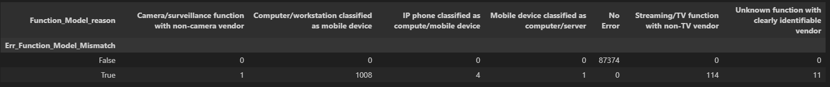
Data Quality Assessment – Cross-field consistency check ( cont..)
Function–Model Mismatch Detection
Example Rules:
Computer / Workstation → should be devices like Dell, HP, MacBook
Mobile Devices (Smartphone/Tablet) → should be iPhone, Samsung Galaxy
Network Devices (Router/Switch/Firewall) → should be Cisco, Aruba, Juniper
IP Phones / VoIP Devices → should be Cisco IP Phone, Polycom
Printers → should be HP Printer, Xerox, Ricoh
Cameras / Surveillance → should be Axis, Hikvision, Sony cameras
Output:
Binary Flag :- True(mismatch Detected)/False(Valid Record)
Error Reason :- Explains the mismatch

Slide 23
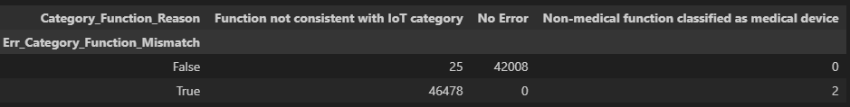
Data Quality Assessment – Cross-field consistency check ( cont..)
Category–Function Mismatch Detection
Example Rules:
IT Category → should include Computer, Workstation, Laptop
Network Category → should include Router, Switch, Firewall, Access Point
IoT Category → should include Camera, Smart Devices, Sensors, Smart TV
Medical Category → should include MRI, CT Scanner, Ultrasound, Patient Monitoring
Unknown Category → should only be used when function is unclear
Output:
Binary Flag :- True(mismatch Detected)/False(Valid Record)
Error Reason :- Explains the mismatch

Slide 24
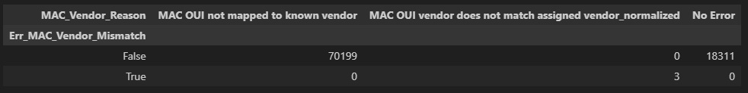
Data Quality Assessment – Cross-field consistency check ( cont..)
MAC OUI – Vendor Mismatch Detection
Example Rules:
Apple OUI → must map to Apple Devices.
Cisco OUI → must map to Cisco networking equipment
HP/Dell OUI → map to corresponding enterprise hardware.
VMware OUI → map to virtualised infrastructure
Network vendors(Aruba, Juniper, Netgear) → match networking devices.
Output:
Binary Flag :- True(mismatch Detected)/False(Valid Record)
Error Reason :- Explains the mismatch

Slide 25
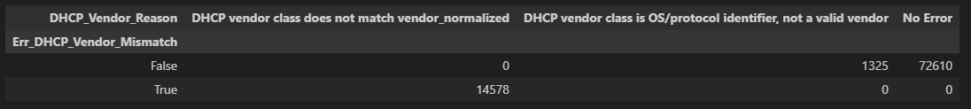
Data Quality Assessment – Cross-field consistency check ( cont..)
DHCP Vendor Class vs Vendor Mismatch Detection
Example Rules:
Cisco IP Phone / AP strings → must map to Cisco.
HP JetDirect / LaserJet → must map to HP
ArubaAP / Sensor → must map to Aruba
FortiWiFi / Fortinet strings → must map to Fortinet
Android DHCP → typically Samsung / Android ecosystem.
MSFT 5.0 / PXEClient → Microsoft / OS-level identifiers (not vendor)
DHCPD / UDHCP / Linux strings → treated as non-vendor system identifiers
Output:
Binary Flag :- True(mismatch Detected)/False(Valid Record)
Error Reason :- Explains the mismatch

Slide 26
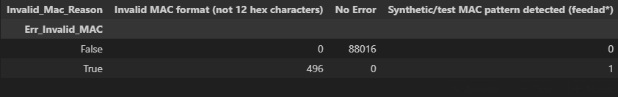
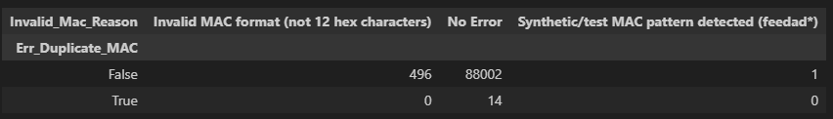
Data Quality Assessment – Schema & Format Validation
MAC Address Validation
MAC addresses must follow a strict 12-character hexadecimal format representing a unique hardware identifier. It must not be
All zeros (000000000000)
Broadcast-like patterns (ffffffffffff)
Synthetic/test identifiers (feedad*, deadbe*)
Duplicate MAC Detection
Each device is expected to have a unique MAC address representing its hardware identity. For 14 records , we have detected duplicate MAC.

Slide 27
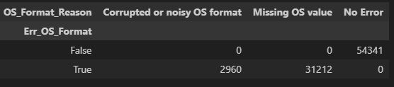
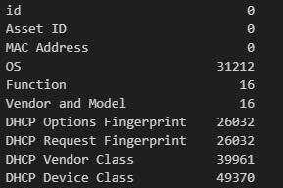
Data Quality Assessment – Schema & Format Validation ( cont..)
OS Format Validation
The following rule-based checks were applied:
Missing or null OS values.
Generic placeholders (unknown, na, none)
Network artifacts (PXE, DHCP, boot clients)
Corrupted or noisy strings
Misclassified vendor or DHCP values
Missing Value Detection

Slide 28
Data Quality Assessment - Device Identity & Uniqueness Checks
Same MAC with conflicting identity
The system groups records by MAC Address and checks variability in:
Operating System (OS)
Vendor and Model
Device Function
Category
If more than one unique value exists in any attribute, it is flagged as a conflict. There are only 4 assets where Identity conflict detected.
Duplicate Fingerprint Analysis
The fingerprint is based on DHCP Options Fingerprint, DHCP Request Fingerprint, DHCP Vendor Class and DHCP Device Class. This is not unique per device it is based on OS-level patterns, Device-type templates, Vendor DHCP profiles
88,195 devices share common DHCP behaviour patterns.

Slide 29
Data Quality Assessment Device Identity & Uniqueness Checks (cont..)
Same MAC with conflicting identity
The system groups records by MAC Address and checks variability in:
Operating System (OS)
Vendor and Model
Device Function
Category
If more than one unique value exists in any attribute, it is flagged as a conflict. There are only 4 assets where Identity conflict detected.
Duplicate Fingerprint Analysis
The fingerprint is based on DHCP Options Fingerprint, DHCP Request Fingerprint, DHCP Vendor Class and DHCP Device Class. This is not unique per device it is based on OS-level patterns, Device-type templates, Vendor DHCP profiles
88,195 devices share common DHCP behaviour patterns.

Slide 30
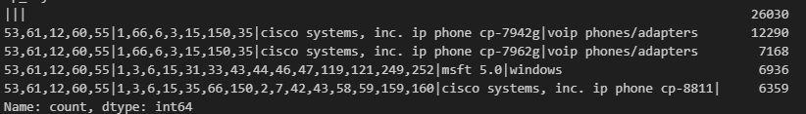
Data Quality Assessment- DHCP Fingerprint Analysis
Top Fingerprint Clusters (DHCP Options Fingerprint, DHCP Request Fingerprint, DHCP Vendor Class, DHCP Device Class)
Devices were analyzed using DHCP-based fingerprints to identify patterns, detect anomalies, and assess data completeness.
There are 26030 records where the fingerprints are completely missing.
DHCP Request Fingerprint Inconsistency
Same device (MAC) should have consistent DHCP Request Fingerprint. There are only 2 records with inconsistency.

Slide 31
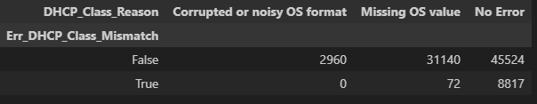
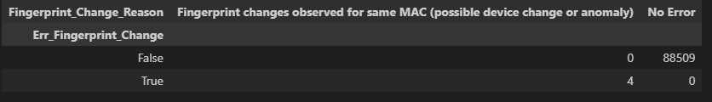
Data Quality Assessment- DHCP Fingerprint Analysis ( cont..)
DHCP Vendor Class vs Device Class Mismatch
Vendor Class and Device Class should be aligned.
Example:
Cisco → Cisco / IP Phone / AP
Android → mobile / handset
Printer → HP / Lexmark etc.
Temporal Fingerprint Changes
Same MAC should not frequently change fingerprints over time. We detect Frequent changes → device swap / spoofing / data issue . But this for only 4 assets only.

Slide 32
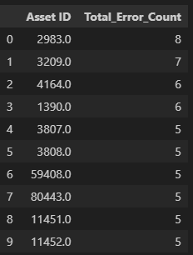
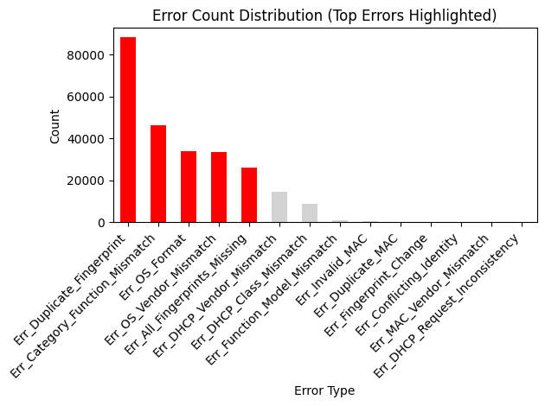
Data Quality Assessment- Summary
Top 10 Assets with most errors Error Distribution

Slide 33
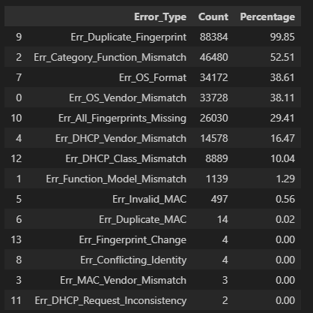
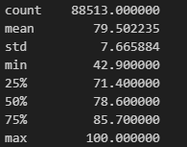

Data Quality Assessment- Summary
Error Summary Data Quality Score
The Avg Data Quality Score is 78.6 %
Descriptive statistics
Data Quality Level

Slide 34
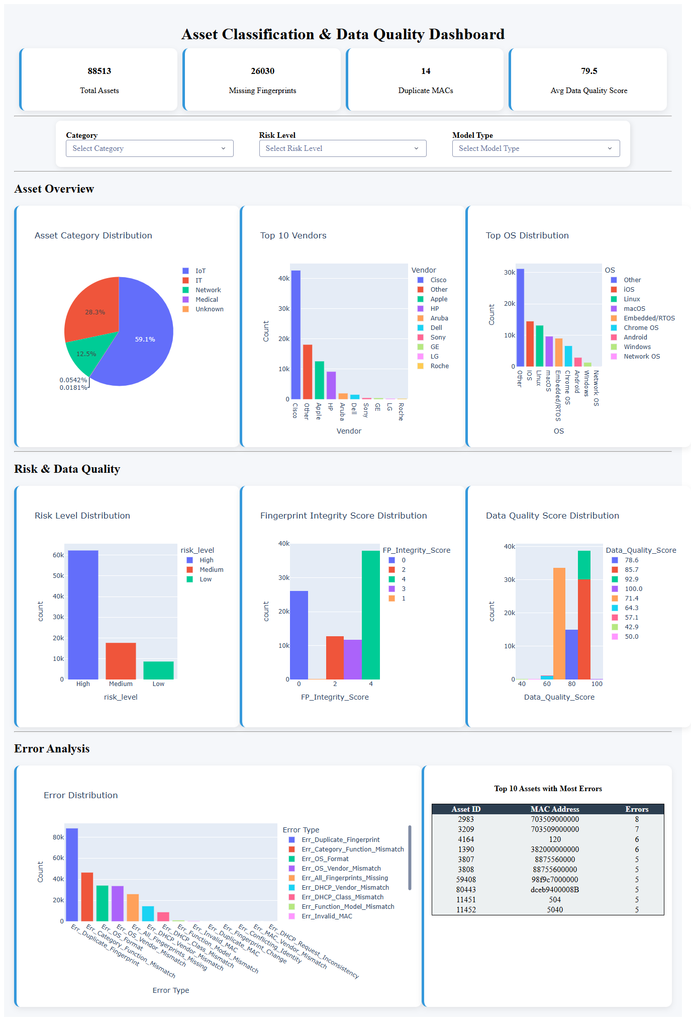
Dashboard

Slide 35
Technical Improvements
Optimize Error computation logic.
Scalability of Dashboard filters
Improve the data validation layer at the data ingestion level
Continuous monitoring and logging
Enhance data model structure

Slide 36
Business Improvements
Focus on High-Error Assets
Fix critical Data Quality Issues like missing fingerprints, duplicate MAC address.
Risk Based Asset Management as it shows higher error.
OS and Model Type standardization
Data Quality Score as Governance Metric

Slide 37

Questions

