Slide 1
Balanced Binary Search Trees
If we can keep the left and right subtrees of roughly equal depth, then we will have O(log n) lookup time.
We have already seen that a perfect tree has height log(n), so looking up items in a perfect tree is O(log n).
For ease of presentation, let's equate the height with the number of levels (starting at 1).

Slide 2
44
17
78
7
32
50
88
3
12
27
37
48
62
85
91

Slide 3
Balanced Binary Search Trees
Consider the smallest possible balanced tree of height h. Let n(h) be the number of nodes in that tree.
The left and right subtrees differ in height by no more than a constant number. Let’s use 1.
If the root has height h, then one subtree is of height h-1, and the other is of height h-2.
Even this smallest possible balanced BST of height h has an exponential number of nodes.

Slide 4
44
17
78
32
50
88
48

Slide 5
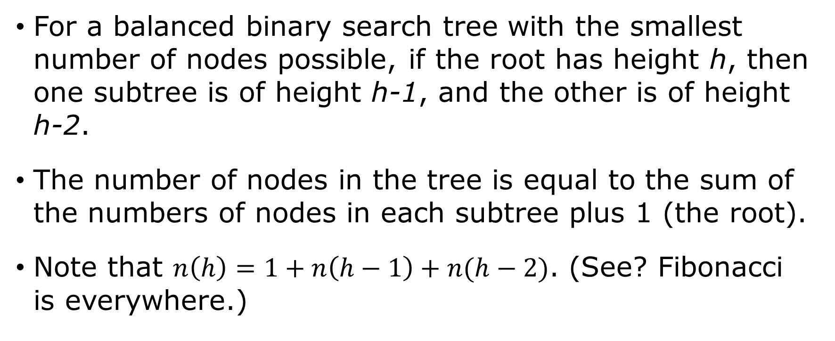
Balanced Binary Search Trees
For a balanced binary search tree with the smallest number of nodes possible, if the root has height h, then one subtree is of height h-1, and the other is of height h-2.
The number of nodes in the tree is equal to the sum of the numbers of nodes in each subtree plus 1 (the root).
Note that $n\left(h\right)=1+n\left(h−1\right)+n(h−2)$. (See? Fibonacci is everywhere.)

Slide 6
Balanced Binary Search Trees
First, we show that the number of nodes in a balanced BST with as few nodes as possible grows exponentially with the height of the tree (even if the tree is not perfect).
Once we establish that the number of nodes grows exponentially with the height, algebra shows us that the number of levels grows logarithmically with the number of nodes.

Slide 7

Balanced Binary Search Trees
$$\begin{aligned}n(h)&=1+n\left(h−1\right)+n(h−2) \\ &>2∙n(h−2) \\ &>4∙n(h−4) \\ &>8∙n(h−6) \\ ⋮ \\ &>2^{i}∙n(h−2i)\end{aligned}$$

Slide 8
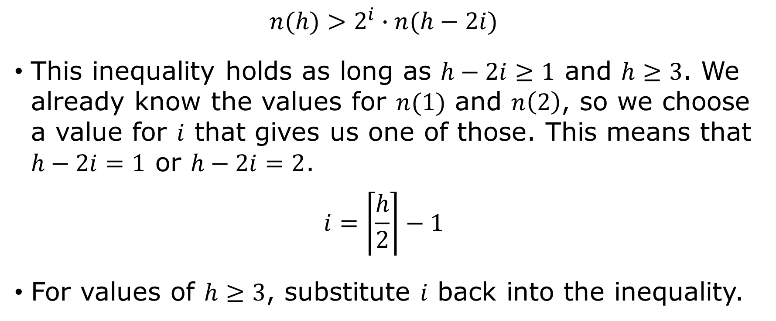
Balanced Binary Search Trees
$$n(h)>2^{i}∙n(h−2i)$$
This inequality holds as long as $h−2i≥1$ and $h≥3$. We already know the values for $n(1)$ and $n\left(2\right)$, so we choose a value for $i$ that gives us one of those. This means that $h−2i=1$ or $h−2i=2$.
$$i=\left\lceil \frac{h}{2}\right\rceil −1$$
For values of $h≥3$, substitute $i$ back into the inequality.

Slide 9

Balanced Binary Search Trees
$$\begin{aligned}n\left(h\right)&>2^{i}∙n\left(h−2i\right) \\ &>2^{\left\lceil \frac{h}{2}\right\rceil −1}∙n\left(h−2\left\lceil \frac{h}{2}\right\rceil +2 \right) \\ &≥2^{\left\lceil \frac{h}{2}\right\rceil −1}∙n\left(1\right) \\ n(h)&≥2^{\left\lceil \frac{h}{2}\right\rceil −1}\end{aligned}$$
Now just take the log of both sides.

Slide 10
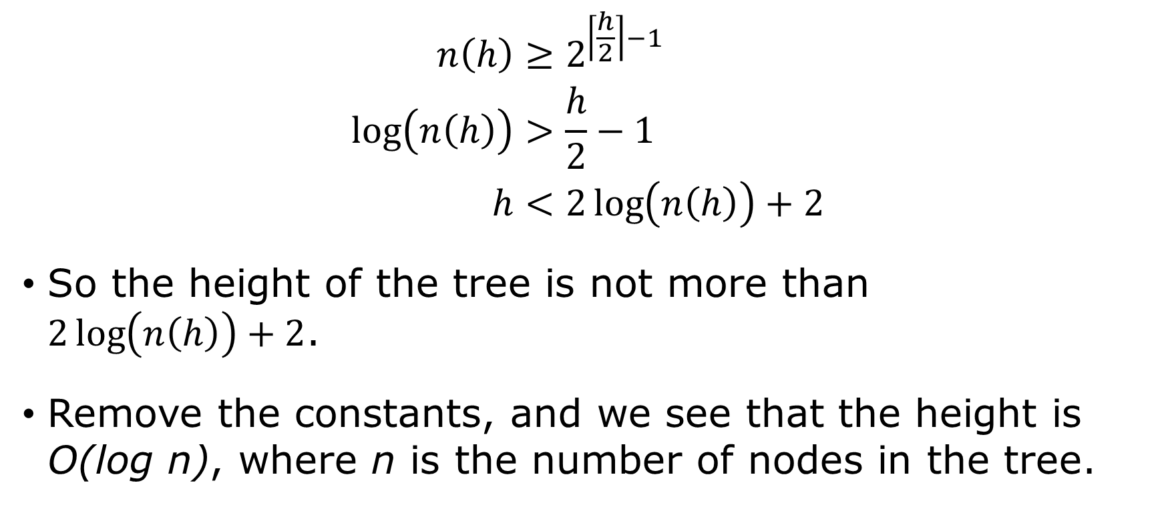
Balanced Binary Search Trees
$$\begin{aligned}n\left(h\right)&≥2^{\left\lceil \frac{h}{2}\right\rceil −1} \\ \log\left(n\left(h\right)\right)&>\frac{h}{2}−1 \\ h&<2\log\left(n\left(h\right)\right)+2\end{aligned}$$
So the height of the tree is not more than $2\log\left(n\left(h\right)\right)+2$.
Remove the constants, and we see that the height is O(log n), where n is the number of nodes in the tree.

Slide 11
Balanced Binary Search Trees
Whenever the tree becomes unbalanced because of an insertion, rotate nodes away from the unbalanced side to re-balance it.
Be sure to maintain the ordered property of a BST!

Slide 12
20 10 5

Slide 13
20 10 5
20
10
10
5
20
5

Slide 14
Balanced Binary Search Trees
Rotation is easy when there are no children in the way, but consider the case when the new root previously had two children.
When rotating right, what used to be the right child of the new root becomes the left child of the old root.
When rotating left, what used to be the left child of the new root becomes the right child of the old root.

Slide 15
20 10 40 5 15 7

Slide 16
20 10 40 5 15 7
10
20
5
20
10
40
5
7
15
15
40
7

Slide 17
The AVL Tree ADT
Add an additional field to the Node structure to track the height of the tree rooted at that node.
A 0 balance means that both child subtrees are of the same height.
A negative balance means that the left subtree is taller than the right subtree.
A positive balance means that the right subtree is taller than the left subtree.

Slide 18
The AVL Tree ADT
After an insertion, consider the balances starting at the insertion point and moving upward to the root.
If a balance ever becomes -2 or +2, the subtree rooted at that node is unbalanced.
There are four possible ways that an AVL tree can fall out of balances. Two are easily fixed with a single rotation. The other two require two rotations.

Slide 19
Four AVL Unbalanced Cases
Left-Left: The root of the unbalanced subtree has balance -2, and its left child has balance -1. Fix with a single right rotation at the -2 node.
44
17
17
C
A
44
A
B
B
C

Slide 20
Four AVL Unbalanced Cases
Right-Right: The root of the unbalanced subtree has balance +2, and its right child has balance +1. Fix with a single left rotation at the +2 node.
17
44
A
44
17
C
B
C
A
B

Slide 21
Four AVL Unbalanced Cases
Left-Right: The root of the unbalanced subtree has balance -2, and its left child has balance +1. Fix with a left rotation at the +1 node, then a right rotation at the -2 node.

Slide 22
Left-Right: Rotate left at +1, then right at -2
44
44
17
C
B
C
A
B
17
R
L
R
A
L

Slide 23
Left-Right: Rotate left at +1, then right at -2
44
B
B
C
17
44
17
R
A
L
R
C
A
L

Slide 24
Four AVL Unbalanced Cases
Right-Left: The root of the unbalanced subtree has balance +2, and its right child has balance -1. Fix with a right rotation at the -1 node, then a left rotation at the +2 node.

Slide 25
Right-Left: Rotate right at -1, then left at +2
17
17
A
44
A
B
B
C
L
44
L
R
R
C

Slide 26
Right-Left: Rotate right at -1, then left at +2
17
B
A
B
17
44
L
44
A
L
R
C
R
C

Slide 27
INSERT
50, 30, 20, 10, 5,
25, 60, 70, 80, 22

Slide 28
INSERT 50, 30, 20, 10, 5, 25, 60, 70, 80, 22

