Slide 1
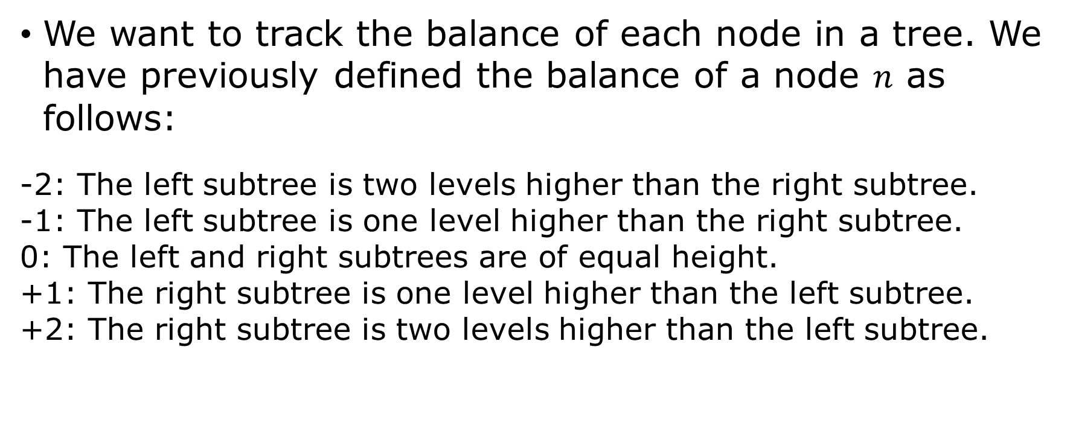
Computing Balance in AVL Trees
We want to track the balance of each node in a tree. We have previously defined the balance of a node $n$ as follows:
-2: The left subtree is two levels higher than the right subtree. -1: The left subtree is one level higher than the right subtree. 0: The left and right subtrees are of equal height. +1: The right subtree is one level higher than the left subtree. +2: The right subtree is two levels higher than the left subtree.

Slide 2
Computing Balance in AVL Trees
Because the balance can be computed easily when the heights of the two child subtrees are available, we don't have to store a __balance attribute in the node class.
Storing the height of the subtree rooted at any node allows the parent of that node to compare the heights of its children and compute balance in constant time.

Slide 3
Computing Balance in AVL Trees
The only nodes whose height or balance can be affected by an insertion are the nodes along the insertion path from the root to the leaf position where the insertion occurs.
On the return path from recursive insertion, check for balance, rotating when necessary, and updating heights.
Notice the height of the subtree rooted at node t is the max of the heights of t's child subtrees plus one.

Slide 4
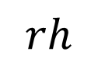
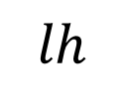
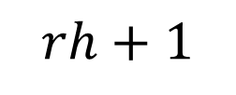
t
$$rh+1$$
$$lh$$
$$rh$$

Slide 5
Balanced Insertion in AVL Trees
Perform insertion recursively as before, but return the balanced tree rooted at t at each step.
Given node (subtree) t, how do we balance? Remember there are four cases plus trivial cases where balancing is not required.

Slide 6
Balancing AVL Tree at Node t
If t is None, the tree is already balanced. Return t.
If t is left-heavy by 2:
If t's left child is left-heavy by 1, rotate right about t and return the new root.
If t's left child is right-heavy by 1, rotate left about t's left child, then rotate right about t and return the new root.

Slide 7
Balancing AVL Tree at Node t
If t is right-heavy by 2:
If t's right child is right-heavy by 1, rotate left about t and return the new root.
If t's right child is left-heavy by 1, rotate right about t’s right child, then rotate left about t and return the new root.
Before returning the new (balanced) root, recompute the heights of the two nodes involved in each rotation.

Slide 8
Recursive BST Insertion
Insert value x at node t (initially the root).
If t is None, make a new Node with value x and return that node as the new root. (Base case)
If x < t's value, update t's left child to be the return value of inserting x at node t's left child.
If x > t's value, update t's right child to be the return value of inserting insert x at node t's right child.
Update t’s height and return t.

Slide 9
Recursive AVL Insertion
Insert value x at node t (initially the root).
If t is None, make a new Node with value x and return that node as the new root. (Base case)
If x < t's value, update t's left child to be the return value of inserting x at node t's left child.
If x > t's value, update t's right child to be the return value of inserting insert x at node t's right child.
Update t’s height and return balanced(t).

Slide 10
Balanced Removal in AVL Trees
Perform removal recursively as before, but return the balanced tree rooted at t at each step.
The balance operation is the same as it was for insertion. When you encounter an imbalance of 2 on the return path, rotate before returning t.

Slide 11
Recursive BST Deletion
Delete value x from tree rooted at node t (initially the root).
If t is None, then the item was not found. Return t.
If x < t's value, update t's left child to be the subtree returned by removing x from the subtree rooted at node t's left child.
If x > t's value, update t's right child to be the subtree returned by removing x from the subtree rooted at node t's right child.
If x == t's value, consider how many children t has.

Slide 12
Recursive BST Deletion
If t has two children (neither child reference is None), then update t's value with the smallest value r from t's right child. Then update t's right child to be the subtree returned by removing r from the subtree rooted at t's right child.
If t's left child is None, then update t to be t's right child. Otherwise, update t to be t's left child.
Update t’s height and return t.

Slide 13
Recursive AVL Deletion
If t has two children (neither child reference is None), then update t's value with the smallest value r from t's right child. Then update t's right child to be the subtree returned by removing r from the subtree rooted at t's right child.
If t's left child is None, then update t to be t's right child. Otherwise, update t to be t's left child.
Update t’s height and return balanced(t).

Slide 14
Balancing AVL Tree at Node t
If t is None, the tree is already balanced. Return t.
If t is left-heavy by 2:
If t's left child is left-heavy by 1 or balanced at 0, rotate right about t and return the new root.
If t's left child is right-heavy by 1, rotate left about t's left child, then rotate right about t and return the new root.

Slide 15
Balancing AVL Tree at Node t
If t is right-heavy by 2:
If t's right child is right-heavy by 1 or balanced at 0, rotate left about t and return the new root.
If t's right child is left-heavy by 1, rotate right about t’s right child, then rotate left about t and return the new root.
Before returning the new (balanced) root, recompute the heights of the two nodes involved in each rotation.

Slide 16
INSERT 25, 30, 31, 50, 45, 55, 34
REMOVE
50, 25, 30

Slide 17
INSERT 25, 30, 31, 50, 45, 55, 34
REMOVE 50, 25, 30

